Slide 1

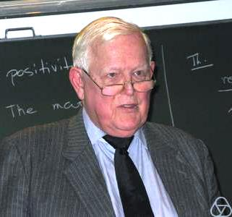

Slide 2

Kalman Filter for throwing distance estimation
MSP Presentation
Digital Communication (dcom)
Bernhard Dominik

Slide 3
Outline
I – Problem Statement
Real life scenario
Used sensors
II - Practical Application
Sensor specifications
Use of the Kalman Filter
III –Theoretical Foundation
Kalman Filter, Prediction & Correction
IV - Conclusion
Testing Results
Conclusion & Summary
Possible improvements

Slide 4
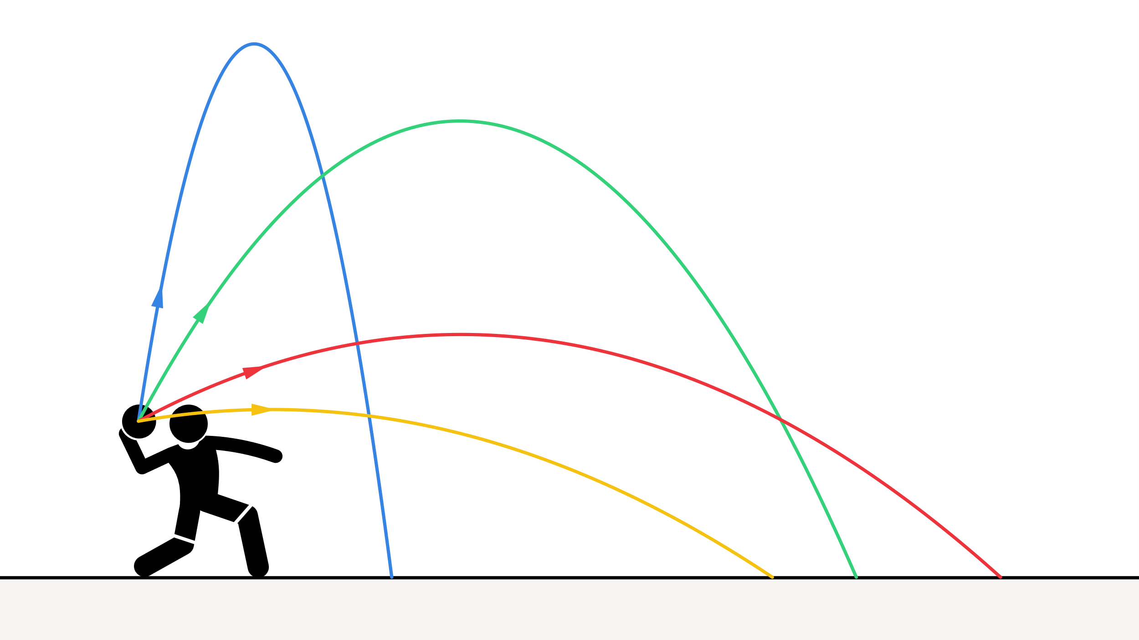
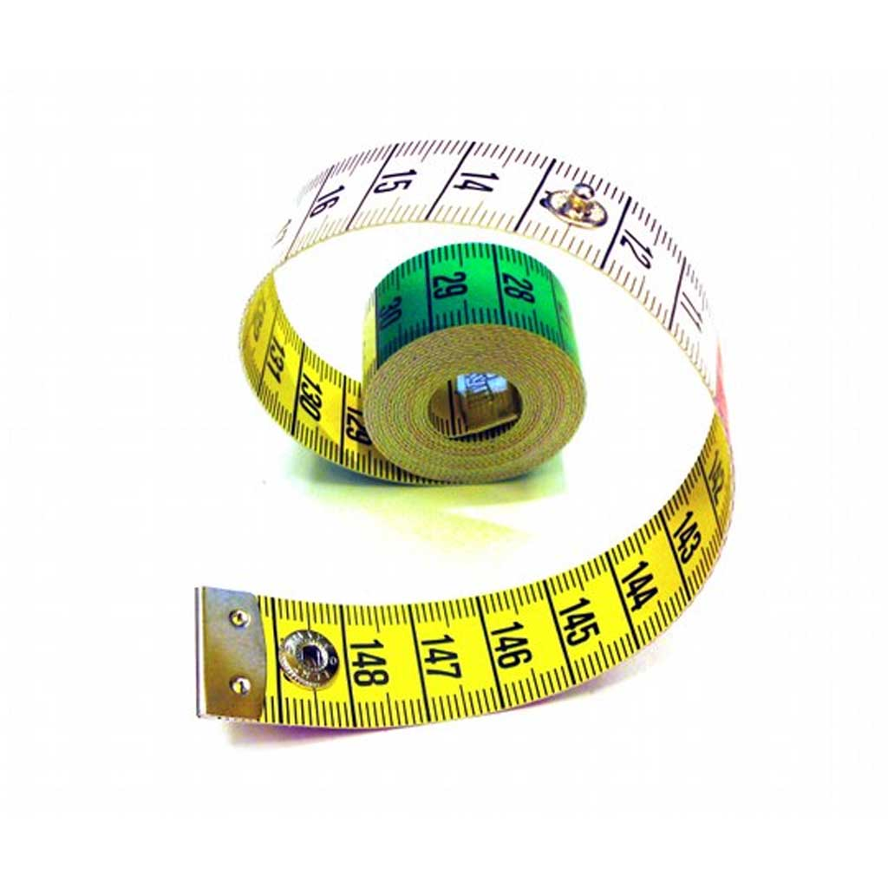
Scenario: Ball throwing competition
What distance has the ball traveled horizontally?
Notes:
Measuring tape → possible but time-consuming

Slide 5

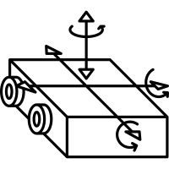
Sensors used
Camera for
absolute position
measurement
IMU for relative
velocity
measurement

Slide 6
Sensor specifications
Sampling Rate | 30 FPS → 33 Hz (1 Sample every 33ms) | 1‘000 Hz (1 Sample every 1 ms)
Gaussian Error (standard deviation 68%, 1σ) | +/- 0.4m absolute | +/- 5% of measured velocity value
Offset over time | No (absolute measurements) | Yes, +2% of each measured velocity value. Caused by heat.
Sensorspecific problems | Low sampling rate | Large offset over time
Notes:
Image processing software in the background that gives us the absolute distance from the camera

Slide 7
Use of the Kalman filter
Two sensors, each one has unique problems → can we combine them?
YES we can!
The Kalman filter works with two steps
Prediction Step → IMU provides frequent data (relative data, with offset over time)
Correction Step → camera provides data at a slow rate (absolute data, no offset)

Slide 8
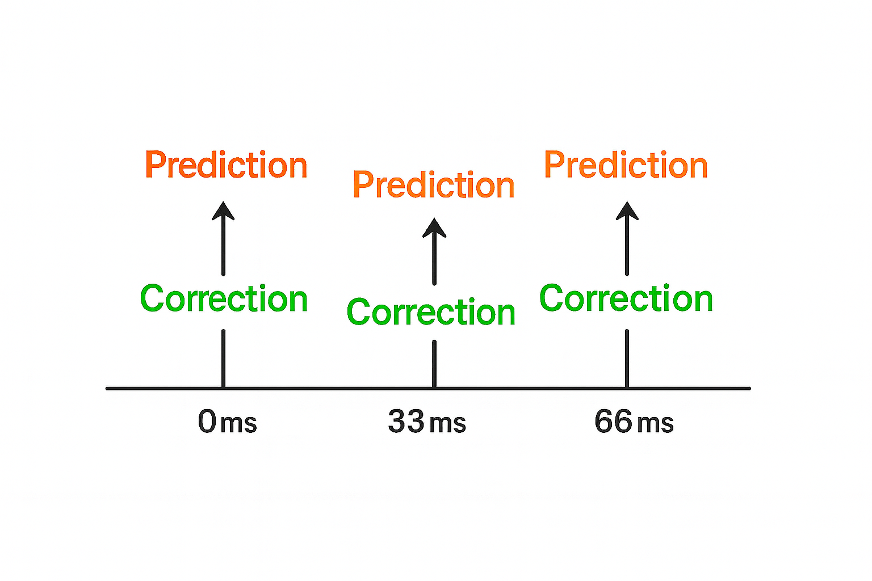
Kalman Filter, Prediction & Correction
Prediction every 1ms
Error-Covariance P increases
Correction every 33ms
Updates Error-Covariance P
→ P decreases

Slide 9
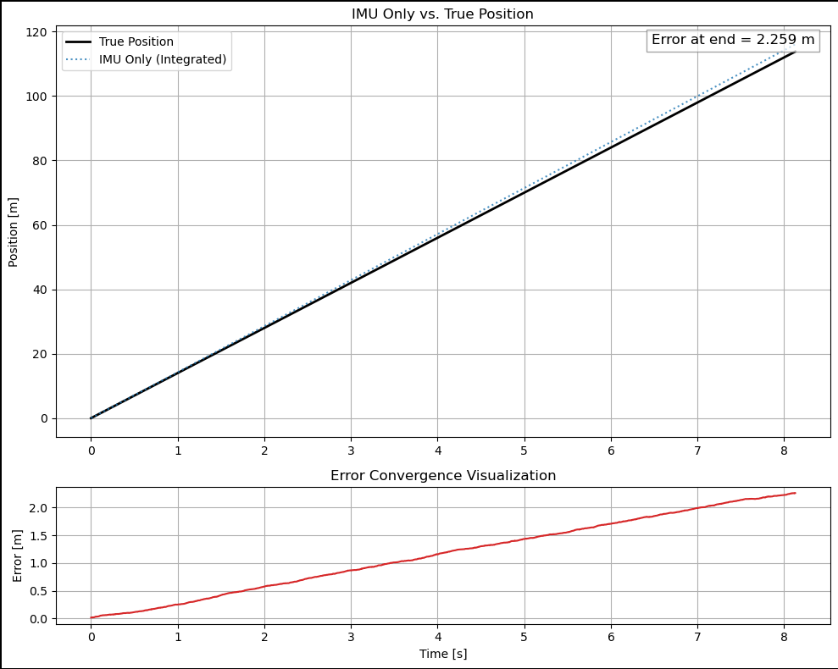
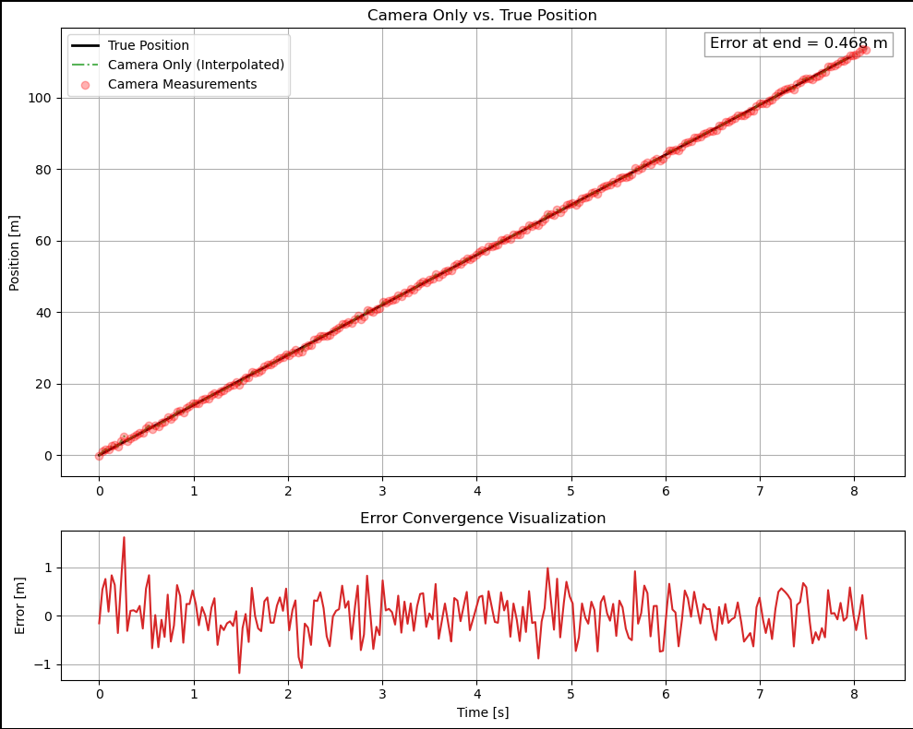
Testing Results (good example)

Slide 10
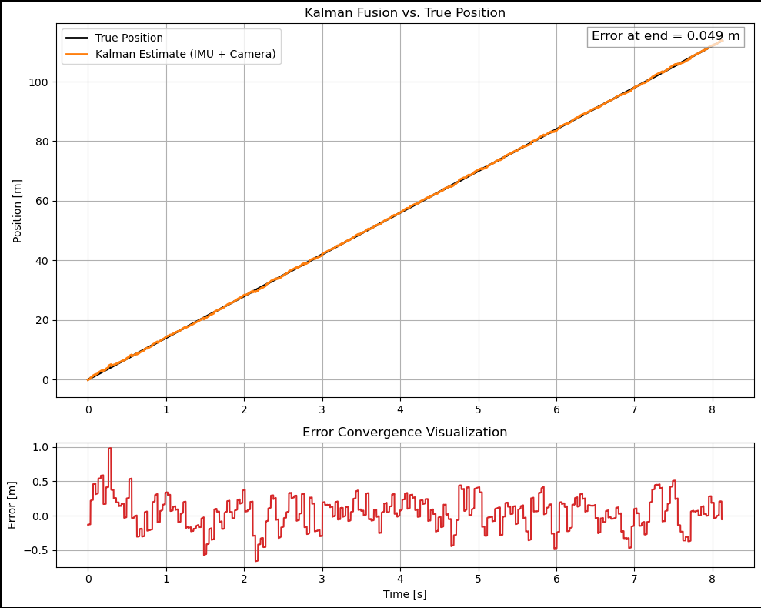
Testing Results (good example)
Error IMU = 2.259m
Error camera = 0.468m
Error Kalman = 0.049m

Slide 11

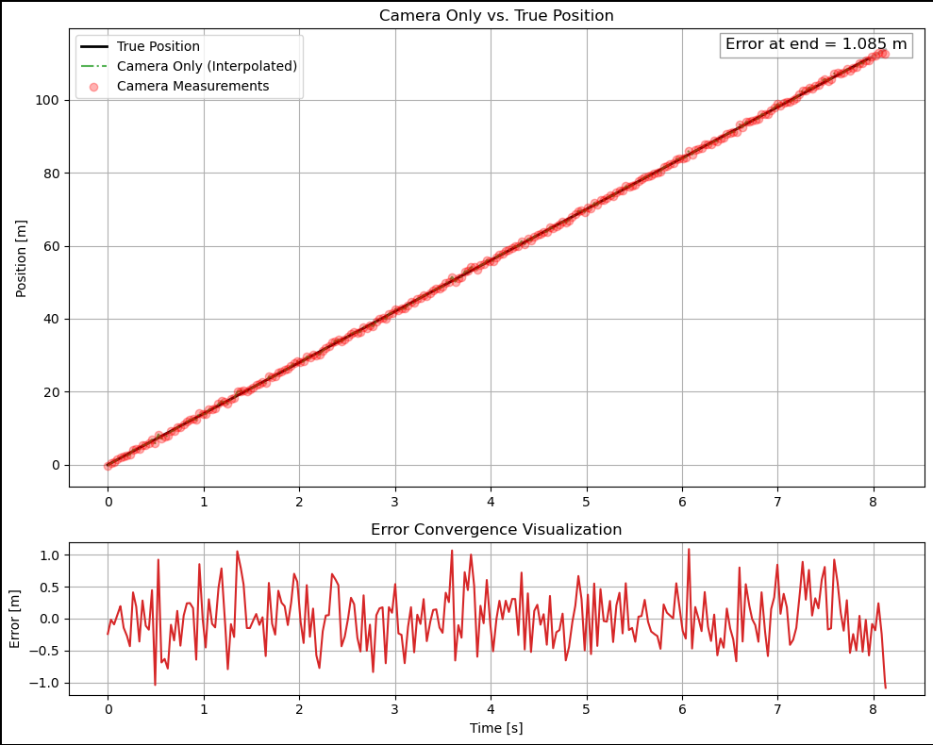
Testing Results (bad example)

Slide 12
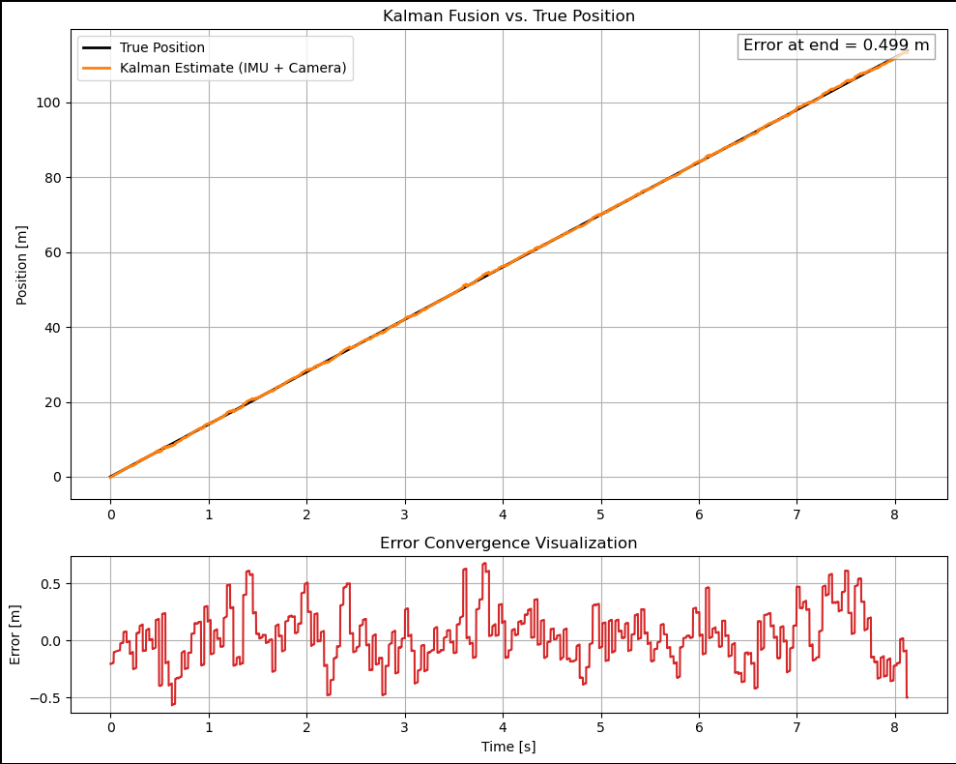
Testing Results (bad example)
Error IMU = 2.199m
Error camera = 1.085m
Error Kalman = 0.499m

Slide 13
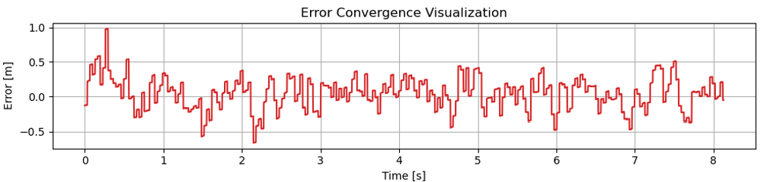
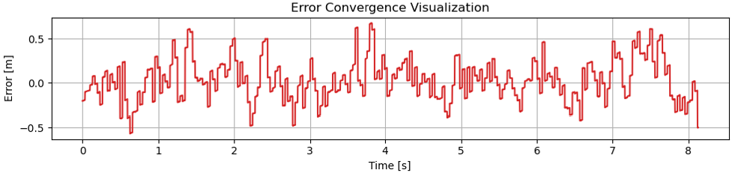
Conclusion & Summary
Performance of Kalman overall good
Filter not fully converged
Consistency of Error Convergence → quite large deviations between meaurements

Slide 14
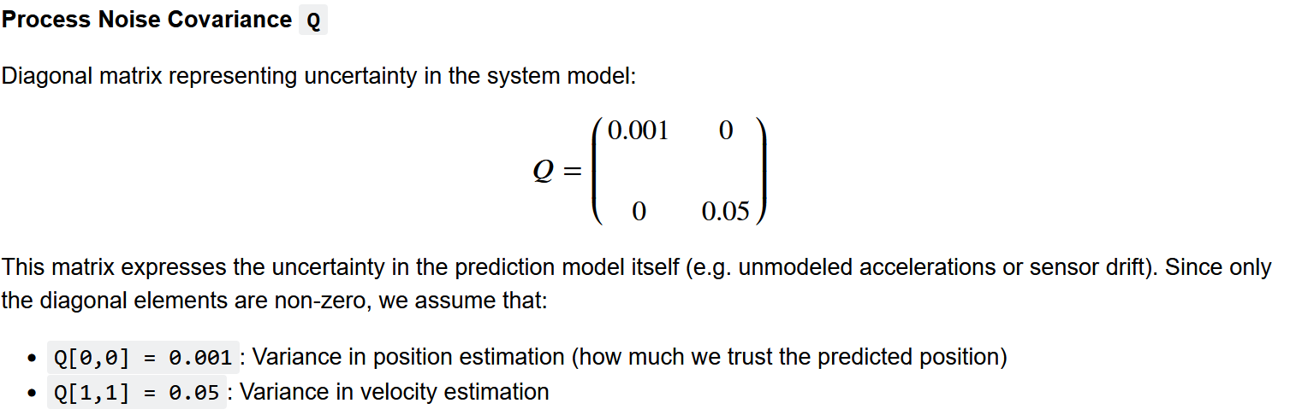
Possible improvements
Use actual data → measure multiple throws to have realistic test data
Set Kalman parameters via an optimizing algorythm

Slide 15

Questions & Answer

Slide 16
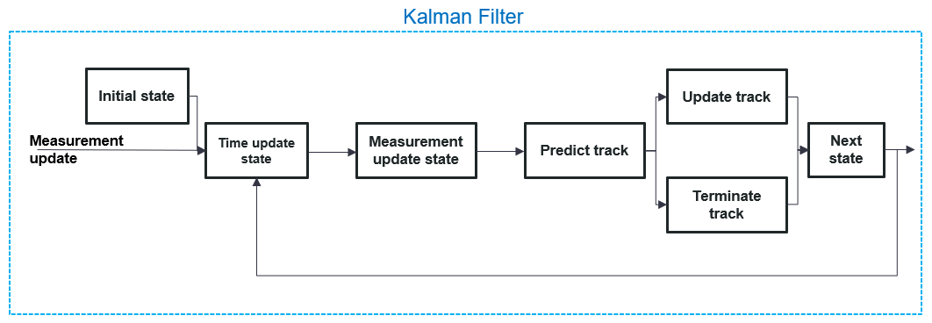
Appendix
Block diagramm of a general Kalman Filter

Slide 17
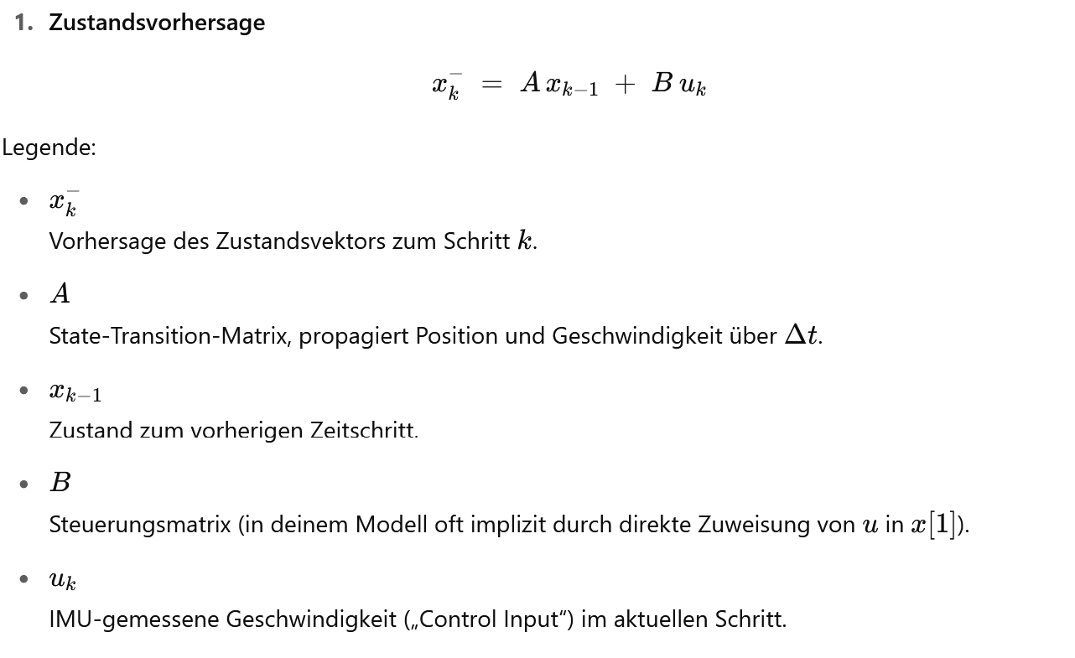
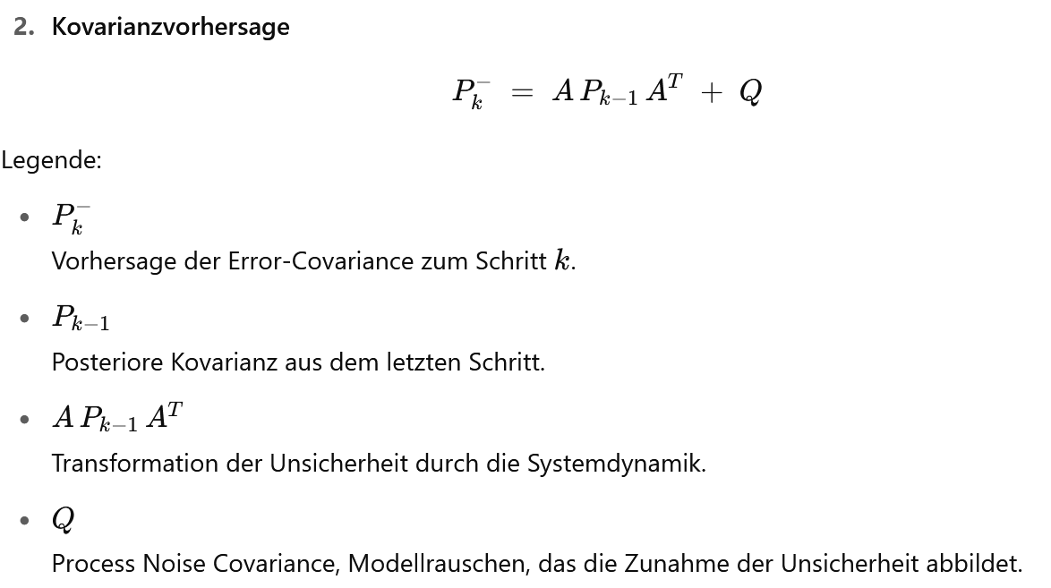
Prediction Step

Slide 18
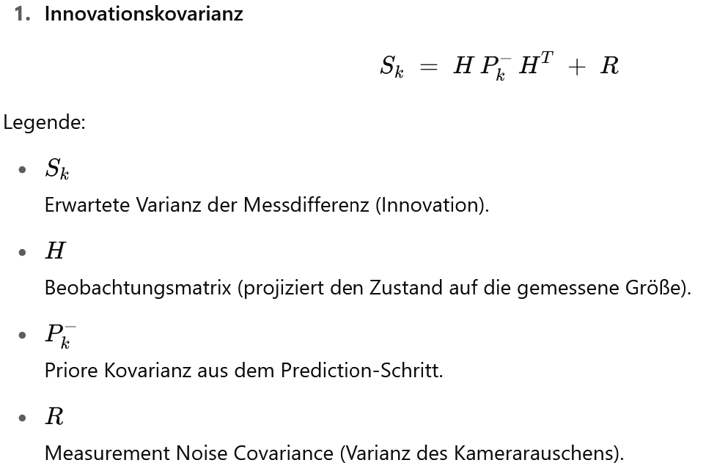
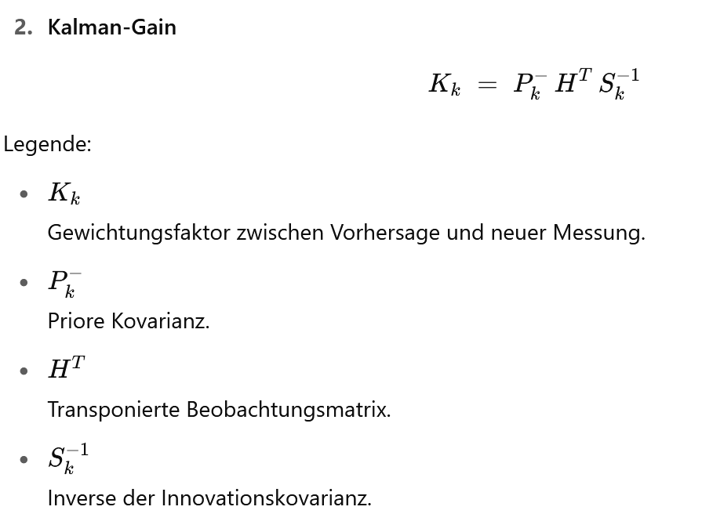
Correction Step (1/2)

Slide 19
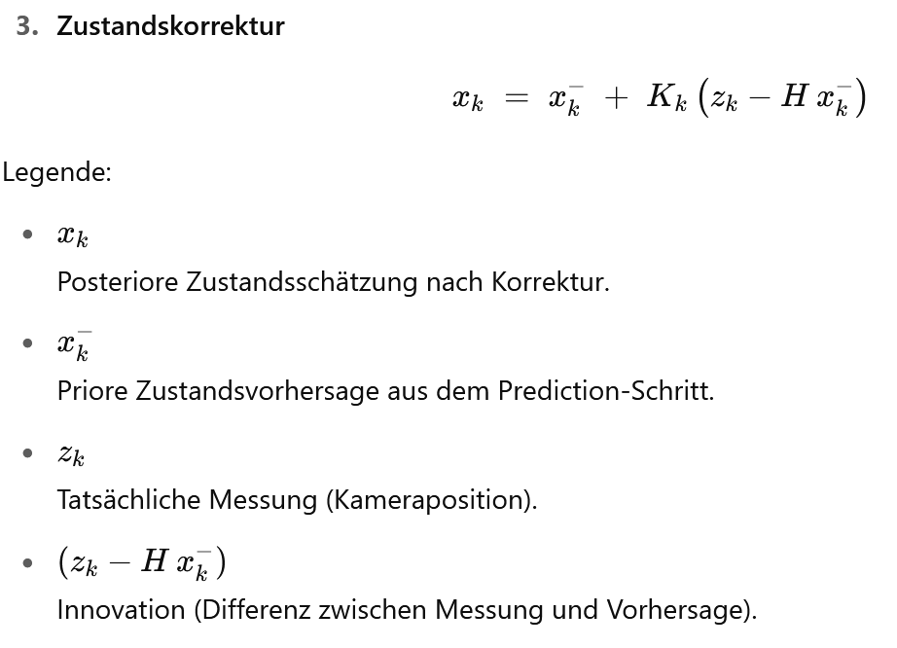
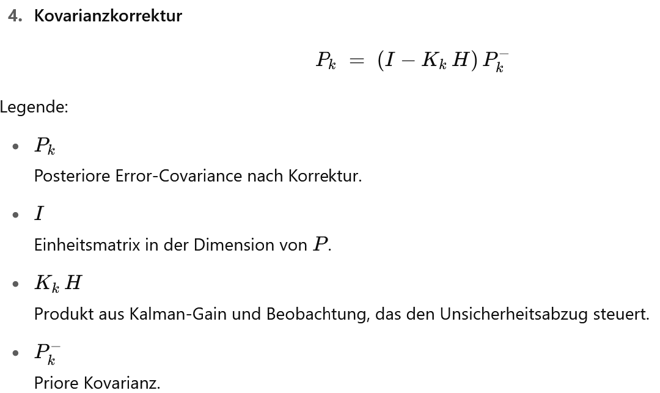
Correction Step (2/2)

