Slide 1
Chapter 6
SQL – Data Manipulation
Pearson Education © 2014

Slide 2
Chapter 6 - Objectives
Purpose and importance of SQL.
How to retrieve data from database using SELECT and:
Use compound WHERE conditions.
Sort query results using ORDER BY.
Use aggregate functions.
Group data using GROUP BY and HAVING.
Use subqueries.
Pearson Education © 2014

Slide 3
Chapter 6 - Objectives
Join tables together.
Perform set operations (UNION, INTERSECT, EXCEPT).
How to update database using INSERT, UPDATE, and DELETE.
Pearson Education © 2014
3

Slide 4
Objectives of SQL
Ideally, database language should allow user to:
create the database and relation structures;
perform insertion, modification, deletion of data from relations;
perform simple and complex queries.
Must perform these tasks with minimal user effort and command structure/syntax must be easy to learn.
It must be portable.
Pearson Education © 2014
4

Slide 5
Objectives of SQL
SQL is a transform-oriented language with 2 major components:
A DDL for defining database structure.
A DML for retrieving and updating data.
Until SQL:1999, SQL did not contain flow of control commands. These had to be implemented using a programming or job-control language, or interactively by the decisions of user.
Pearson Education © 2014
5

Slide 6
Objectives of SQL
SQL is relatively easy to learn:
it is non-procedural - you specify what information you require, rather than how to get it;
it is essentially free-format.
Pearson Education © 2014
6

Slide 7
Objectives of SQL
Consists of standard English words:
1) CREATE TABLE Staff(staffNo VARCHAR(5),
lName VARCHAR(15),
salary DECIMAL(7,2));
2) INSERT INTO Staff VALUES (‘SG16’, ‘Brown’, 8300);
3) SELECT staffNo, lName, salary
FROM Staff
WHERE salary > 10000;
Pearson Education © 2014
7

Slide 8
Objectives of SQL
Can be used by range of users including DBAs, management, application developers, and other types of end users.
An ISO standard now exists for SQL, making it both the formal and de facto standard language for relational databases.
Pearson Education © 2014
8

Slide 9
History of SQL
In 1974, D. Chamberlin (IBM San Jose Laboratory) defined language called ‘Structured English Query Language’ (SEQUEL).
A revised version, SEQUEL/2, was defined in 1976 but name was subsequently changed to SQL for legal reasons.
Pearson Education © 2014
9

Slide 10
History of SQL
Still pronounced ‘see-quel’, though official pronunciation is ‘S-Q-L’.
IBM subsequently produced a prototype DBMS called System R, based on SEQUEL/2.
Roots of SQL, however, are in SQUARE (Specifying Queries as Relational Expressions), which predates System R project.
Pearson Education © 2014
10

Slide 11
Literals
Literals are constants used in SQL statements.
All non-numeric literals must be enclosed in single quotes (e.g. ‘London’).
All numeric literals must not be enclosed in quotes (e.g. 650.00).
Pearson Education © 2014
11

Slide 12
SELECT Statement
SELECT [DISTINCT | ALL]
{* | [columnExpression [AS newName]] [,...] }
FROM TableName [alias] [, ...]
[WHERE condition]
[GROUP BY columnList] [HAVING condition]
[ORDER BY columnList]
Pearson Education © 2014
12

Slide 13
SELECT Statement
FROM Specifies table(s) to be used.
WHERE Filters rows.
GROUP BY Forms groups of rows with same
column value.
HAVING Filters groups subject to some
condition.
SELECT Specifies which columns are to
appear in output.
ORDER BY Specifies the order of the output.
Pearson Education © 2014
13

Slide 14
Example 6.1 All Columns, All Rows
List full details of all staff.
SELECT staffNo, fName, lName, address,
position, sex, DOB, salary, branchNo
FROM Staff;
Can use * as an abbreviation for ‘all columns’:
SELECT *
FROM Staff;
Pearson Education © 2014
14

Slide 15
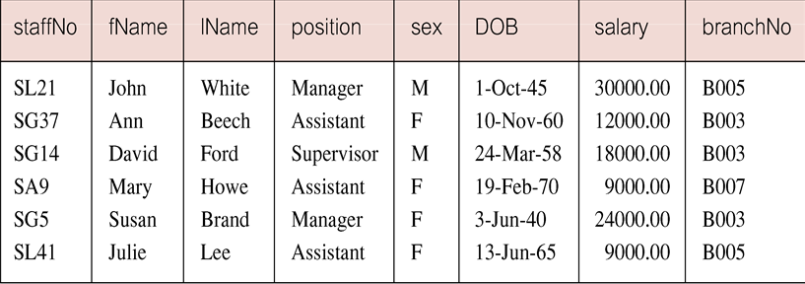
Example 6.1 All Columns, All Rows
Pearson Education © 2014
15

Slide 16
Example 6.2 Specific Columns, All Rows
Produce a list of salaries for all staff, showing only staff number, first and last names, and salary.
SELECT staffNo, fName, lName, salary
FROM Staff;
Pearson Education © 2014
16

Slide 17
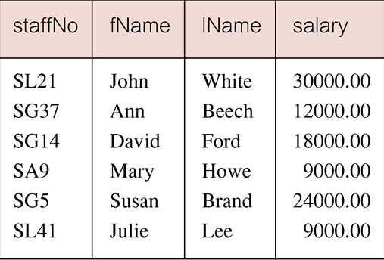
Example 6.2 Specific Columns, All Rows
Pearson Education © 2014
17

Slide 18
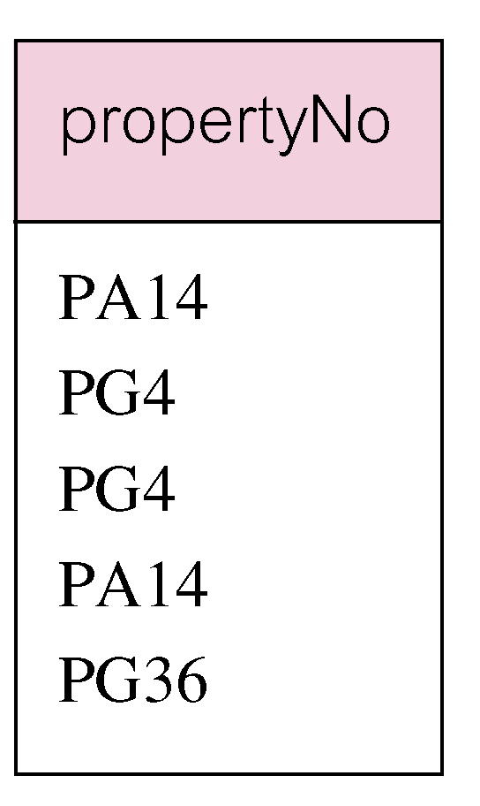
Example 6.3 Use of DISTINCT
List the property numbers of all properties that have been viewed.
SELECT propertyNo
FROM Viewing;
Pearson Education © 2014
18

Slide 19
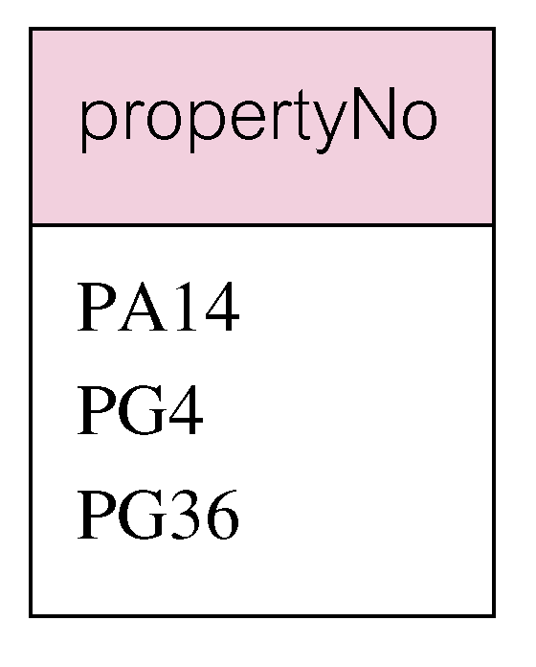
Example 6.3 Use of DISTINCT
Use DISTINCT to eliminate duplicates:
SELECT DISTINCT propertyNo
FROM Viewing;
Pearson Education © 2014
19

Slide 20
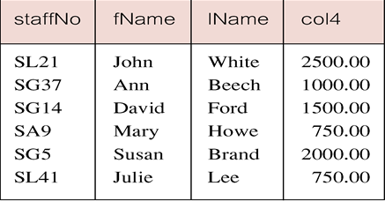
Example 6.4 Calculated Fields
Produce list of monthly salaries for all staff, showing staff number, first/last name, and salary.
SELECT staffNo, fName, lName, salary/12
FROM Staff;
20
Pearson Education © 2014

Slide 21
Example 6.4 Calculated Fields
To name column, use AS clause:
SELECT staffNo, fName, lName, salary/12
AS monthlySalary
FROM Staff;
Pearson Education © 2014
21

Slide 22
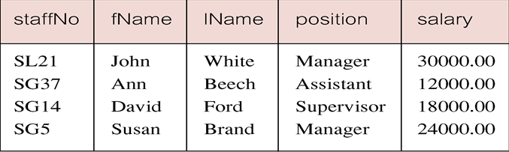
Example 6.5 Comparison Search Condition
List all staff with a salary greater than 10,000.
SELECT staffNo, fName, lName, position, salary
FROM Staff
WHERE salary > 10000;
Pearson Education © 2014
22

Slide 23
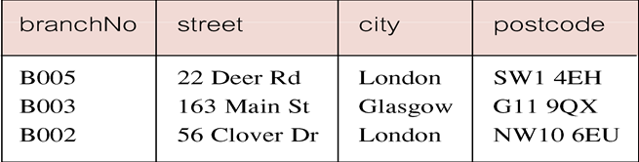
Example 6.6 Compound Comparison Search Condition
List addresses of all branch offices in London or Glasgow.
SELECT *
FROM Branch
WHERE city = ‘London’ OR city = ‘Glasgow’;
Pearson Education © 2014
23

Slide 24
Example 6.7 Range Search Condition
List all staff with a salary between 20,000 and 30,000.
SELECT staffNo, fName, lName, position, salary
FROM Staff
WHERE salary BETWEEN 20000 AND 30000;
BETWEEN test includes the endpoints of range.
Pearson Education © 2014
24

Slide 25
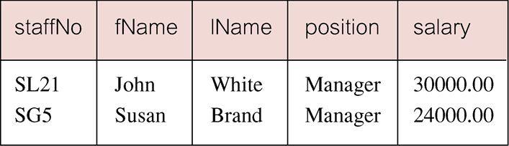
Example 6.7 Range Search Condition
Pearson Education © 2014
25

Slide 26
Example 6.7 Range Search Condition
Also a negated version NOT BETWEEN.
BETWEEN does not add much to SQL’s expressive power. Could also write:
SELECT staffNo, fName, lName, position, salary
FROM Staff
WHERE salary>=20000 AND salary <= 30000;
Useful, though, for a range of values.
Pearson Education © 2014
26

Slide 27
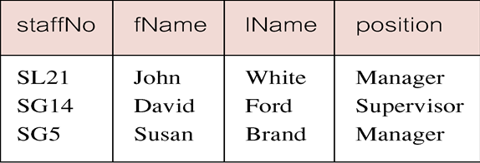
Example 6.8 Set Membership
List all managers and supervisors.
SELECT staffNo, fName, lName, position
FROM Staff
WHERE position IN (‘Manager’, ‘Supervisor’);
Pearson Education © 2014
27

Slide 28
Example 6.8 Set Membership
There is a negated version (NOT IN).
IN does not add much to SQL’s expressive power. Could have expressed this as:
SELECT staffNo, fName, lName, position
FROM Staff
WHERE position=‘Manager’ OR
position=‘Supervisor’;
IN is more efficient when set contains many values.
Pearson Education © 2014
28

Slide 29
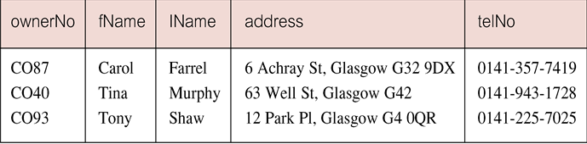
Example 6.9 Pattern Matching
Find all owners with the string ‘Glasgow’ in their address.
SELECT ownerNo, fName, lName, address, telNo
FROM PrivateOwner
WHERE address LIKE ‘%Glasgow%’;
Pearson Education © 2014
29

Slide 30
Example 6.9 Pattern Matching
SQL has two special pattern matching symbols:
%: sequence of zero or more characters;
_ (underscore): any single character.
LIKE ‘%Glasgow%’ means a sequence of characters of any length containing ‘Glasgow’.
WHERE section LIKE ‘Lab_’
Find students in any lab courses
WHERE city LIKE ‘[a-c]%’
All cities beginning with a, b, or c
Pearson Education © 2014
30

Slide 31
Example 6.10 NULL Search Condition
List details of all viewings on property PG4 where a comment has not been supplied.
There are 2 viewings for property PG4, one with and one without a comment.
Have to test for null explicitly using special keyword IS NULL:
SELECT clientNo, viewDate
FROM Viewing
WHERE propertyNo = ‘PG4’ AND
comment IS NULL;
Pearson Education © 2014
31

Slide 32
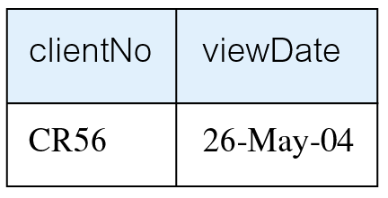
Example 6.10 NULL Search Condition
Negated version (IS NOT NULL) can test for non-null values.
Pearson Education © 2014

Slide 33
Example 6.11 Single Column Ordering
List salaries for all staff, arranged in descending order of salary.
SELECT staffNo, fName, lName, salary
FROM Staff
ORDER BY salary DESC;
Pearson Education © 2014
33

Slide 34
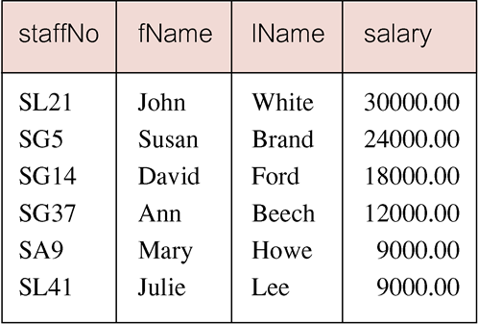
Example 6.11 Single Column Ordering
Pearson Education © 2014
34

Slide 35
Example 6.12 Multiple Column Ordering
Produce abbreviated list of properties in order of property type.
SELECT propertyNo, type, rooms, rent
FROM PropertyForRent
ORDER BY type;
Pearson Education © 2014
35

Slide 36
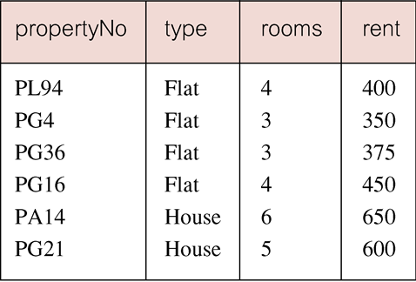
Example 6.12 Multiple Column Ordering
Pearson Education © 2014
36

Slide 37
Example 6.12 Multiple Column Ordering
Four flats in this list - as no minor sort key specified, system arranges these rows in any order it chooses.
To arrange in order of rent, specify minor order:
SELECT propertyNo, type, rooms, rent
FROM PropertyForRent
ORDER BY type, rent DESC;
Pearson Education © 2014
37

Slide 38
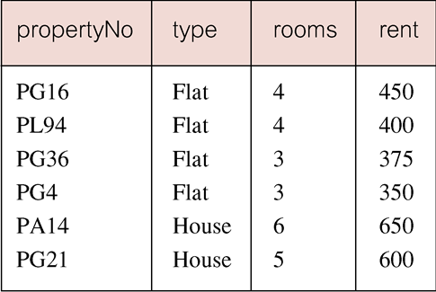
Example 6.12 Multiple Column Ordering
Pearson Education © 2014
38

Slide 39
SELECT Statement - Aggregates
ISO standard defines five aggregate functions:
COUNT returns number of values in specified column.
SUM returns sum of values in specified column.
AVG returns average of values in specified column.
MIN returns smallest value in specified column.
MAX returns largest value in specified column.
Pearson Education © 2014
39

Slide 40
SELECT Statement - Aggregates
Each operates on a single column of a table and returns a single value.
COUNT, MIN, and MAX apply to numeric and non-numeric fields, but SUM and AVG may be used on numeric fields only.
Apart from COUNT(*), each function eliminates nulls first and operates only on remaining non-null values.
Pearson Education © 2014
40

Slide 41
SELECT Statement - Aggregates
COUNT(*) counts all rows of a table, regardless of whether nulls or duplicate values occur.
Can use DISTINCT before column name to eliminate duplicates.
DISTINCT has no effect with MIN/MAX, but may have with SUM/AVG.
Pearson Education © 2014
41

Slide 42
SELECT Statement - Aggregates
Aggregate functions can be used only in SELECT list and in HAVING clause.
If SELECT list includes an aggregate function and there is no GROUP BY clause, SELECT list cannot reference a column out with an aggregate function. For example, the following is illegal:
SELECT staffNo, COUNT(salary)
FROM Staff;
Pearson Education © 2014
42

Slide 43
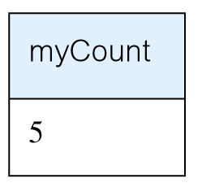
Example 6.13 Use of COUNT(*)
How many properties cost more than £350 per month to rent?
SELECT COUNT(*) AS myCount
FROM PropertyForRent
WHERE rent > 350;
Pearson Education © 2014

Slide 44
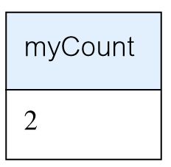
Example 6.14 Use of COUNT(DISTINCT)
How many different properties viewed in May ‘13?
SELECT COUNT(DISTINCT propertyNo) AS myCount
FROM Viewing
WHERE viewDate BETWEEN ‘1-May-13’
AND ‘31-May-13’;
Pearson Education © 2014

Slide 45
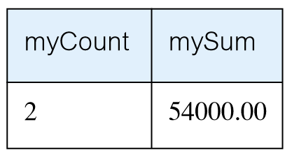
Example 6.15 Use of COUNT and SUM
Find number of Managers and sum of their salaries.
SELECT COUNT(staffNo) AS myCount,
SUM(salary) AS mySum
FROM Staff
WHERE position = ‘Manager’;
Pearson Education © 2014

Slide 46
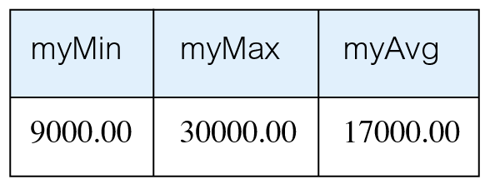
Example 6.16 Use of MIN, MAX, AVG
Find minimum, maximum, and average staff salary.
SELECT MIN(salary) AS myMin,
MAX(salary) AS myMax,
AVG(salary) AS myAvg
FROM Staff;
Pearson Education © 2014

Slide 47
SELECT Statement - Grouping
Use GROUP BY clause to get sub-totals.
SELECT and GROUP BY closely integrated: each item in SELECT list must be single-valued per group, and SELECT clause may only contain:
column names
aggregate functions
constants
expression involving combinations of the above.
Pearson Education © 2014
47

Slide 48
SELECT Statement - Grouping
All column names in SELECT list must appear in GROUP BY clause unless name is used only in an aggregate function.
If WHERE is used with GROUP BY, WHERE is applied first, then groups are formed from remaining rows satisfying predicate.
ISO considers two nulls to be equal for purposes of GROUP BY.
Pearson Education © 2014
48

Slide 49
Example 6.17 Use of GROUP BY
Find number of staff in each branch and their total salaries.
SELECT branchNo,
COUNT(staffNo) AS myCount,
SUM(salary) AS mySum
FROM Staff
GROUP BY branchNo
ORDER BY branchNo;
Pearson Education © 2014
49

Slide 50
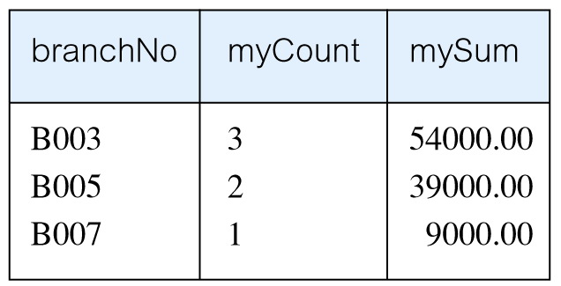
Example 6.17 Use of GROUP BY
Pearson Education © 2014
50

Slide 51
Restricted Groupings – HAVING clause
HAVING clause is designed for use with GROUP BY to restrict groups that appear in final result table.
Similar to WHERE, but WHERE filters individual rows whereas HAVING filters groups.
Column names in HAVING clause must also appear in the GROUP BY list or be contained within an aggregate function.
Pearson Education © 2014
51

Slide 52
Example 6.18 Use of HAVING
For each branch with more than 1 member of staff, find number of staff in each branch and sum of their salaries.
SELECT branchNo,
COUNT(staffNo) AS myCount,
SUM(salary) AS mySum
FROM Staff
GROUP BY branchNo
HAVING COUNT(staffNo) > 1
ORDER BY branchNo;
Pearson Education © 2014
52

Slide 53
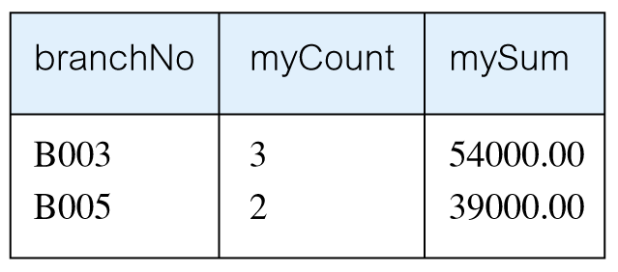
Example 6.18 Use of HAVING
Pearson Education © 2014
53

Slide 54
Subqueries
Some SQL statements can have a SELECT embedded within them.
A subselect can be used in WHERE and HAVING clauses of an outer SELECT, where it is called a subquery or nested query.
Subselects may also appear in INSERT, UPDATE, and DELETE statements.
Pearson Education © 2014
54

Slide 55
Example 6.19 Subquery with Equality
List staff who work in branch at ‘163 Main St’.
SELECT staffNo, fName, lName, position
FROM Staff
WHERE branchNo =
(SELECT branchNo
FROM Branch
WHERE street = ‘163 Main St’);
Pearson Education © 2014
55

Slide 56
Example 6.19 Subquery with Equality
Inner SELECT finds branch number for branch at ‘163 Main St’ (‘B003’).
Outer SELECT then retrieves details of all staff who work at this branch.
Outer SELECT then becomes:
SELECT staffNo, fName, lName, position
FROM Staff
WHERE branchNo = ‘B003’;
Pearson Education © 2014
56

Slide 57
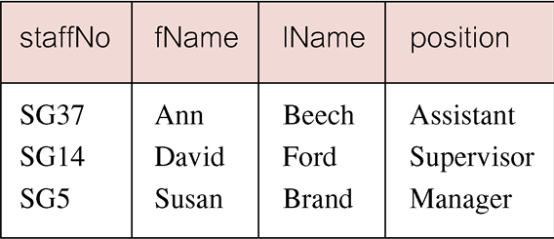
Example 6.19 Subquery with Equality
Pearson Education © 2014
57

Slide 58
Example 6.20 Subquery with Aggregate
List all staff whose salary is greater than the average salary, and show by how much.
SELECT staffNo, fName, lName, position,
salary – (SELECT AVG(salary) FROM Staff) As SalDiff
FROM Staff
WHERE salary >
(SELECT AVG(salary)
FROM Staff);
Pearson Education © 2014
58

Slide 59
Example 6.20 Subquery with Aggregate
Cannot write ‘WHERE salary > AVG(salary)’
Instead, use subquery to find average salary (17000), and then use outer SELECT to find those staff with salary greater than this:
SELECT staffNo, fName, lName, position,
salary – 17000 As salDiff
FROM Staff
WHERE salary > 17000;
Pearson Education © 2014
59

Slide 60
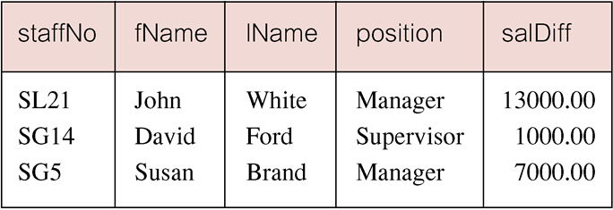
Example 6.20 Subquery with Aggregate
Pearson Education © 2014
60

Slide 61
Subquery Rules
ORDER BY clause may not be used in a subquery (although it may be used in outermost SELECT).
Subquery SELECT list must consist of a single column name or expression, except for subqueries that use EXISTS.
By default, column names refer to table name in FROM clause of subquery. Can refer to a table in FROM using an alias.
Pearson Education © 2014
61

Slide 62
Subquery Rules
When subquery is an operand in a comparison, subquery must appear on right-hand side.
A subquery may not be used as an operand in an expression.
Pearson Education © 2014
62

Slide 63
Example 6.21 Nested subquery: use of IN
List properties handled by staff at ‘163 Main St’.
SELECT propertyNo, street, city, postcode, type, rooms, rent
FROM PropertyForRent
WHERE staffNo IN
(SELECT staffNo
FROM Staff
WHERE branchNo =
(SELECT branchNo
FROM Branch
WHERE street = ‘163 Main St’));
Pearson Education © 2014
63

Slide 64
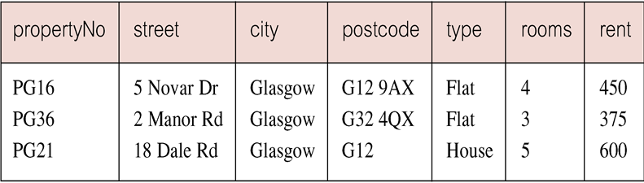
Example 6.21 Nested subquery: use of IN
Pearson Education © 2014
64

Slide 65
ANY and ALL
ANY and ALL may be used with subqueries that produce a single column of numbers.
With ALL, condition will only be true if it is satisfied by all values produced by subquery.
With ANY, condition will be true if it is satisfied by any values produced by subquery.
If subquery is empty, ALL returns true, ANY returns false.
SOME may be used in place of ANY.
Pearson Education © 2014
65

Slide 66
Example 6.22 Use of ANY/SOME
Find staff whose salary is larger than salary of at least one member of staff at branch B003.
SELECT staffNo, fName, lName, position, salary
FROM Staff
WHERE salary > SOME
(SELECT salary
FROM Staff
WHERE branchNo = ‘B003’);
Pearson Education © 2014
66

Slide 67
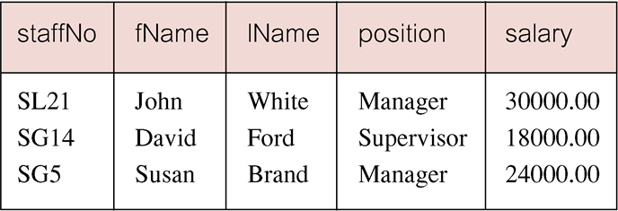
Example 6.22 Use of ANY/SOME
Inner query produces set {12000, 18000, 24000} and outer query selects those staff whose salaries are greater than any of the values in this set.
Pearson Education © 2014
67

Slide 68
Example 6.23 Use of ALL
Find staff whose salary is larger than salary of every member of staff at branch B003.
SELECT staffNo, fName, lName, position, salary
FROM Staff
WHERE salary > ALL
(SELECT salary
FROM Staff
WHERE branchNo = ‘B003’);
Pearson Education © 2014
68

Slide 69
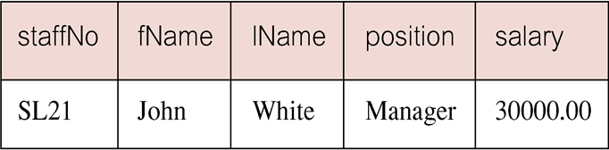
Example 6.23 Use of ALL
Pearson Education © 2014
69

Slide 70
Multi-Table Queries
Can use subqueries provided result columns come from same table.
If result columns come from more than one table must use a join.
To perform join, include more than one table in FROM clause.
Use comma as separator and typically include WHERE clause to specify join column(s).
Pearson Education © 2014
70

Slide 71
Multi-Table Queries
Also possible to use an alias for a table named in FROM clause.
Alias is separated from table name with a space.
Alias can be used to qualify column names when there is ambiguity.
Pearson Education © 2014
71

Slide 72
Example 6.24 Simple Join
List names of all clients who have viewed a property along with any comment supplied.
SELECT c.clientNo, fName, lName,
propertyNo, comment
FROM Client c, Viewing v
WHERE c.clientNo = v.clientNo;
Pearson Education © 2014
72

Slide 73
Example 6.24 Simple Join
Only those rows from both tables that have identical values in the clientNo columns (c.clientNo = v.clientNo) are included in result.
Equivalent to equi-join in relational algebra.
Pearson Education © 2014
73

Slide 74
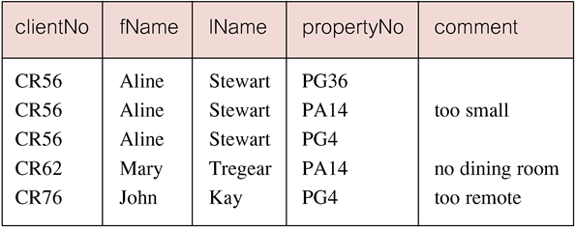
Example 6.24 Simple Join
Pearson Education © 2014
74

Slide 75
Alternative JOIN Constructs
SQL provides alternative ways to specify joins:
FROM Client c JOIN Viewing v ON c.clientNo = v.clientNo
FROM Client JOIN Viewing USING clientNo
FROM Client NATURAL JOIN Viewing
In each case, FROM replaces original FROM and WHERE. However, first produces table with two identical clientNo columns.
Pearson Education © 2014
75

Slide 76
Example 6.25 Sorting a join
For each branch, list numbers and names of staff who manage properties, and properties they manage.
SELECT s.branchNo, s.staffNo, fName, lName,
propertyNo
FROM Staff s, PropertyForRent p
WHERE s.staffNo = p.staffNo
ORDER BY s.branchNo, s.staffNo, propertyNo;
Pearson Education © 2014
76

Slide 77
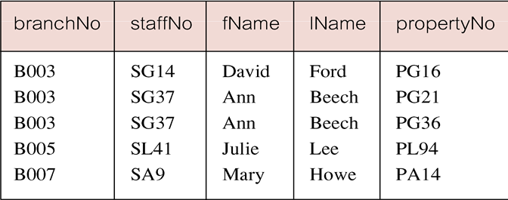
Example 6.25 Sorting a join
Pearson Education © 2014
77

Slide 78
Example 6.26 Three Table Join
For each branch, list staff who manage properties, including city in which branch is located and properties they manage.
SELECT b.branchNo, b.city, s.staffNo, fName, lName,
propertyNo
FROM Branch b, Staff s, PropertyForRent p
WHERE b.branchNo = s.branchNo AND
s.staffNo = p.staffNo
ORDER BY b.branchNo, s.staffNo, propertyNo;
Pearson Education © 2014
78

Slide 79
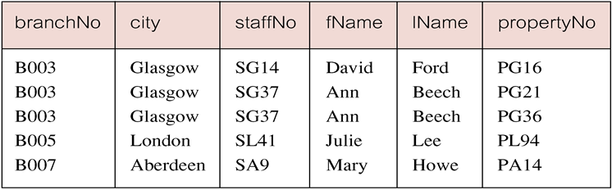
Example 6.26 Three Table Join
Alternative formulation for FROM and WHERE:
FROM (Branch b JOIN Staff s USING branchNo) AS
bs JOIN PropertyForRent p USING staffNo
Pearson Education © 2014
79

Slide 80
Example 6.27 Multiple Grouping Columns
Find number of properties handled by each staff member.
SELECT s.branchNo, s.staffNo, COUNT(*) AS myCount
FROM Staff s, PropertyForRent p
WHERE s.staffNo = p.staffNo
GROUP BY s.branchNo, s.staffNo
ORDER BY s.branchNo, s.staffNo;
Pearson Education © 2014
80

Slide 81
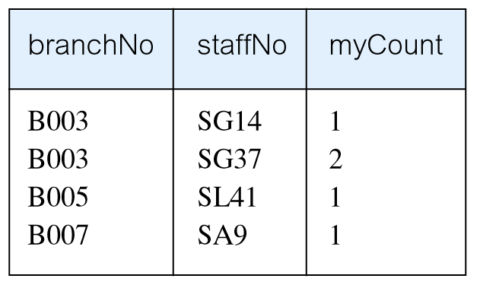
Example 6.27 Multiple Grouping Columns
Pearson Education © 2014
81

Slide 82
Computing a Join
Procedure for generating results of a join are:
1. Form Cartesian product of the tables named in FROM clause.
2. If there is a WHERE clause, apply the search condition to each row of the product table, retaining those rows that satisfy the condition.
3. For each remaining row, determine value of each item in SELECT list to produce a single row in result table.
Pearson Education © 2014
82

Slide 83
Computing a Join
4. If DISTINCT has been specified, eliminate any duplicate rows from the result table.
5. If there is an ORDER BY clause, sort result table as required.
SQL provides special format of SELECT for Cartesian product:
SELECT [DISTINCT | ALL] {* | columnList}
FROM Table1 CROSS JOIN Table2
Pearson Education © 2014
83

Slide 84
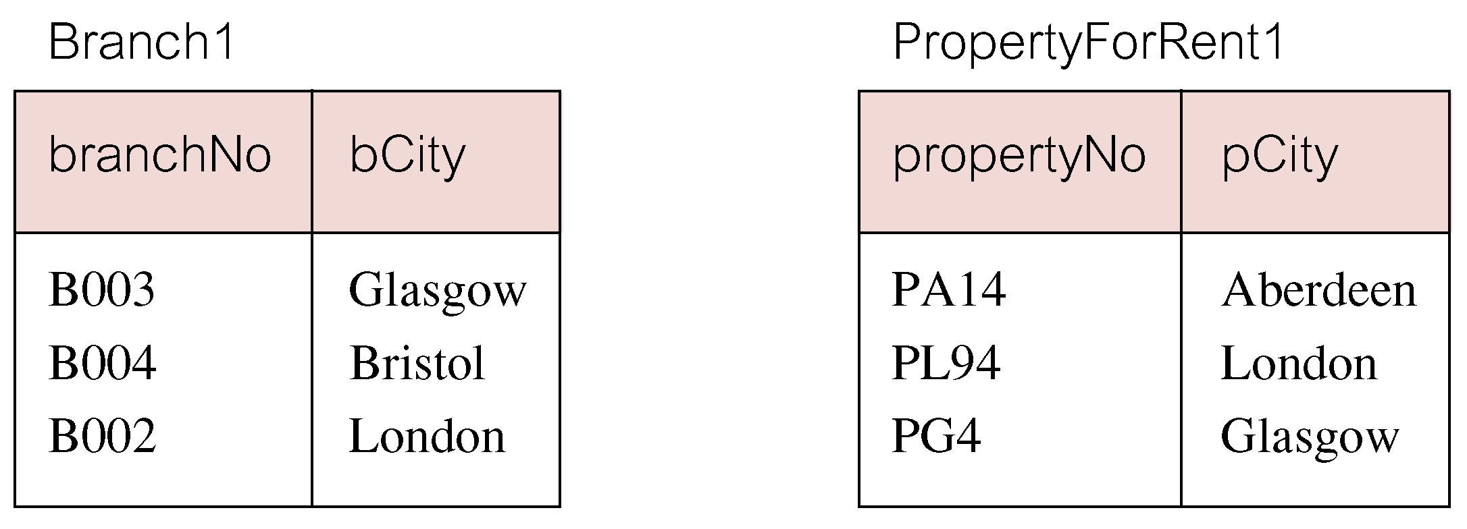
Outer Joins
If one row of a joined table is unmatched, row is omitted from result table.
Outer join operations retain rows that do not satisfy the join condition.
Consider following tables:
84
Pearson Education © 2014

Slide 85
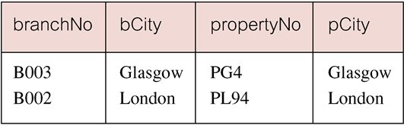
Outer Joins
The (inner) join of these two tables:
SELECT b.*, p.*
FROM Branch1 b, PropertyForRent1 p
WHERE b.bCity = p.pCity;
Pearson Education © 2014
85

Slide 86
Outer Joins
Result table has two rows where cities are same.
There are no rows corresponding to branches in Bristol and Aberdeen.
To include unmatched rows in result table, use an Outer join.
Pearson Education © 2014
86

Slide 87
Example 6.28 Left Outer Join
List branches and properties that are in same city along with any unmatched branches.
SELECT b.*, p.*
FROM Branch1 b LEFT JOIN
PropertyForRent1 p ON b.bCity = p.pCity;
Pearson Education © 2014
87

Slide 88
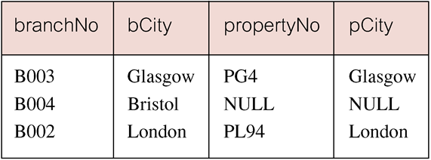
Example 6.28 Left Outer Join
Includes those rows of first (left) table unmatched with rows from second (right) table.
Columns from second table are filled with NULLs.
Pearson Education © 2014
88

Slide 89
Example 6.29 Right Outer Join
List branches and properties in same city and any unmatched properties.
SELECT b.*, p.*
FROM Branch1 b RIGHT JOIN
PropertyForRent1 p ON b.bCity = p.pCity;
Pearson Education © 2014
89

Slide 90
Example 6.29 Right Outer Join
Right Outer join includes those rows of second (right) table that are unmatched with rows from first (left) table.
Columns from first table are filled with NULLs.
Pearson Education © 2014
90

Slide 91
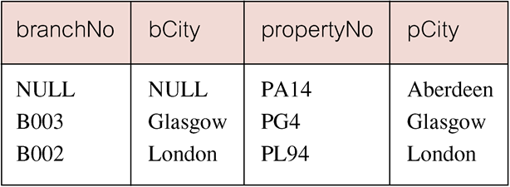
Example 6.29 Right Outer Join
Pearson Education © 2014
91

Slide 92
Example 6.30 Full Outer Join
List branches and properties in same city and any unmatched branches or properties.
SELECT b.*, p.*
FROM Branch1 b FULL JOIN
PropertyForRent1 p ON b.bCity = p.pCity;
Pearson Education © 2014
92

Slide 93
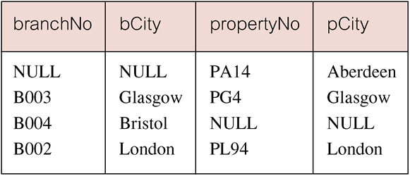
Example 6.30 Full Outer Join
Includes rows that are unmatched in both tables.
Unmatched columns are filled with NULLs.
Pearson Education © 2014
93

Slide 94
EXISTS and NOT EXISTS
EXISTS and NOT EXISTS are for use only with subqueries.
Produce a simple true/false result.
True if and only if there exists at least one row in result table returned by subquery.
False if subquery returns an empty result table.
NOT EXISTS is the opposite of EXISTS.
Pearson Education © 2014
94

Slide 95
EXISTS and NOT EXISTS
As (NOT) EXISTS check only for existence or non-existence of rows in subquery result table, subquery can contain any number of columns.
Common for subqueries following (NOT) EXISTS to be of form:
(SELECT * ...)
Pearson Education © 2014
95

Slide 96
Example 6.31 Query using EXISTS
Find all staff who work in a London branch.
SELECT staffNo, fName, lName, position
FROM Staff s
WHERE EXISTS
(SELECT *
FROM Branch b
WHERE s.branchNo = b.branchNo AND
city = ‘London’);
Pearson Education © 2014
96

Slide 97
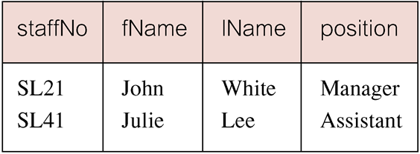
Example 6.31 Query using EXISTS
Pearson Education © 2014
97

Slide 98
Example 6.31 Query using EXISTS
Note, search condition s.branchNo = b.branchNo is necessary to consider correct branch record for each member of staff.
If omitted, would get all staff records listed out because subquery:
SELECT * FROM Branch WHERE city=‘London’
would always be true and query would be:
SELECT staffNo, fName, lName, position FROM Staff
WHERE true;
Pearson Education © 2014
98

Slide 99
Example 6.31 Query using EXISTS
Could also write this query using join construct:
SELECT staffNo, fName, lName, position
FROM Staff s, Branch b
WHERE s.branchNo = b.branchNo AND
city = ‘London’;
Pearson Education © 2014
99

Slide 100
Union, Intersect, and Difference (Except)
Can use normal set operations of Union, Intersection, and Difference to combine results of two or more queries into a single result table.
Union of two tables, A and B, is table containing all rows in either A or B or both.
Intersection is table containing all rows common to both A and B.
Difference is table containing all rows in A but not in B.
Two tables must be union compatible.
Pearson Education © 2014
100

Slide 101
Union, Intersect, and Difference (Except)
Format of set operator clause in each case is:
op [ALL] [CORRESPONDING [BY {column1 [, ...]}]]
If CORRESPONDING BY specified, set operation performed on the named column(s).
If CORRESPONDING specified but not BY clause, operation performed on common columns.
If ALL specified, result can include duplicate rows.
Pearson Education © 2014
101

Slide 102
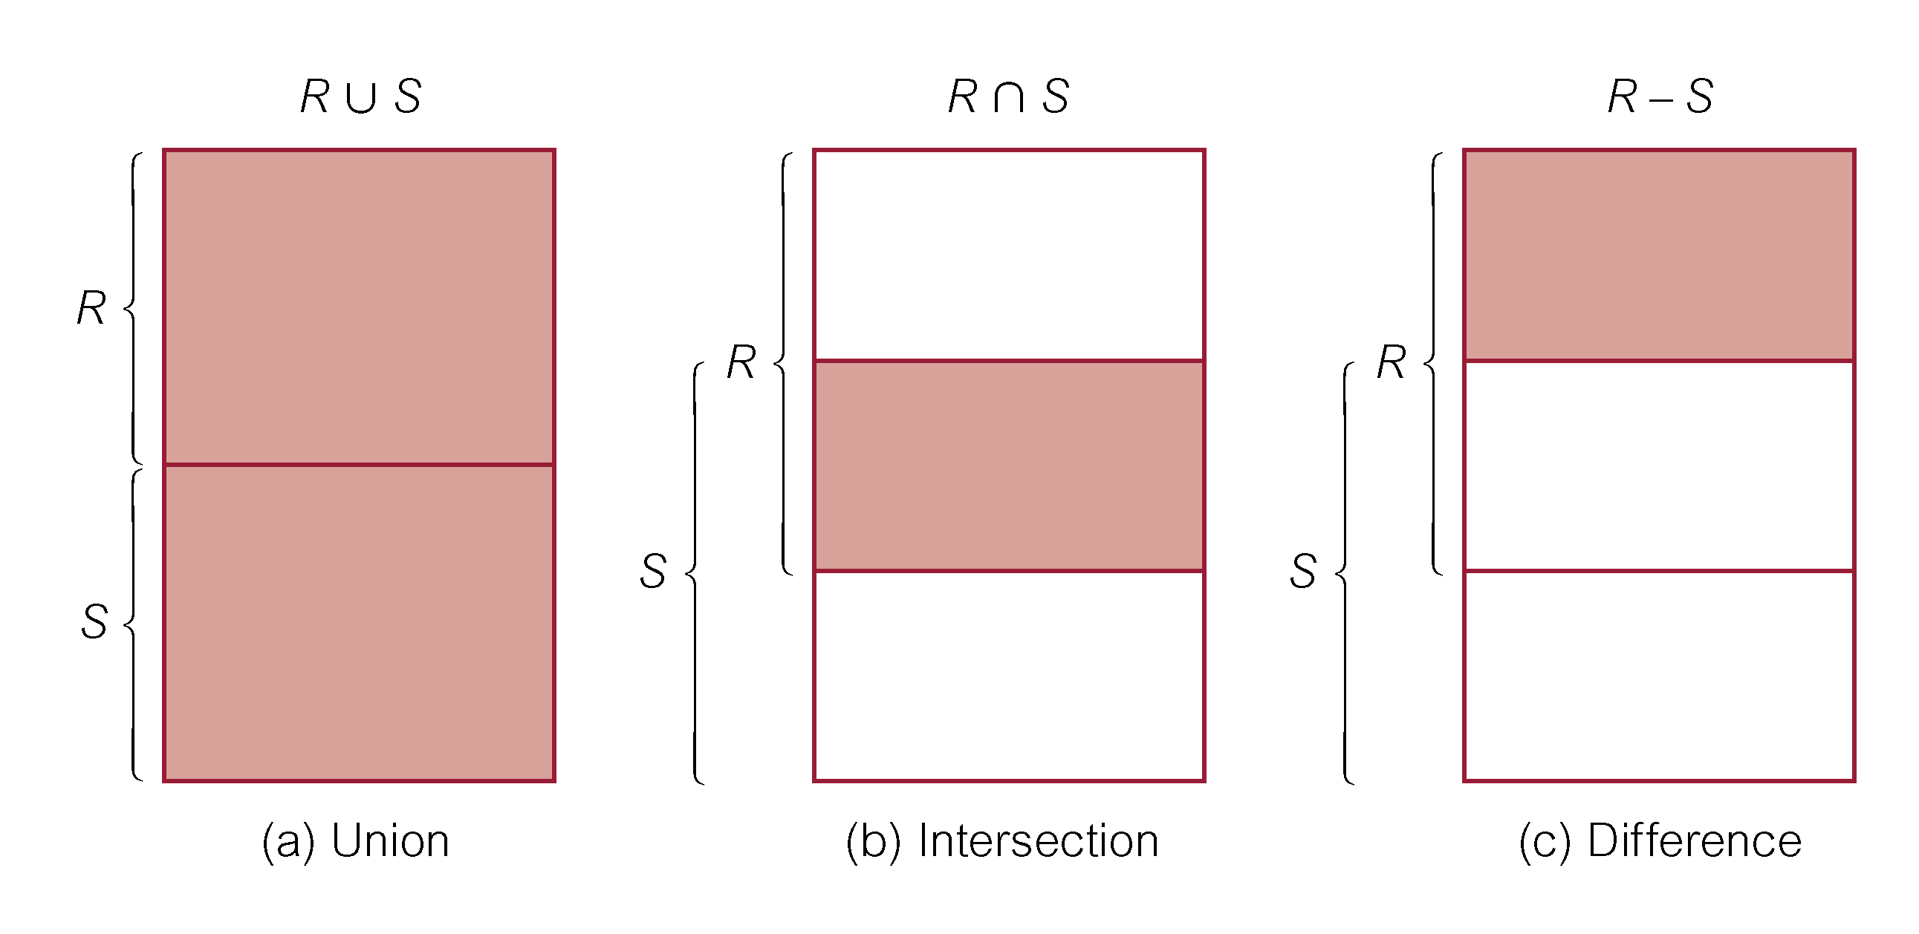
Union, Intersect, and Difference (Except)
Pearson Education © 2014
102

Slide 103
Example 6.32 Use of UNION
List all cities where there is either a branch office or a property.
(SELECT city
FROM Branch
WHERE city IS NOT NULL) UNION
(SELECT city
FROM PropertyForRent
WHERE city IS NOT NULL);
Pearson Education © 2014
103

Slide 104
Example 6.32 Use of UNION
Or
(SELECT * FROM Branch WHERE city IS NOT NULL) UNION CORRESPONDING BY city (SELECT * FROM PropertyForRent WHERE city IS NOT NULL);
Pearson Education © 2014
104

Slide 105
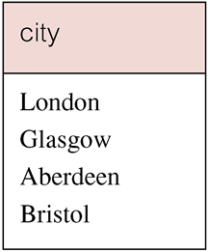
Example 6.32 Use of UNION
Produces result tables from both queries and merges both tables together.
Pearson Education © 2014
105

Slide 106
Example 6.33 Use of INTERSECT
List all cities where there is both a branch office and a property.
(SELECT city FROM Branch)
INTERSECT
(SELECT city FROM PropertyForRent);
Pearson Education © 2014
106

Slide 107
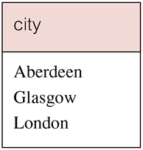
Example 6.33 Use of INTERSECT
Or
(SELECT * FROM Branch)
INTERSECT CORRESPONDING BY city
(SELECT * FROM PropertyForRent);
107
Pearson Education © 2014

Slide 108
Example 6.33 Use of INTERSECT
Could rewrite this query without INTERSECT operator:
SELECT b.city
FROM Branch b PropertyForRent p
WHERE b.city = p.city;
Or:
SELECT DISTINCT city FROM Branch b
WHERE EXISTS
(SELECT * FROM PropertyForRent p
WHERE p.city = b.city);
Pearson Education © 2014
108

Slide 109
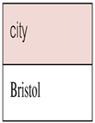
Example 6.34 Use of EXCEPT
List of all cities where there is a branch office but no properties.
(SELECT city FROM Branch)
EXCEPT
(SELECT city FROM PropertyForRent);
Or
(SELECT * FROM Branch)
EXCEPT CORRESPONDING BY city
(SELECT * FROM PropertyForRent);
Pearson Education © 2014
109

Slide 110
Example 6.34 Use of EXCEPT
Could rewrite this query without EXCEPT:
SELECT DISTINCT city FROM Branch
WHERE city NOT IN
(SELECT city FROM PropertyForRent);
Or
SELECT DISTINCT city FROM Branch b
WHERE NOT EXISTS
(SELECT * FROM PropertyForRent p
WHERE p.city = b.city);
Pearson Education © 2014
110

