Slide 1


Slide 2
Chapter 13
Disk Storage, Basic File Structures, and Hashing

Slide 3
Chapter Outline
Disk Storage Devices
Files of Records
Operations on Files
Unordered Files
Ordered Files
Hashed Files
Dynamic and Extendible Hashing Techniques
RAID Technology

Slide 4
Disk Storage Devices
Preferred secondary storage device for high storage capacity and low cost.
Data stored as magnetized areas on magnetic disk surfaces.
A disk pack contains several magnetic disks connected to a rotating spindle.
Disks are divided into concentric circular tracks on each disk surface.
Track capacities vary typically from 4 to 50 Kbytes or more

Slide 5
Disk Storage Devices (contd.)
A track is divided into smaller blocks or sectors
because it usually contains a large amount of information
The division of a track into sectors is hard-coded on the disk surface and cannot be changed.
One type of sector organization calls a portion of a track that subtends a fixed angle at the center as a sector.
A track is divided into blocks.
The block size B is fixed for each system.
Typical block sizes range from B=512 bytes to B=4096 bytes.
Whole blocks are transferred between disk and main memory for processing.

Slide 6
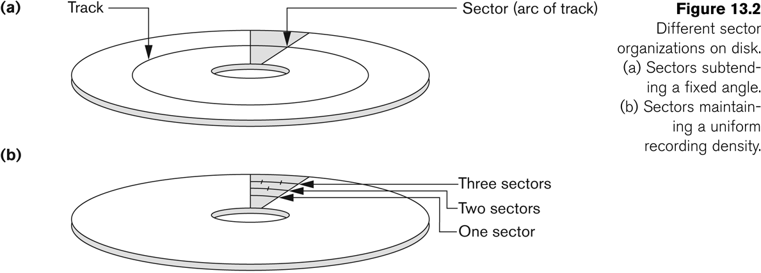
Disk Storage Devices (contd.)

Slide 7
Disk Storage Devices (contd.)
A read-write head moves to the track that contains the block to be transferred.
Disk rotation moves the block under the read-write head for reading or writing.
A physical disk block (hardware) address consists of:
a cylinder number (imaginary collection of tracks of same radius from all recorded surfaces)
the track number or surface number (within the cylinder)
and block number (within track).
Reading or writing a disk block is time consuming because of the seek time s and rotational delay (latency) rd.
Double buffering can be used to speed up the transfer of contiguous disk blocks.

Slide 8
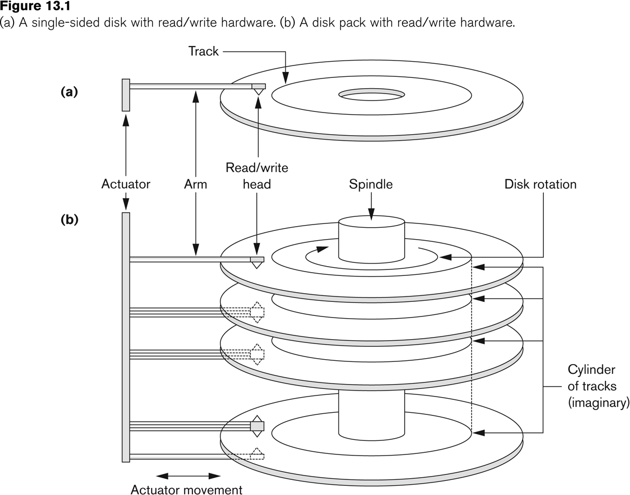
Disk Storage Devices (contd.)

Slide 9
Files
Files for a data-driven application consist of a sequence of records
Records contain fields which have values of a particular type
E.g., amount, date, time, age
Fields may be fixed length or variable length
A file descriptor (or file header) includes information that describes the file, such as the field names and their data types, and the size of each field.

Slide 10
Records
Records may be fixed and variable length
If one field is variable length, then record is variable length
If fields are variable length:
Separator characters or length fields are needed so that the record can be “parsed.” e.g., csv
Susan,Math,3.8
Lawrence,English,4.0
John,CS,2.2

Slide 11
Blocking
Blocking:
Refers to storing a number of records in one block on the disk.
Blocking factor (bfr) refers to the number of records per block.
There may be empty space in a block if an integral number of records do not fit in one block.
Spanned Records:
Refers to records that either are too large to fit in a single block, or a records that are allowed to be part in one block and the rest in the other to avoid any wasted space.

Slide 12
Blocking Factor Calculation
Name: 16 char 16B
Age: int 4B
Major: 4 char 4B
GPA: float 4B
Record size: 28B
Block size: 4096B
Bfr: floor (4096/28) = floor (146.28) = 146

Slide 13
Files of Records (contd.)
File records can be unspanned or spanned
Unspanned: no record can span two blocks
Spanned: a record can be stored in more than one block
The physical disk blocks that are allocated to hold the records of a file can be contiguous, linked, or indexed.
In a file of fixed-length records, all records have the same format. Usually, unspanned blocking is used with such files.
Files of variable-length records require additional information to be stored in each record, such as separator characters and field types.
Usually spanned blocking is used with such files.

Slide 14
Operation on Files
Typical file operations include:
OPEN: Readies the file for access, and associates a pointer that will refer to a current file record at each point in time.
FIND: Searches for the first file record that satisfies a certain condition, and makes it the current file record.
FINDNEXT: Searches for the next file record (from the current record) that satisfies a certain condition, and makes it the current file record.
READ: Reads the current file record into a program variable.
INSERT: Inserts a new record into the file & makes it the current file record.
DELETE: Removes the current file record from the file, usually by marking the record to indicate that it is no longer valid.
MODIFY: Changes the values of some fields of the current file record.
CLOSE: Terminates access to the file.
REORGANIZE: Reorganizes the file records.
For example, the records marked deleted are physically removed from the file or a new organization of the file records is created.
READ_ORDERED: Read the file blocks in order of a specific field of the file.

Slide 15
Unordered Files
Also called a heap or a pile file.
New records are inserted at the end of the file.
A linear search through the file records is necessary to search for a record.
This requires reading and searching half the file blocks on the average, and is hence quite expensive.
Record insertion is quite efficient.
Reading the records in order of a particular field requires sorting the file records.

Slide 16
Ordered Files
Also called a sequential file.
File records are kept sorted by the values of an ordering field.
Insertion is expensive: records must be inserted in the correct order.
It is common to keep a separate unordered overflow (or transaction) file for new records to improve insertion efficiency; this is periodically merged with the main ordered file.
A binary search can be used to search for a record on its ordering field value.
This requires reading and searching log₂ of the file blocks on the average, an improvement over linear search.
Reading the records in order of the ordering field is quite efficient.

Slide 17
Handling Overflow in Seq Files
1) rewrite the file from then on down (on avg ½ file) for each insertion
2) Have an overflow area (heap/pile file)
Do binary search on sequential file
If not found
Do linear search in overflow file
Efficient because sequential file is >> overflow file
10,000,000 in sq fi, 1,000 in overflow
Periodically, reorganize: sort overflow and merge to create larger seq file

Slide 18
Overflow
Can append overflow records at end
Bookeeping in config file or header to keep track of where sorted area ends and unsorted overflow starts
Preallocate blank areas between records
Record
NewRecord
AnotherNewRecord
Record2
If no blanks available; rewrite file (rec, bl, rec, bl, …)

Slide 19
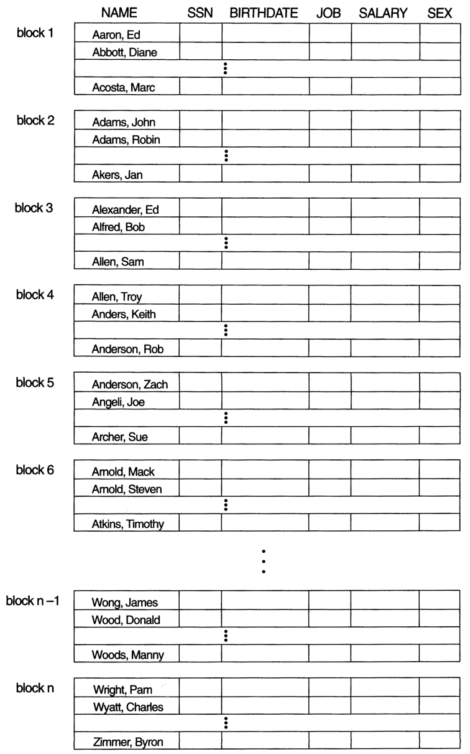
Ordered Files (contd.)

Slide 20
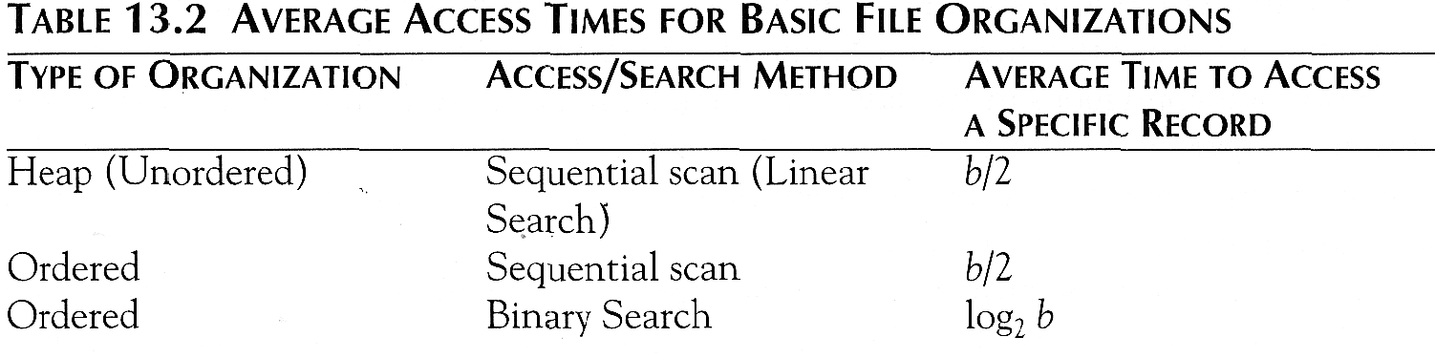
Average Access Times
The following table shows the average access time to access a specific record for a given type of file

Slide 21
Example
Block: 4096B; Rec_Size: 28B;
Bfr: floor (4096/28) = 146 records/block
If 100,000 records
Numblocks = ceiling (100,000/146) = 685 blocks
Linear search = ceiling(685/2) = 343 block reads Binary Search = ceiling (log₂685) = 10 block reads
If 10,000,000 records
Numblocks = ceiling (10,000,000/146) = 68,494
Linear search = ceiling(68,494/2) = 34,247 block reads
Binary Search = ceiling (log₂685) = 17 block reads

Slide 22
Hashed Files
Hashing for disk files is called External Hashing
The file blocks are divided into M equal-sized buckets, numbered bucket₀, bucket₁, ..., bucket_{M-1}.
Typically, a bucket corresponds to one (or a fixed number of) disk blocks.
One of the file fields is designated to be the hash key of the file.
The record with hash key value K is stored in bucket i, where i=h(K), and h is the hashing function.
Search is very efficient on the hash key.
Collisions occur when a new record hashes to a bucket that is already full.
An overflow file is kept for storing such records.
Overflow records that hash to each bucket can be linked together.

Slide 23
Hashed Files (contd.)
There are numerous methods for collision resolution, including the following:
Open addressing: Proceeding from the occupied position specified by the hash address, the program checks the subsequent positions in order until an unused (empty) position is found.
Chaining: For this method, various overflow locations are kept, usually by extending the array with a number of overflow positions. In addition, a pointer field is added to each record location. A collision is resolved by placing the new record in an unused overflow location and setting the pointer of the occupied hash address location to the address of that overflow location.
Multiple hashing: The program applies a second hash function if the first results in a collision. If another collision results, the program uses open addressing or applies a third hash function and then uses open addressing if necessary.

Slide 24
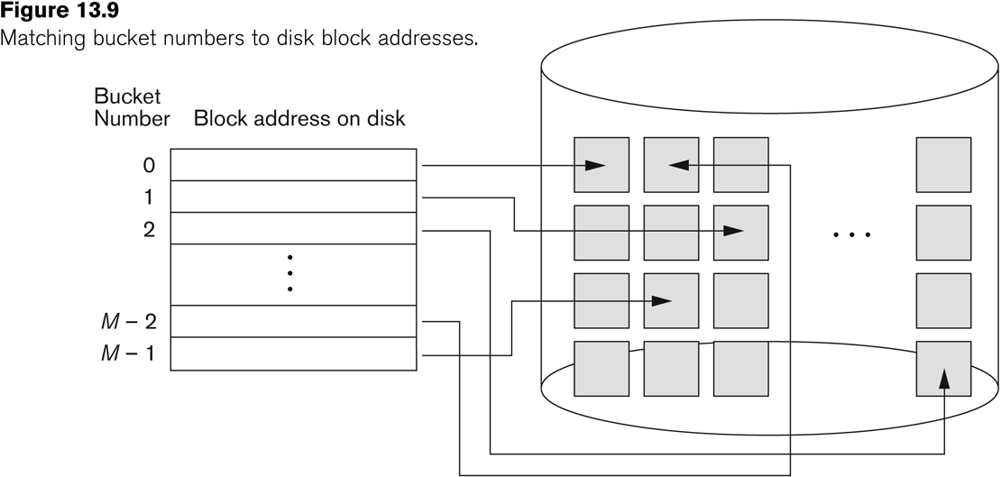
Hashed Files (contd.)

Slide 25
Hashed Files (contd.)
To reduce overflow records, a hash file is typically kept 70-80% full.
The hash function h should distribute the records uniformly among the buckets
Otherwise, search time will be increased because many overflow records will exist.
Main disadvantages of static external hashing:
Fixed number of buckets M is a problem if the number of records in the file grows or shrinks.
Ordered access on the hash key is quite inefficient (requires sorting the records).

Slide 26
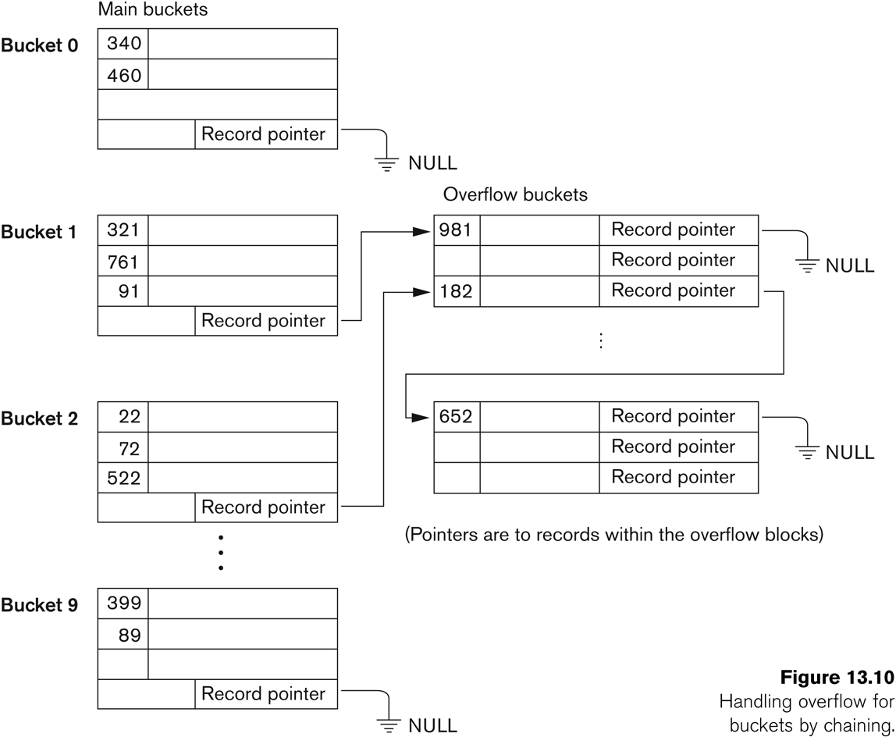
Hashed Files - Overflow handling

Slide 27
Dynamic And Extendible Hashed Files
Dynamic and Extendible Hashing Techniques
Hashing techniques are adapted to allow the dynamic growth and shrinking of the number of file records.
Both build a directory on top of the hash table buckets
Both dynamic and extendible hashing use the binary representation of the hash value h(K) in order to access a directory.

Slide 28
Dynamic Hashing
Build a binary search tree on top of the hash table
Each node in search tree points to a fixed size hash file
As insertions cause number of buckets to increase, grow the directory by adding nodes
i.e., instead of a search tree based on first 2 bits of the hash key (4 nodes), expand to a search tree based on first 3 bits of the hash key (8 nodes)

Slide 29
Extendible Hashing
In extendible hashing the search directory is an array of size 2^{d} where d is called the global depth.
i.e., if you index into the array with 2 bits, there are 2² elements in the array (4)
Each element points to a hashtable
Expand by using first 3 bits of hash key 2³ elements in the array (8)

Slide 30
Dynamic And Extendible Hashing (contd.)
The directories can be stored on disk, and they expand or shrink dynamically.
Directory entries point to the disk blocks that contain the stored records.
An insertion in a disk block that is full causes the block to split into two blocks and the records are redistributed among the two blocks.
The directory is updated appropriately.
Dynamic and extendible hashing do not require an overflow area.
Linear hashing does require an overflow area but does not use a directory.
Blocks are split in linear order as the file expands.

Slide 31
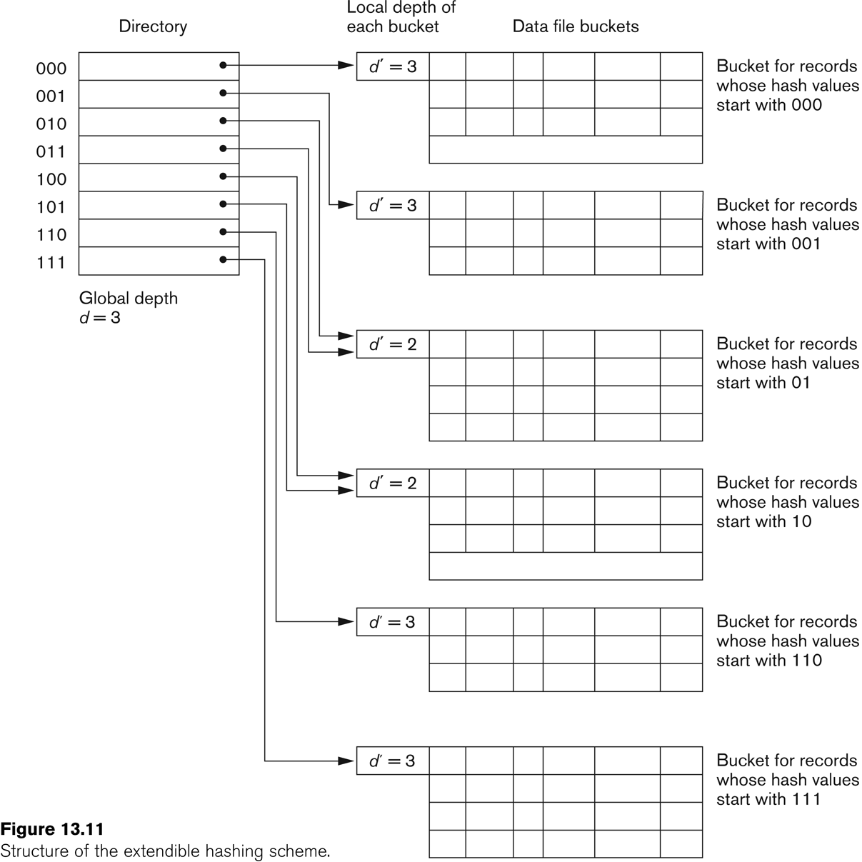
Extendible Hashing

