Slide 1
Chapter 5
Relational Algebra and
Relational Calculus

Slide 2

Chapter 5 - Objectives
Meaning of the term relational completeness.
How to form queries in relational algebra.
Categories of relational DML.

Slide 3
Introduction
Relational algebra and relational calculus are formal languages associated with the relational model.
Informally, relational algebra is a (high-level) procedural language and relational calculus a non-procedural language.
However, formally both are equivalent to one another.

Slide 4
Relational Algebra
Relational algebra operations work on one or more relations to define another relation without changing the original relations.
Both operands and results are relations, so output from one operation can become input to another operation.
This property is called closure.
Allows expressions to be nested, just as in arithmetic.
Notes:
Eg, arithmetic is closed on Real numbers. But NOT on Whole Numbers (integers).

Slide 5
Relational Algebra
Five basic operations in relational algebra: Selection, Projection, Cartesian product, Union, and Set Difference.
These perform most of the data retrieval operations needed.
Also have Join, Intersection, and Division operations, which can be expressed in terms of 5 basic operations.

Slide 6
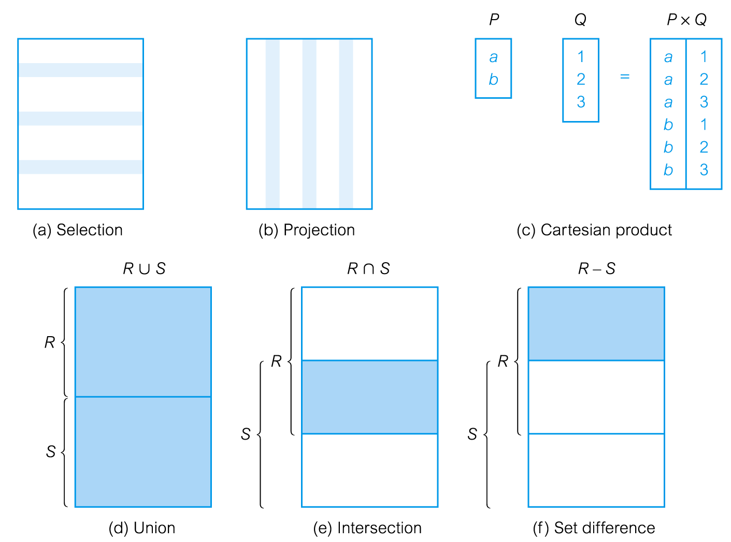
Relational Algebra Operations

Slide 7
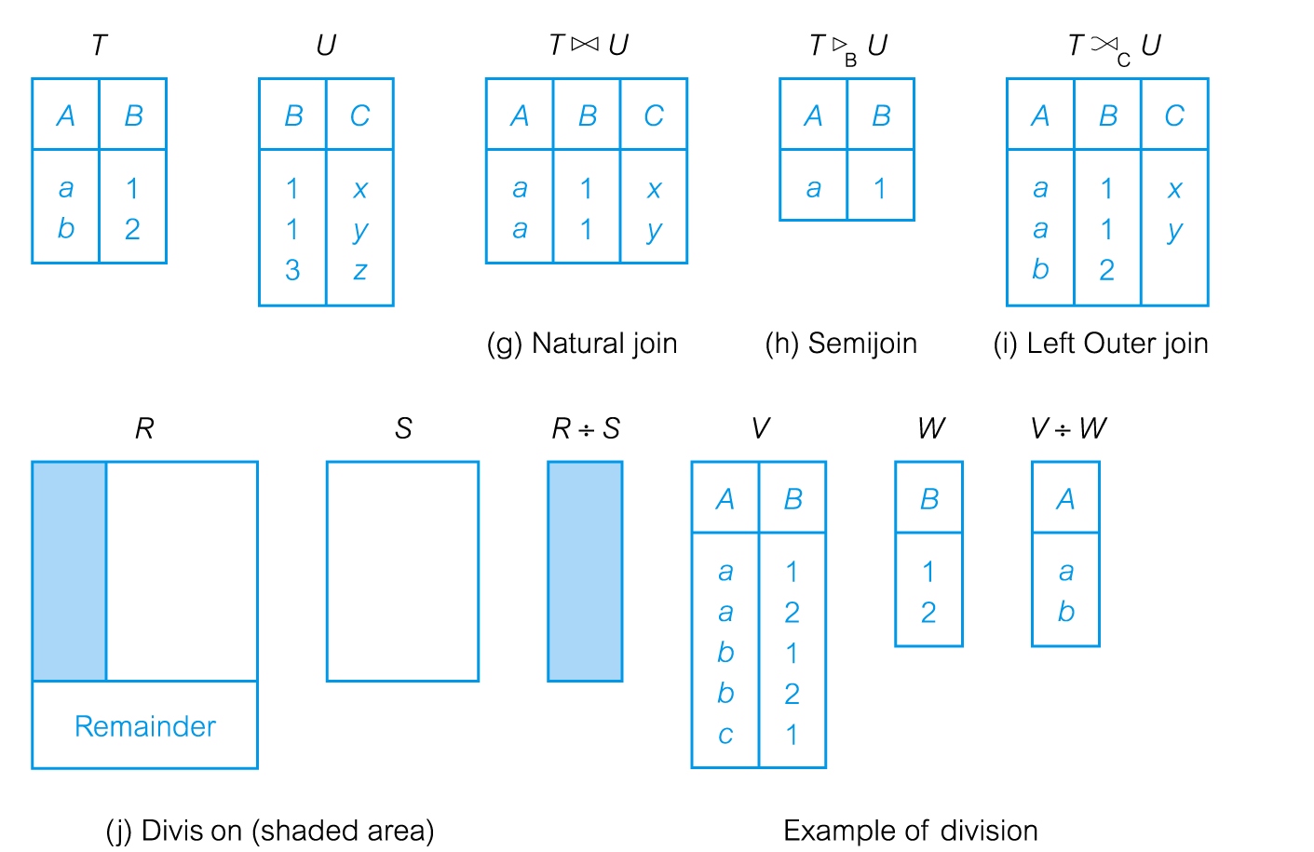
Relational Algebra Operations

Slide 8
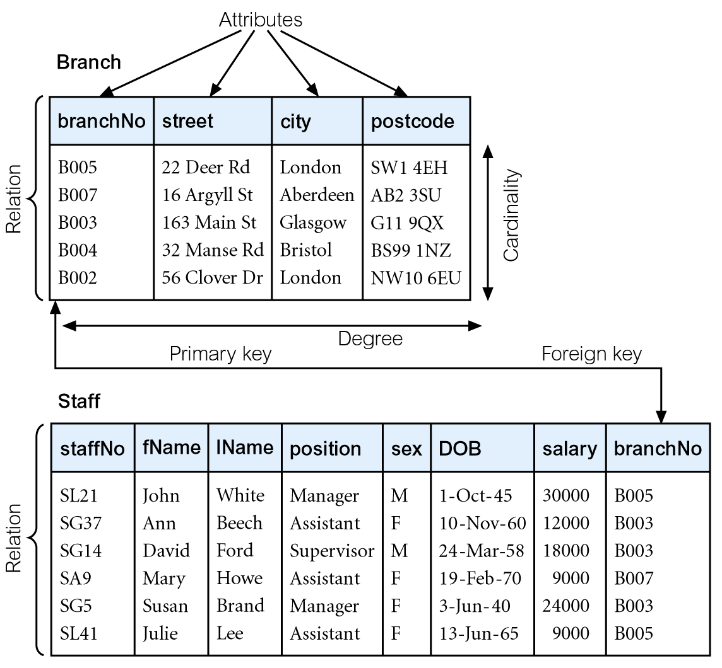
Instances of Branch and Staff Relations
Attributes can appear in any order in the relation and convey the same meaning
The instances of the Branch and Staff relations.
Notes:
BranchNo is a superkey; BranchNo + street is a superkey, but it is not minimal, so it isn’t a candidate key
Street is a superkey and a candidate key; so is postcode
City is NOT a superkey; City + postcode is superkey, but not a candidate key
Pick one candidate key (branchNo or street or postcode) to be the primary key

Slide 9
See Page 160 for DreamHome rental database
For the next section we will be using
Figure 4-3: Instance of the DreamHome rental database. See the Textbook page 160,
(page 112 in some other textbooks)

Slide 10
Selection
σ_{predicate} (R)
Works on a single relation R and defines a relation that contains only those tuples (rows) of R that satisfy the specified condition (predicate).

Slide 11
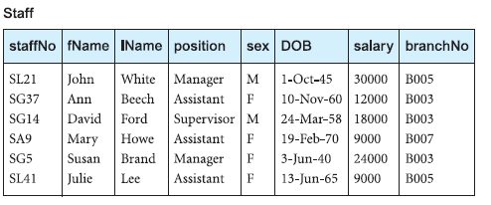
Example - Selection
List all staff with a salary greater than £10,000.
σ_{salary > 10000} (Staff)
Notes:
Selects rows that match predicate with all their attributes.

Slide 12
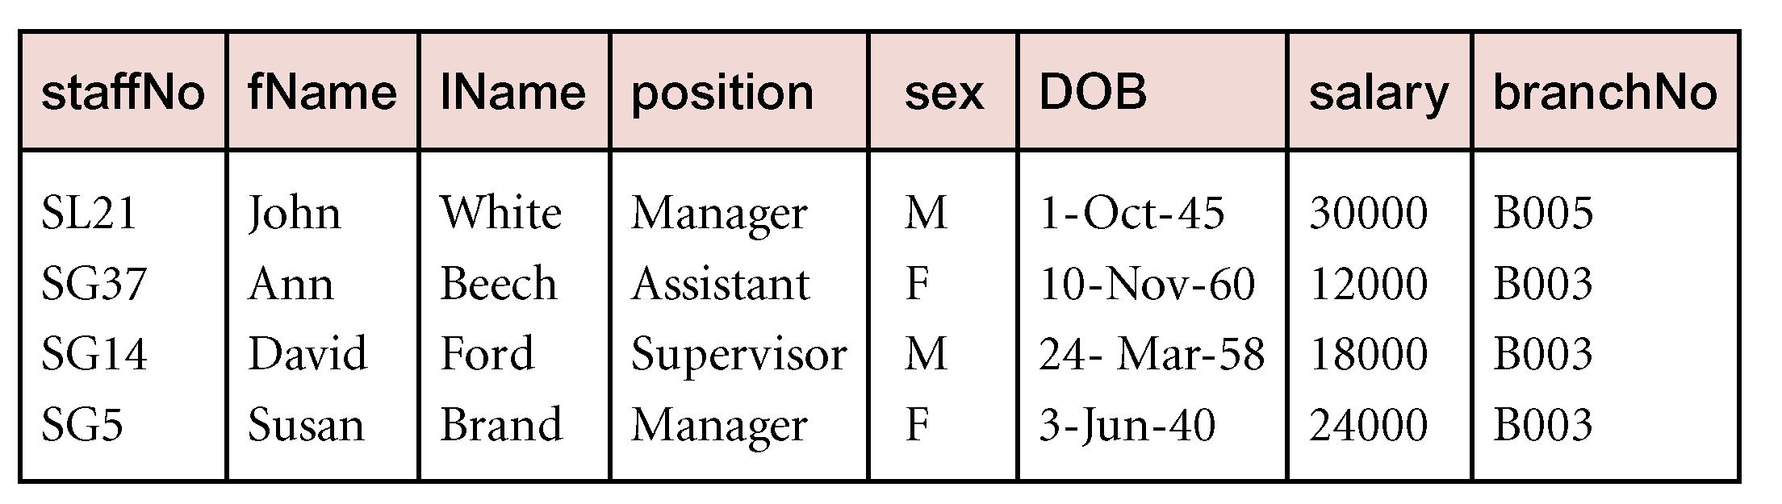
σ_{salary > 10000} (Staff)

Slide 13
Projection
Π_{col1, . . . , coln}(R)
Works on a single relation R and defines a relation that contains a vertical subset of R, extracting the values of specified attributes and eliminating duplicates.
Duplicates created when keys are left off
In practice: real systems don’t remove duplicates unless the user/programmer asks for it
Why?
Notes:
Pi for Projection
Answer: So you can count the duplicates

Slide 14
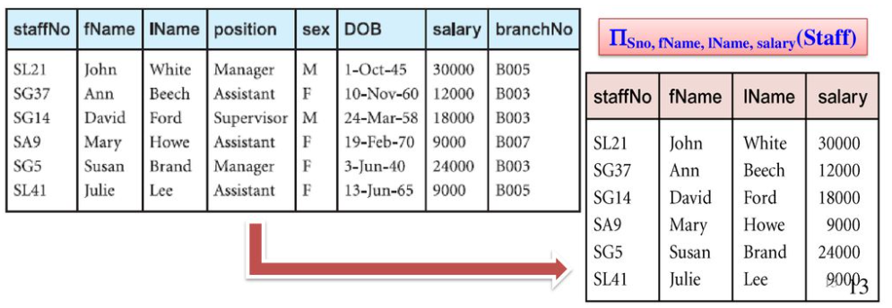
Example - Projection
Produce a list of salaries for all staff, showing only staffNo, fName, lName, and salary details.
Π_{staffNo, fName, lName, salary}(Staff)

Slide 15
Example – Selection with Projection
Produce a list of salaries for all staff with a salary greater than £10,000
List only staffNo, fName, lName, and salary details.
Π_{staffNo, fName, lName, salary} σ_{salary > 10000} (Staff)
OR
σ_{salary > 10000}Π_{staffNo, fName, lName, salary} (Staff)
Which is more efficient?
Notes:
The first: select then project.
Why: Create temporary relation that is a subset of rows then select a subset of some columns from that relation
Vs
Create temporary relation that is a subset of columns then select a subset of some rows from that relation
Usually many more rows (tuples/instances) than columns (attributes).
So, consider Staff table: 7 attributes; maybe 10,000 employees; 500 earn > 10,000 pounds
1st: Temporary relationship is 500 rows x 7 columns -> 500 x 4 for final
2nd: Temporary relationships is 10,000 rows x 4 columns -> 500 x 4 for final

Slide 16
Union R ∪ S
Union of two relations R and S defines a relation that contains all the tuples of R, or S, or both R and S, duplicate tuples being eliminated.
R and S must be union-compatible.
Union compatible: both tables have the same number of attributes and the corresponding attributes (attributes in same order) have the same datatype.
(R, S) have I, J tuples R ∪ S One relation with maximum of (I+J)tuples

Slide 17
Example - Union
List all cities where there is either a branch office or a property for rent.
Assumes another table “PropertyForRent”
Assume attributes (street, city, cost, availableDate)
Branch and PropertyForRent would not be union compatible
Π_{city}(Branch) ∪ Π_{city}(PropertyForRent)

Slide 18
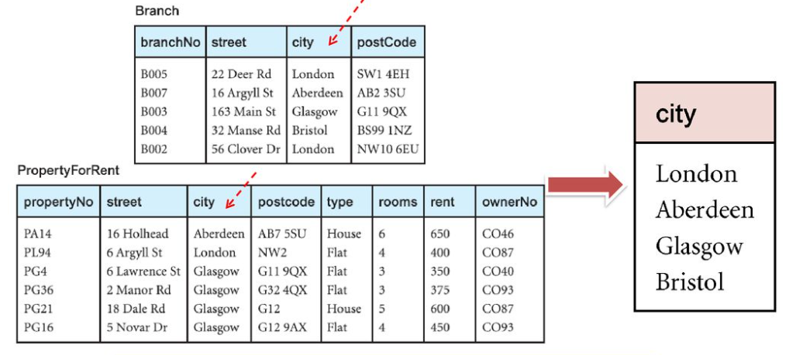
Π_{city}(Branch) ∪ Π_{city}(PropertyForRent)
Notes:
Must create two TEMPORARY, unamed relations by projecting city from Branch and city from PropertyForRent, then Union them.
These temporary relations are union compatible.
Note implied order of operations: Project before Select (unary operations before binary operations).
Left to right when there is a tie.

Slide 19
Renaming r _{B1,…,Bn} (R)
Example:
Input schema: Branch(branchNo, street, city, postcode)
r_{postcode->zipcode} (Branch)
Output schema: Branch(branchNo, street, city, zipcode)

Slide 20
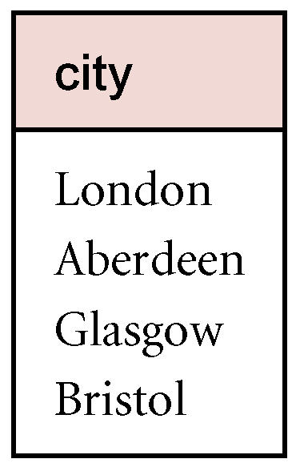
Example – Union with Renaming
List all cities where there is either a branch office or a property for rent.
Assumes another table “PropertyForRent”
Assume attributes (street, town, cost, availableDate)
Π_{city}(Branch) ∪ Π_{city}(r _{town->city} (PropertyForRent))

Slide 21
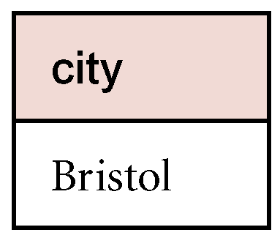
Set Difference R – S
Defines a relation consisting of the tuples that are in relation R, but not in S.
R and S must be union-compatible.
Example:
List all cities where there is a branch office but no properties for rent.
Π_{city}(Branch) – Π_{city}(PropertyForRent)
Notes:
See next slide for the table's explanation

Slide 22
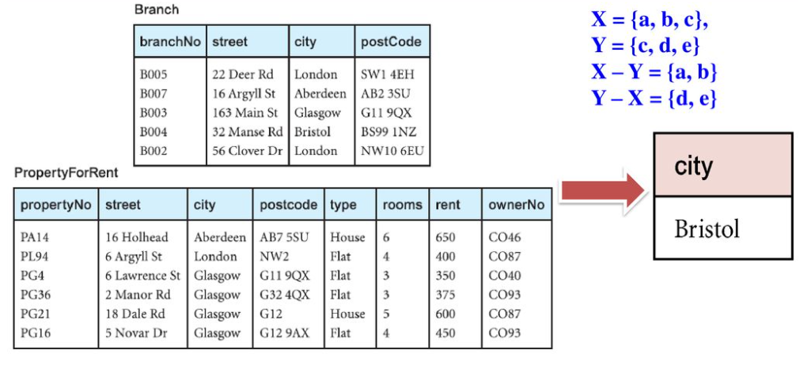
Π_{city}(Branch) – Π_{city}(PropertyForRent)

Slide 23
Intersection R ∩ S
R ∩ S
Defines a relation consisting of the set of all tuples that are in both R and S.
R and S must be union-compatible.
Expressed using basic operations:
R ∩ S = R – (R – S)

Slide 24
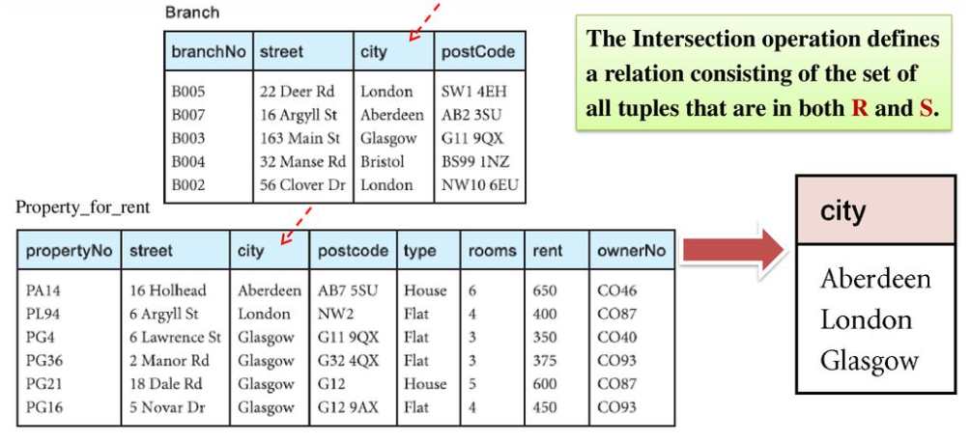
Example - Intersection
List all cities where there is both a branch office and at least one property for rent. Π_{city}(Branch) ∩ Π_{city}(PropertyForRent)

Slide 25
Cartesian product R X S
R X S
Defines a relation that is the concatenation of every tuple of relation R with every tuple of relation S.
If there are n tuples in R and m tuples in S, the resulting relation will have a maximum of n*m tuples
Duplicate tuples are removed
Duplicate attributes are qualified to remove ambiguity

Slide 26
Example - Cartesian product
List the names and comments of all clients who have viewed a property for rent. [4 Clients, 5 Viewings = 20 results]
(Π_{clientNo, fName, lName}(Client)) X (Π_{clientNo, propertyNo, comment} (Viewing))

Slide 27
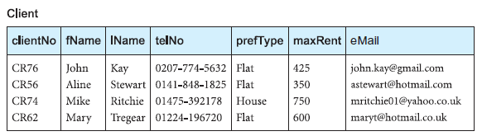
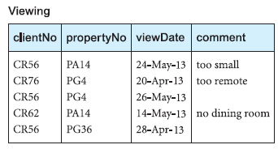
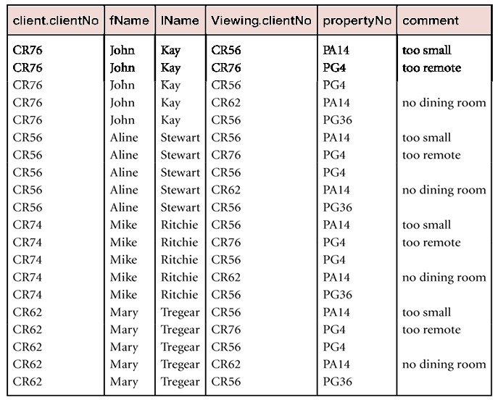

Slide 28
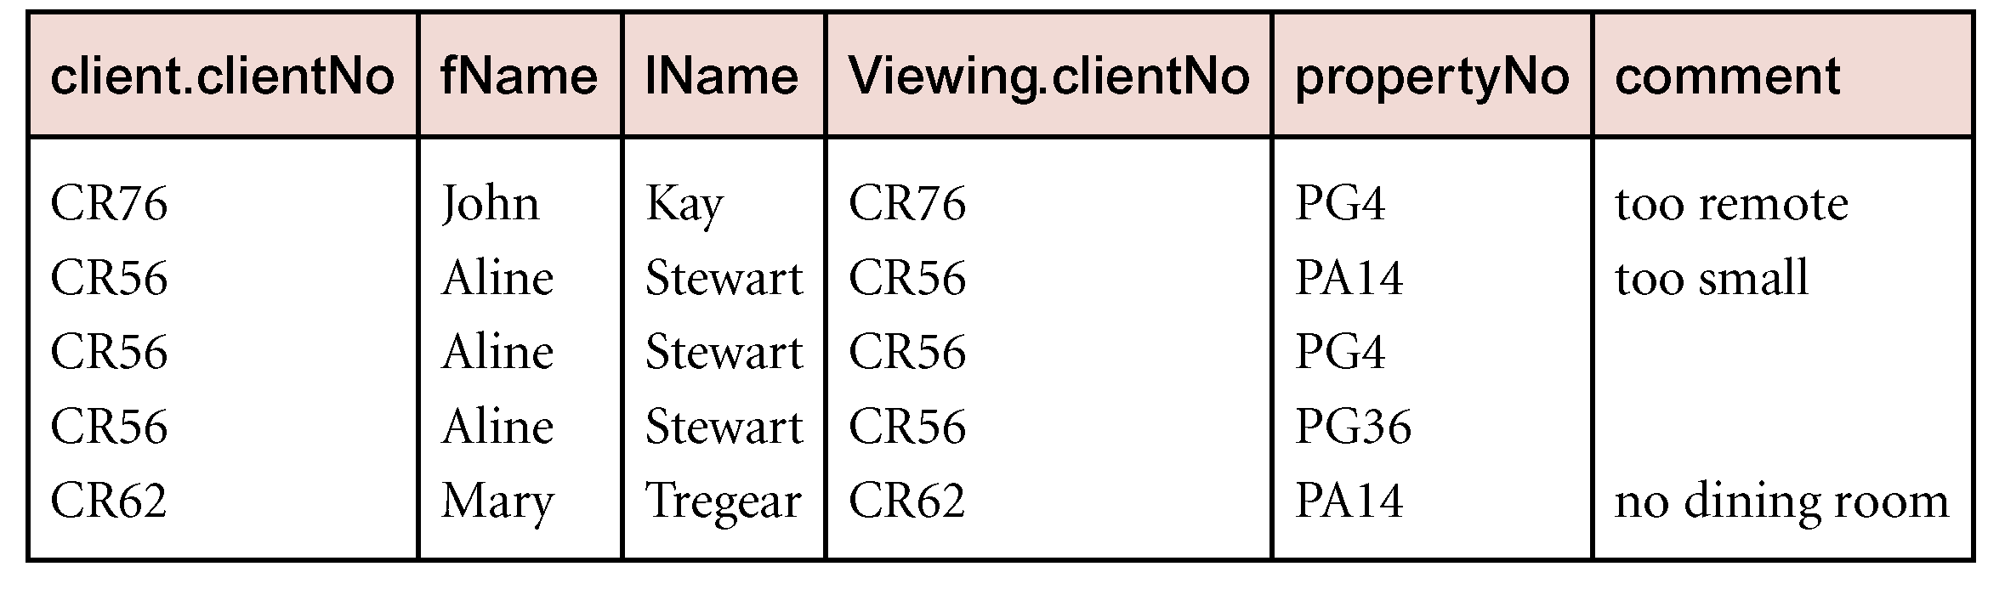
Example - Cartesian product and Selection
Use selection operation to extract those tuples where Client.clientNo = Viewing.clientNo.
σ Client.clientNo = Viewing.clientNo((Π _{clientNo, fName, lName}(Client)) Χ (Π _{clientNo, propertyNo, comment}(Viewing)))
Note: Cartesian product and Selection can be reduced to a single operation called a Join.

Slide 29
Decomposing Operations
Relational algebra operations can be complex
Can break them into multiple steps with use of temporary variables
“Show clientNo, Name, propertyNo, and comments from clients whom have viewed a property”
σ Client.clientNo = Viewing.clientNo((Π _{clientNo, fName, lName}(Client)) Χ (Π _{clientNo, propertyNo, comment}(Viewing)))
Same as:
TempViewing ← Π _{clientNo, propertyNo, comment}(Viewing)
TempClient ← Π _{clientNo, fName, lName}(Client))
Result ← σ Client.clientNo = Viewing.clientNo(TempClient X TempViewing)

Slide 30
Join Operations
Join is a derivative of Cartesian product.
Equivalent to performing a Selection, using join predicate as selection formula, over Cartesian product of the two operand relations.
One of the most difficult operations to implement efficiently in an RDBMS and one reason why RDBMSs have intrinsic performance problems.

Slide 31
Join Operations
Various forms of join operation
Theta join
Equijoin (a particular type of Theta join)
Natural join
Outer join
Semijoin

Slide 32
Theta join (θ-join)
R _{F}S
Defines a relation that contains tuples satisfying the predicate F from the Cartesian product of R and S.
The predicate F is of the form R.a_{i} θ S.b_{i} where θ may be one of the comparison operators (<, ≤, >, ≥, =, ≠).

Slide 33
Theta join (θ-join)
Can rewrite Theta join using basic Selection and Cartesian product operations.
R _{F}S = σ_{F}(R Χ S)
Degree of a Theta join is sum of degrees of the operand relations R and S. If predicate F contains only equality (=), the term Equijoin is used.

Slide 34
Equijoin
R ₌ S
A theta join where the only operator allow is =
Attributes being compared don’t need to have the same names

Slide 35
Example - Equijoin
List the names and comments of all clients who have viewed a property for rent.
(Π_{clientNo, fName, lName}(Client)) Client.clientNo = Viewing.clientNo (Π_{clientNo, propertyNo, comment}(Viewing))

Slide 37
Natural join R S
R S
An Equijoin of the two relations R and S over all common attributes x. One occurrence of each common attribute is eliminated from the result.

Slide 38
Example - Natural join
List the names and comments of all clients who have viewed a property for rent.
(Π_{clientNo, fName, lName}(Client))
(Π_{clientNo, propertyNo, comment}(Viewing))

Slide 39
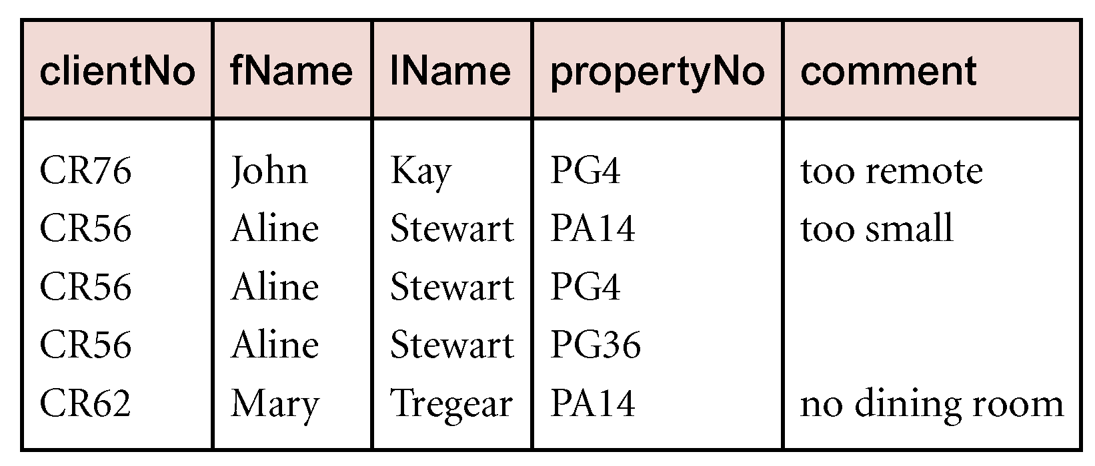

Slide 40
Outer join
To ALSO display rows in the result that do not have matching values in the join column, use Outer join.
Notes:
Basically, opposite of the natural join.

Slide 41
Left/Right Outer join
R S
(Left) outer join is join in which tuples from R that do not have matching values in common columns of S are also included in result relation.
R S
(Right) outer join is join in which tuples from S that do not have matching values in common columns of R are also included in result relation.
Notes:
Basically, opposite of the natural join.

Slide 42
Example - Left Outer join
Produce a status report on property viewings.
i.e., all viewings for each property in the inventory; include properties with no viewings
Π_{propertyNo, street, city}(PropertyForRent) Viewing

Slide 43
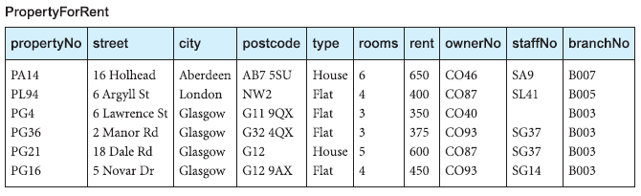

Slide 44
Example
PropertyForRent (6x10)
Viewing (5x4)
Common attribute: propertyNo
PropertyForRent Viewing
5 x 13
One tuple for each tuple of Viewing
All attributes (except duplicated propertyNo)
E.g.,: 2 entries for PA14 and PG4, one entry for PG36
No entries for PL94, PG21, PG16 (no viewings)

Slide 45
Example - Left Outer join
Produce a status report on property viewings.
Π_{propertyNo, street, city}(PropertyForRent) Viewing

Slide 46
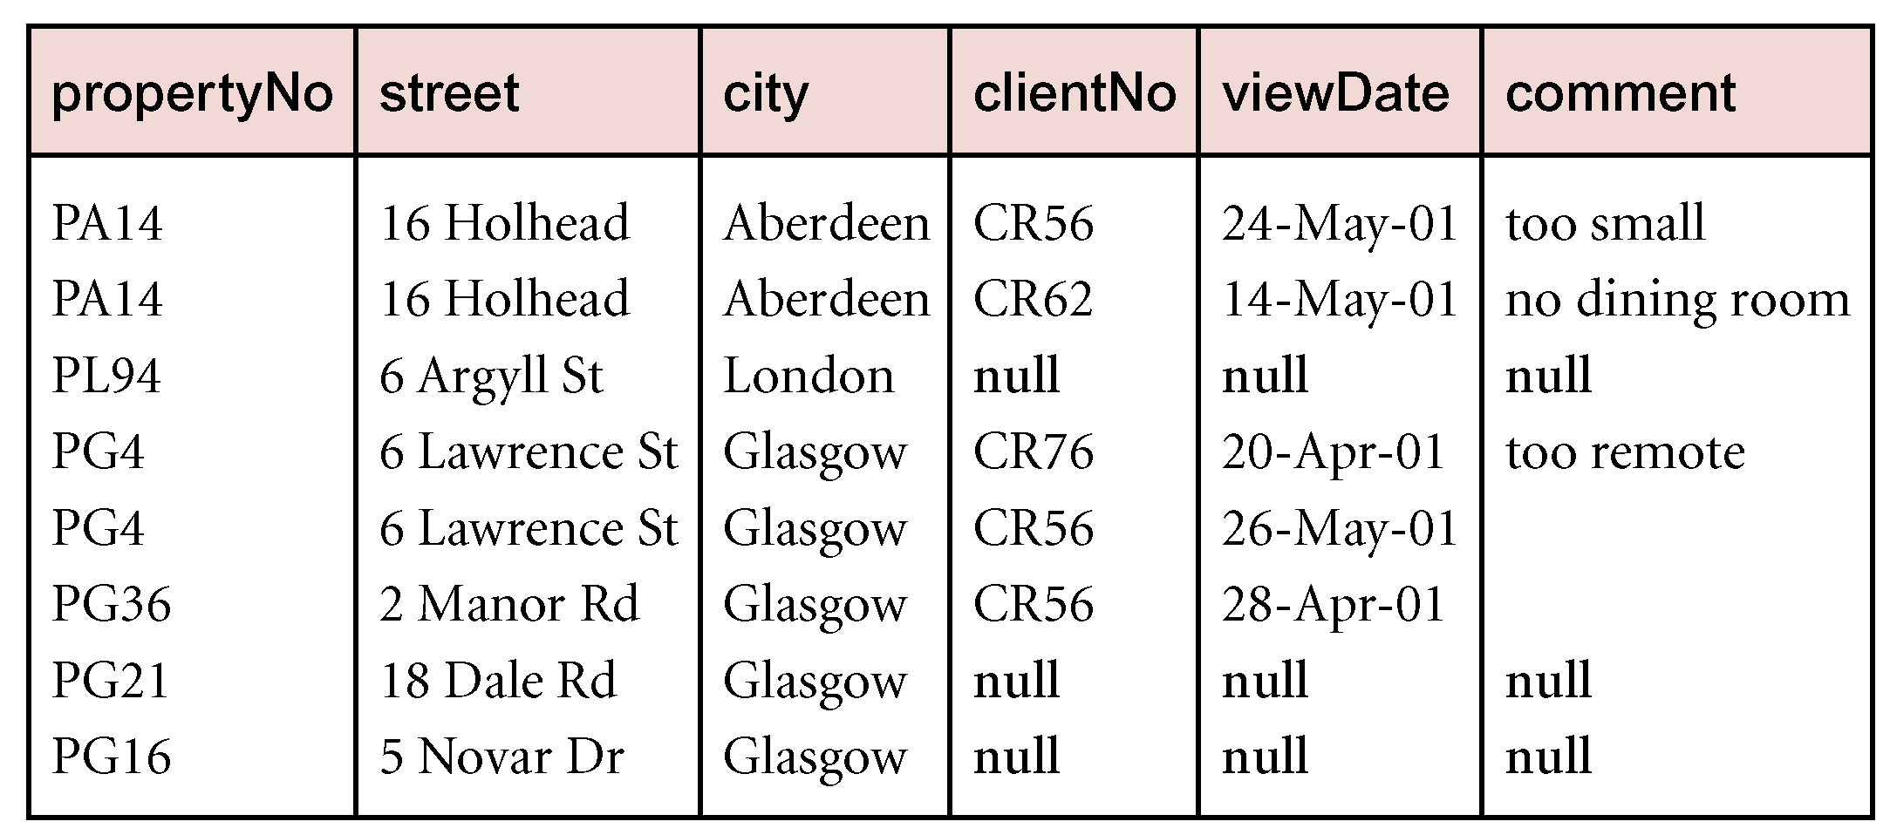

Slide 47
Example: Left Outer Join
PropertyForRent Viewing
5 x 13
PropertyForRent Viewing
Add to Natural Join Result:
One tuple for each tuple of ProperyForRent that does not already appear in result
E.g., add tuples for PL94, PG21, PG16 (no viewings)
5x13 + 3x13 = 8x13
Equivalent to Viewing PropertyForRent
Notes:
Basically, opposite of the natural join.

Slide 48
Full Join
Add all tuples from R and S

Slide 49
Semijoin
R _{F} S
Defines a relation that contains the tuples of R that participate in the join of R with S.
Can rewrite Semijoin using Projection and Join:
R _{F} S = Π_{A}(R _{F} S )
where A are the attributes of R

Slide 50
Example - Semijoin
List complete details of all staff who work at the branch in Glasgow.
Staff (σ_{city=‘Glasgow’}(Branch))

Slide 51
Example - Semijoin
List complete details of all staff who work at the branch in Glasgow.
Staff (σ_{city=‘Glasgow’}(Branch))
6x8 join 1x4 common attribute: branchNo
Result: 3x11
3 tuples in Staff with branchNo=B003
8+4-1 attributes (duplicate attribute removed)
However, don’t want Branch details, just Staff Details
Semijoin: 3x8 not 1

Slide 52
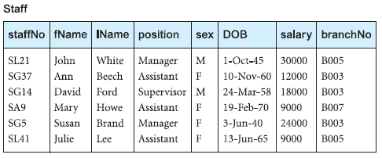
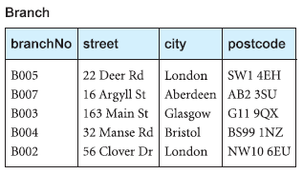
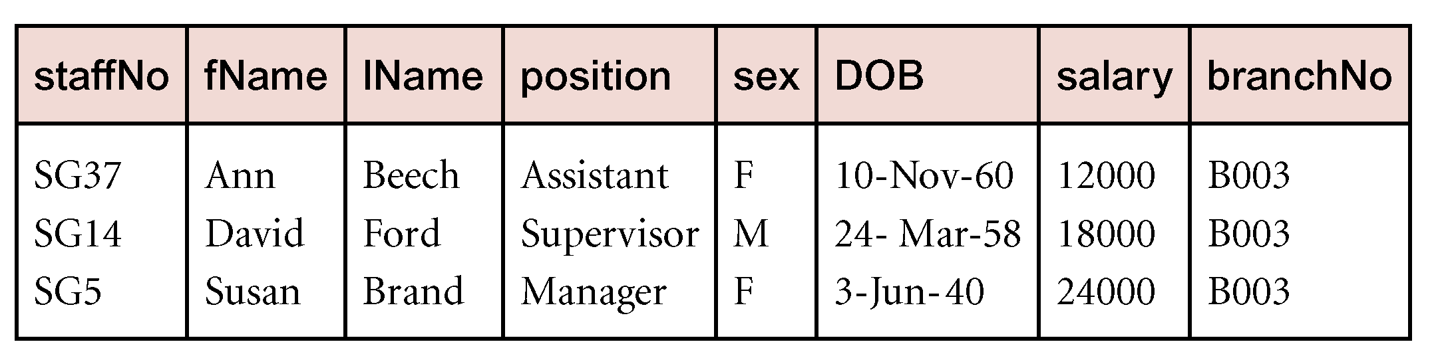
Staff _{Staff.branchNo=Branch.branchNo}(σ_{city=‘Glasgow’}(Branch))

Slide 53
Division R ÷ S
R ÷ S
Defines a relation over the attributes C that consists of set of tuples from R that match combination of every tuple in S.
Expressed using basic operations:
T₁ ← Π_{C}(R)
T₂ ← Π_{C}((S X T₁) – R)
T ← T₁ – T₂

Slide 54
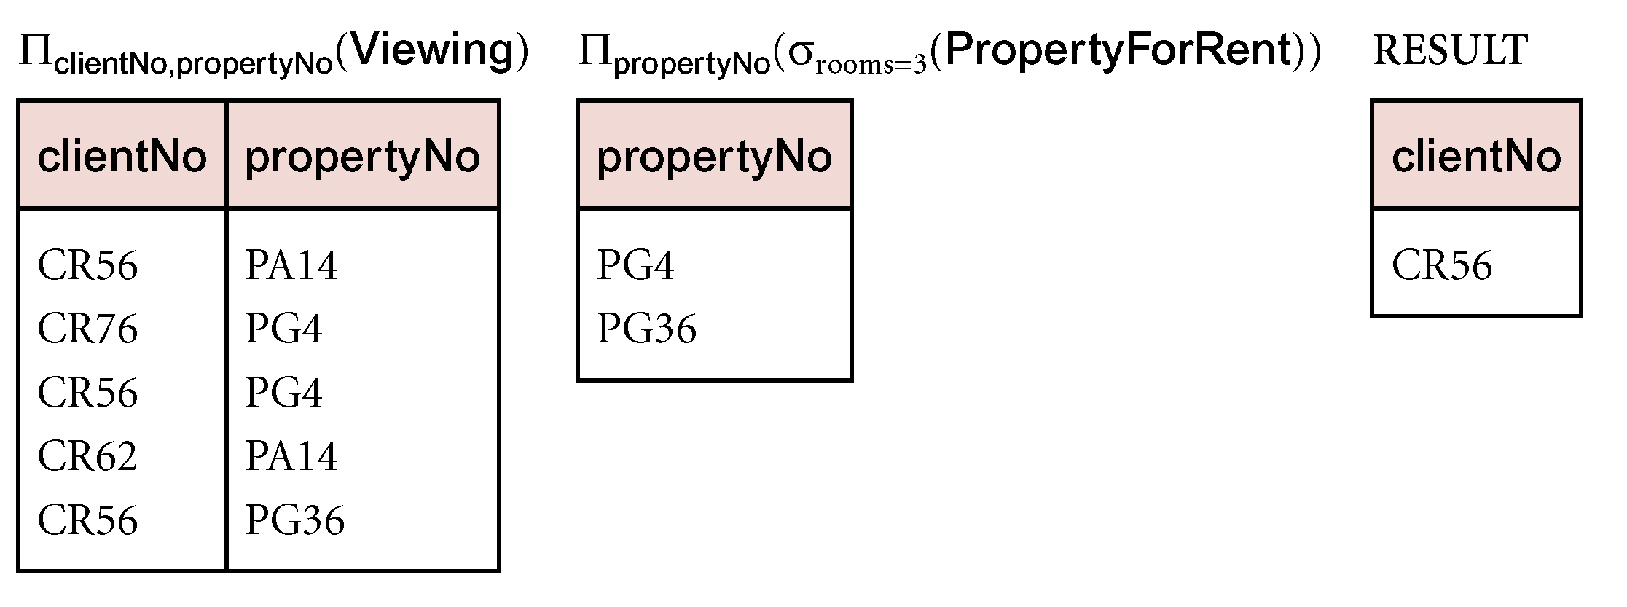
Example - Division
Identify all clients who have viewed all properties with three rooms.
(Π_{clientNo, propertyNo}(Viewing)) ÷
(Π_{propertyNo}(σ_{rooms = 3} (PropertyForRent)))

Slide 55
Aggregate Operations
ℑ_{AL}(R)
Applies aggregate function list, AL, to R to define a relation over the aggregate list.
AL contains one or more (<aggregate_function>, <attribute>) pairs .
Main aggregate functions are: COUNT, SUM, AVG, MIN, and MAX.

Slide 56
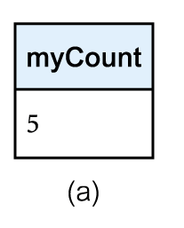
Example – Aggregate Operations
How many properties cost more than £350 per month to rent?
Creates a new relation with one attribute “renamed” myCount
ρ_{R}(myCount) ℑ_{COUNT} _{propertyNo} (σ_{rent > 350} (PropertyForRent))

Slide 57
Grouping Operation
_{GA}ℑ_{AL}(R)
Groups tuples of R by grouping attributes, GA, and then applies aggregate function list, AL, to define a new relation.
AL contains one or more (<aggregate_function>, <attribute>) pairs.
Resulting relation contains the grouping attributes, GA, along with results of each of the aggregate functions.

Slide 58
Example – Grouping Operation
Find the number of staff working in each branch and the sum of their salaries.
Creates new relation with 3 attributes “renamed” branchNo, myCount, and mySum
ρ_{R}(branchNo, myCount, mySum)
_{branchNo} ℑ _{COUNT staffNo,} _{SUM salary} (Staff)

Slide 59
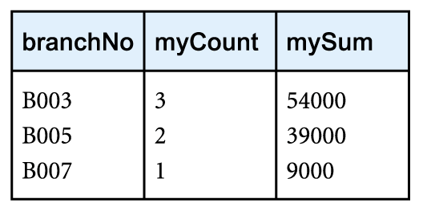
Example – Grouping Operation
ρ_{R}(branchNo, myCount, mySum)
_{branchNo} ℑ _{COUNT staffNo,} _{SUM salary} (Staff)

