Slide 1
Introduction to Computer Graphics with WebGL
Ed Angel
Professor Emeritus of Computer Science
Founding Director, Arts, Research, Technology and Science Laboratory
University of New Mexico
Angel and Shreiner: Interactive Computer Graphics 7E © Addison-Wesley 2015

Slide 2
Designing Parametric Cubic Curves
Ed Angel
Professor Emeritus of Computer Science
University of New Mexico
Angel and Shreiner: Interactive Computer Graphics 7E © Addison-Wesley 2015

Slide 3
Objectives
Introduce the types of curves
  Interpolating
  Hermite
  Bezier
  B-spline
Analyze their performance
Angel and Shreiner: Interactive Computer Graphics 7E © Addison-Wesley 2015

Slide 4
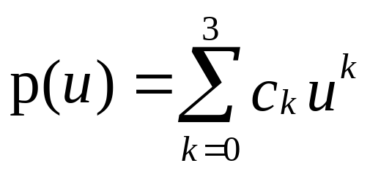
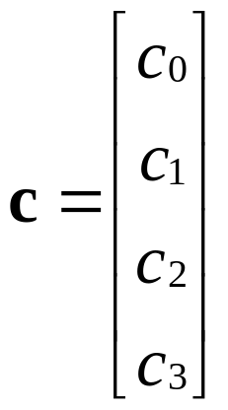
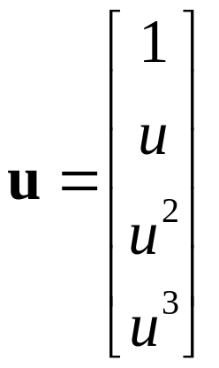
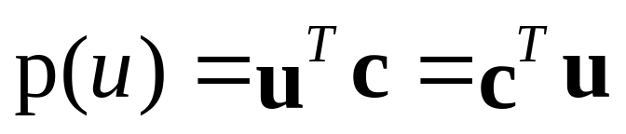
Matrix-Vector Form
define
then
Angel and Shreiner: Interactive Computer Graphics 7E © Addison-Wesley 2015

Slide 5
Interpolating Curve
p₁
p₃
p₀
p₂
Given four data (control) points p₀ , p₁ ,p₂ , p₃
determine cubic p(u) which passes through them
Must find c₀ ,c₁ ,c₂ , c₃
Angel and Shreiner: Interactive Computer Graphics 7E © Addison-Wesley 2015

Slide 6
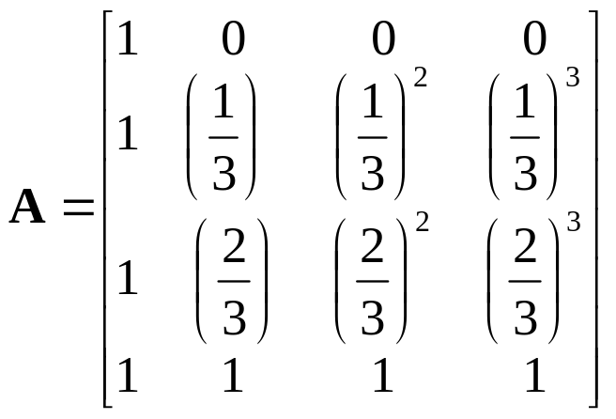
Interpolation Equations
apply the interpolating conditions at u=0, 1/3, 2/3, 1
p₀=p(0)=c₀
p₁=p(1/3)=c₀+(1/3)c₁+(1/3)²c₂+(1/3)³c₂
p₂=p(2/3)=c₀+(2/3)c₁+(2/3)²c₂+(2/3)³c₂
p₃=p(1)=c₀+c₁+c₂+c₂
or in matrix form with p = [p₀ p₁ p₂ p₃]^{T}
p=Ac
Angel and Shreiner: Interactive Computer Graphics 7E © Addison-Wesley 2015

Slide 7
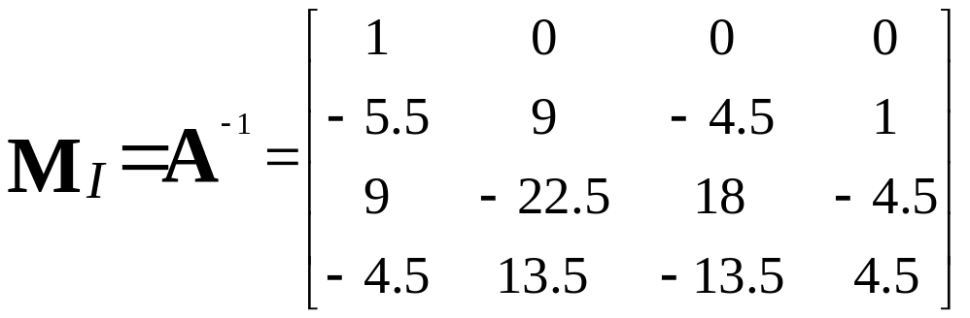
Interpolation Matrix
Solving for c we find the interpolation matrix
c=M_{I}p
Note that M_{I} does not depend on input data and
can be used for each segment in x, y, and z
Angel and Shreiner: Interactive Computer Graphics 7E © Addison-Wesley 2015

Slide 8
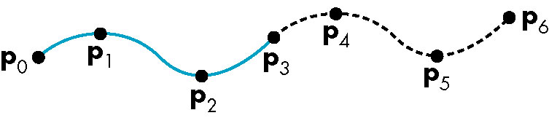
Interpolating Multiple Segments
use p = [p₃ p₄ p₅ p₆]^{T}
use p = [p₀ p₁ p₂ p₃]^{T}
Get continuity at join points but not
continuity of derivatives
Angel and Shreiner: Interactive Computer Graphics 7E © Addison-Wesley 2015

Slide 9
Blending Functions
Rewriting the equation for p(u)
p(u)=u^{T}c=u^{T}M_{I}p = b(u)^{T}p
where b(u) = [b₀(u) b₁(u) b₂(u) b₃(u)]^{T} is
an array of blending polynomials such that
p(u) = b₀(u)p₀+ b₁(u)p₁+ b₂(u)p₂+ b₃(u)p₃
b₀(u) = -4.5(u-1/3)(u-2/3)(u-1)
b₁(u) = 13.5u (u-2/3)(u-1)
b₂(u) = -13.5u (u-1/3)(u-1)
b₃(u) = 4.5u (u-1/3)(u-2/3)
Angel and Shreiner: Interactive Computer Graphics 7E © Addison-Wesley 2015

Slide 10
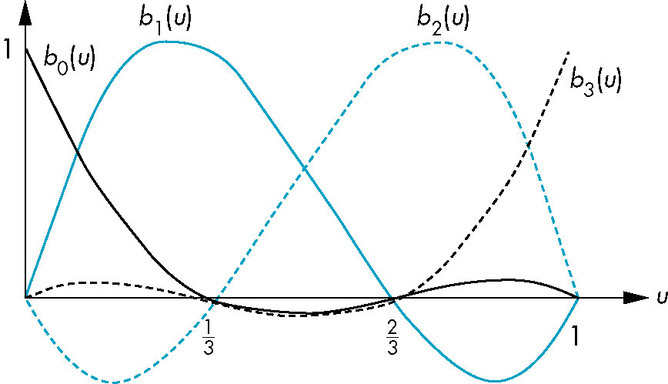
Blending Functions
These functions are not smooth
  Hence the interpolation polynomial is not smooth
Angel and Shreiner: Interactive Computer Graphics 7E © Addison-Wesley 2015

Slide 11
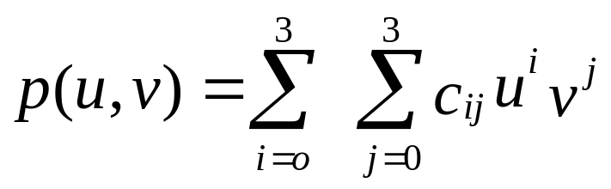
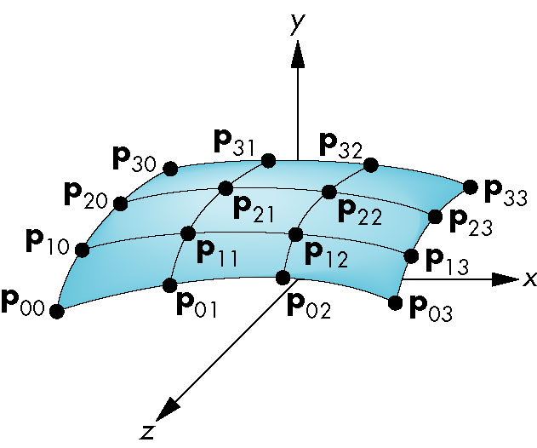
Interpolating Patch
Need 16 conditions to determine the 16 coefficients c_{ij}
Choose at u,v = 0, 1/3, 2/3, 1
Angel and Shreiner: Interactive Computer Graphics 7E © Addison-Wesley 2015

Slide 12
Matrix Form
Define v = [1 v v² v³]^{T}
C = [c_{ij}] P = [p_{ij}]
p(u,v) = u^{T}Cv
If we observe that for constant u (v), we obtain
interpolating curve in v (u), we can show
C=M_{I}PM_{I}
p(u,v) = u^{T}M_{I}PM_{I}^{T}v
Angel and Shreiner: Interactive Computer Graphics 7E © Addison-Wesley 2015

Slide 13
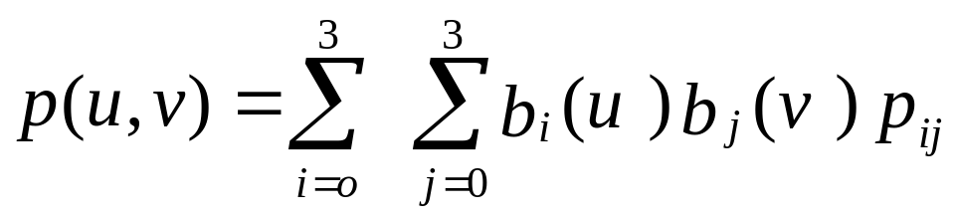
Blending Patches
Each b_{i}(u)b_{j}(v) is a blending patch
Shows that we can build and analyze surfaces
from our knowledge of curves
Angel and Shreiner: Interactive Computer Graphics 7E © Addison-Wesley 2015

Slide 14
Other Types of Curves and Surfaces
How can we get around the limitations of the interpolating form
  Lack of smoothness
  Discontinuous derivatives at join points
We have four conditions (for cubics) that we can apply to each segment
  Use them other than for interpolation
  Need only come close to the data
Angel and Shreiner: Interactive Computer Graphics 7E © Addison-Wesley 2015

Slide 15
Hermite Form
p’(0)
p’(1)
p(0)
p(1)
Use two interpolating conditions and
two derivative conditions per segment
Ensures continuity and first derivative
continuity between segments
Angel and Shreiner: Interactive Computer Graphics 7E © Addison-Wesley 2015

Slide 16
Equations
Interpolating conditions are the same at ends
p(0) = p₀ = c₀
p(1) = p₃ = c₀+c₁+c₂+c₃
Differentiating we find p’(u) = c₁+2uc₂+3u²c₃
Evaluating at end points
p’(0) = p’₀ = c₁
p’(1) = p’₃ = c₁+2c₂+3c₃
Angel and Shreiner: Interactive Computer Graphics 7E © Addison-Wesley 2015

Slide 17
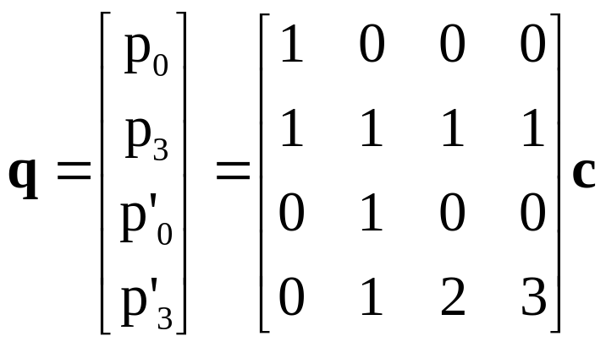
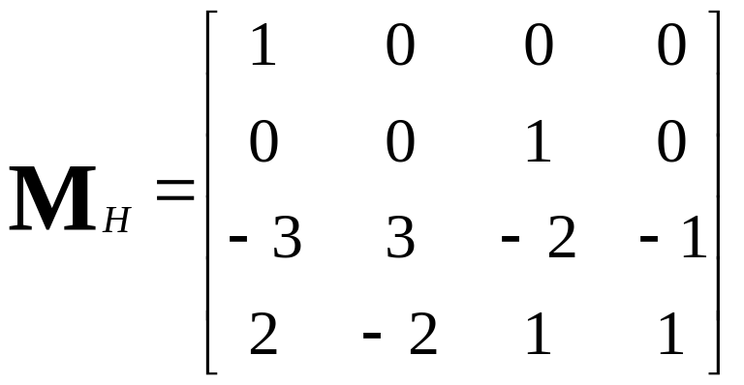
Matrix Form
Solving, we find c=M_{H}q where M_{H} is the Hermite matrix
Angel and Shreiner: Interactive Computer Graphics 7E © Addison-Wesley 2015

Slide 18
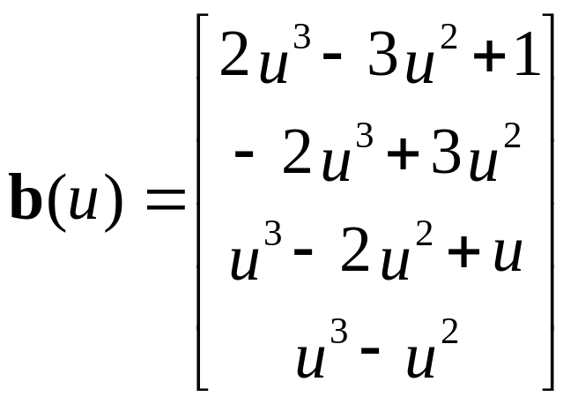
Blending Polynomials
p(u) = b(u)^{T}q
Although these functions are smooth, the Hermite form
is not used directly in Computer Graphics and CAD
because we usually have control points but not derivatives
However, the Hermite form is the basis of the Bezier form
Angel and Shreiner: Interactive Computer Graphics 7E © Addison-Wesley 2015

Slide 19
Parametric and Geometric Continuity
We can require the derivatives of x, y,and z to each be continuous at join points (parametric continuity)
Alternately, we can only require that the tangents of the resulting curve be continuous (geometry continuity)
The latter gives more flexibility as we have need satisfy only two conditions rather than three at each join point
Angel and Shreiner: Interactive Computer Graphics 7E © Addison-Wesley 2015

Slide 20
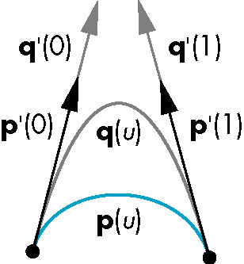
Example
Here the p and q have the same tangents at the ends of the segment but different derivatives
Generate different
Hermite curves
This techniques is used
in drawing applications
Angel and Shreiner: Interactive Computer Graphics 7E © Addison-Wesley 2015

Slide 21
Higher Dimensional Approximations
The techniques for both interpolating and Hermite curves can be used with higher dimensional parametric polynomials
For interpolating form, the resulting matrix becomes increasingly more ill-conditioned and the resulting curves less smooth and more prone to numerical errors
In both cases, there is more work in rendering the resulting polynomial curves and surfaces
Angel and Shreiner: Interactive Computer Graphics 7E © Addison-Wesley 2015

