Slide 1
Classical Viewing

Slide 2
Objectives
Introduce the classical views
Compare and contrast image formation by computer with how images have been formed by architects, artists, and engineers
Learn the benefits and drawbacks of each type of view

Slide 3
Classical Viewing
Viewing requires three basic elements
One or more objects
A viewer with a projection surface
Projectors that go from the object(s) to the projection surface
Classical views are based on the relationship among these elements
The viewer picks up the object and orients it how she would like to see it
Each object is assumed to constructed from flat principal faces
Buildings, polyhedra, manufactured objects

Slide 4
Planar Geometric Projections
Standard projections project onto a plane
Projectors are lines that either
converge at a center of projection
are parallel
Such projections preserve lines
but not necessarily angles
Nonplanar projections are needed for applications such as map construction

Slide 5
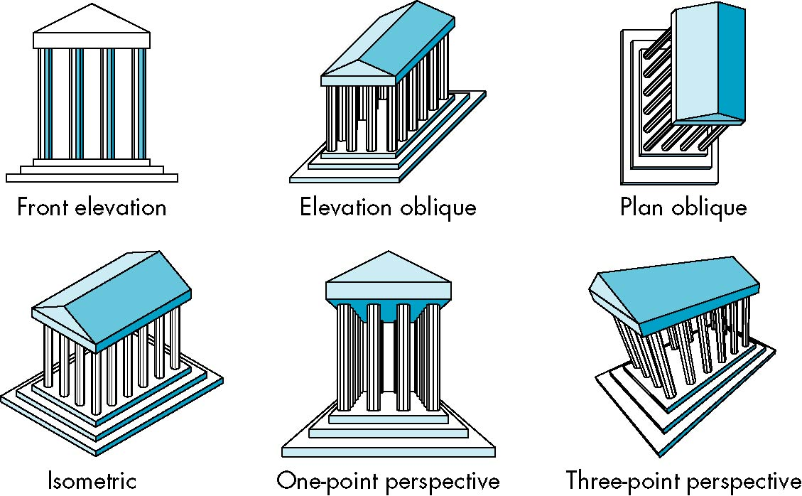
Classical Projections

Slide 6
Perspective vs Parallel
Computer graphics treats all projections the same and implements them with a single pipeline
Classical viewing developed different techniques for drawing each type of projection
Fundamental distinction is between parallel and perspective viewing even though mathematically parallel viewing is the limit of perspective viewing

Slide 7
Taxonomy of Planar Geometric Projections
planar geometric projections
parallel
perspective
1 point
2 point
3 point
multiview
orthographic
axonometric
oblique
isometric
dimetric
trimetric

Slide 8
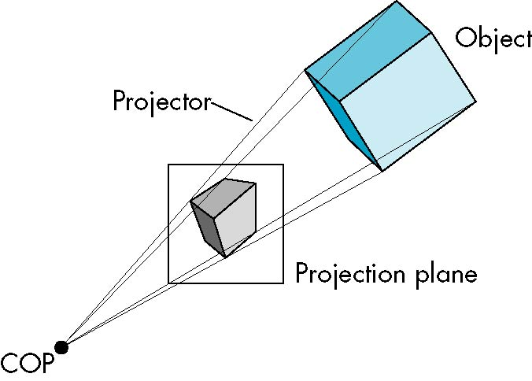
Perspective Projection

Slide 9
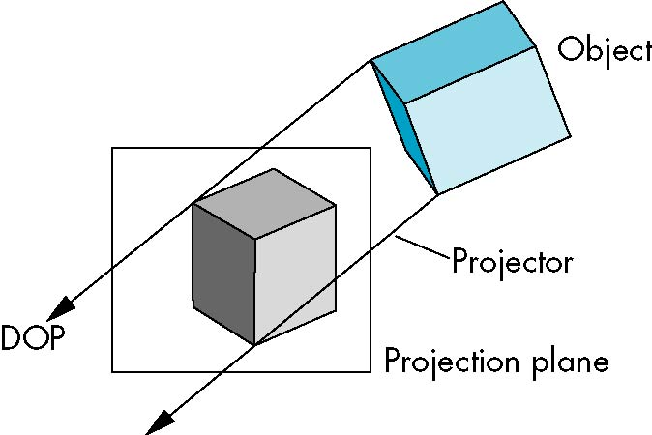
Parallel Projection

Slide 10
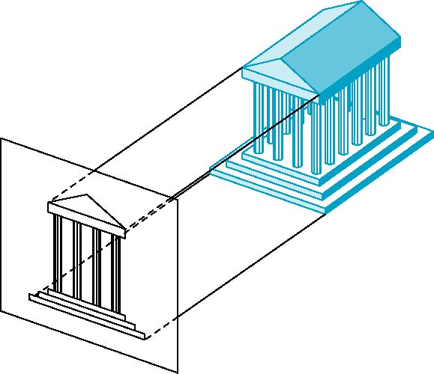
Orthographic Projection
Projectors are orthogonal to projection surface

Slide 11

Multiview Orthographic Projection
Projection plane parallel to principal face
Usually form front, top, side views
isometric (not multiview
orthographic view)
front
in CAD and architecture,
we often display three
multiviews plus isometric
side

Slide 12
Advantages and Disadvantages
Preserves both distances and angles
Shapes preserved
Can be used for measurements
Building plans
Manuals
Cannot see what object really looks like because many surfaces hidden from view
Often we add the isometric

Slide 13
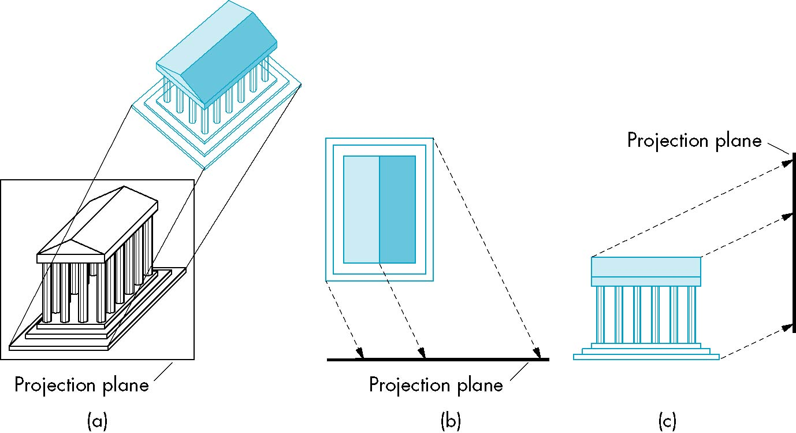
Oblique Projection
Arbitrary relationship between projectors and projection plane

Slide 14
Advantages and Disadvantages
Can pick the angles to emphasize a particular face.
Architecture: plan oblique, elevation oblique
Angles in faces parallel to projection plane are preserved while we can still see “around” side
In physical world, cannot create with simple camera; possible with bellows camera or special lens

Slide 15
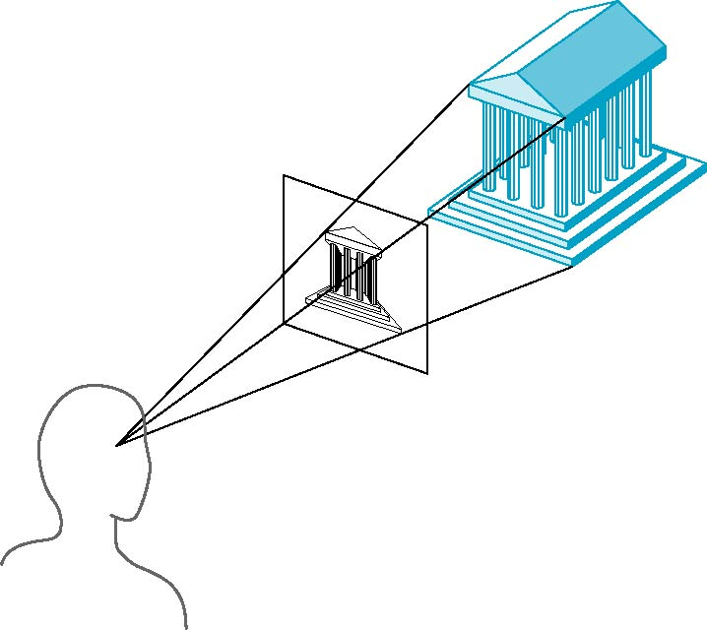
Perspective Projection
Projectors coverge at center of projection

Slide 16
Vanishing Points
Parallel lines (not parallel to the projection plan) on the object converge at a single point in the projection (the vanishing point)
Drawing simple perspectives by hand uses these vanishing point(s)
vanishing point

Slide 17
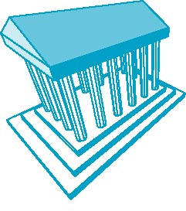
Three-Point Perspective
No principal face parallel to projection plane
Three vanishing points for cube

Slide 18
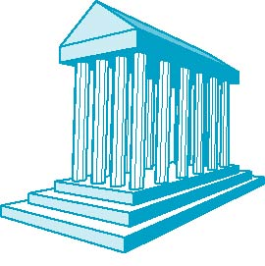
Two-Point Perspective
On principal direction parallel to projection plane
Two vanishing points for cube

Slide 19
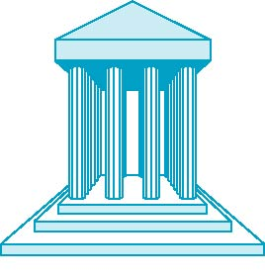
One-Point Perspective
One principal face parallel to projection plane
One vanishing point for cube

Slide 20
Advantages and Disadvantages
Objects further from viewer are projected smaller than the same sized objects closer to the viewer (diminution) so it looks realistic
Equal distances along a line are not projected into equal distances (nonuniform foreshortening)
Angles preserved only in planes parallel to the projection plane
More difficult to construct by hand than parallel projections (but not more difficult by computer)

