Slide 1
Computer Viewing

Slide 2
Objectives
Introduce the mathematics of projection
Introduce OpenGL viewing functions
Look at alternate viewing APIs

Slide 3
Computer Viewing
There are three aspects of the viewing process, all of which are implemented in the pipeline,
Positioning the camera
Setting the model-view matrix
Selecting a lens
Setting the projection matrix
Clipping
Setting the view volume

Slide 4
The OpenGL Camera
In OpenGL, initially the object and camera frames are the same
Default model-view matrix is an identity
The camera is located at origin and points in the negative z direction
OpenGL also specifies a default view volume that is a cube with sides of length 2 centered at the origin
Default projection matrix is an identity

Slide 5
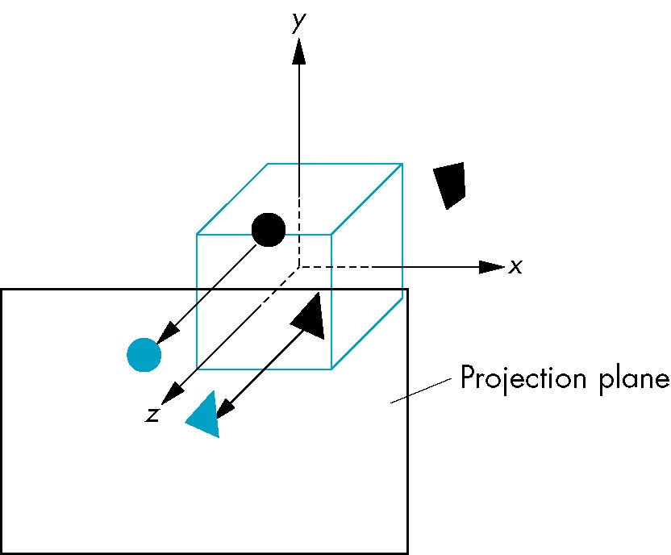
Default Projection
Default projection is orthogonal
clipped out
2
z=0

Slide 6
Moving the Camera Frame
If we want to visualize object with both positive and negative z values we can either
Move the camera in the positive z direction
Translate the camera frame
Move the objects in the negative z direction
Translate the world frame
Both of these views are equivalent and are determined by the model-view matrix
Use translation glTranslatef(0.0,0.0,-d)
where d > 0

Slide 7
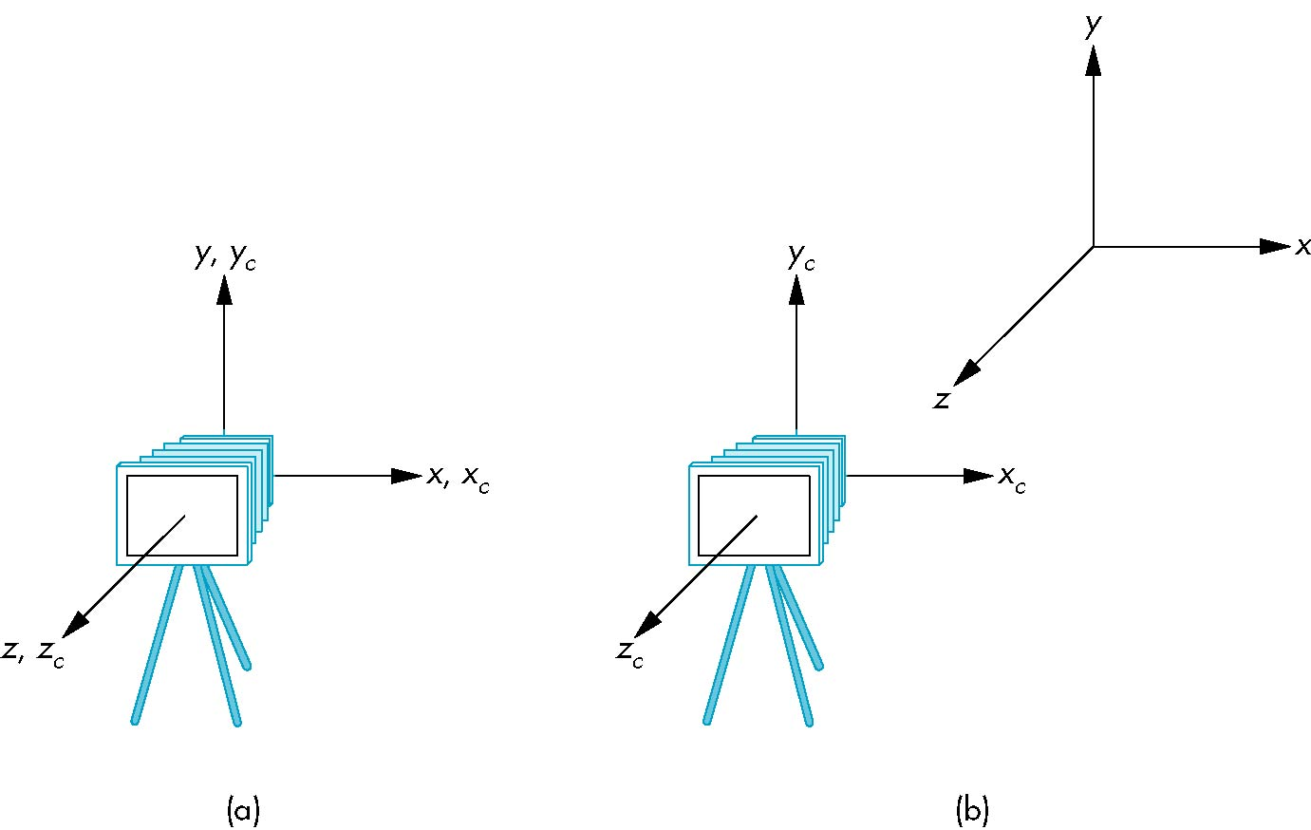
Moving Camera back from Origin
frames after translation by –d
d > 0
default frames

Slide 8
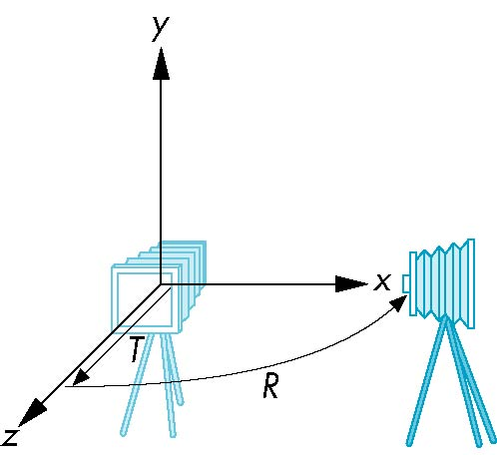
Moving the Camera
We can move the camera to any desired position by a sequence of rotations and translations
Example: side view
Rotate the camera
Move it away from origin
Model-view matrix C = TR

Slide 9
OpenGL code
Remember that last transformation specified is first to be applied
glMatrixMode(GL_MODELVIEW)
glLoadIdentity();
glTranslatef(0.0, 0.0, -d);
glRotatef(90.0, 0.0, 1.0, 0.0);

Slide 10
The LookAt Function
The GLU library contains the function gluLookAt to create the modelview matrix where we specify the eye position, at position, and up direction
Can concatenate with modeling transformations
Example: isometric view of cube aligned with axes
glMatrixMode(GL_MODELVIEW):
glLoadIdentity();
gluLookAt( 1.0, 1.0, 1.0, // eye position
0.0, 0.0, 0.0, // at position
0.0, 1.0, 0.0); // up direction

Slide 11
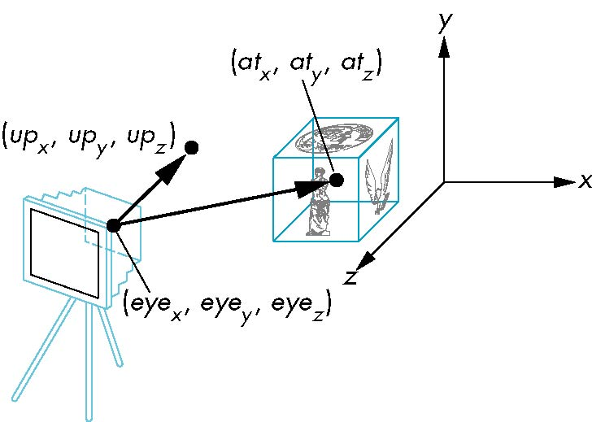
gluLookAt
gluLookAt(eyex, eyey, eyez, atx, aty, atz, upx, upy, upz)

Slide 12
Other Viewing APIs
The LookAt function is only one possible API for positioning the camera
Others include
View reference point, view plane normal, view up (PHIGS, GKS-3D)
Yaw, pitch, roll
Elevation, azimuth, twist
Direction angles

Slide 13
Projections and Normalization
The default projection in the eye (camera) frame is orthogonal
For points within the default view volume
Most graphics systems use view normalization
All other views are converted to the default view by transformations that determine the projection matrix
Allows use of the same pipeline for all views
x_{p} = x
y_{p} = y
z_{p} = 0

Slide 14
Homogeneous Coordinate Representation
default orthographic projection
x_{p} = x
y_{p} = y
z_{p} = 0
w_{p} = 1
p_{p} = Mp
M =
In practice, we can let M = I and set
the z term to zero later

Slide 15
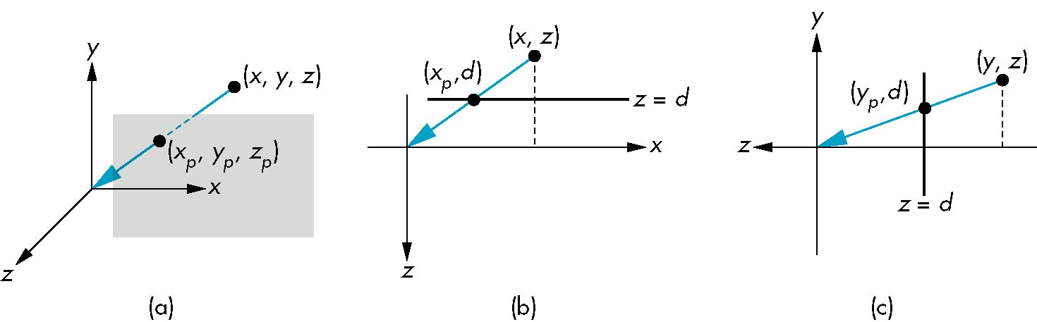
Simple Perspective
Center of projection at the origin
Projection plane z = d, d < 0

Slide 16
Perspective Equations
Consider top and side views
x_{p} =
y_{p} =
z_{p} = d

Slide 17
Homogeneous Coordinate Form
X
Y
Z
1
consider q = Mp where
M =
p =
⇒ q =

Slide 18
Perspective Division
However w ≠ 1, so we must divide by w to return from homogeneous coordinates
This perspective division yields
the desired perspective equations
We will consider the corresponding clipping volume with the OpenGL functions
x_{p} =
y_{p} =
z_{p} = d

Slide 19
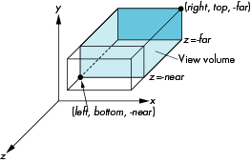
OpenGL Orthogonal Viewing
glOrtho(left,right,bottom,top,near,far)
near and far measured from camera

Slide 20
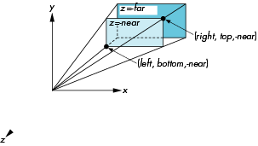
OpenGL Perspective
glFrustum(left,right,bottom,top,near,far)

Slide 21
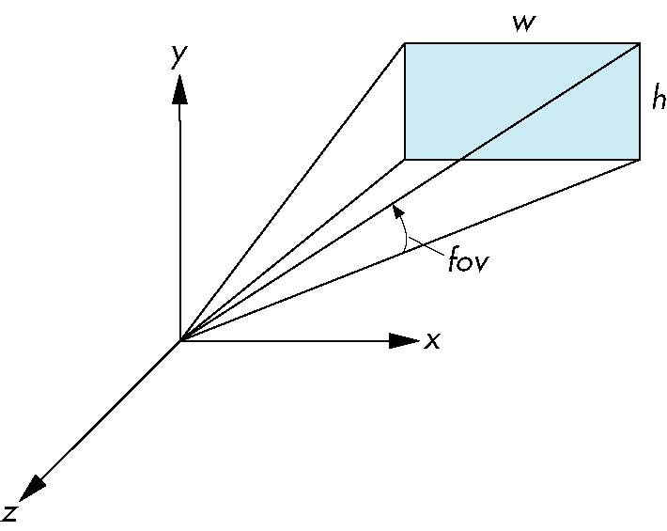
Using Field of View
With glFrustum it is often difficult to get the desired view
gluPerpective(fovy, aspect, near, far) often provides a better interface
front plane
aspect = w/h

