Slide 1
Implementation I

Slide 2
Objectives
Introduce basic implementation strategies
Clipping
Scan conversion

Slide 3
Overview
At end of the geometric pipeline, vertices have been assembled into primitives
Must clip out primitives that are outside the view frustum
Algorithms based on representing primitives by lists of vertices
Must find which pixels can be affected by each primitive
Fragment generation
Rasterization or scan conversion

Slide 4
Required Tasks
Clipping
Rasterization or scan conversion
Transformations
Some tasks deferred until fragement processing
Hidden surface removal
Antialiasing

Slide 5
Rasterization Meta Algorithms
Consider two approaches to rendering a scene with opaque objects
For every pixel, determine which object that projects on the pixel is closest to the viewer and compute the shade of this pixel
Ray tracing paradigm
For every object, determine which pixels it covers and shade these pixels
Pipeline approach
Must keep track of depths

Slide 6
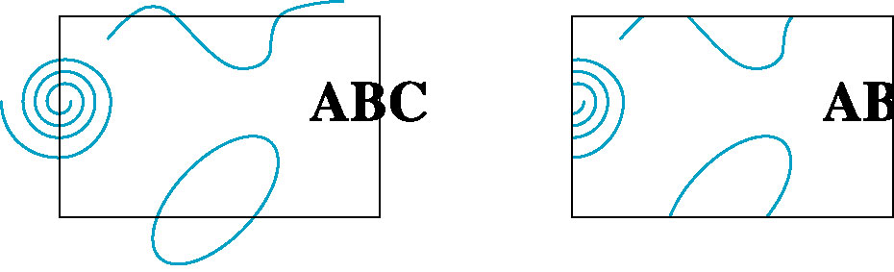
Clipping
2D against clipping window
3D against clipping volume
Easy for line segments polygons
Hard for curves and text
Convert to lines and polygons first

Slide 7
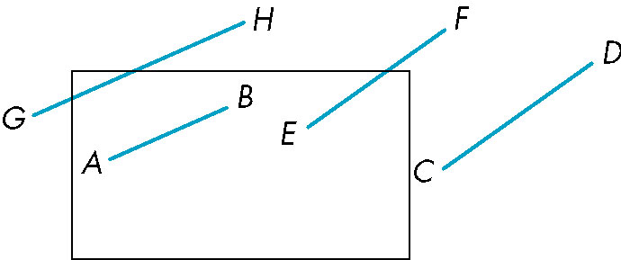
Clipping 2D Line Segments
Brute force approach: compute intersections with all sides of clipping window
Inefficient: one division per intersection

Slide 8
Cohen-Sutherland Algorithm
Idea: eliminate as many cases as possible without computing intersections
Start with four lines that determine the sides of the clipping window
y = y_{max}
x = x_{min}
x = x_{max}
y = y_{min}

Slide 9
The Cases
Case 1: both endpoints of line segment inside all four lines
Draw (accept) line segment as is
Case 2: both endpoints outside all lines and on same side of a line
Discard (reject) the line segment
y = y_{max}
x = x_{min}
x = x_{max}
y = y_{min}

Slide 10
The Cases
Case 3: One endpoint inside, one outside
Must do at least one intersection
Case 4: Both outside
May have part inside
Must do at least one intersection
y = y_{max}
x = x_{min}
x = x_{max}

Slide 11
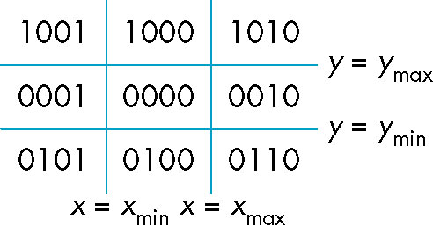
Defining Outcodes
For each endpoint, define an outcode
Outcodes divide space into 9 regions
Computation of outcode requires at most 4 subtractions
b₀b₁b₂b₃
b₀ = 1 if y > y_{max}, 0 otherwise
b₁ = 1 if y < y_{min}, 0 otherwise
b₂ = 1 if x > x_{max}, 0 otherwise
b₃ = 1 if x < x_{min}, 0 otherwise

Slide 12
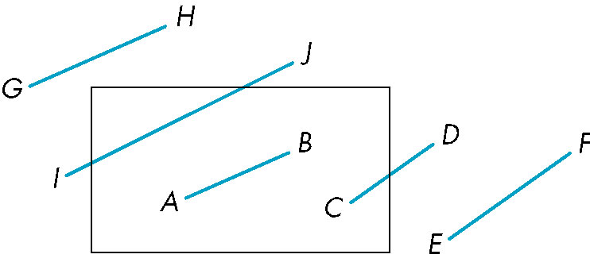
Using Outcodes
Consider the 5 cases below
AB: outcode(A) = outcode(B) = 0
Accept line segment

Slide 13
Using Outcodes
CD: outcode (C) = 0, outcode(D) ≠ 0
Compute intersection
Location of 1 in outcode(D) determines which edge to intersect with
Note if there were a segment from A to a point in a region with 2 ones in outcode, we might have to do two interesections

Slide 14
Using Outcodes
EF: outcode(E) logically ANDed with outcode(F) (bitwise) ≠ 0
Both outcodes have a 1 bit in the same place
Line segment is outside of corresponding side of clipping window
reject

Slide 15
Using Outcodes
GH and IJ: same outcodes, neither zero but logical AND yields zero
Shorten line segment by intersecting with one of sides of window
Compute outcode of intersection (new endpoint of shortened line segment)
Reexecute algorithm

Slide 16
Efficiency
In many applications, the clipping window is small relative to the size of the entire data base
Most line segments are outside one or more side of the window and can be eliminated based on their outcodes
Inefficiency when code has to be reexecuted for line segments that must be shortened in more than one step

Slide 17
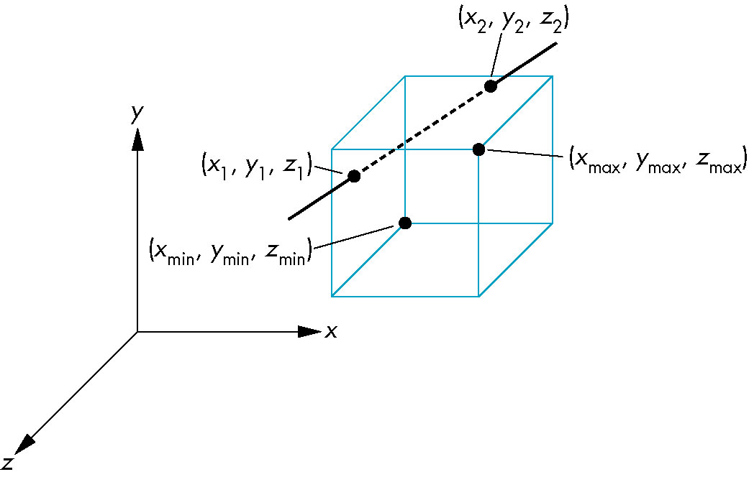
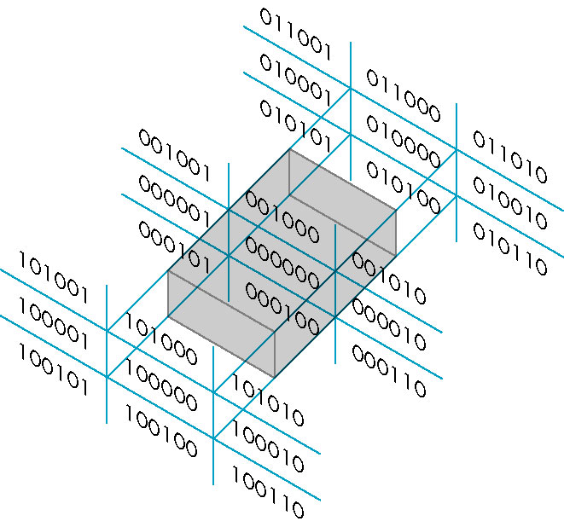
Cohen Sutherland in 3D
Use 6-bit outcodes
When needed, clip line segment against planes

Slide 18
Liang-Barsky Clipping
Consider the parametric form of a line segment
We can distinguish between the cases by looking at the ordering of the values of α where the line determined by the line segment crosses the lines that determine the window
p(α) = (1-α)p₁+ αp₂ 1 ≥ α ≥ 0
p₂
p₁

Slide 19
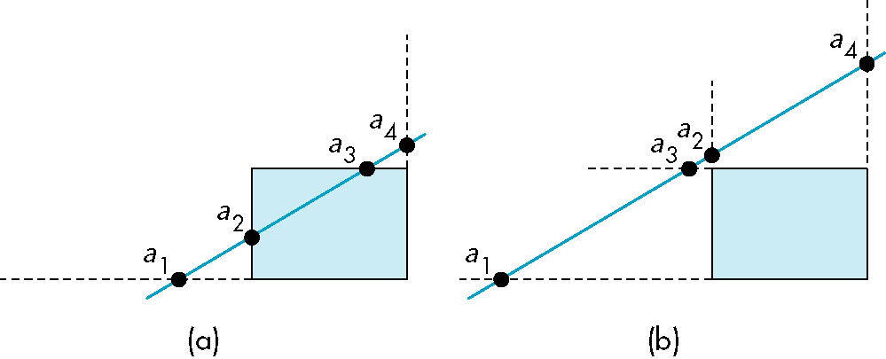
Liang-Barsky Clipping
In (a): α₄ > α₃ > α₂ > α₁
Intersect right, top, left, bottom: shorten
In (b): α₄ > α₂ > α₃ > α₁
Intersect right, left, top, bottom: reject

Slide 20
Advantages
Can accept/reject as easily as with Cohen-Sutherland
Using values of α, we do not have to use algorithm multiple times as with C-S
Extends to 3D

