Slide 1
Implementation II

Slide 2
Objectives
Introduce clipping algorithms for polygons
Survey hidden-surface algorithms

Slide 3
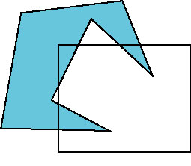
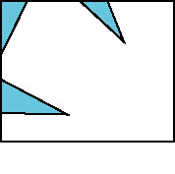
Polygon Clipping
Not as simple as line segment clipping
Clipping a line segment yields at most one line segment
Clipping a polygon can yield multiple polygons
However, clipping a convex polygon can yield at most one other polygon

Slide 4

Tessellation and Convexity
One strategy is to replace nonconvex (concave) polygons with a set of triangular polygons (a tessellation)
Also makes fill easier
Tessellation code in GLU library

Slide 5
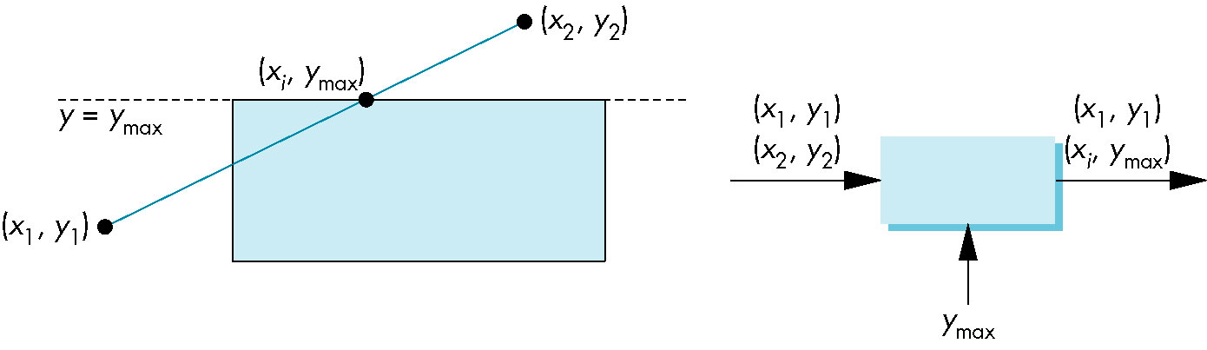
Clipping as a Black Box
Can consider line segment clipping as a process that takes in two vertices and produces either no vertices or the vertices of a clipped line segment

Slide 6
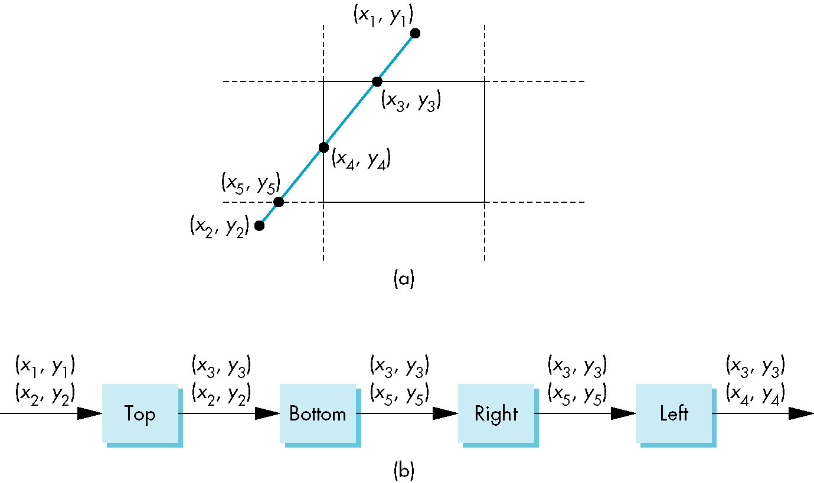
Pipeline Clipping of Line Segments
Clipping against each side of window is independent of other sides
Can use four independent clippers in a pipeline

Slide 7
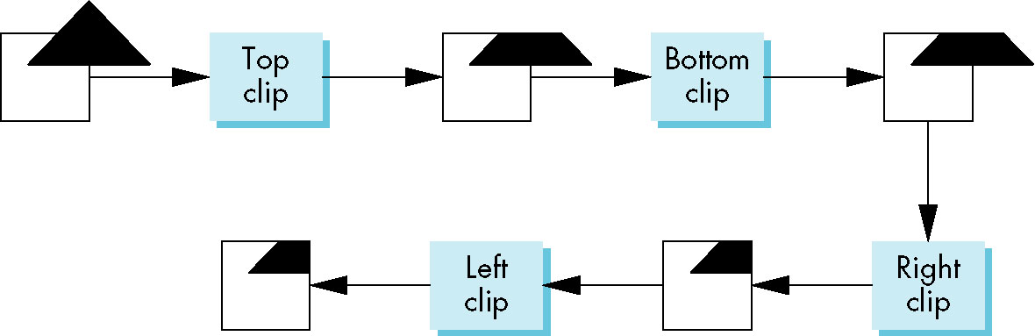
Pipeline Clipping of Polygons
Three dimensions: add front and back clippers
Strategy used in SGI Geometry Engine
Small increase in latency

Slide 8
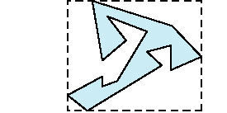
Bounding Boxes
Rather than doing clipping on a complex polygon, we can use an axis-aligned bounding box or extent
Smallest rectangle aligned with axes that encloses the polygon
Simple to compute: max and min of x and y

Slide 9
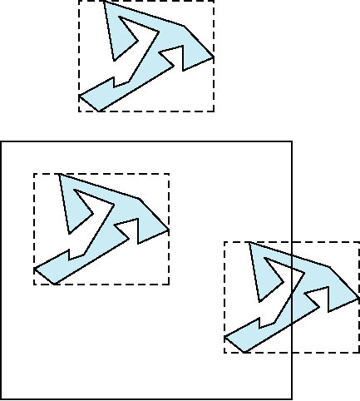
Bounding boxes
Can usually determine accept/reject based only on bounding box
reject
accept
requires detailed
clipping

Slide 10
Clipping and Visibility
Clipping has much in common with hidden-surface removal
In both cases, we are trying to remove objects that are not visible to the camera
Often we can use visibility or occlusion testing early in the process to eliminate as many polygons as possible before going through the entire pipeline

Slide 11
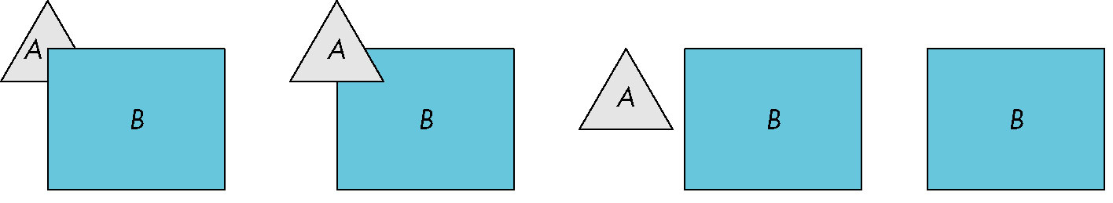
Hidden Surface Removal
Object-space approach: use pairwise testing between polygons (objects)
Worst case complexity O(n²) for n polygons
partially obscuring
can draw independently

Slide 12
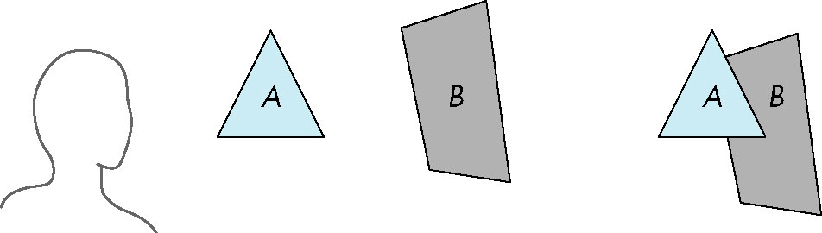
Painter’s Algorithm
Render polygons a back to front order so that polygons behind others are simply painted over
B behind A as seen by viewer
Fill B then A

Slide 13
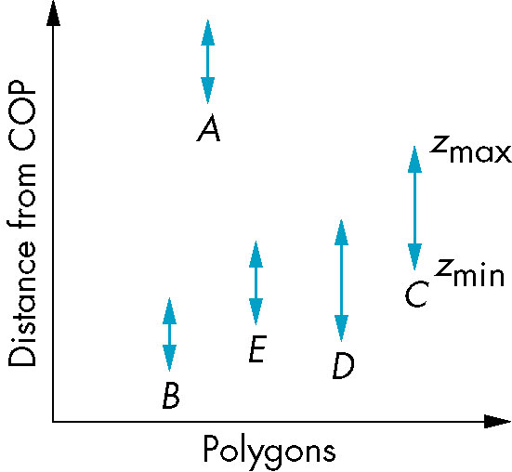
Depth Sort
Requires ordering of polygons first
O(n log n) calculation for ordering
Not every polygon is either in front or behind all other polygons
Order polygons and deal with
easy cases first, harder later
Polygons sorted by
distance from COP

Slide 14
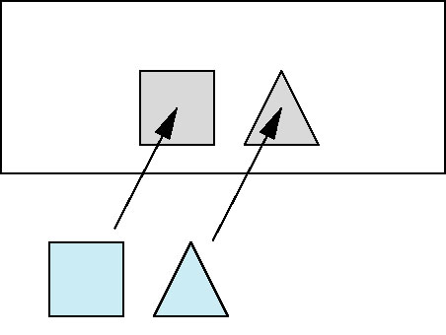
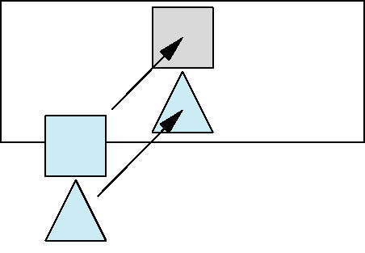
Easy Cases
A lies behind all other polygons
Can render
Polygons overlap in z but not in either x or y
Can render independently

Slide 15
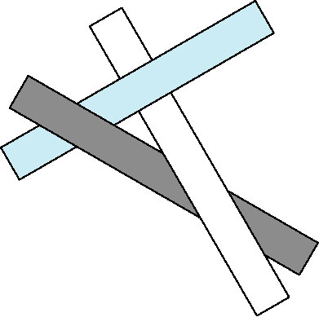
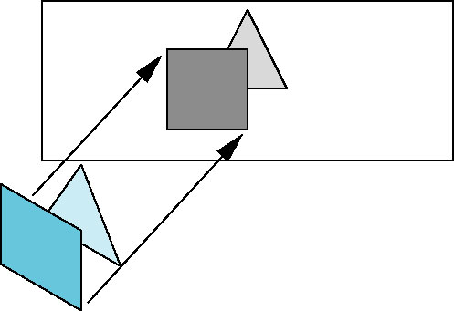
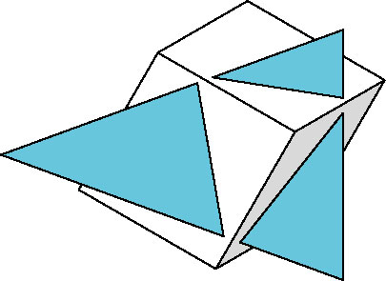
Hard Cases
cyclic overlap
Overlap in all directions
but can one is fully on
one side of the other
penetration

Slide 16
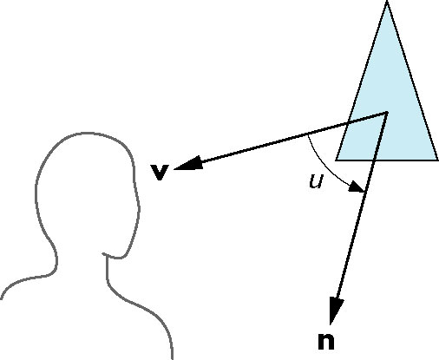
Back-Face Removal (Culling)
face is visible iff 90 ≥ θ ≥ -90
equivalently cos θ ≥ 0
or v • n ≥ 0
θ
plane of face has form ax + by +cz +d =0
but after normalization n = ( 0 0 1 0)^{T}
need only test the sign of c
In OpenGL we can simply enable culling
but may not work correctly if we have nonconvex objects

Slide 17
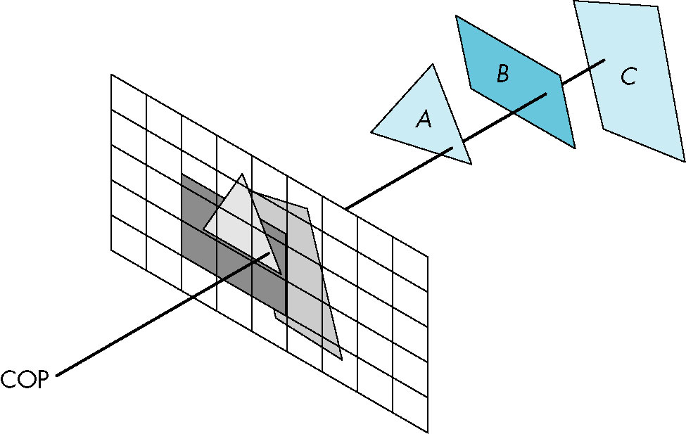
Image Space Approach
Look at each projector (nm for an n x m frame buffer) and find closest of k polygons
Complexity O(nmk)
Ray tracing
z-buffer

Slide 18
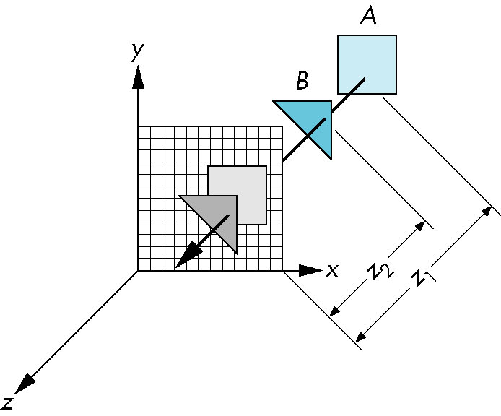
z-Buffer Algorithm
Use a buffer called the z or depth buffer to store the depth of the closest object at each pixel found so far
As we render each polygon, compare the depth of each pixel to depth in z buffer
If less, place shade of pixel in color buffer and update z buffer

Slide 19
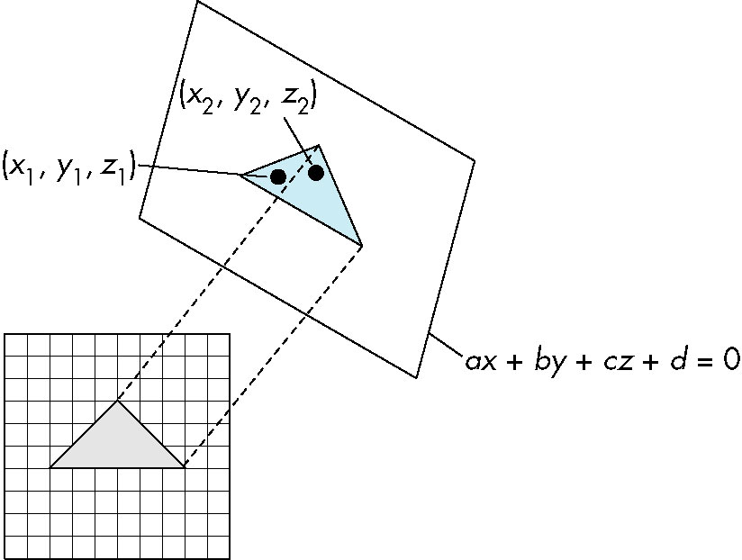
Efficiency
If we work scan line by scan line as we move across a scan line, the depth changes satisfy aΔx+bΔy+cΔz=0
Along scan line
Δy = 0
Δz = - Δx
In screen space Δx = 1

Slide 20
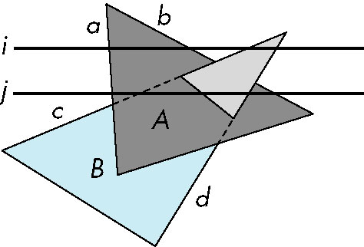
Scan-Line Algorithm
Can combine shading and hsr through scan line algorithm
scan line i: no need for depth
information, can only be in no
or one polygon
scan line j: need depth
information only when in
more than one polygon

Slide 21
Implementation
Need a data structure to store
Flag for each polygon (inside/outside)
Incremental structure for scan lines that stores which edges are encountered
Parameters for planes

Slide 22
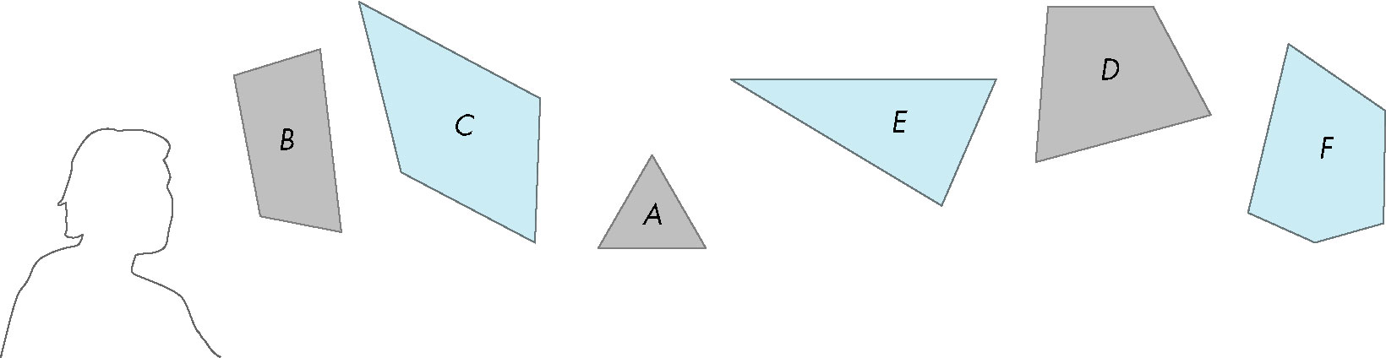
Visibility Testing
In many realtime applications, such as games, we want to eliminate as many objects as possible within the application
Reduce burden on pipeline
Reduce traffic on bus
Partition space with Binary Spatial Partition (BSP) Tree

Slide 23
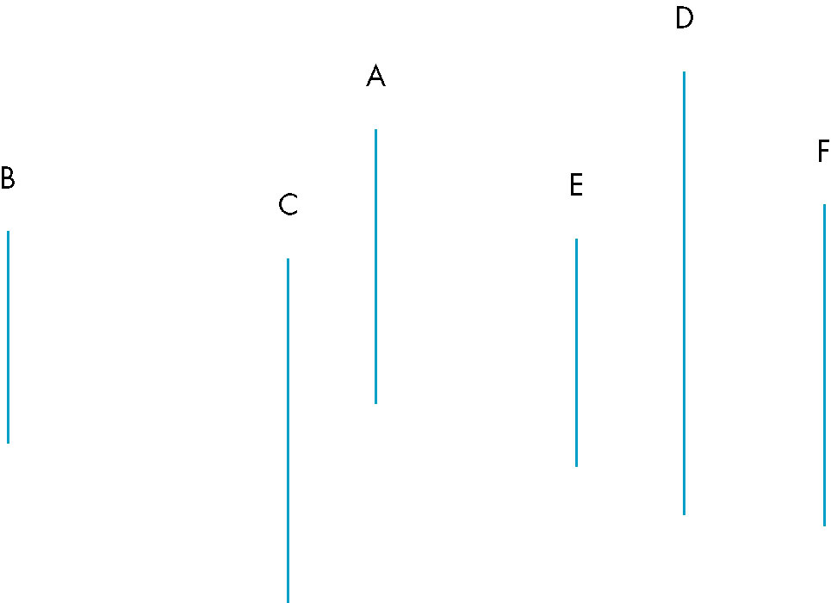
Simple Example
consider 6 parallel polygons
top view
The plane of A separates B and C from D, E and F

Slide 24
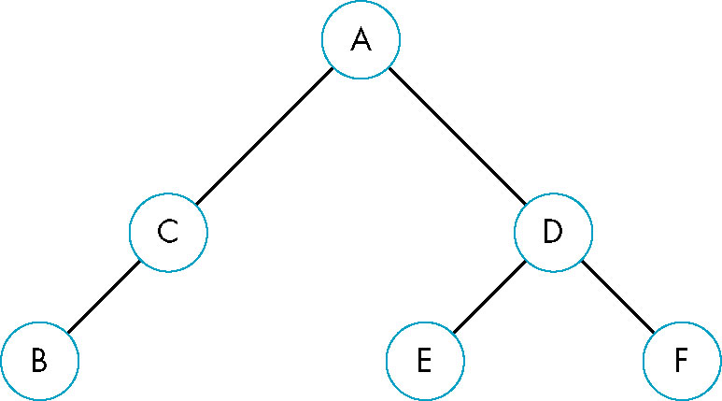
BSP Tree
Can continue recursively
Plane of C separates B from A
Plane of D separates E and F
Can put this information in a BSP tree
Use for visibility and occlusion testing

