Slide 1
Sublinear Algorithm and Birds Voices
Submitted By: Shajaf Gonen & Roy Sheffer

Slide 2
Motivation
We have a long .wav file with a bird’s voice recorded.
We wish to identify what bird made that noise (classification).
Given that we’ve many identified recordings. (Ground through).
We solve this problem, in a sub-linear approach.

Slide 3
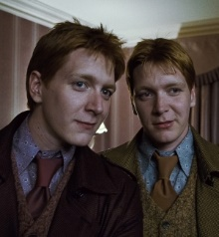
Reminder - Identity problem
Let p, q be distributions over [n]
p is a black-box distribution q is explicitly given
The task is to distinguish the case where p = q from the case |p − q| > ε using as few samples (from p) as possible.
sky
building
tree
plane
grass

Slide 4

Identity problem
Tugkan Batu: "TESTING PROPERTIES OF DISTRIBUTIONS". 2001

Slide 5
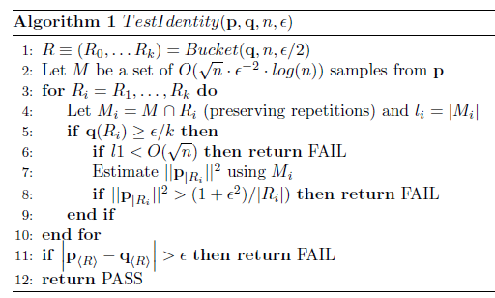

Identity problem
Tugkan Batu solved the problem by using $\tilde{o}(\sqrt{n} poly(ε^{−1}))$ samples with the TestIdentity algorithm.

Slide 6
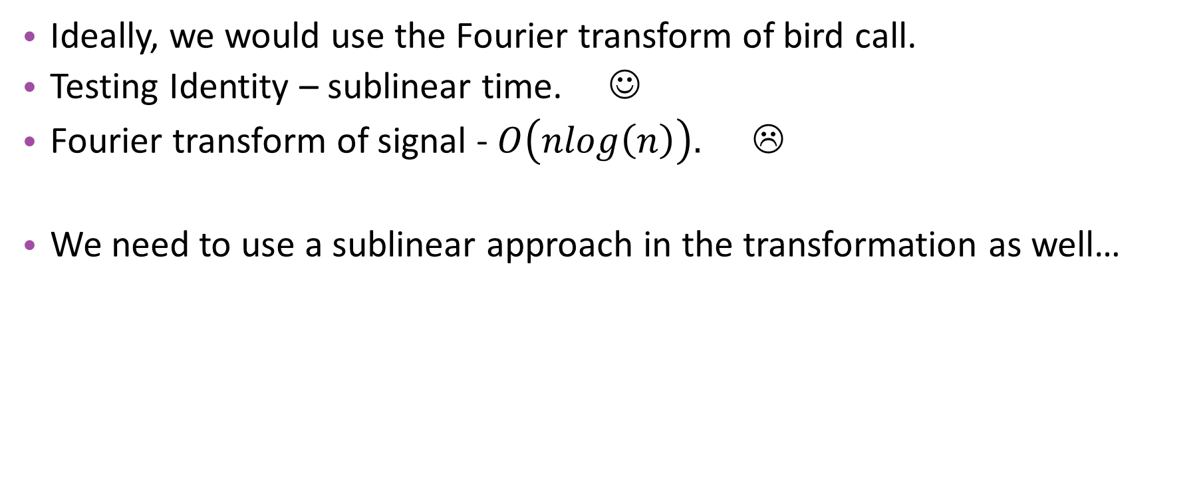
First attempt…
Ideally, we would use the Fourier transform of bird call.
Testing Identity – sublinear time. ☺
Fourier transform of signal -$O\left(nlog\left(n\right)\right).$☹
We need to use a sublinear approach in the transformation as well…

Slide 7
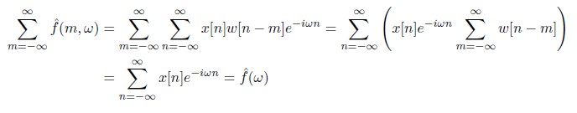
Key Observation
“The discrete Fourier transform of a signal equals the sum of the discrete STFT calculated on all possible windows”.
Not accurate for the sum of the absolute values of the STFT of the signal
Leads us to assume that the normalized sum is a good stimation

Slide 8
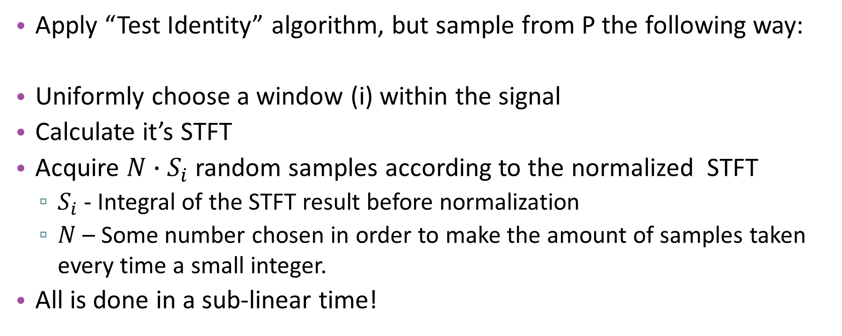
Second Key
Apply “Test Identity” algorithm, but sample from P the following way:
Uniformly choose a window (i) within the signal
Calculate it’s STFT
Acquire $N∙S_{i}$ random samples according to the normalized STFT
$S_{i}$ - Integral of the STFT result before normalization
$N$ – Some number chosen in order to make the amount of samples taken every time a small integer.
All is done in a sub-linear time!

Slide 9
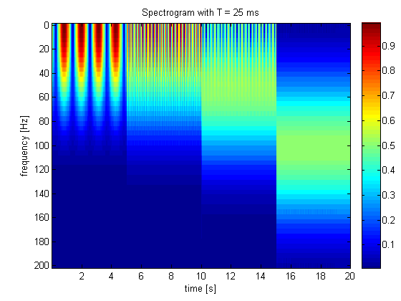
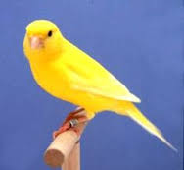
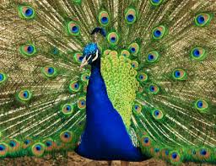
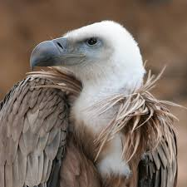
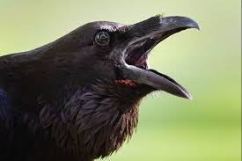
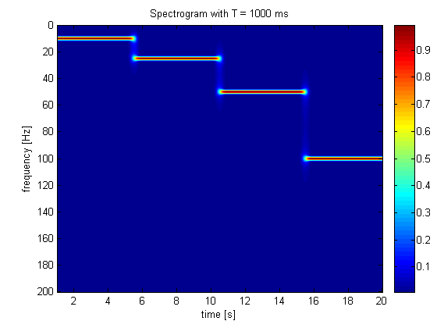






Identification Pipeline
GT
First we calculate our ground truth
$$q_{Canary}$$
$$signal(t)$$
Stft on all signal
Get the distribution
$$q_{Peacock}$$
$$q_{Crow}$$
$$q_{vulture}$$
$$signal(t)$$

Slide 10

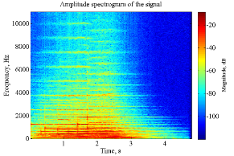
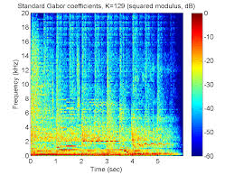
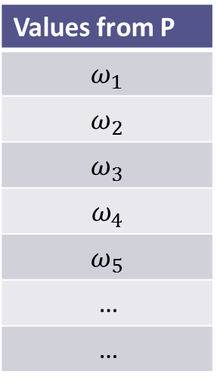

Identification Pipeline
Then we sample…
Values from P
$$ω_{1}$$
$$ω_{2}$$
$$ω_{3}$$
$$ω_{4}$$
$$ω_{5}$$
…
…
Calculate several stft from random parts of the signal
Sample values!
$$singal(t)$$

Slide 11
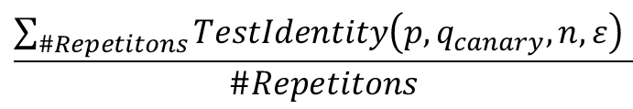
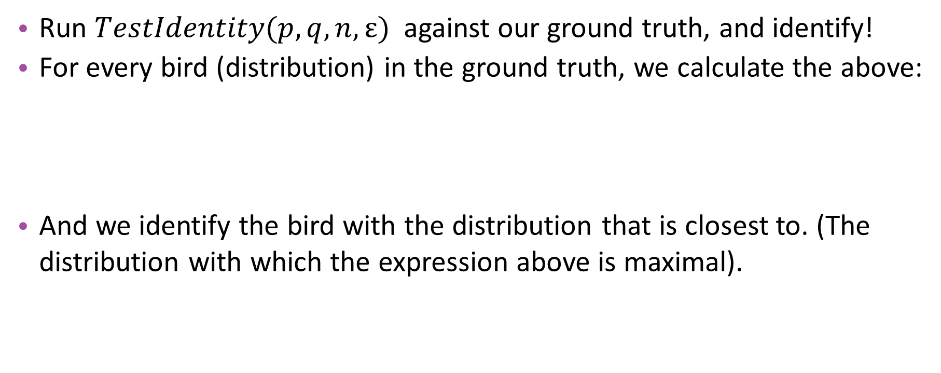
Identification Pipeline
Run $TestIdentity(p, q, n, ε)$ against our ground truth, and identify!
For every bird (distribution) in the ground truth, we calculate the above:
And we identify the bird with the distribution that is closest to. (The distribution with which the expression above is maximal).
$$\frac{\sum_{\#Repetitons}{TestIdentity\left(p,q_{canary},n,ε\right) }}{\#Repetitons}$$

Slide 12
Why birds?
We’re not ornithologists yet.
We presumed low variance in dominating frequencies of bird calls between birds of the same species.

Slide 13
What n to choose?

Slide 14
What ε to choose?

Slide 15
How many repetitions?

Slide 16
Results

Slide 17
What next?

Slide 18
Questions?

