Slide 1

SLA Sentinel
CB23F35 · LOW-CODE ZOHO CREATOR
Intelligent SLA Monitoring and Vendor Performance Management System
Met
At Risk
Breached
Mohamed Abshar · Reg. No. 240701317
B.E. CSE · Rajalakshmi Engineering College · End Semester Project

Slide 2




THE PROBLEM
Deadlines hidden in PDFs
Vendor SLAs are tracked in spreadsheets, e-mail and PDFs
No incident shows its own response or resolution deadline.
No early warning
Breaches surface at the month-end review, if at all.
So breaches are found late, uptime is guessed and contractual credits are left on the table.
Unreliable uptime
Outage times are incomplete and planned maintenance is not separated.
Unclaimed credits
Penalties are rarely calculated and there is no approval trail.

Slide 3





What SLA Sentinel sets out to do
OBJECTIVES
01
02
03
Model the domain
Time every incident
Escalate early
Vendors, agreements, incidents, downtime, credits and scorecards.
Compute deadlines; judge response and resolution separately.
Check every 15 minutes with three staged, logged escalations.
04
05
06
Close each month
Connect services
Keep it secure
Uptime without planned maintenance, credits and vendor scorecards.
Zoho Mail, Zoho Cliq and the UptimeRobot REST API.
Roles, vendor-level record criteria, audit trail, staged deployment.

Slide 4


Zoho Creator versus a custom build
WHY LOW-CODE
Traditional code
Zoho Creator
10–12 weeks
3–4 weeks
Own VM, database, backups and SSL
Hosted by Zoho; backups and SSL included
Separate mobile UI or native app
Mobile app generated automatically
Auth, RBAC and audit logging hand-coded
Built-in roles, profiles and record criteria
Every SLA rule change is a redeploy
Targets and credit tiers edited as data
Development times are estimates for one student developer. Trade-off: UI layout and scheduling below 15 minutes are limited by the platform.

Slide 5
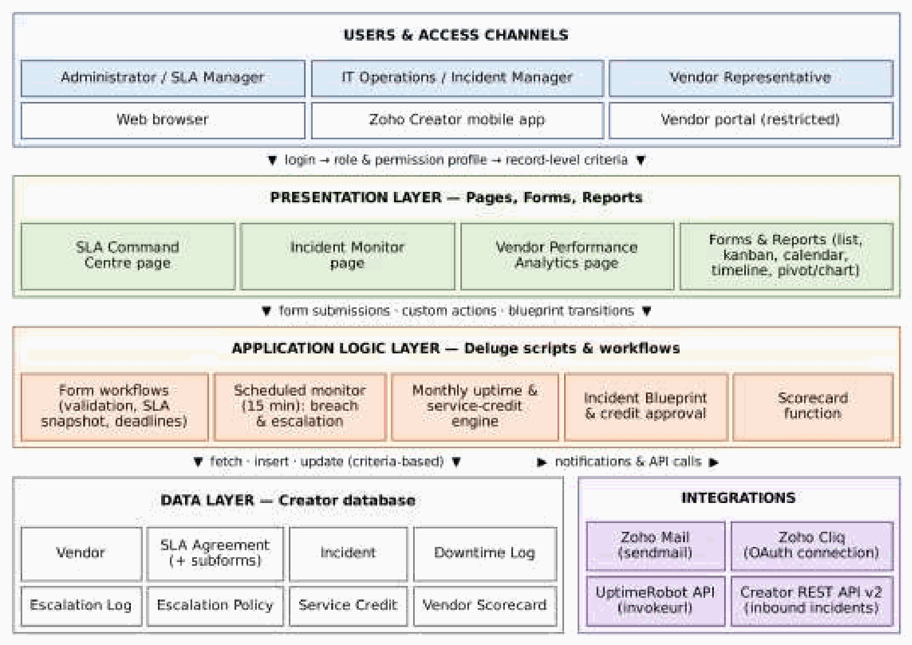



Four layers on one platform
ARCHITECTURE
Access
Admin, Incident Manager and Vendor Rep via web, mobile or portal
Presentation
10 forms, 13 reports and 3 dashboard pages
Logic
13 Deluge scripts, 4 schedules, a Blueprint and an approval
Integrations
Zoho Mail, Zoho Cliq, UptimeRobot and Creator REST API

Slide 6
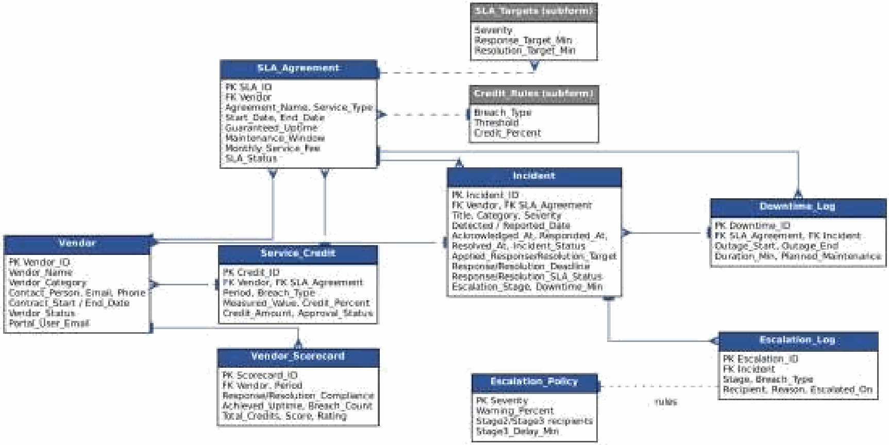
Ten forms joined by lookups and subforms
DATA MODEL
2
subforms
SLA_Targets and Credit_Rules inside each agreement
9
lookup links
Vendor and agreement feed incidents, downtime, credits
1
snapshot rule
Targets are frozen on the incident when it is saved
Escalation_Policy is matched by severity; Scheduler_Control drives the self-rescheduling monitor.

Slide 7




Ten forms in four groups
FORMS
Master data
Operations
Outcomes
Configuration
Vendor
Incident
Escalation_Log
Escalation_Policy
SLA_Agreement
Incident_Update
Service_Credit
Scheduler_Control
+ SLA_Targets
Downtime_Log
Vendor_Scorecard
+ Credit_Rules
16 field types, including Auto Number, Lookup, Subform, Date-Time, Currency, Users, File Upload, Decision Box and an AI Keyword Extraction field.

Slide 8




Thirteen Deluge scripts carry the SLA rules
AUTOMATION
Form events
Functions
Schedules
Process
DS-01
DS-04
DS-06
DS-10
Filter agreements by vendor
Evaluate response and resolution
SLA monitor, every 15 min
Blueprint timestamps
DS-02
DS-05
DS-08
DS-11
Block invalid incidents
Log, e-mail and Cliq escalation
Monthly close: uptime, credits
Credit approval decision
DS-03
DS-09
DS-12
Snapshot targets, set deadlines
Weighted vendor scorecard
Daily expiry housekeeping
DS-07
DS-13
Downtime duration, no overlaps
Sync uptime from UptimeRobot

Slide 9


Three escalation stages, each sent exactly once
SLA MONITORING
Every 15 min
Stage 1
Stage 2
Stage 3
Schedule checks all open incidents
Warning % reached → reminder to vendor
Deadline missed → Incident Manager alerted
Breach outlasts policy delay → SLA Administrator
Monitor
At Risk
Breached
Escalated
Policy per severity: Critical warns at 50 % and escalates after 15 min of breach; Low warns at 90 % and escalates after 4 hours. Critical breaches also post to Zoho Cliq.

Slide 10
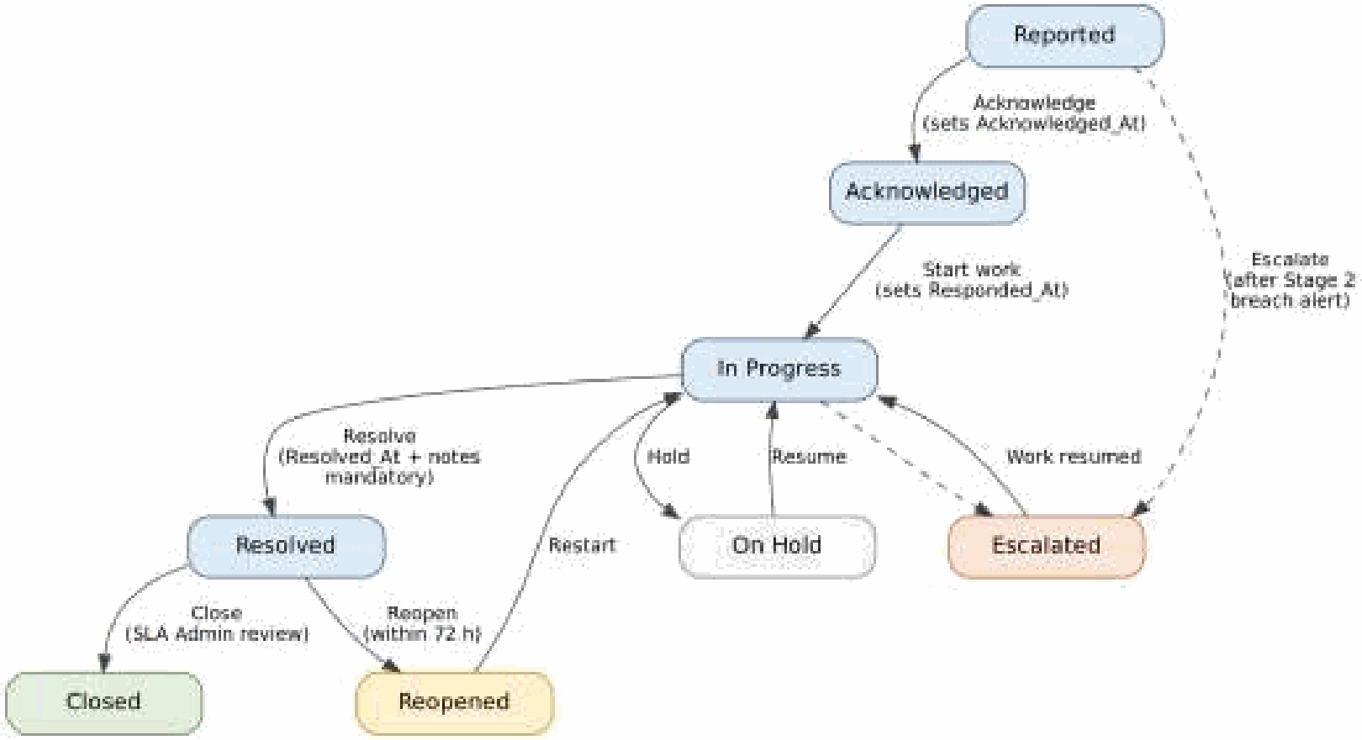
A Blueprint stamps every timestamp
INCIDENT LIFECYCLE
Worked example
10:00
Critical incident reported
10:10
Acknowledged → response Met
10:15
Response deadline
14:00
Resolution deadline
15:00
Resolved → resolution Breached
Targets are copied onto the incident when saved, so later contract edits never change recorded deadlines.
→ 300 minutes of downtime logged automatically

Slide 11




One app at the centre of four services
INTEGRATIONS
Zoho Mail
Zoho Cliq
sendmail task
OAuth connection
Incident, escalation, approval and expiry e-mails
Stage 2+ Critical breaches to #slaalerts
SLA Sentinel
UptimeRobot API v2
Creator REST API v2
invokeurl POST
Inbound POST
Daily 30-day uptime ratio per service
Monitoring tools log incidents; rules still run

Slide 12




Three roles, each with only what it needs
ACCESS CONTROL
Administrator / SLA Manager
Incident Manager
Vendor Representative
Vendors, agreements, policies
Registers and moves incidents
Portal: own vendor only
Approves service credits
Records downtime
Acknowledges, updates, resolves
All dashboards and reports
Views agreements and credits
Sees approved credits only
Manages users
No policy or scheduler access
No dashboards or other vendors

Slide 13
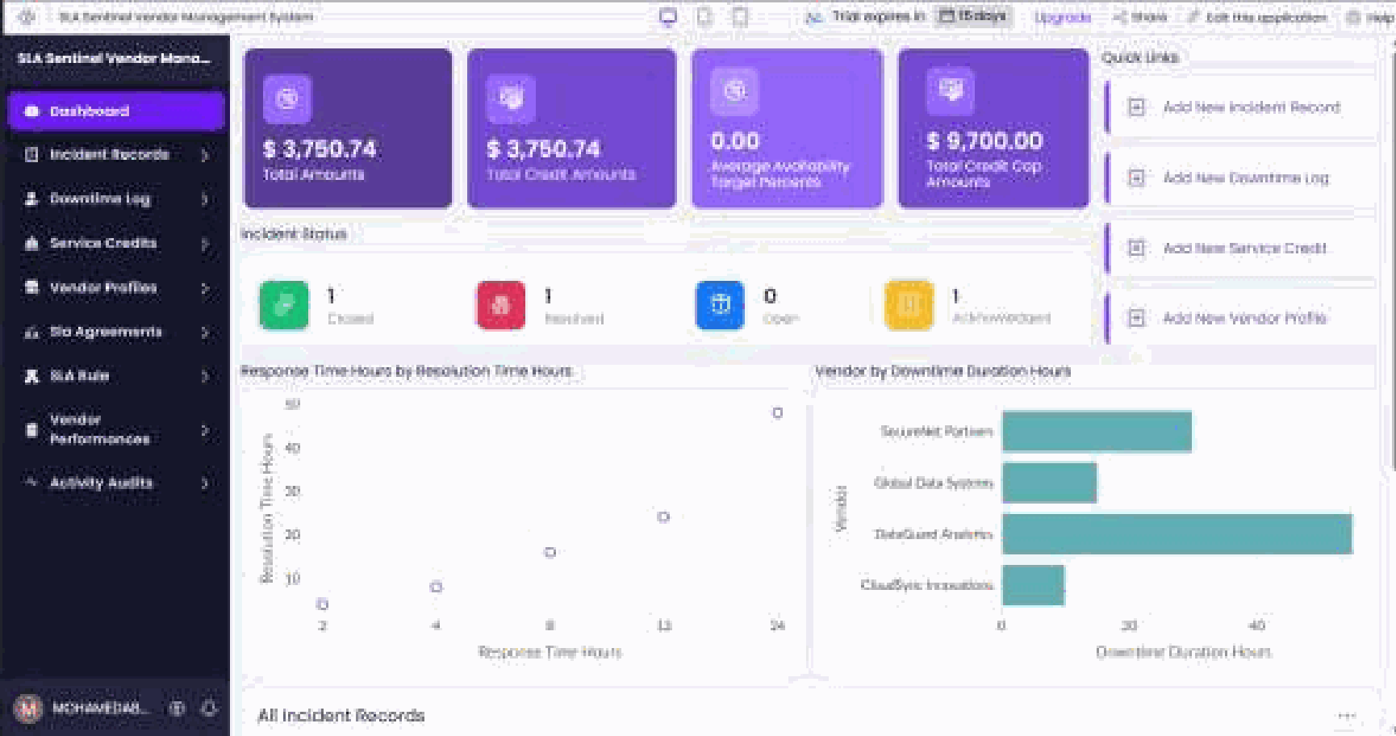
Everything the SLA manager needs on one screen
REPORTS AND DASHBOARD
13
reports
list, Kanban, calendar, timeline, pivot and charts
3
pages
Command Centre, Incident Monitor, Vendor Analytics
3
status colours
Met, At Risk and Breached stand out everywhere

Slide 14
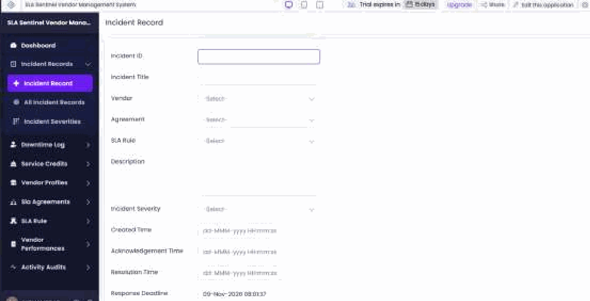
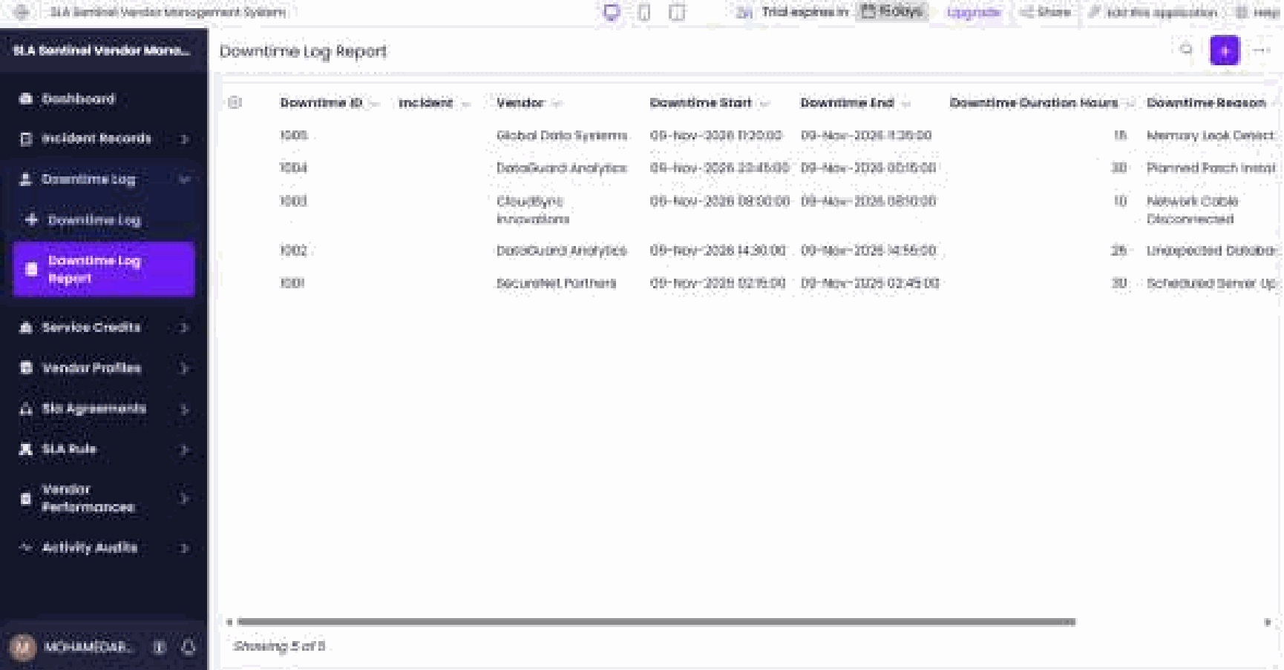
Logging incidents and outages
DATA CAPTURE
Incident record form
Downtime log report
Vendor picks filter the agreement list; deadlines appear on save.
Each outage has a start, end, duration and reason.

Slide 15
Monthly close turns downtime into accountability
CREDITS AND SCORECARDS
Vendor performance score
Response 30 %
Resolution 40 %
Uptime 30 %
Rating
Service credits
Poor
Average
Good
Excellent
< 60
60+
75+
90+
Highest matching uptime tier applies, e.g. below 99.9 % → 5 % of the monthly fee.
Resolution credit per breach, capped at the rule's threshold.
Every credit waits for Administrator approval; the vendor is e-mailed the decision.
Example: 90 % response, 80 % resolution and uptime score 100 give 89.0 → Good.
Zia: keyword extraction tags incident descriptions for recurring-problem analysis only.

Slide 16

Eighteen test cases across rules and roles
TESTING
18
5
2
3
test cases
invalid inputs blocked
access checks
defects fixed
Deadlines
Uptime
Critical at 10:00 → 10:15 / 14:00, unchanged after agreement edit
60 min unplanned + 120 planned in 30 days → 99.861 %, 5 % credit
Escalation
Isolation
Stage 1 sent once; Stage 2 then Stage 3 with a Cliq post
A vendor portal user sees only its own incidents

Slide 17

Before and after SLA Sentinel
RESULTS
Before
With SLA Sentinel
Finding the SLA deadline
~5 min PDF lookup
Computed on save
Breach detection
Month-end, if at all
Within 15 minutes
Escalation
Ad hoc phone calls
Staged and logged
Uptime
Manual estimate
Monthly, maintenance excluded
Service credits
Rarely calculated
Generated and approved
Data access
Shared spreadsheet
Role-based with audit trail
All six objectives met per the report's test cases; 31 of 32 Zoho Creator features implemented (no pro-code extension).

Slide 18


Where low-code reached its limits
LIMITATIONS
15-minute polling
Continuous clocks
A breach can be detected up to 15 minutes late.
Timers do not pause for business hours or holidays.
Platform limits
Vendor lock-in
Deluge execution limits; live countdowns need a widget.
Forms, Blueprint and Deluge would need rebuilding elsewhere.
No-code built forms, reports, roles, Blueprint and approvals. Low-code Deluge supplied the SLA logic. Pro-code was not needed.

Slide 19

From monitoring today to prediction tomorrow
CONCLUSION AND FUTURE WORK
Business-hours clocks
Delivered
Working-hour calendars and public holidays per agreement
Contracts and incidents in one place
Both SLAs evaluated separately
Staged, auditable escalation
Monthly uptime, credits and scorecards
Role-based access and vendor portal
Breach-risk prediction
Zia model trained on past incidents
One-minute monitoring
Catalyst cron function for Critical incidents
Automatic deductions
Approved credits applied in Zoho Books invoices

Slide 20
Thank you
Questions and live demonstration
Mohamed Abshar · 240701317 · SLA Sentinel

