Slide 1
Moving Past the Arduino for Embedded Development

Slide 2
Abstract
Learn how to write embedded software with tools that aren’t the Arduino IDE
Learn how to work with C/C++ for embedded development

Slide 3
Speaker Bio
Al Rodriguez
.NET Dev for over a decade
Java dev for the beginning of that
C++ dev for a few weeks
@ProgrammerAL on Twitter

Slide 4
Steps to Create an Embedded App
1) Type out the code
2) Compile to Native Instructions (8-bit ARM in our case)
With choice of compiler depending on language
3) Copy binary file to target board

Slide 5
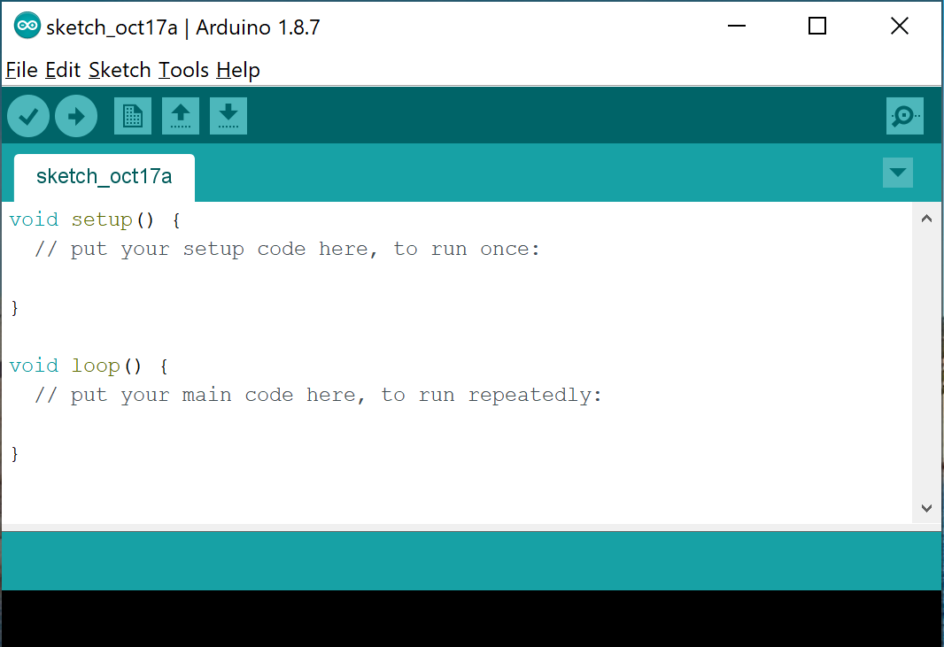
Arduino IDE
https://www.arduino.cc/
Pros
Easy to setup
Abstracts low level concepts
C and C++ under the hood
Adding external libraries is very easy
Cons
Built for prototyping
Proprietary project system

Slide 6
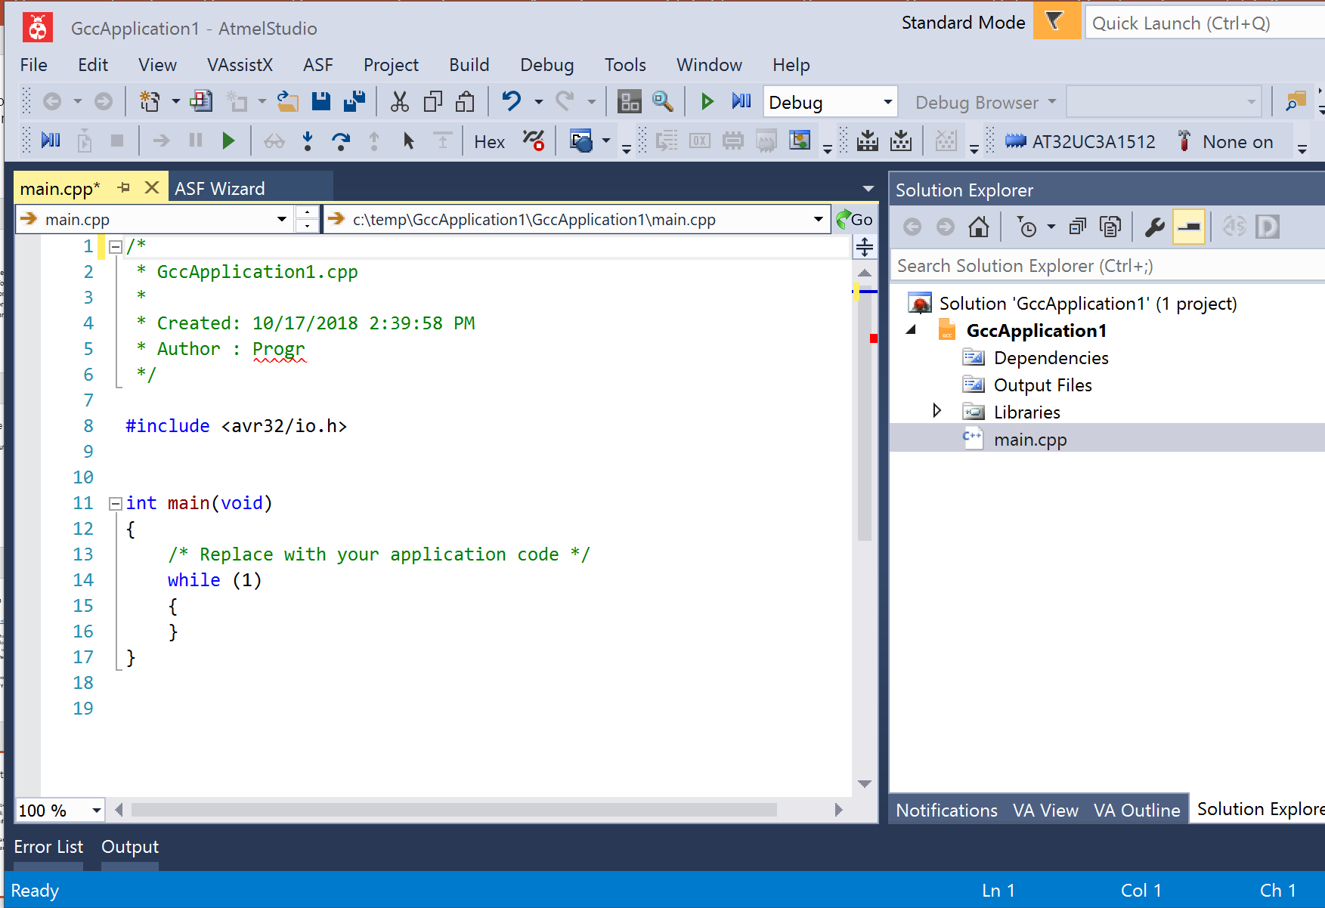
Atmel Studio
Pros
Lots of tools built in
Can work with C, C++, and Arduino projects
Familiar if you use Visual Studio
Cons
Some manual setup
Proprietary project system

Slide 7
Roll Your Own with CMake
Pros
Cross Platform
Cross IDE
Can add unit tests!!!
Cons
Lots of time to setup
Easy to lose cross-platform benefits

Slide 8
Other Systems
Arduino CLI
https://github.com/arduino/arduino-cli
Arduino IDE, but a CLI tool
Meant for scripting scenarios
IoTZ
https://github.com/Azure/iotz
Wrapper to other tools for working with embedded applications
One Stop Shop for embedded tooling
NPM Package

Slide 9
What’s Installed on the Machine
Arduino
Just for AVRDude. You may not need this for your projects.
Atmel Studio
AVR Toolchain
C/C++ compilers, linker, etc
AVR Standard Library
Note: Arduino IDE Installs this too
Atmel Studio has newer versions than what Arduino comes with
Visual Studio 2017
Include C++ features
Include Windows 8.1 SDK (for compiling unit tests to x86)
NMake
Installed by Visual Studio
CMake

Slide 10
Embedded C/C++ Gotchas
No stdlib
Missing a lot of features you’re used to
‘new’ keyword
Can make your own or find them online
Trickery involved in getting unit tests created/run
Can’t debug unit tests easily
Even though they’re compiled for x86

Slide 11
Cmake Gotchas
Manually add/remove files included in compilation
Variable scope/lifetime

Slide 12
What else to look into?
Debuggers
They exist!
No idea how they work…
Other build systems for C/C++
https://medium.com/@julienjorge/an-overview-of-build-systems-mostly-for-c-projects-ac9931494444
Rust Language?
Found a compiler somewhere on the internet to generate AVR. Not officially supported.

Slide 13
Other Resources
ATMEL AVR Microcontrollers book
Starts out with a great description embedded development in general
https://www.amazon.com/Programming-Interfacing-ATMELs-Thomas-Grace/dp/1305509994

