Slide 1
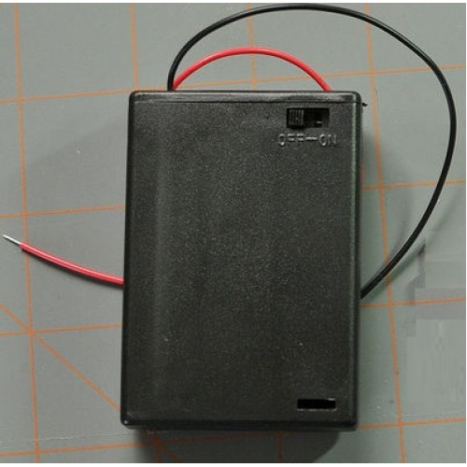


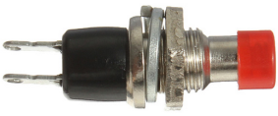
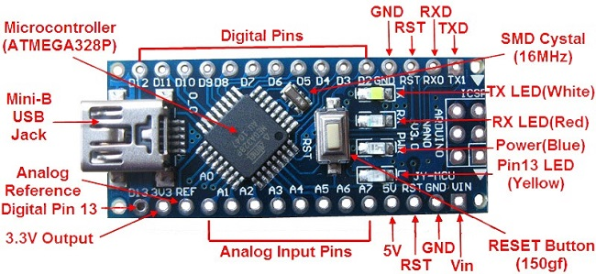
Always turn power off before connecting to PC's USB.
GND
Data Input (DI)
WS2812B Addressable LED strip (12)
3 AA
Battery Pack
5V
Mode switch
Arduino Nano

Slide 2
Sample Moving Rainbow Program
#include <Adafruit_NeoPixel.h>
#define LEDPIN 12 // Connect the yellow data from the LED strip to this pin on the Arduino
#define NUMBER_PIXELS 12 // the number of pixels in your LED strip
Adafruit_NeoPixel strip = Adafruit_NeoPixel(NUMBER_PIXELS, LEDPIN, NEO_GRB + NEO_KHZ800);
int delayTime = 100; // 100 milliseconds = 1/10 of a second
void setup() { strip.begin(); // initialize the strip
}
void loop() { for (int i=0; i<strip.numPixels()-1; i++) { // a for loop where I goes from 0 to 11 rainbow7(i, delayTime); // starting at the index, i, draw the 7 color rainbow pattern and wait the delay time } // each redraws the rainbow over one pixel
}
// a function that draws a seven segment rainbow with red on the highest pixel
void rainbow7(uint16_t i, uint16_t wait) { int np = strip.numPixels(); // we use the modulo function with this number to get the "remainder" after a divide by 12 strip.setPixelColor(i % np, 25, 0, 25); // violet is a bit of red and blue strip.setPixelColor((i+1) % np, 255, 0, 255); // indigo is a LOT of red and blue strip.setPixelColor((i+2) % np, 0, 0, 150); // blue strip.setPixelColor((i+3) % np, 0, 150, 0); // green strip.setPixelColor((i+4) % np, 255, 255, 0); // yellow strip.setPixelColor((i+5) % np, 110, 70, 0); // orange strip.setPixelColor((i+6) % np, 150, 0, 0); // red // we don't need to touch 7, 8 and 9 strip.setPixelColor((i+10) % np, 0, 0, 0); // turn the second to the last one off strip.setPixelColor((i+11) % np, 0, 0, 0); // turn the last one off strip.show(); delay(wait);
}

Slide 3


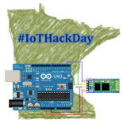
Internet of Things
HackDay
Arduino LED Halloween Costume Design
17th
October
2015
Ann Kelly and Dan McCreary

