Slide 1
Moving Rainbow Artwork Ideas

Slide 2

Moving Rainbow Logo
A rainbow that is moving
with "motion lines"
Stick to the true color order (red, orange, yellow, green, blue, indigo, violet)

Slide 3
Core Principals
Color, Motion, Social
Ideas – kids in a group around a kit with color and motion

Slide 4
Computer Science
variables
for (i=0; i<12;i++) {
setColor(i, red, green, blue)
}
testing
debugging
setup()
functions
loop()
Kids surrounded by the wonders of computers

Slide 5
Fear to in Control
Hey, this is not as hard as I thought!
So complicated!
Where do I start?
By breaking problems down into smaller parts we can concur large tasks

Slide 6
Getting Started
What is an IDE?
You mean it does all that in one program?
Integrated Development Environment
Finding a Program, Editing, Compiling, Uploading, Debugging, Saving

Slide 7
Safety
Will I blow this up?
Some basic does and don'ts
Be careful to avoid short circuits
Don't connect the +5 directly to ground
Don't make arbitrary connections

Slide 8
Circuits Basics
So what is voltage?

Slide 9
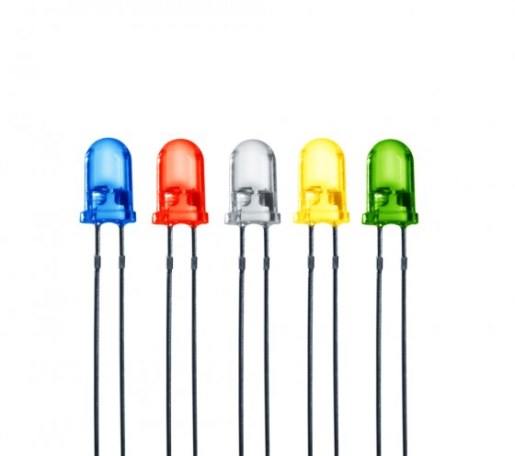
What is an LED?
What is an LED?
Positive and Negative
Anode and Cathode

Slide 10
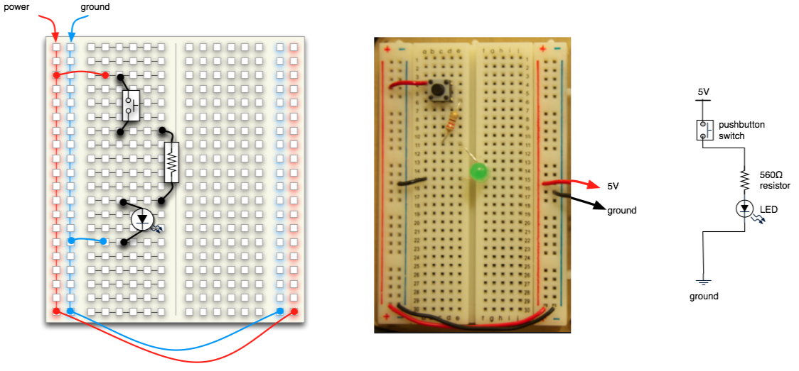

Slide 11
How can I talk to them all with one wire?
36 LEDs with one wire? Really!
+5
Data
In
Data
Out
GND

Slide 12
Blink
Make the first pixel go on and off

