Slide 1
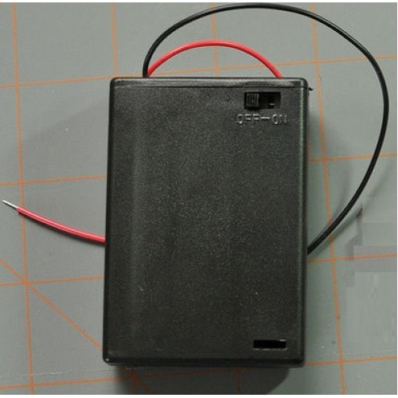


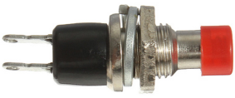
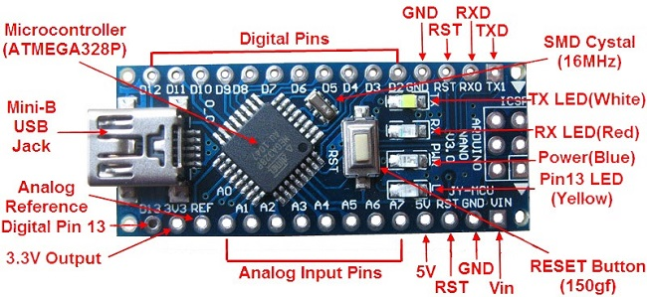
Always turn power off before connecting to PC's USB.
GND
Data Input (DI)
WS2812B Addressable LED strip (12)
3 AA
Battery Pack
5V
Mode switch
Arduino Nano

