Slide 1

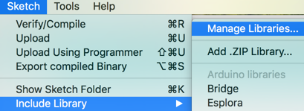


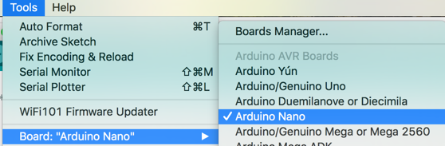
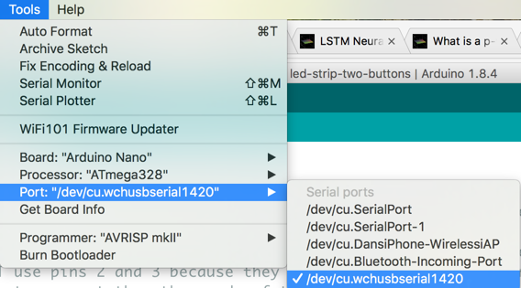
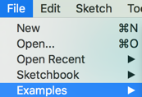

2018 Moving Rainbow LED Kit
Arduino Moving Rainbow
Kit Contents
Arduino Nano (CH340 driver)
1/2 breadboard (400 tie points)
USB cable (mini-b)
60 pixel NeoPixel strip with GND (black), 5v (red) and data (yellow)
2 Momentary push buttons and hookup wire
Wall port to USB 5v adapter
4 AA Battery pack
Step 1: Download the Arduino Integrated Development Environment (IDE)
Download the Arduino IDE software from https://www.arduino.cc/en/Main/Software
Step 2: Install the NeoPixel Library
Step 3: Install the CH340 Driver
Download CH341 driver from: http://www.wch.cn/download/CH341SER_ZIP.html (Chinese)
Step 4: Set the Board to Nano and Port to COM or /dev/cu.wchusbserial1420
Note on Windows the port name is “COM3”
or “COM4”. On a Mac the
Name will be similar to:
/dev/cu.wchusbserial1420
Step 5: Run the NeoPixel Example strandtest
Name | Red | Green | Blue
Yellow | 255 | 255 | 0
Purple | 255 | 0 | 255
Orange | 255 | 165 | 0
Pink | 255 | 200 | 200
Violet | 230 | 130 | 230
Gold | 255 | 215 | 0
Cyan | 0 | 255 | 255
PIN = 12
Number Pixels = 60
Step 6: Open the Moving Rainbow Labs
Open: http://moving-rainbow.readthedocs.io/en/latest/README/

Slide 2
NeoPixel Code Examples
Sample Preamble
#include <Adafruit_NeoPixel.h>
#define LEDPIN 12 // connect the Data from the strip to this pin on the Arduino
#define NUMBER_PIXELS 60 // the number of pixels in your LED strip
Adafruit_NeoPixel strip = Adafruit_NeoPixel(NUMBER_PIXELS, LEDPIN, NEO_GRB + NEO_KHZ800);
Sample Setup
void setup() {
strip.begin(); // initialize all the variables – don’t forget this line!
strip.setPixelColor(0, 255, 125, 0); // set pixel 0 to be yellow
strip.show(); // send the data to the LED strip – must do this after any change
delay(1000); // wait 1 second
}
Sample Moving Pixel
void loop() {
for (int i=0; i<NUMBER_PIXELS; i++) {
strip.setPixelColor(i, 255, 0, 0); // turn the "i"th pixel on
strip.show(); // send the data to the LED strip
delay(100); // wait 1/10th of a second – a lower number makes it go faster
strip.setPixelColor(i, 0, 0, 0); // turn the "i"th pixel off
strip.show(); // send the data to the LED strip
delay(100); // wait 1/10th of a second – a lower number makes it go faster
}
}
Sample Labs
Get the first pixel to flash red on for 1 second and off for 1 second
Change the speed of flashing to be 1/50th of a second on and 1/50th of a second off
How fast can you make the first pixel flash?
Can you change the color of the first pixel (red, green, blue)
Run the other NeoPixel example programs (like strandtest)
Find Moving Rainbow examples
Work though various examples
On moving rainbow github/src find hackday-2018 LED strip two buttons program
Wire button from D2 and D3 (interrupts) to ground through a momentary push button
Try all the modes
Create your own mode pattern
Can you create a game? Can you trap a moving pixel in a “jail” to get a point?
Can you make a single LED “dot” go half way down the strip and change direction?
Look up “Arduino denouncing”. Can you find the debounce code in the examples? What is the
Look up Arduino Interrupt Service Routine on the internet. Find the ISR in the example code.

