Slide 1
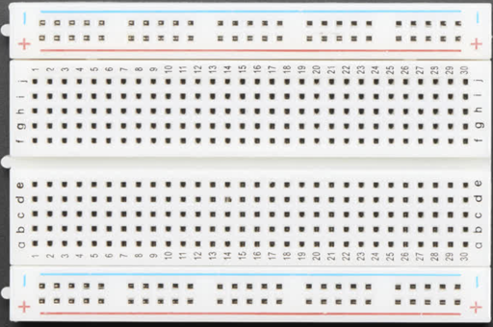
Breadboard Layout
Row Connectors
(Horizontally Connected)
Power Rail Columns
(Vertically Connected)

Slide 2
Basic Circuits

