Slide 1
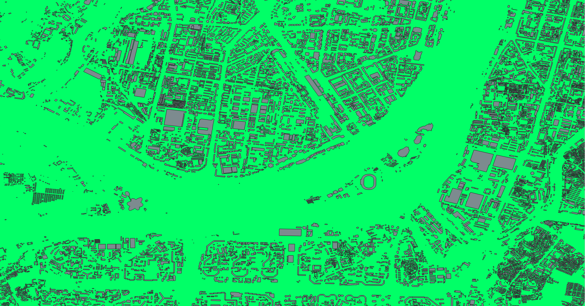
North Korea Various maps of the North Korea
PROJECT WORK Data Analysis course of the PTE TTK
Király Márk

Slide 2
The content of the presentation
PART 1: Brief description of the shapefiles [QGIS]
PART 2: Sparse SQL queries [PostGIS]
PART 3: Transferring the CSV dataset to [Python, PostGIS, QGIS] PostgreSQL with Python and visualizing the results in the QGIS application
PART 4: Analyzing a CSV file with [Python, Pandas, NumPy] Pandas and creating various plots
The datasets, files, and source codes related to the presentations are
all available in my GitHub repository at the following link:
https://github.com/ProgrammerGnome/data-analysis-presentation

Slide 3
PART 1 Brief description of the shapefiles
Visual Representation Key:
Red dot: Railway stations
Green dot: Settlements
Gray line: Roads
Red line: Train tracks
Gray filled shape: Buildings
Light green filled shape: Cities
Another colors filled shape: Borders (admin levels 2, 1, 0)
Categories of Layers:
Points (stations, settlements)
Lines (roads, train tracks)
Polygons (buildings, borders, cities)
The sources of
the dataset:
PostGIS layers: https://data.humdata.org/group/ prk?ext_geodata=1&q=&sort=last_modified%20desc&ext_page_size=25
CSV: https://www.kaggle.com/datasets/fanbyprinciple/north-korea-missile-test-database

Slide 4
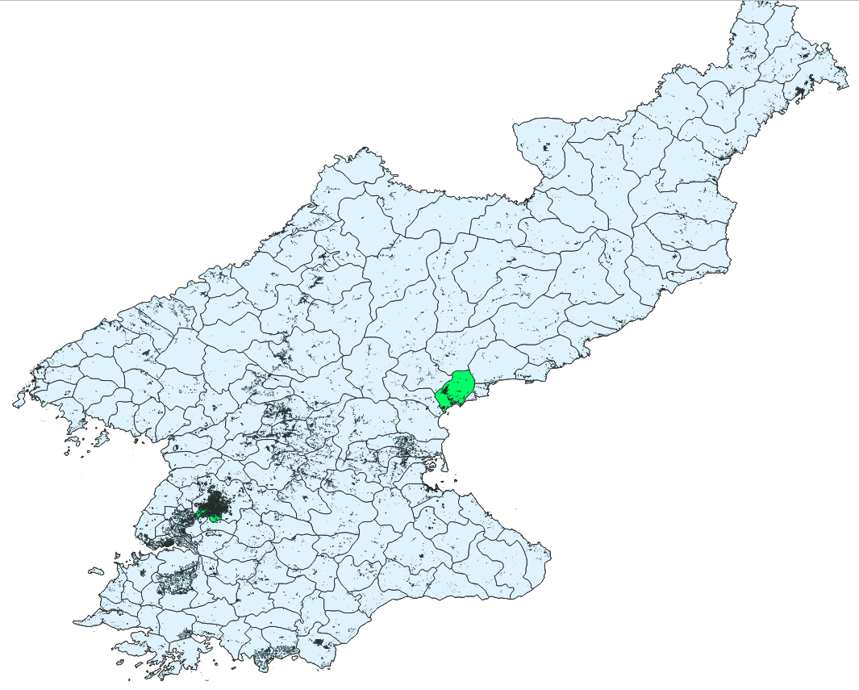
Polygon Layers
Buildings:
Dataset:
hotosm_prk_buildings_polygons_shp
Marker: Gray filled shape
Cities (Greatest):
Dataset:
whosonfirst-data-admin-kp-locality
Marker: Light green filled shape
Borders:
Admin Level 2: prk_admbnda_adm2_wfp_20190624
Admin Level 1: prk_admbnda_adm1_wfp_20190624
Admin Level 0: prk_admbnda_adm0_wfp_20190624

Slide 5
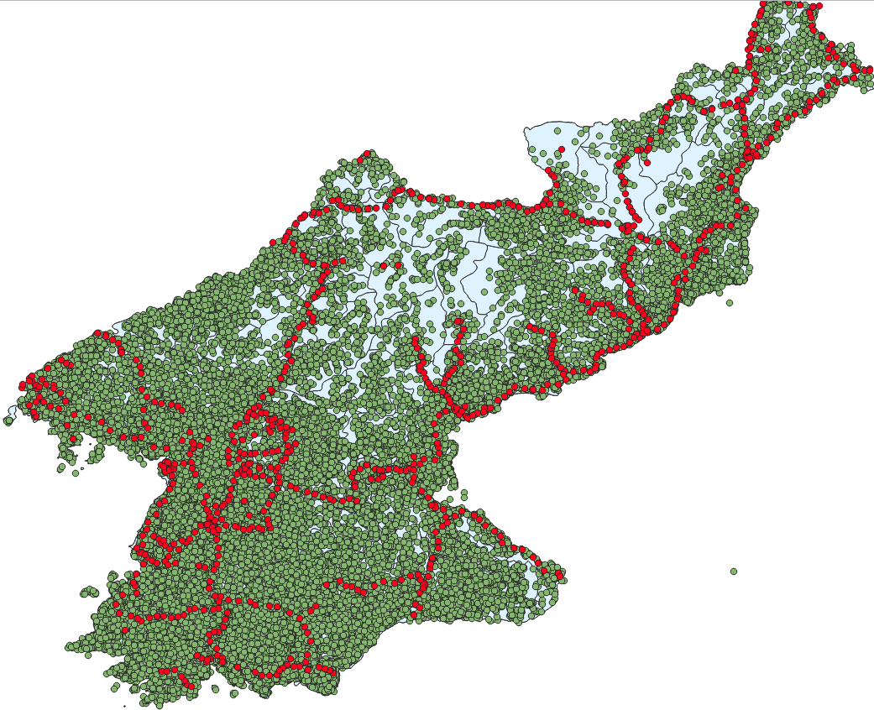
Point Layers
Railway Stations:
Dataset: hotosm_prk_railways_points_shp
Marker: Red dot
Settlements:
Dataset: whosonfirst-data-admin-kp-locality
Marker: Green dot

Slide 6
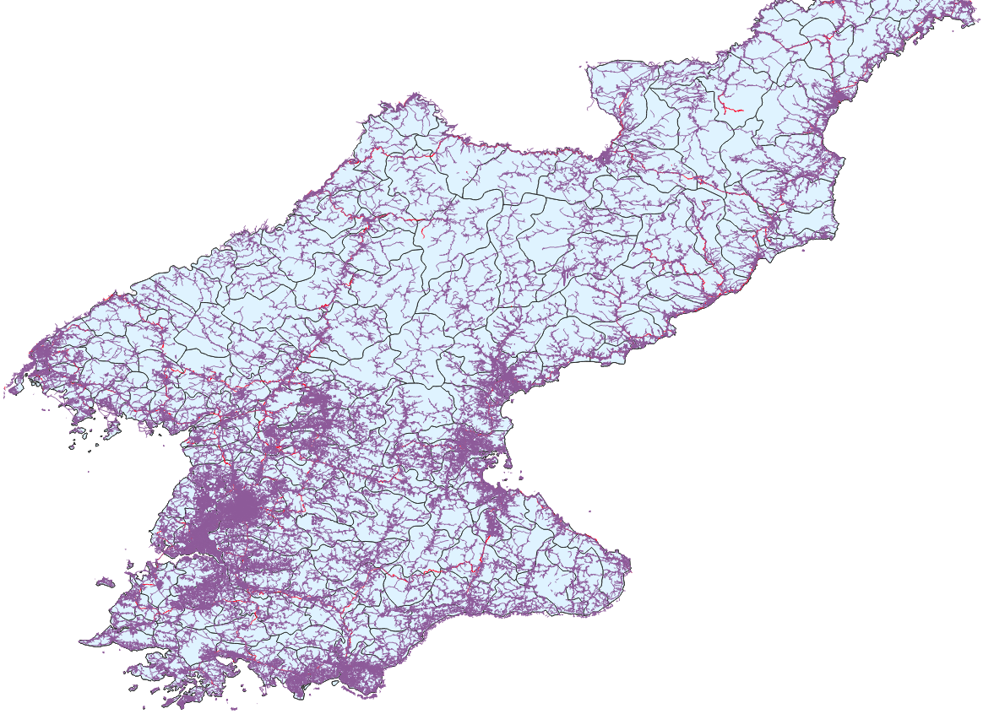
Line Layers
Roads:
Dataset: hotosm_prk_roads_lines_shp
Marker: Gray line
Train Tracks:
Dataset: hotosm_prk_railways_lines_shp
Marker: Red line

Slide 7
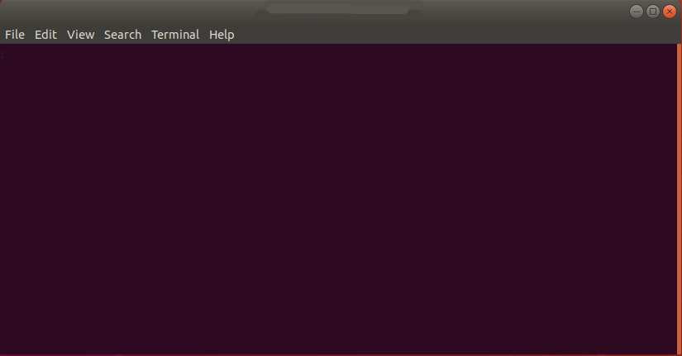
PART 2 Sparse SQL queries
-- Find 10 building polygons that intersect with railway points (railway stations)
-- and copy their data into a new table (railways_buildings)
CREATE TABLE railways_buildings AS
SELECT b.*
FROM buildings_polygons b
JOIN railways_points r ON ST_Intersects(b.wkb_geometry, r.wkb_geometry)
LIMIT 10;
SELECT * FROM railways_buildings;

Slide 8
PART 2 - Sparse SQL queries
-- Find the railway station located near the centroid of the Pyongyang polygon (settlements_polygons.name_hun),
-- then retrieve the building_polygon related to that station, and copy the data into a new table (center_phenjan_station)
-- Search for the railway station and building near the centroid of the Pyongyang polygon
CREATE TABLE center_phenjan_station AS
WITH phenjan_centroid AS (
SELECT ST_Centroid(s.wkb_geometry) AS centroid_geom
FROM settlements_polygons s
WHERE s.name_hun = 'Phenjan'
)
SELECT b.*
FROM phenjan_centroid c
JOIN railways_points r ON ST_DWithin(r.wkb_geometry, c.centroid_geom, 1000)
JOIN buildings_polygons b ON ST_Intersects(r.wkb_geometry, b.wkb_geometry)
ORDER BY ST_Distance(r.wkb_geometry, c.centroid_geom)
LIMIT 1;
SELECT * FROM center_phenjan_station;

Slide 9
PART 2 - Sparse SQL queries
-- Find the settlement (only its Hungarian, English, and Korean names) that is the farthest from the railways_lines
-- and save the data into a new table (isolated_settlement)
CREATE TABLE isolated_settlement AS
SELECT s.name_hun, s.name_eng, s.name_kor
FROM settlements_polygons s
ORDER BY (
SELECT MAX(ST_Distance(s.wkb_geometry, r.wkb_geometry))
FROM railways_lines r
) DESC
LIMIT 1;
SELECT * FROM isolated_settlement;

Slide 10
PART 2 - Sparse SQL queries
-- List all settlements that intersect with the boundaries_lvl1 line and save them into a new table (lvl1_boundaries_settlements)
CREATE TABLE lvl1_boundaries_settlements AS
SELECT s.*
FROM settlements_polygons s
JOIN boundaries_lvl1 b ON ST_Intersects(s.wkb_geometry,b.wkb_geometry);
SELECT * FROM lvl1_boundaries_settlements;

Slide 11
PART 3 Transferring the CSV dataset to PostgreSQL with Python and visualizing the results in the QGIS application
In Python, we extract the settlements names coordinates (and names) a CSV file and save them into a new table in a PostgreSQL database.
Finally, we display them using QGIS.
EXPERIMENT:
Hypothesis: These facilities must have a railway station or at least a railway line nearby.
Using Python, we extract data from the tables associated with the layers to determine:
Whether there is a station within a 10 km radius of the given settlement.
Whether there is a railway track within a 10 km radius.
We then combine and visualize these results in QGIS!

Slide 12
PART 3 Transferring the CSV dataset to PostgreSQL with Python and visualizing the results in the QGIS application
The Python code used to process the CSV file and load it into the database.
https://github.com/ProgrammerGnome/data-analysis-presentation/blob/main/ DataAnalysis_project_Mark.py
Using the following SQL queries and table creation scripts can I implement the filtering mentioned on the previous slide.
https://github.com/ProgrammerGnome/data-analysis-presentation/blob/main/ SQL-scripts/facility_near_railway_buildings.sql
(not working ?=> data issue?)
https://github.com/ProgrammerGnome/data-analysis presentation/blob/main/ SQL-scripts/facility_near_railway_points.sql
https://github.com/ProgrammerGnome/data-analysis-presentation/blob/main/ SQL-scripts/facility_near_railway_lines.sql

Slide 13
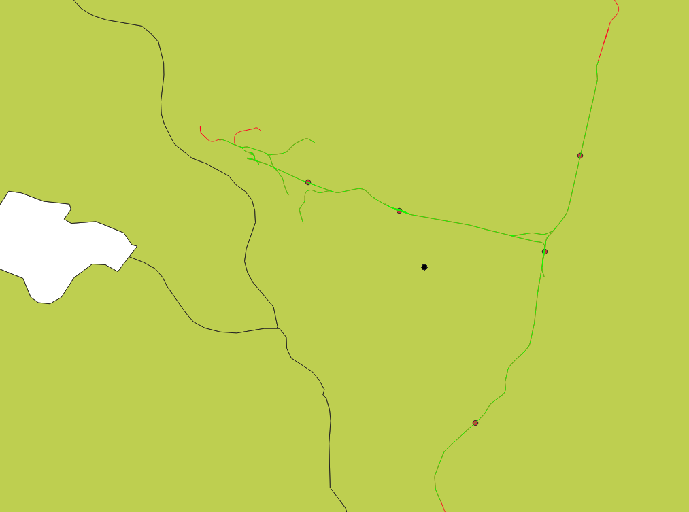
PART 4 Visualize the result in QGIS
normal
railway
normal railway
settlements from the facility 10 km range
missile facility
railway from the facility 10 km range

Slide 14
PART 5 Analyze the CSV with Pandas
In the previous slides, we discussed missile facilities. While we’re at it, let’s explore a few additional interesting aspects related to them.
Using Pandas, we will now create a few charts based on the CSV data inserted into PostgreSQL.
The source code:
https://github.com/ProgrammerGnome/data-analysis-presentation/blob/main/ DataAnalysis_project_Mark.ipynb

Slide 15
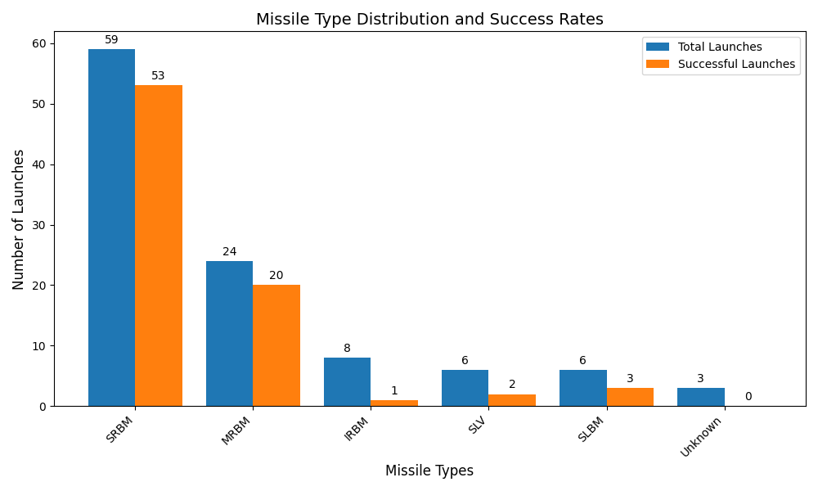

Slide 16
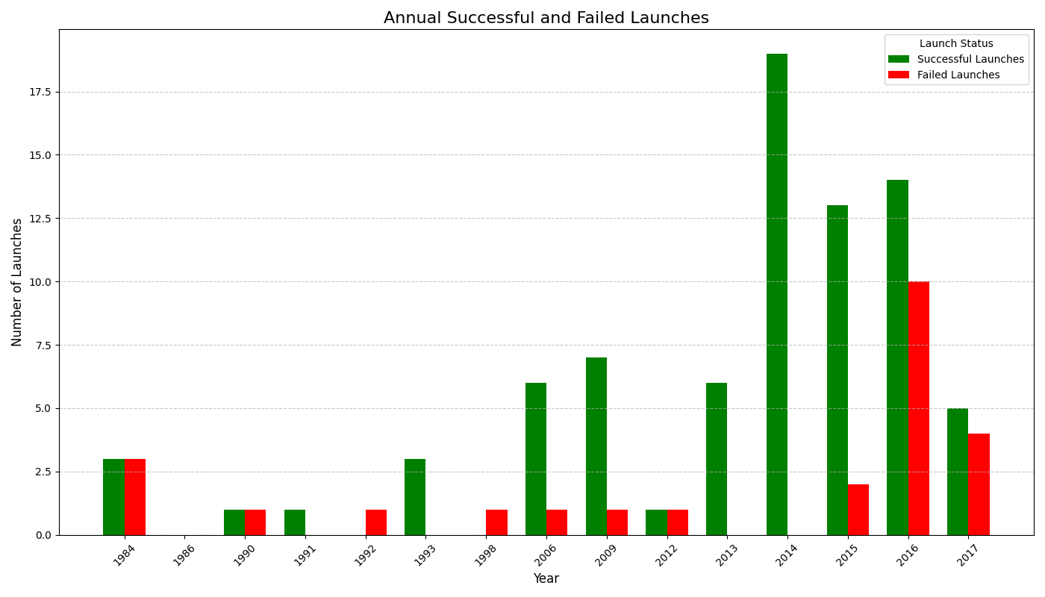

Slide 17

Thank you for your attention!

