Slide 1

FinBridge AI
An AI financial copilot helping students and families plan tuition, manage money and navigate cross-border funding.
Notes:
Dark cover: wallet-to-university movement and growing funding bars. Only product name and one sentence appear as textual content.
Introduce FinBridge AI as a student and family finance project. It combines planning, simulated remittances and a tool-based AI copilot. All payment flows are sandbox simulations; no real money is moved.
Repository evidence: README.md; public/brand/mark.svg
This dark visual edition uses explicit example data and staged workflow animations. The story is an illustrative scenario, not an interviewed person. All payments and quotes are sandbox simulations. Captures labeled Actual demo UI show the local demo interface. Native charts and numeric labels remain editable.

Slide 2
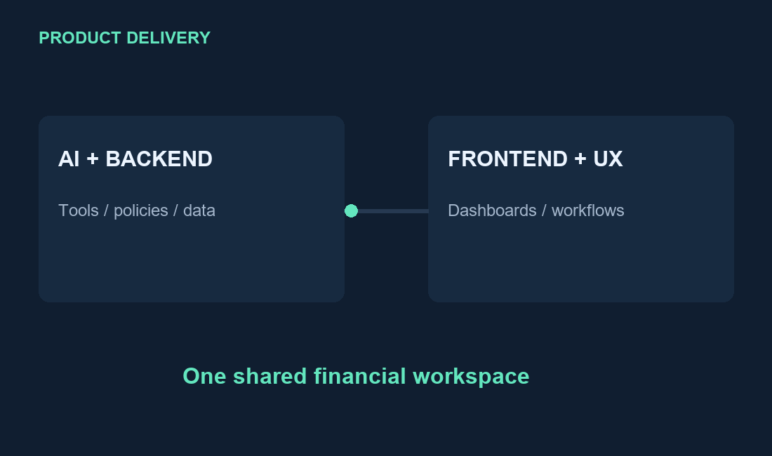
DEVELOPER INTRODUCTION
The team behind FinBridge AI
Developer 1
Developer 2
AI & Backend
Frontend & UX
Demo portraits, names and roles — replace with your team.
FINBRIDGE AI
10 / 10
Notes:
Two editable circular demo portraits with placeholder names and suggested roles. The user requested demo details to replace manually. These are not verified repository contributor identities. Use Change Picture, and crop replacement photos to oval. The delivery diagram connects AI/backend work to frontend/UX work.
These are demo avatars and suggested role placeholders, explicitly requested by the user. They do not identify actual repository contributors and must not be presented as verified authorship. To replace a portrait, select the circular picture and use Change Picture. The PNG contains a circular portrait with transparent corners; apply Crop to Shape > Oval to any replacement photo. All name and role fields are normal editable PowerPoint text boxes.
Repository evidence: User instruction: keep developer details demo for manual replacement; README.md project identity
This dark visual edition uses explicit example data and staged workflow animations. The story is an illustrative scenario, not an interviewed person. All payments and quotes are sandbox simulations. Captures labeled Actual demo UI show the local demo interface. Native charts and numeric labels remain editable.

Slide 3
PROBLEM STATEMENT
A bank balance is not tuition readiness.
TUITION FUNDING BRIDGE
40,000
40k
33,250
83%
30k
27,500
funded
20k
10,000
10k
4,250
UNFUNDED TUITION
0k
CNY 6,750
Now
+ Income
− Living
Projected
Tuition
CNY · two-month example · scholarship = 0
Living costs, future income and transfer fees all change what a student can actually afford.
Notes:
Example is proportional to the tuition-gap unit test: available CNY 27,500 + two months of CNY 5,000 income - two months of CNY 2,125 living costs = CNY 33,250. Tuition CNY 40,000 leaves CNY 6,750 gap and CNY 3,375 per-month additional target. The readiness figure is 83.125%, displayed as 83%. Formula: src/lib/money.ts fundingGap; tests/finance.test.ts. No real-person outcome is claimed.
Frame the problem using the workflows implemented in this repository rather than unsourced market statistics. The project targets international students, parents and educational sponsors.
Repository evidence: README.md; src/services/tuition.service.ts; src/services/remittance.service.ts; src/services/parent-controls.service.ts
This dark visual edition uses explicit example data and staged workflow animations. The story is an illustrative scenario, not an interviewed person. All payments and quotes are sandbox simulations. Captures labeled Actual demo UI show the local demo interface. Native charts and numeric labels remain editable.

Slide 4
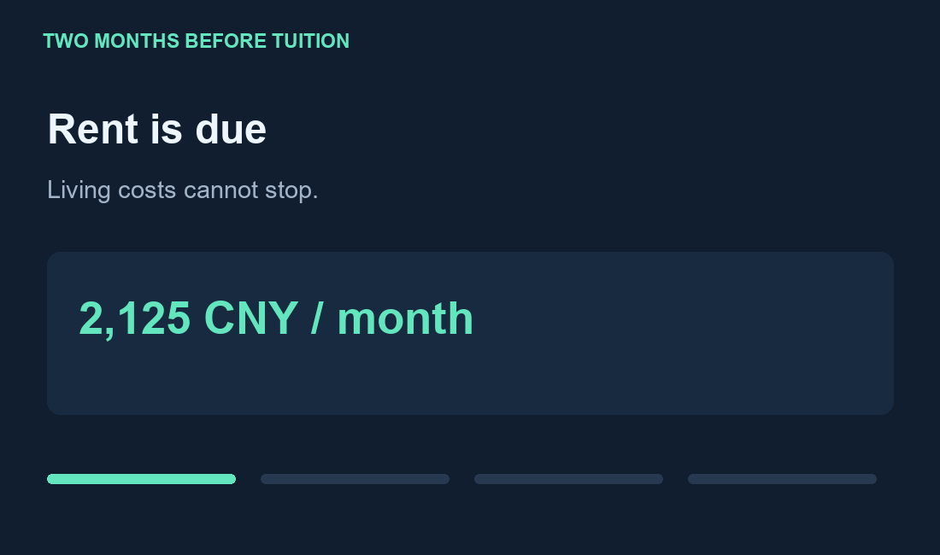
REAL-WORLD STRUGGLES
Real-world struggles: one deadline, two countries.
Illustrative scenario: a Bangladeshi student in China must keep paying living costs while preparing tuition.
FUNDING RUNWAY · CNY
Extra savings needed
3,375 / mo
Rent continues
Family funds in BDT
Tuition approaches
CNY 2,125 / month
Compare total FX cost
Close the CNY 6,750 gap
FINBRIDGE AI
03 / 10
Notes:
A real-world struggle scenario, explicitly illustrative rather than a documented case study. The chart uses the same inputs and exact formula as slide 2. Funding is CNY 27,500 initially, CNY 30,375 after one month and CNY 33,250 after two. The tuition line remains CNY 40,000. Student expenses, a parent funding from Bangladesh and a fixed tuition deadline motivate the app modules. No invented prevalence or survey statistics are used. Sources: README.md; src/lib/money.ts; src/services/tuition.service.ts; src/services/remittance.service.ts; src/actions/parent.actions.ts.
This dark visual edition uses explicit example data and staged workflow animations. The story is an illustrative scenario, not an interviewed person. All payments and quotes are sandbox simulations. Captures labeled Actual demo UI show the local demo interface. Native charts and numeric labels remain editable.

Slide 5
OUR SOLUTION
See the gap. Compare the cost. Coordinate the funding.
One workspace links tuition planning, cross-border comparison, parent approval and payment evidence.
SEND BDT → RECEIVE CNY 6,750
FUNDING GAP
Extra sender cost vs lowest quote | BDT
CNY 6,750
LOWEST DEMO QUOTE
BDT 115,434
QUOTE DIFFERENCE
BDT 2,914
Extra cost vs lowest quote | sandbox seed rates | fees + spread included
Plan
→
Compare
→
Approve
→
Record
Tuition + budget
Fees + FX
User + parent
Receipt + ledger
FINBRIDGE AI
04 / 10
Notes:
Provider comparison is computed with the actual repository formula, seeded provider fees and seeded rates CNY 5.21 / BDT 88.5. Target receipt is CNY 6,750. Principal = receipt / (targetRate/sourceRate * (1-spread)), rounded to cents; total = principal + principal*percentage_fee + fixed_fee. Providers and seed settings from scripts/generate-demo.mjs. These are sandbox seed values, not current market quotes. Bars show additional sender cost relative to the lowest demo quote; zero means no extra cost versus that baseline. Full exact values are in presentation/dark-assets/chart-data.json. Native workflow nodes show the product solution.
The same payment backend is reused by student, parent and AI workflows. Shared experience includes onboarding, preferred currency, language, time zone, notifications, theme, search, subscriptions, saved demo cards and personal model settings. The platform is a sandbox with manual external settlement.
Repository evidence: src/actions/dashboard.actions.ts; src/components/layout/shell.tsx; src/actions/preferences.actions.ts; src/services/payment.service.ts; IMPLEMENTATION_STATUS.md
This dark visual edition uses explicit example data and staged workflow animations. The story is an illustrative scenario, not an interviewed person. All payments and quotes are sandbox simulations. Captures labeled Actual demo UI show the local demo interface. Native charts and numeric labels remain editable.

Slide 6
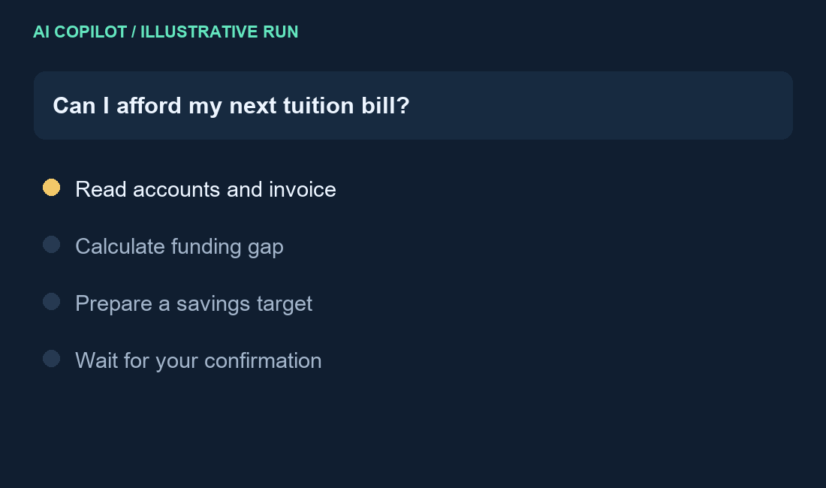
OUR IMPLEMENTATION / AI FIRST
The AI turns financial questions into reviewed actions.
Application-owned tools ground the answer; confirmation and server checks control execution.
APPLICATION TOOL GRAPH
getAccounts + getWorkspaceData
Balances, invoice and spending
calculateTuitionGap
CNY 6,750 gap → CNY 3,375 / month
requestAction → confirmAgentAction
Structured proposal → explicit review
Gemini · OpenAI · deterministic mock
React / Next.js
→
AI + Zod
→
Server Actions
→
MySQL ledger
User workspace
Validated tools
Auth / role / risk
Locks / idempotency
FINBRIDGE AI
05 / 10
Notes:
Combined implementation slide retains AI emphasis while making room for the real-world-struggles slide. The animated tool run is an illustrative reproduction of implemented tool and review behavior, not a recording of a live provider call. Exact tool names appear in src/ai/tools/index.ts and src/ai/action-catalog.ts. Confirmed non-financial proposals dispatch through src/actions/agent-workflow.actions.ts; money requests reuse src/services/payment.service.ts. Stack: Next.js/React/TypeScript, Zod, MySQL, Decimal.js. Chat can read authorized application context, compare providers, propose budgets and funding plans, draft payments, navigate and ask follow-ups. Financial execution requires confirmation. Tool logs and action state persist.
Primary AI capabilities: getStudentProfile, getAccounts, analyseTransactions, calculateTuitionGap, compareRemittance, getFxRates, generateBudgetSuggestion, analyseFinancialHealth, getCreditGuidance, getWorkspaceData, assessPaymentRisk, draftPayment, beneficiary tools, requestAction and respond. The role-checked catalog also supports account, transaction, budget, tuition, alert, credit, family, preference, report and subscription tasks. Financial execution requires explicit UI confirmation. Some approved low-impact tools may create drafts, beneficiaries or alerts; do not claim the model is universally read-only. The chart is a deliberately simplified illustrative plan, not a live account or measured result.
Repository evidence: src/ai/tools/index.ts; src/ai/action-catalog.ts; src/ai/mock-provider.ts; src/ai/gemini-provider.ts; src/ai/openai-provider.ts
This dark visual edition uses explicit example data and staged workflow animations. The story is an illustrative scenario, not an interviewed person. All payments and quotes are sandbox simulations. Captures labeled Actual demo UI show the local demo interface. Native charts and numeric labels remain editable.

Slide 7
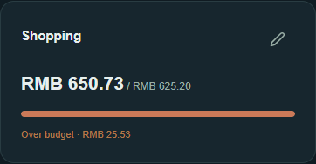
FEATURES / STUDENT
Student features
Track everyday money, plan tuition and act with the AI copilot.
Accounts & activity
BUDGET VS SPENDING · CNY
Multi-currency wallets, cash, transactions, categories, search/filter, CSV mapping/import.
Tuition & planning
Invoices, scholarships, deadlines, savings scenarios, category budgets, credit guidance.
Payments & transfers
FX/providers, quotes, sends, top-ups, manual deposits, withdrawals, recipients and receipts.
AI copilot
Chat/tool history, advice, follow-ups, navigation, reviewed actions and model selection.
Illustrative monthly budget: housing is CNY 100 over plan.
Family & notifications
Invitations, recipient/transfer approvals, reminders, alerts/snooze and ledger history.
ACTUAL DEMO UI
Personal account
Category progress
and overspend alerts
Plans/quotas/history, saved cards/models, profile/security, reports, export and closure.
3 languages · themes · country/currency · time zone · search
FINBRIDGE AI
06 / 10
Notes:
The native chart is illustrative, using monthly expenses CNY 1,500 housing + 450 food + 175 transport = 2,125. The shopping card is an actual screenshot from the local demo, separate from the illustrative scenario; its amounts are not part of the story dataset. Shared account preferences include language, theme, country, currency, timezone and notification choices. Monthly/annual sandbox subscriptions, cancellation/history, CSV limits/preview/atomic rollback, photo/password settings, data export and closure remain implemented. All original capability detail is retained below.
Student feature inventory: account creation/rename/archive; separate cash and payment wallet semantics; manual categorized transactions and confidence display; pagination/filtering; CSV file and row limits, mapping and preview; budget creation/edit, mixed-currency normalization and AI suggestions; tuition paid and scholarship tracking, monthly funding plans and readiness; educational credit profile and country-specific checklist; FX charts/provider comparisons, locked quotes and reviewed legacy sandbox execution; unified internal/card/manual/external payment requests and beneficiary approvals; saved card management; payment statuses, cancellation, receipts, ledger and audit activity; AI providers, personal keys, selection and tests; family invitation acceptance; automatic alerts and user reminders; subscription quotas, monthly/annual sandbox checkout, change history and cancellation; support reports; profile photo/name/email, password reset/change, locale/country/currency/time zone/theme/notifications; data export and account closure. The mini bars are illustrative visual cues.
Repository evidence: src/actions/; src/components/accounts/; src/components/tuition/; src/components/budget/; src/components/payments/; src/components/layout/utility-pages.tsx; src/components/settings/platform-panels.tsx
This dark visual edition uses explicit example data and staged workflow animations. The story is an illustrative scenario, not an interviewed person. All payments and quotes are sandbox simulations. Captures labeled Actual demo UI show the local demo interface. Native charts and numeric labels remain editable.

Slide 8
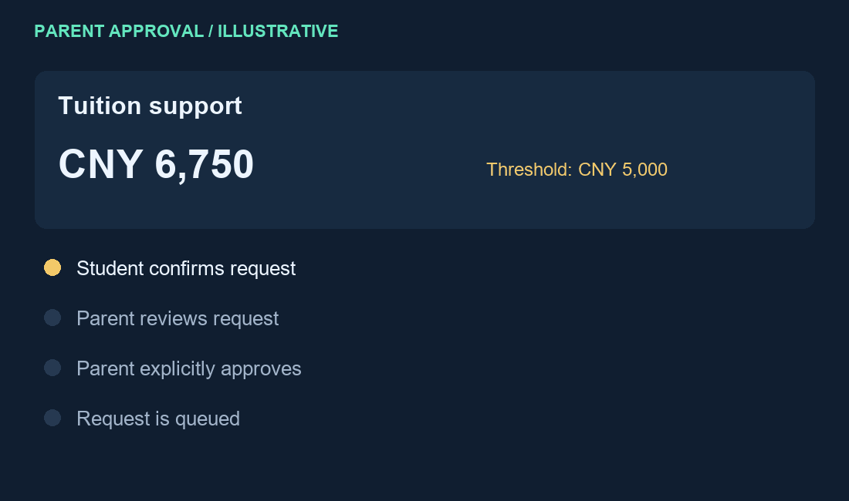
FEATURES / PARENT
Parent features
Support the student with scoped visibility, clear approval rules and spending limits.
Family circle
TRANSFER REVIEW BOUNDARIES · CNY
Invite/link students, review linked finances and revoke relationships.
Visibility matrix
Balances, category totals, descriptions, tuition, budgets and permission-aware alerts.
Approval center
Approve/reject payments and beneficiaries; reasons/history; tuition/conversion sign-off.
Spending controls
Thresholds, transfer/daily/monthly caps, category limits, auto-approval and one-time recipients.
Parent money & AI
Own wallets, student funding, deposits/payments, transactions/CSV and reviewed AI actions.
Shared account tools
Plans, cards/models, alerts/reports, profile/security, preferences, export and closure.
Parent policies can tighten platform limits.
FINBRIDGE AI
07 / 10
Notes:
Illustrative threshold CNY 5,000, request CNY 6,750 and per-transfer cap CNY 10,000. The request exceeds the approval threshold but stays below the hard cap, so it needs parent review rather than automatic rejection (other policy checks still apply). The animation is a state demonstration, not a real transfer. Parent authorization is explicit; the model cannot approve by itself. The strongest applicable parent policy wins, and parents cannot relax platform risk limits.
Parent functions include linking and revocation, configurable visibility, parent-owned financial accounts and wallet transfers, transaction recording and CSV imports under role ownership, approval decisions and history, beneficiary decisions, controls for tuition/conversion, caps and thresholds, non-beneficiary policy and category limits. Strictest applicable parent policy wins and can only tighten administrator ceilings. Parent AI actions are restricted by the role catalog; the model does not approve by itself. Parent access to automatic alerts respects visibility. Parent subscriptions, cards, models and preferences share the customer workflow. Illustrative bars show nested policy constraints, not measured amounts.
Repository evidence: src/actions/parent.actions.ts; src/services/parent-controls.service.ts; src/services/payment.service.ts; src/ai/action-catalog.ts; src/components/family/family-page.tsx; src/services/automatic-alerts.service.ts
This dark visual edition uses explicit example data and staged workflow animations. The story is an illustrative scenario, not an interviewed person. All payments and quotes are sandbox simulations. Captures labeled Actual demo UI show the local demo interface. Native charts and numeric labels remain editable.

Slide 9
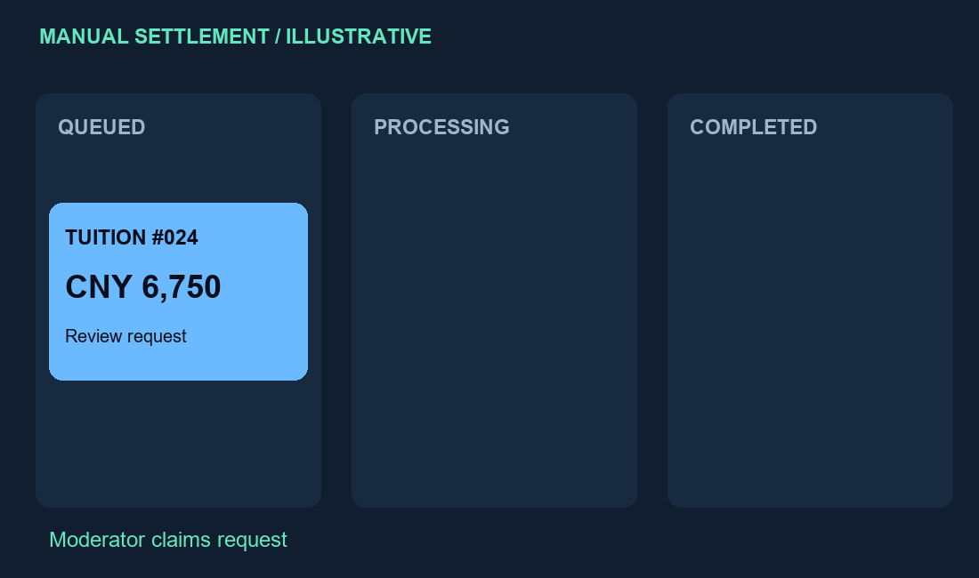
FEATURES / ADMIN & MODERATOR
Admin features
Configure the sandbox, resolve requests and inspect the evidence behind each financial action.
Users & roles
User/role management, suspend/reactivate, metrics and delegated moderator scopes.
Manual settlement
Claim/process/complete/fail, payout references, held funds/refunds and receiving details.
Financial configuration
Risk/frequency ceilings, FX, providers/fees/spreads/routes and credit guidance.
Catalog & subscriptions
Countries/currencies, defaults/settings, pricing, quotas and feature limits.
EXAMPLE QUEUE SNAPSHOT
AI & platform team
Shared models/keys, connection tests, run/tool inspection and published team profiles.
Reports & evidence
Resolve reports; audit logs, transfer receipts, project and security evidence exports.
Moderator access is limited to assigned sections.
FINBRIDGE AI
08 / 10
Notes:
Queue counts 6, 2 and 12 are illustrative snapshot values, not production metrics. Animated card shows manual queue progression with a reference and receipt, with no actual transfer execution. Admin uses role-restricted settlement service, provider/catalog/risk/plan controls and evidence inspection. Moderator delegations and team publishing remain in the feature list. Source code and original detailed inventory follow.
Administrator features verified against admin.actions.ts, platform.actions.ts, payment.actions.ts, admin-page.tsx and financial-config.tsx. Moderator delegations cover reports, team, agent, models, users, finance and catalog; access is individually checked. Team editing includes publishing, designation and CEO designation, profile photo and limited moderator self-edit. Settlement actions are role restricted. Financial controls include risk caps, provider and route settings and country-specific credit education. Reporting and evidence are application artifacts, not independent compliance certification.
Repository evidence: src/actions/admin.actions.ts; src/actions/platform.actions.ts; src/actions/payment.actions.ts; src/components/admin/; src/lib/admin-permissions.ts; src/components/layout/evidence-page.tsx
This dark visual edition uses explicit example data and staged workflow animations. The story is an illustrative scenario, not an interviewed person. All payments and quotes are sandbox simulations. Captures labeled Actual demo UI show the local demo interface. Native charts and numeric labels remain editable.

Slide 10
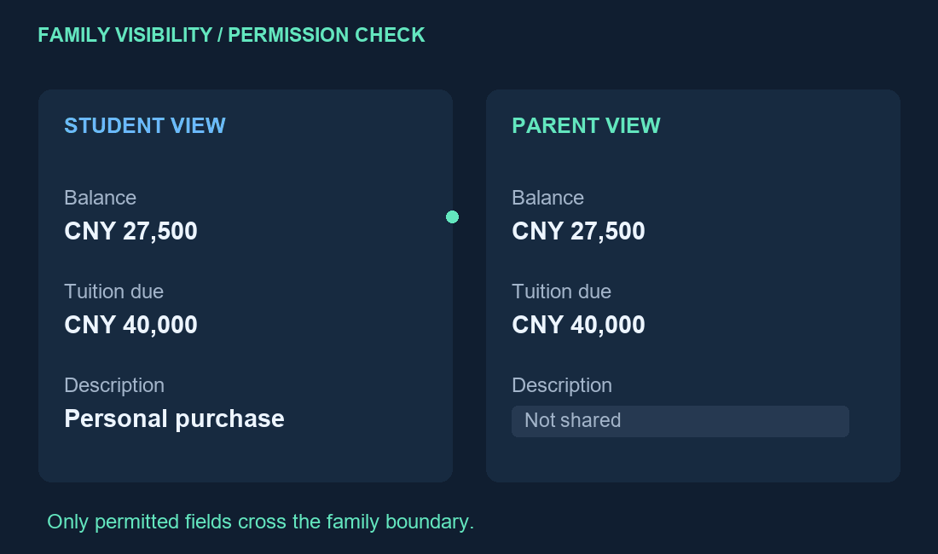
SECURITY & PRIVACY
Security & privacy
Controls are applied to each action and each field of financial context.
01
IDENTITY
bcrypt hashes; signed sessions; revocation.
02
ACCESS
Role + ownership checks; parent permissions.
03
AI & SECRETS
AES-256-GCM model keys; validated tools.
04
MONEY INTEGRITY
Confirmation, locks, tokens, balanced ledger.
Data export · Account closure · No stored full PAN/CVV · Selected AI context may reach the configured provider
FINBRIDGE AI
09 / 10
Notes:
The animation demonstrates the existing permission matrix: a parent may see balances and tuition while transaction descriptions remain hidden. It does not imply a specific demo account has these permissions. Encrypted-key handling is for AI API keys, not a claim that all financial data is encrypted. User closure revokes access but is not an erasure promise. Fields sent through AI tools may reach the configured provider. Controls are implemented; no independent certification is claimed.
Security claims are code-level controls, not a certification. session.ts uses HS256, 8-hour JWT expiry, httpOnly, SameSite lax and production secure cookies; auth.ts verifies session_version. Passwords use bcrypt. secrets.ts encrypts AI keys using AES-256-GCM. Parent permissions govern disclosure. Avatar validation in current src/lib/avatar.ts accepts PNG/JPEG/WebP data URLs, checks signatures and enforces 300,000 bytes; README describes a different limit, so the slide deliberately makes no size claim. Profile export is capped per table and is not an exhaustive privacy portability certification. Account closure changes status and revokes sessions/links; it is not an erasure promise. AI adapters send selected conversational/tool context to the configured provider. No claim is made that all financial data is encrypted at rest. Legacy sandbox transfer uses locked quotes and single-use execution tokens. Unified payment path uses idempotency, transactional locking and policy checks. No fresh audit was run for this deck.
Repository evidence: src/lib/session.ts; src/lib/auth.ts; src/lib/secrets.ts; src/lib/avatar.ts; src/lib/permissions.ts; src/lib/risk-engine.ts; src/actions/user.actions.ts; src/services/sandbox-payment.service.ts; src/services/payment.service.ts; src/ai/
This dark visual edition uses explicit example data and staged workflow animations. The story is an illustrative scenario, not an interviewed person. All payments and quotes are sandbox simulations. Captures labeled Actual demo UI show the local demo interface. Native charts and numeric labels remain editable.

