Slide 1
Feature Selection for High Dimensional Data Using Weighted K-Nearest Neighbours and Genetic Algorithm

Slide 2
Introduction

Slide 3
Feature selection is an important task in machine learning and data science.
It is the process of selecting a subset of features from a larger set of features that are present in a dataset.
The selection of features has a great impact on the model performance, since it affects the accuracy and interpretability of the model.
In this project, we will use the weighted k-nearest neighbours and genetic algorithms to select the most relevant features from a dataset.

Slide 4
PROBLEM STATEMENT

Slide 5
The feature selection problem is an important task in machine learning and data science. It is the process of selecting a subset of features from a larger set of features that are present in a dataset. Feature selection helps to reduce the complexity of data and enables a more accurate and efficient analysis.
In this project, we will use the weighted k-nearest neighbors and genetic algorithms to select the most relevant features from Prostate cancer dataset. We will compare the results of the two methods and evaluate their performance. Like here we are required to understand that whether the number of features our dataset possesses when applied to algorithm are enough to allow us inform the patients about the cancer accurately or not.

Slide 6
Dataset

Slide 7
Prostate Cancer Dataset
This is the dataset of 100 patients to implement the machine learning algorithm and thereby interpreting results. The data set consists of 100 observations and 10 variables, out of which 8 numeric variables and one categorical variable and is ID.
There are ten columns or features in the Prostate cancer dataset, which includes
information on 100 prostate cancer patients. The radius, texture, perimeter, area, and
smoothness are the first five features that are related to the physical characteristics of
the prostate tumor. The span highlight alludes to the typical separation from the
middle to the edge of the cancer, while the surface element depicts the variety in dark
level power inside the growth. The edge highlight addresses the length of the cancer
limit, and the region include relates to the all out region involved by the growth. At
last, the perfection highlight addresses the variety in cancer limit distances.

Slide 8
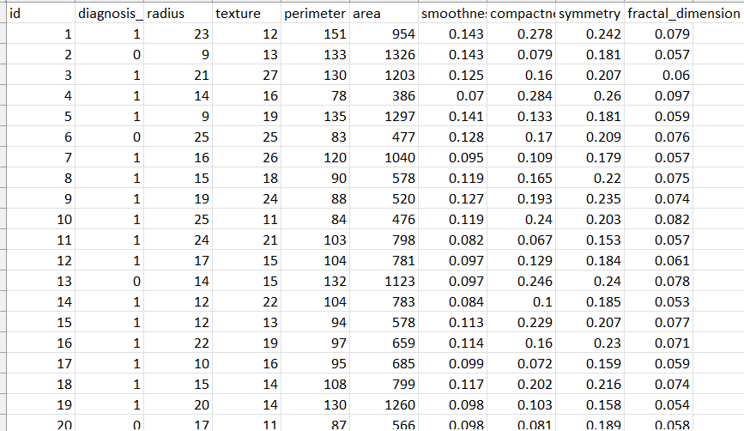

Slide 9
Working Principle

Slide 10
> WKNNGAFS algorithm is mainly composed of five parts: initial population, calculating prediction of training samples, calculation of individual fitness, performing genetic operators and finally obtaining optimal weight vector.
> For the Prostate malignant growth dataset or simply Prostate cancer dataset with 100 lines and 10 segments, the WKNN and GA procedures will be utilized to distinguish the most educational elements for anticipating the analysis aftereffect of prostate disease patients. The classification model is likely to rely heavily on the tumor's radius, perimeter, and area as physical characteristics. In any case, the WKNN and GA methods can likewise recognize different elements that might be more subtle yet at the same time useful for the arrangement task, for example, the surface and fractal aspect of the growth. A classification model for the prostate cancer dataset that is both more accurate and more effective can be developed by utilizing WKNN and GA for feature selection.
Finally, we use the selected subset of features to train a classification model.

Slide 12
Implementation

Slide 13
We implemented the feature Selection for High Dimensional Data Using Weighted K-Nearest Neighbors and Genetic Algorithm over Prostate Cancer Database with following steps:
1.Preprocessing: The dataset needs to be preprocessed to remove any missing values, normalize the data, and split it into training and testing sets.
2.Feature selection using WKNN: The WKNN approach can be used to assign weights to each feature based on their relevance to the classification task. This involves selecting the value of k and calculating the weight of each feature based on its distance to the k-nearest neighbors.
3.Feature selection using GA: The GA approach involves defining a fitness function that measures the performance of the classification model using a given set of features. The GA algorithm then iteratively selects the best set of features that maximize the fitness function.
4.Hybrid approach: A hybrid approach can be used to combine the benefits of both WKNN and GA approaches. In this approach, the WKNN technique can be used to identify a subset of features, which can then be further optimized using GA.
5.Evaluation: The selected features can be used to train a classification model, such as logistic regression, support vector machine, or random forest. The performance of the classification model can then be evaluated using metrics such as accuracy.

Slide 14
Result
14

Slide 15
Diagnosis_result: We discovered that the following features, which are already present in our dataset, have a significant impact on drawing conclusions for any patient with this kind of cancer: This component gives data about the conclusion of malignant growth, which is many times the main variable for order.
Radius: The tumor's size can be an important criterion for classification thanks to this feature.
Texture: This characteristic provides information about the tumor's uniformity, which can be a useful classification factor.
Perimeter: This component gives data about the state of the growth, which can be a significant element for order.
Area: The tumor's size can be an important criterion for classification thanks to this feature.
Smoothness: This element gives data about the perfection of the growth limit, which can be a helpful variable for order.
Symmetry: This characteristic provides information about the tumor's symmetry, which may play a significant role in classification.

Slide 16
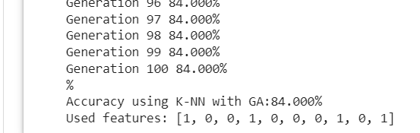
Compactness: This characteristic provides information about the tumor's compactness, which can be a useful classification factor.
Dimension of a fractal: This characteristic reveals the tumor's complexity, which may play a significant role in classification.
Therefore, we achieved a notable accuracy of 84.00% by implementing our code with the dataset.

