Slide 1
OpenFOAM CPU Optimisation
Gadi Baseline and Scaling
2026 APAC HPC-AI Competition · validated baseline
Notes:
[Sources]
Structured data: data/results/gadi_baseline_validated.json

Slide 2
Task definition
The score is the raw 4-node simpleFoam ClockTime; scaling uses normalised per-step timing.
›
occDrivAerStaticMesh · official 65,334,765-cell mesh
›
simpleFoam · OpenFOAM v2512
›
Official workloads: 40 / 80 / 150 SIMPLE iterations on 1 / 2 / 4 nodes
›
Official score: 4-node simpleFoam ClockTime
Notes:
[Sources]
Task rules supplied by user; baseline data: data/results/gadi_baseline_validated.json

Slide 3
Fixed scientific workload
Performance experiments may change the execution environment, not the science.
Locked
Optimisation space
›
Mesh
›
Compiler and build flags
›
simpleFoam source
›
MPI and communication settings
›
fvSchemes
›
Rank placement and CPU binding
›
fvSolution.fixedIter
›
Domain decomposition
›
Scientific work per SIMPLE step
Notes:
[Sources]
Task rules supplied by user.

Slide 4
Execution model
The same fixed workload is decomposed across increasing MPI resources.
65M mesh
→
decomposePar
→
MPI subdomains
→
simpleFoam
→
ClockTime
Scaling analysis measures average seconds per SIMPLE step - not raw ClockTime.
Notes:
[Sources]
Task rules supplied by user; metric definitions: .codex/skills/openfoam-slides/references/metric_definitions.md

Slide 5
Gadi baseline configuration
Each validated run uses the official fixedIter workload and 48 MPI ranks per node.
OpenFOAM
MPI
CPU
v2512
OpenMPI 4.1.7
Intel Xeon Platinum 8274
Ranks/node
Status
48
Validated
Notes:
[Sources]
Structured data: data/results/gadi_baseline_validated.json; CPU information supplied by user.

Slide 6
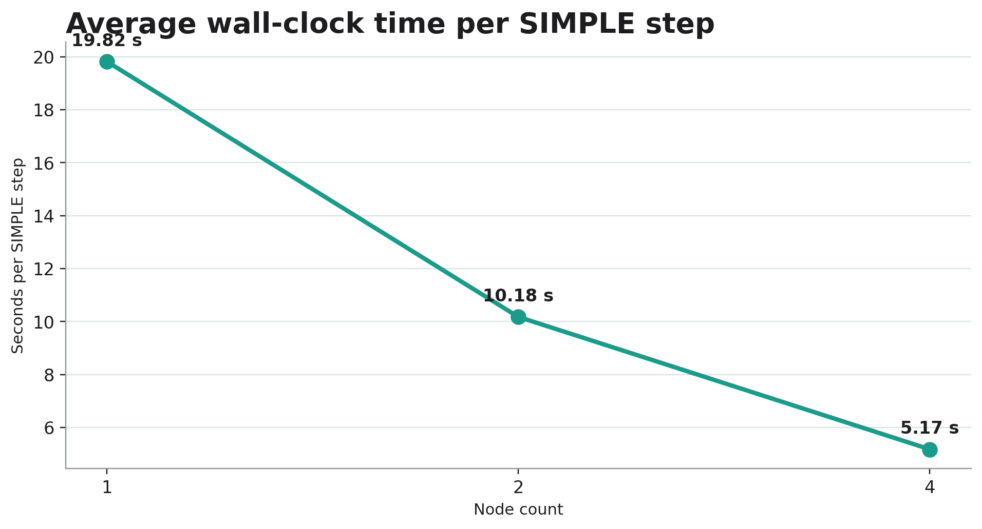
Baseline scaling results
ClockTime covers different work; scaling uses normalised average seconds per SIMPLE step.
Nodes
MPI ranks
Steps
ClockTime (s)
Avg. s/step
Speedup
Efficiency
1
48
40
822
19.82181419661539
1.00000×
100.00%
2
96
80
831
10.17551656303797
1.94799×
97.40%
4
192
150
787
5.174129850805368
3.83095×
95.77%
Different SIMPLE-step counts mean ClockTime is not a scaling metric.
t_step = average measured wall-clock time per SIMPLE step.
Notes:
[Sources]
Table and chart source: data/results/gadi_baseline_scaling.json. ClockTime is shown for official-score context only; 40/80/150 steps are different amounts of work.

Slide 7
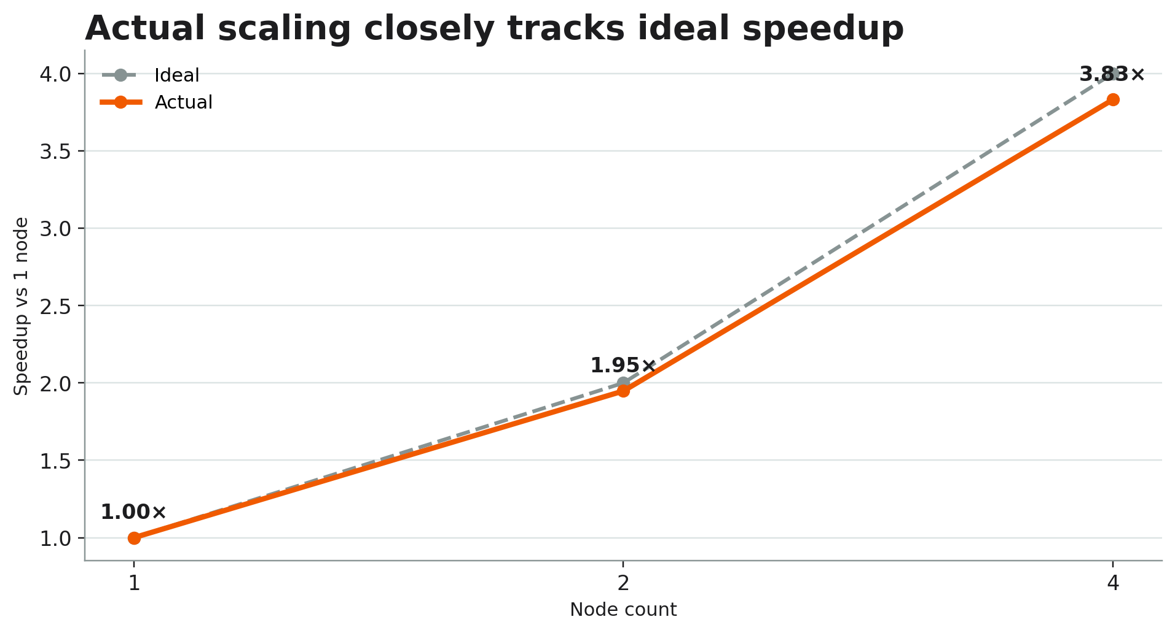
Actual versus ideal speedup
The 4-node result achieves approximately 3.83× speedup relative to one node.
Normalised speedup
S_N = t_step,1 / t_step,N
S_4 = 19.82181419661539 / 5.174129850805368
≈ 3.83095×
Notes:
[Sources]
Formula/table source: data/results/gadi_baseline_scaling.json. t_step is average measured wall-clock seconds per SIMPLE step.

Slide 8
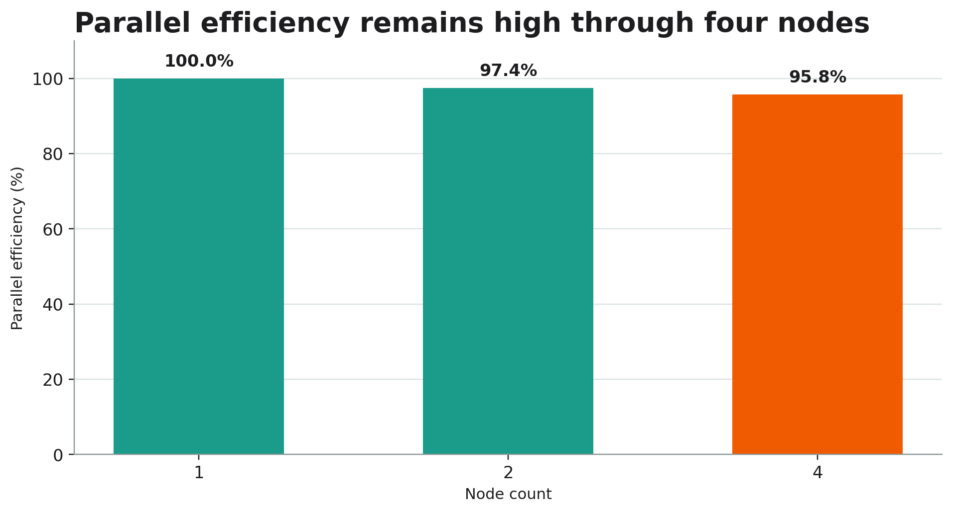
Parallel efficiency
Normalised scaling retains approximately 95.8% efficiency at four nodes.
Parallel efficiency
E_N = (S_N / N) × 100%
E_4 = (3.83095 / 4) × 100%
≈ 95.77%
Notes:
[Sources]
Formula/table source: data/results/gadi_baseline_scaling.json. N is the node multiplier relative to the 1-node baseline.

Slide 9
4-node scored baseline
Official score
787 s
simpleFoam ClockTime · 192 MPI ranks · 150 SIMPLE steps
Notes:
[Sources]
Official score source: data/results/gadi_baseline_validated.json, run_id: gadi-baseline-4n-192r

Slide 10
Interpretation
The validated baseline is close to linear through four nodes.
3.83×
95.8%
1 → 4 node speedup
4-node parallel efficiency
At this scale, the measured data does not yet show a dominant communication penalty. Profiling is required before attributing causes.
Notes:
[Sources]
Derived metrics: data/results/gadi_baseline_scaling.json. Interpretation is limited to validated scaling measurements; no profiling results are claimed.

Slide 11
Profiling plan
Collect evidence before selecting an optimisation variable.
›
Compute time versus MPI time
Planned
›
Communication and synchronisation
No profiling values are shown in this release.
›
Load imbalance across ranks
›
Memory behaviour
Notes:
[Sources]
Planned analysis only; no profiling results available.

Slide 12
Optimisation roadmap
Use controlled, one-variable experiments with evidence-backed keep/discard decisions.
Measure
→
Profile
→
Identify bottleneck
→
Change one variable
→
Rebenchmark
→
Keep / discard
Notes:
[Sources]
Process plan only. Experiment data will be stored in data/optimisation/ and compared from validated result records.

Slide 13
Next steps
The baseline provides the reference for profiling and controlled optimisation experiments.
›
Ingest Arm profiling evidence when available
›
Identify the highest-impact bottleneck
›
Test one permitted configuration variable at a time
›
Regenerate figures and deck from structured validated records
Notes:
[Sources]
Next-step plan. Baseline reference: data/results/gadi_baseline_validated.json.

