Slide 1
OpenFOAM CPU Optimisation
Gadi Baseline and Scaling
2026 APAC HPC-AI Competition · validated baseline
Notes:
[Sources]
Structured data: data/results/gadi_baseline_validated.json

Slide 2
Task definition
The score is the raw 4-node simpleFoam ClockTime; scaling uses normalised per-step timing.
›
occDrivAerStaticMesh · official 65,334,765-cell mesh
›
simpleFoam · OpenFOAM v2512
›
Official workloads: 40 / 80 / 150 SIMPLE iterations on 1 / 2 / 4 nodes
›
Official score: 4-node simpleFoam ClockTime
Notes:
[Sources]
Task rules supplied by user; baseline data: data/results/gadi_baseline_validated.json

Slide 3
Fixed scientific workload
Performance experiments may change the execution environment, not the science.
Locked
Optimisation space
›
Mesh
›
Compiler and build flags
›
simpleFoam source
›
MPI and communication settings
›
fvSchemes
›
Rank placement and CPU binding
›
fvSolution.fixedIter
›
Domain decomposition
›
Scientific work per SIMPLE step
Notes:
[Sources]
Task rules supplied by user.

Slide 4
Execution model
The same fixed workload is decomposed across increasing MPI resources.
65M mesh
→
decomposePar
→
MPI subdomains
→
simpleFoam
→
ClockTime
Scaling analysis measures average seconds per SIMPLE step - not raw ClockTime.
Notes:
[Sources]
Task rules supplied by user; metric definitions: .codex/skills/openfoam-slides/references/metric_definitions.md

Slide 5
Gadi baseline configuration
Each validated run uses the official fixedIter workload and 48 MPI ranks per node.
OpenFOAM
MPI
CPU
v2512
OpenMPI 4.1.7
Intel Xeon Platinum 8274
Ranks/node
Status
48
Validated
Notes:
[Sources]
Structured data: data/results/gadi_baseline_validated.json; CPU information supplied by user.

Slide 6
Baseline scaling comparison
ClockTime covers different work; scaling uses normalised average seconds per SIMPLE step.
Nodes
MPI ranks
SIMPLE steps
ClockTime (s)
Avg. s/step
Speedup
Efficiency
1
48
40
822
19.82
1.00×
100.0%
2
96
80
831
10.18
1.95×
97.4%
4
192
150
787
5.17
3.83×
95.8%
Different SIMPLE-step counts mean ClockTime is not a scaling metric.
t_step = average measured wall-clock time per SIMPLE step.
Notes:
[Sources]
Table source: data/results/gadi_baseline_scaling.json. Visible table values are rounded; full precision remains in this structured data file. ClockTime is official-score context only because 40/80/150 steps are different amounts of work.

Slide 7
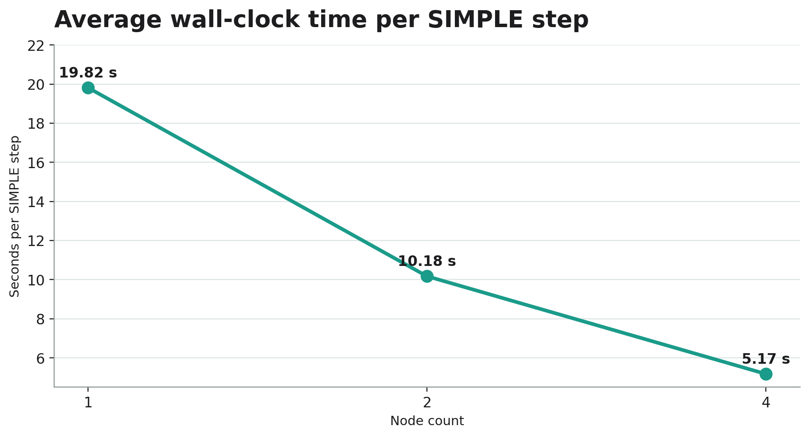
Normalised seconds per SIMPLE step
t_step = average measured wall-clock time per SIMPLE step; measured time falls from 19.82 s to 5.17 s.
Notes:
[Sources]
Chart source: data/results/gadi_baseline_scaling.json. Values are normalised per SIMPLE step, not raw ClockTime.

Slide 8
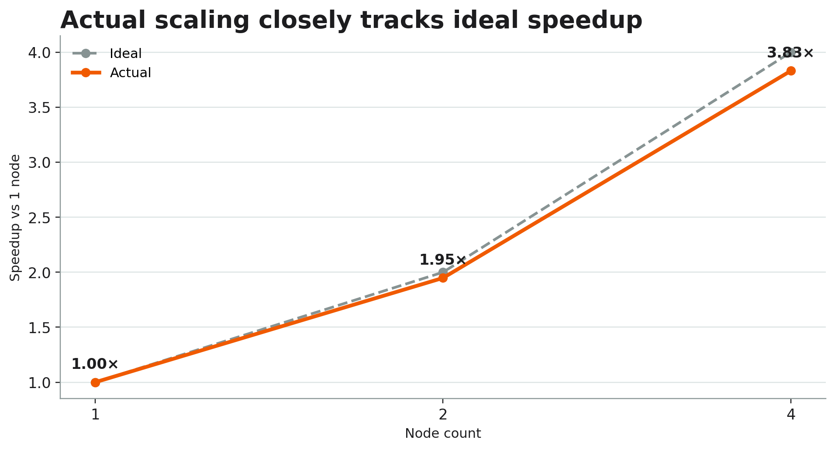
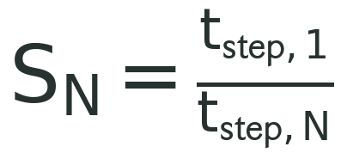
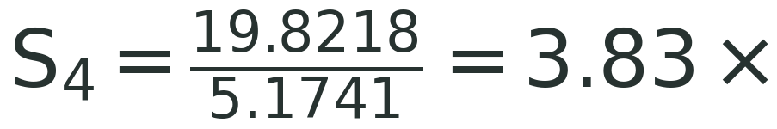
Actual versus ideal speedup
The 4-node result achieves approximately 3.83× speedup relative to one node.
Normalised speedup
Notes:
[Sources]
Formula/table source: data/results/gadi_baseline_scaling.json. t_step is average measured wall-clock seconds per SIMPLE step. Full-precision S_4 = 3.8309464138264846.

Slide 9
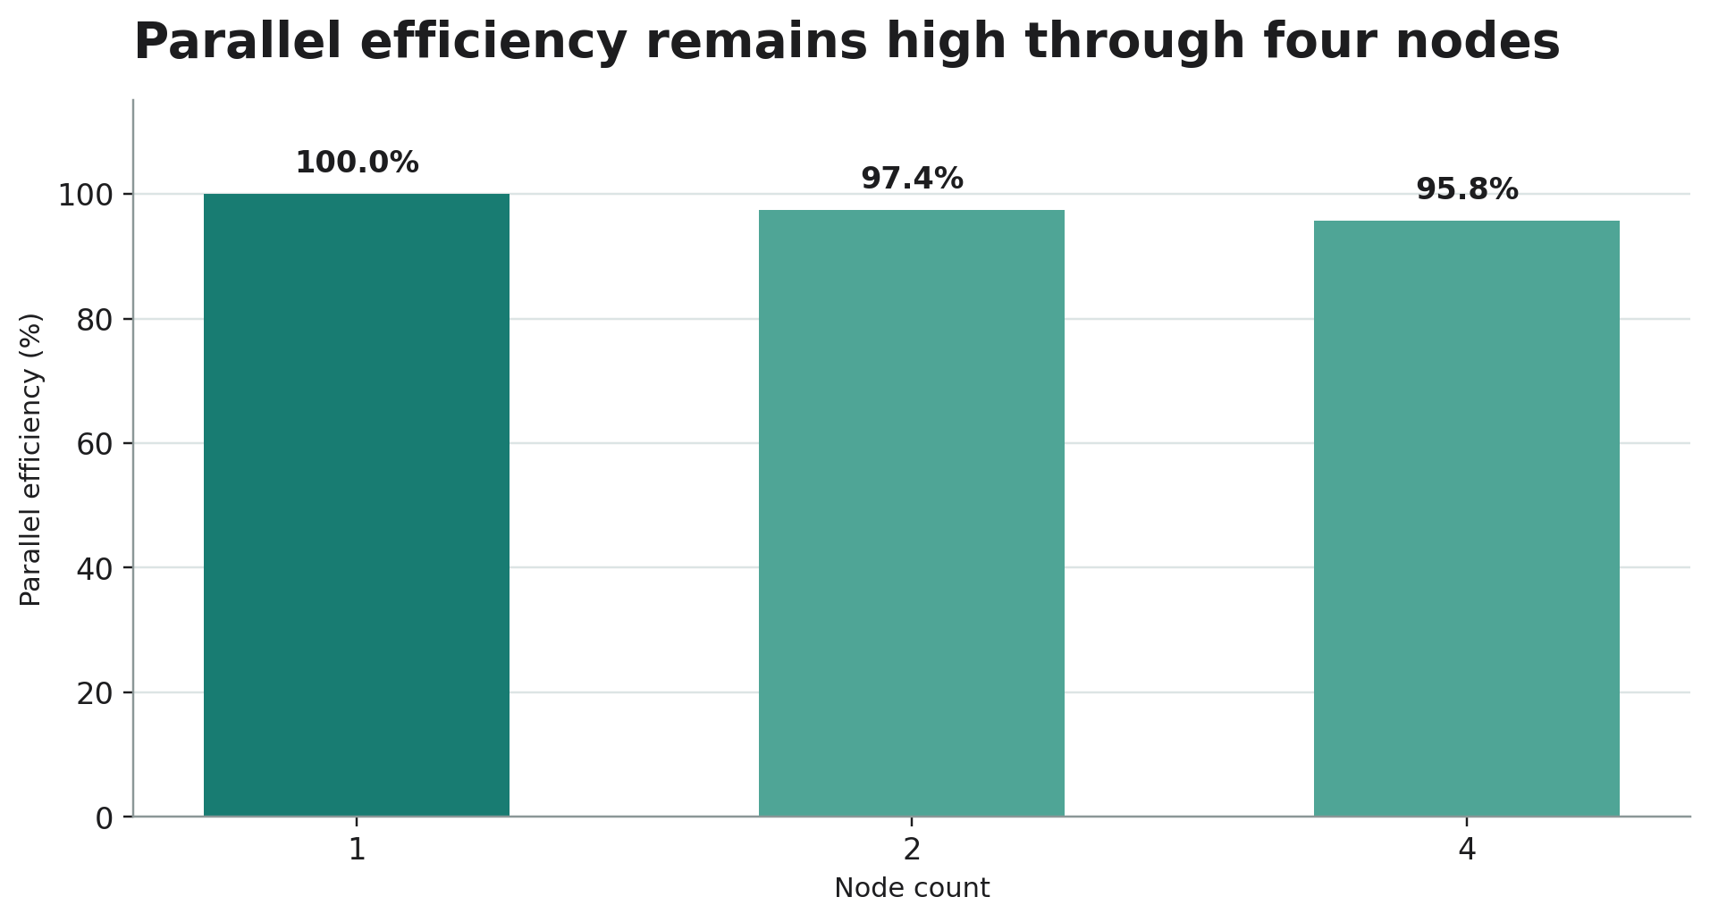
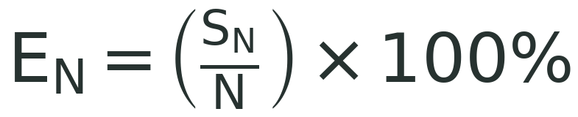
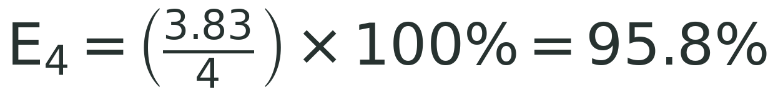
Parallel efficiency
Normalised scaling retains approximately 95.8% efficiency at four nodes.
Parallel efficiency
Notes:
[Sources]
Formula/table source: data/results/gadi_baseline_scaling.json. N is the node multiplier relative to the 1-node baseline. Full-precision E_4 = 95.77366034566211%.

Slide 10
4-node scored baseline
Official score
787 s
simpleFoam ClockTime · 192 MPI ranks · 150 SIMPLE steps
Notes:
[Sources]
Official score source: data/results/gadi_baseline_validated.json, run_id: gadi-baseline-4n-192r

Slide 11
Interpretation
The validated baseline is close to linear through four nodes.
3.83×
95.8%
1 → 4 node speedup
4-node parallel efficiency
At this scale, the measured data does not yet show a dominant communication penalty. Profiling is required before attributing causes.
Notes:
[Sources]
Derived metrics: data/results/gadi_baseline_scaling.json. Interpretation is limited to validated scaling measurements; no profiling results are claimed.

Slide 12
Profiling setup
Arm Performance Reports 22.1.1 completed successfully on the same four-node fixedIter workload.
Profiling time
Resources
Status
797 s
4 nodes · 192 ranks
Exit 0
Diagnostic instrumentation overhead applies. The official scored baseline remains ClockTime = 787 s.
Notes:
[Sources]
Validated profile source: data/profiling/gadi_4n_arm_performance_reports_validated.json; Job ID 177620140.gadi-pbs.

Slide 13
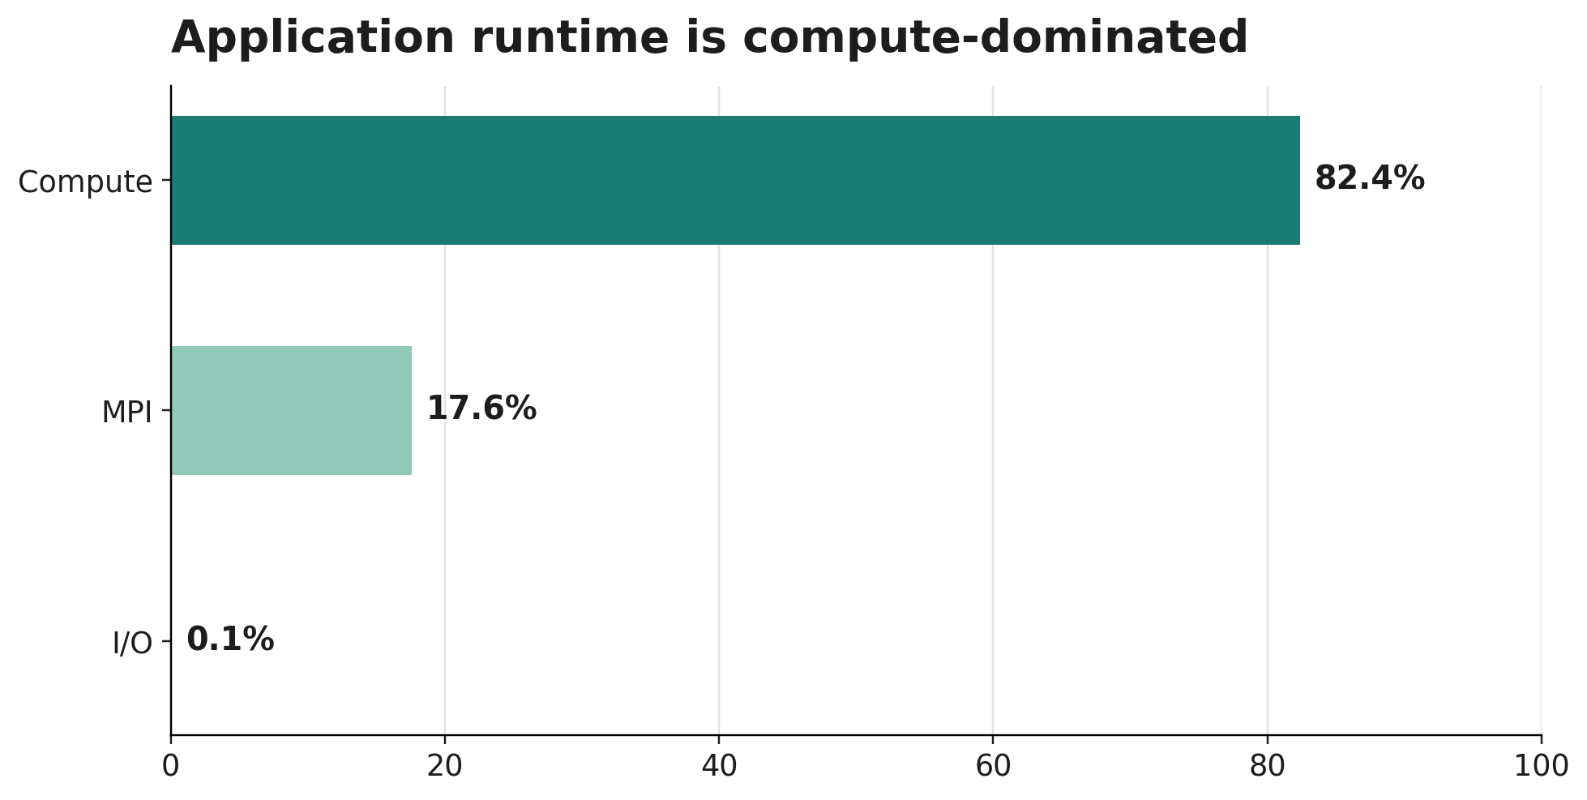
Application-level runtime is compute-dominated
Compute accounts for 82.4%; MPI is 17.6%; I/O is below 0.1%.
Notes:
[Sources]
Source: data/profiling/gadi_4n_arm_performance_reports_validated.json

Slide 14
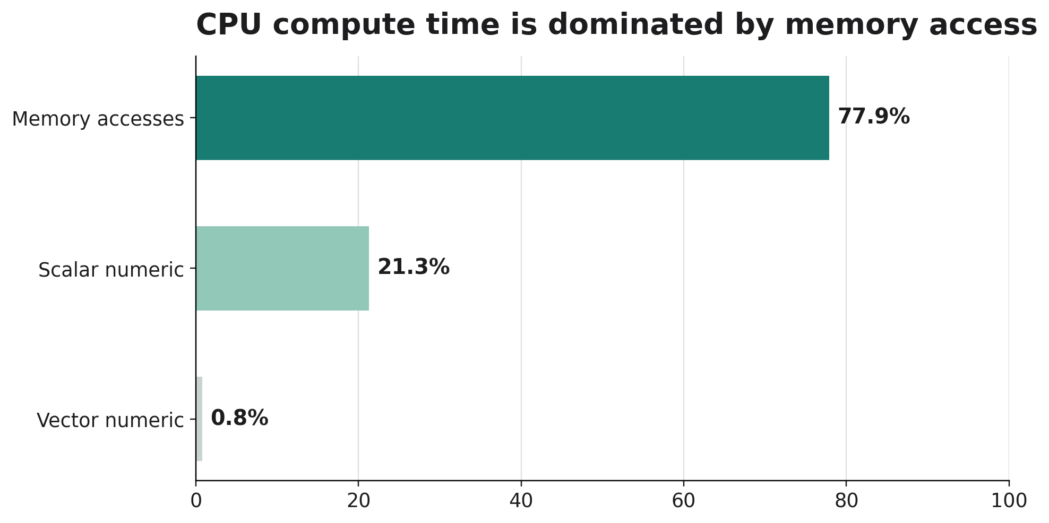
CPU execution is dominated by memory access
Within compute time, 77.9% is associated with memory access and vector activity is 0.8%.
Notes:
[Sources]
Source: data/profiling/gadi_4n_arm_performance_reports_validated.json. Memory-bound describes CPU compute behaviour, not capacity.

Slide 15
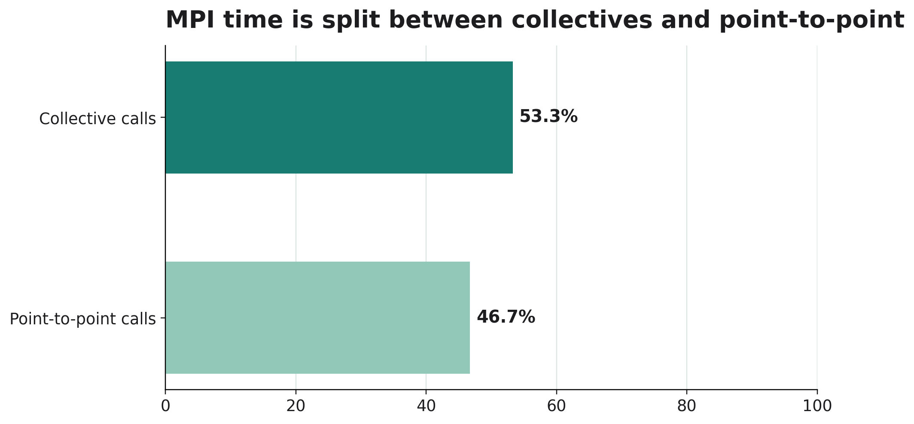
Collective synchronisation is the MPI hypothesis
Collectives are 53.3% of MPI time; the 173 kB/s effective rate can indicate ranks waiting at synchronisation.
Fast ranks → wait · Slow rank → arrives later · Collective proceeds
Notes:
[Sources]
Source: data/profiling/gadi_4n_arm_performance_reports_validated.json. This does not prove the network is slow.

Slide 16
Capacity, utilisation and I/O are not first priorities
The profile shows high CPU utilisation, adequate memory capacity, and negligible I/O runtime.
Core utilisation
Peak node memory
I/O runtime
99.6%
50.0%
<0.1%
Memory capacity ≠ memory bandwidth / latency / memory-access efficiency.
Notes:
[Sources]
Source: data/profiling/gadi_4n_arm_performance_reports_validated.json

Slide 17
Two evidence-backed bottleneck hypotheses
The profile identifies optimisation directions, not guaranteed outcomes.
1 CPU / memory behaviour
2 MPI / load imbalance
›
Memory accesses: 77.9% of compute
›
MPI: 17.6%; collectives: 53.3%
›
Vector numeric operations: 0.8%
›
Low collective rate may reflect waiting
›
Test compiler, flags, and build configuration
›
Test decomposition, placement, binding, MPI
Notes:
[Sources]
Source: data/profiling/gadi_4n_arm_performance_reports_validated.json. I/O, memory capacity, and thread utilisation are not priority targets.

Slide 18
Profiling → optimisation roadmap
Measurement and broad profiling are complete; bottleneck isolation is the current stage.
Measure ✓
→
Profile ✓
→
Identify bottleneck
→
Target one variable
→
Rebenchmark
→
Keep / discard
Notes:
[Sources]
Roadmap based on validated profile evidence.

Slide 19
Arm MAP is the next diagnostic step
Performance Reports provides broad diagnosis; Arm MAP will identify hotspots and rank-level imbalance.
›
Arm MAP 22.1.1 available
›
Find expensive functions and memory behaviour
›
Investigate MPI calls and process/rank imbalance
›
Select the first controlled optimisation experiment
Notes:
[Sources]
Planned next step only; no Arm MAP results are claimed.

Slide 20
Next experiments
Target one permitted variable at a time, then compare only valid like-for-like runs.
›
Compiler / build configuration and vectorisation
›
Decomposition, rank placement, and CPU binding
›
MPI configuration after imbalance evidence
›
Regenerate results, figures, and deck from structured data
Notes:
[Sources]
Next-step plan. No optimisation outcomes are claimed.

