Slide 1
Team Supernova
Nanyang Technological University
ISC26 Virtual Student Cluster Competition

Slide 2



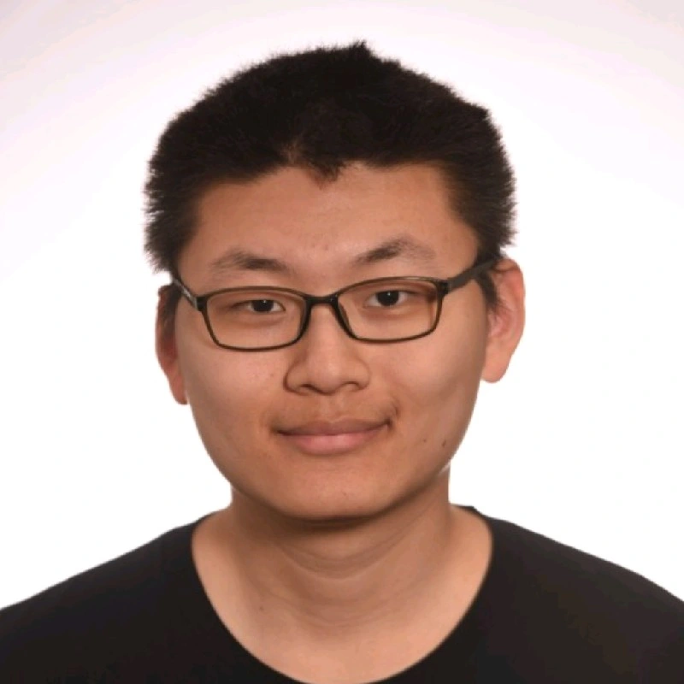


The Team
Zhu Zhanyan
Yuma Ochi
Gu Boyuan
Cao Yuxuan
Pham Ngoc Quang
Koh Kai Jie
Computer Science Y3
Data Science & Artificial Intelligence Y1
Computer Science Y2
Computer Science Y1
Electrical and Electronic Engineering Y1
Computer Science Y2
Zhanyan is interested in the intersection between High Performance Computing (HPC) and distributed data-intensive systems.
Yuma is interested in the optimization of parallel filesystems for AI workloads.
Boyuan is interested in the optimization of various application in High Performance Computing (HPC).
Yuxuan is interested in fine-tuning large-scale systems for AI. He interns at SemiAnalysis where he analyzes frontier LLM’s tokenomics.
Quang is interested in High Performance Computing as well as hardware development for AI and computation enhancements.
Kai Jie is interested in the optimization of various High Performance Computing workloads and applications.
https://mrzzy.co
https://github.com/mrzzy
Notes:
6

Slide 3
Task allocation
AI Task: LLM Training with Maxtext Cao Yuxuan, Zhu Zhanyan
DFTB+ Yuma Ochi
OpenFOAM Gu Boyuan, Pham Ngoc Quang
HemeLB Cao Yuxuan
ASCOT5 Koh Kai Jie

Slide 4
Hardware
ISC26 Virtual Student Cluster Competition

Slide 5
Hardware
Romeo Supercomputer
ROMEO supercomputer "2025" - 58× Grace Hopper servers
Each node:
4×GH200 NVIDIA Grace Hopper superchip
4x72 ARM Neoverse-V2 CPU cores (NVIDIA Grace), no SMT, 3.456Ghz
4×H100 GPUs (80 GB HBM3 each)
GPU Fabric: NVSwitch (Fat Tree topology)
480GB LPDDR5 memory
Interconnect: 800 Gb/s Infiniband
Notes:
Fat tree topology.

Slide 6
Hardware
IRIS supercomputer
IRIS supercomputer (Intel CPU cluster)
Each node:
2× Intel Xeon Platinum 8280 CPUs
2x28 CPU cores (no hyperthreading)
AVX-512 at 30% downclock
~187 GB RAM (NUMA: 2 domains)
Cache: 38.5 MB L3/CPU
Interconnect: Mellanox ConnectX-6 Infiniband
Notes:
Fat tree topology.

Slide 7
AI Task: LLM Training with Maxtext
ISC26 Virtual Student Cluster Competition

Slide 8
AI Task 1: Training Optimisation
Benchmarking Run TPS Average of 40 steps, excluding 10 warmup steps.
Optimisations
TPS | Speedup | Description
9022.55 | 1.00× | Original configuration
9902.32 | 1.10× | Batch size = 2
15998.71 | 1.62× | cuDNN flash attention
16069.40 | 1.78× | Add XLA latency hiding scheduler
16188.37 | 1.79× | Add Triton GEMM/XLA tuning
16300.96 | 1.81× | Enable PGLE (profile-guided latency estimator)
16637.38 | 1.84x | Reduce VRAM (41.27 to 13.76 GB) via host-offloading
17037.38 | 1.89x | Reduces compute by removing L2 norm compute
18169.68 | 2.01x | FP8 Training lowers compute
24726.80 | 2.74x | FP8 Training Lowered VRAM allows for larger batch size
Notes:
show that you tried different parallelism, talk about other parameters you tried.
add slide talking about different types of parallelism

Slide 9
AI Task: LLM Training with Maxtext
Hardware: Romeo Supercomputer “2025”.
Task 1: Optimising of Qwen-14B Model Training on Maxtext
  Goal: Maximise Average Tokens / Second (TPS), excluding first 10 steps (warmup).
Task 2: Profiling Qwen-14B Model Training with XProf
Bonus Task: Multinode Training
Notes:
TPS more

Slide 10


AI Task: Software Environment
Software Environment used in AI task:
Container: ghcr.io/nvidia/jax:maxtext-2026-03-31
Maxtext: Code Change fixed Transformer Engine integration.
  attention=cudnn_flash_te & quantization=te_fp8_currentscaling
  (now fixed in TE PR #2823)

Slide 11
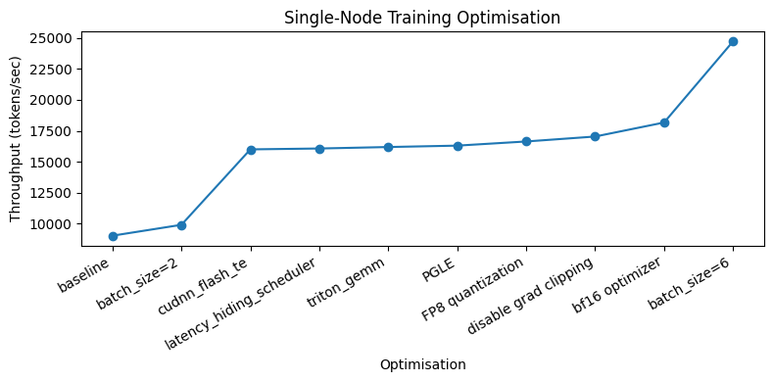
AI Task 1: Training Optimisation
Benchmarking Run TPS Average of 40 steps, excluding 10 warmup steps.
Full Run Best Full Run Throughput (TPS): 24981.62

Slide 12
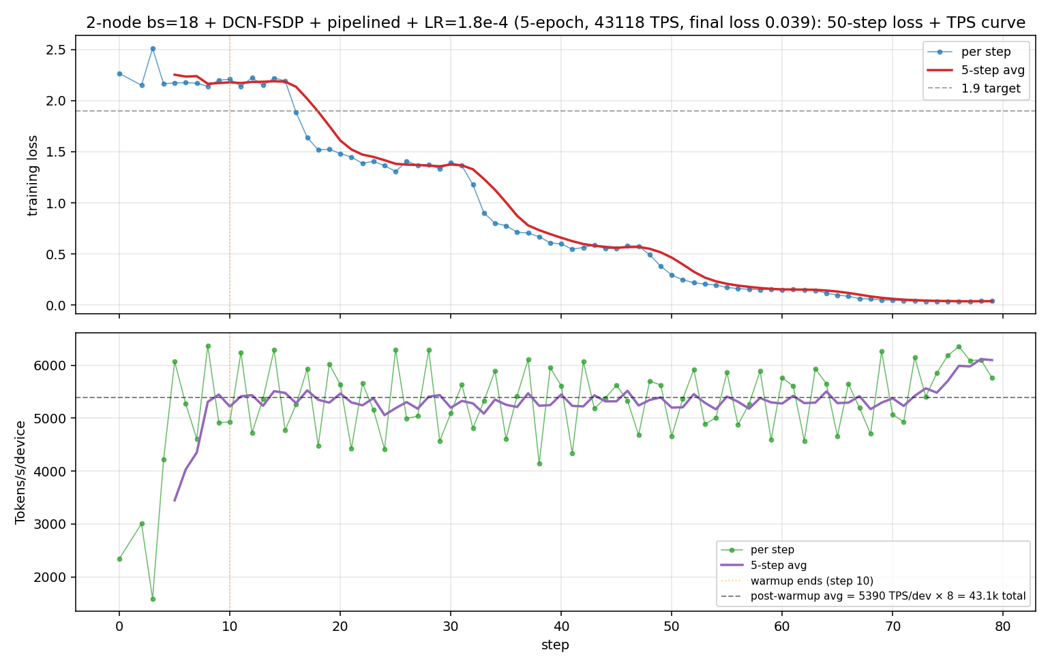
AI Task 1: Loss Curve
Final Loss Best Full Run 1.110 < 1.9 Requirement

Slide 13
AI Task 1: Throughput Curve
Consistent Throughput throughout training run.

Slide 14
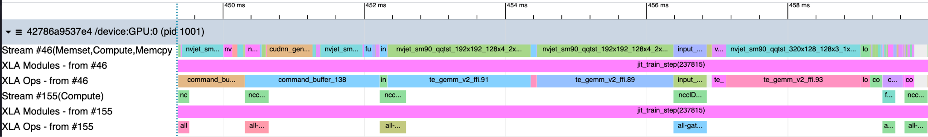
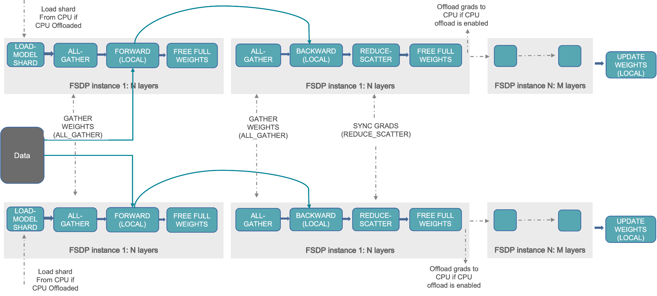
AI Task 2: Profiling & Analysis with xProf
Communication Mapping: Fully Sharded Data Parallelism (FSDP)
  Forward Pass
Compute
Communication
    AllGather → compile model weights for to compute activations

Slide 15
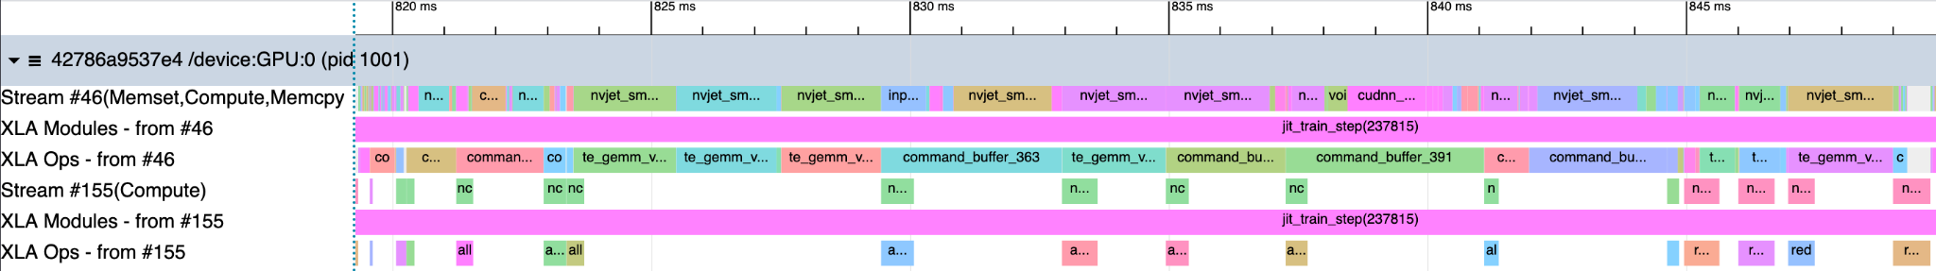
AI Task 2: Profiling & Analysis with xProf
Communication Mapping: Fully Sharded Data Parallelism (FSDP)
  Backward Pass
Compute
Communication
    AllGather → compile model weights to backprop. gradient updates.
    ReduceScatter → shard gradient updates among processes.

Slide 16
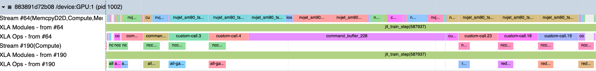
AI Task 2: Overlap & “Funky Factor”
Compute
Communication
Overlap: Communication and computation overlap due to XLA latency hiding scheduler.
Observation: Backward pass computation slightly exceeds communication.
Potential Optimisation: Use less aggressive rematerialisation for backward pass

Slide 17
AI Task Bonus: Multinode Training
Hardware: 2 Nodes x 4 GPU (8 GPUs Total), Infiniband 800G/s
hardware=gpu_multiprocess for JAX distributed backend
Pass SLURM_* & CUDA_VISIBLE_DEVICES to container
Set JAX_COORDINATOR_IP & JAX_COORDINATOR_PORT
FSDP parallelism:
  inter-node (dcn_fsdp_parallelism=2)
  intra-node (ici_fsdp_parallelism=4)
Use Infiniband via --device=/dev/infiniband
Notes:
add single node throughput for comparison
add add batch size scaling as a graph

Slide 18
AI Task Bonus: Multinode Training
Hardware: 2 Nodes x 4 GPU (8 GPUs Total), Infiniband 800G/s
Reducing XLA_PYTHON_CLIENT_MEM_FRACTION=0.8 from 0.9
  Avoid Out Of Memory (OOM) at larger batch sizes.
Utilise System per_device_batch_size=18
Additional XLA flags to tune communication primitives
Notes:
add single node throughput for comparison
add add batch size scaling as a graph

Slide 19
AI Task Bonus: Multinode Training
Hardware: 2 Nodes x 4 GPU (8 GPUs Total), Infiniband 800G/s
Multinode Speedup: 2.02x
40 Steps, Skip 10 Warmup: Multi Node Throughput (TPS): 50570.58
  Final Loss 1.061 (Stable training loss)
40 Steps, Skip 10 Warmup: Single Node Throughput (TPS): 24726.62
Notes:
add single node throughput for comparison
add add batch size scaling as a graph

Slide 20
Results Summary of AI Task
Code Change Fixed Transformer Engine integration
  attention=cudnn_flash_te & quantization=te_fp8_currentscaling
Task 1 Training Optimisation: 1 Node, 4 GPUs
  Final TPS 24726.8 (2.74x baseline)
  Final Loss 1.110 < 1.9
Task 2 Profiling & Analysis
  Communication patterns for Forward & Backward passes
  Funky factor: More Compute than Communication
Task 3 Multinode Training 2 Nodes x 4 GPU (8 GPUs Total), Infiniband 800G/s
  Final TPS 50570.58 (2.02x 1 Node)
  Final Loss 1.061 (Stable training loss)

Slide 21
DFTB+: SCC Energy Calculation
ISC26 Virtual Student Cluster Competition

Slide 22

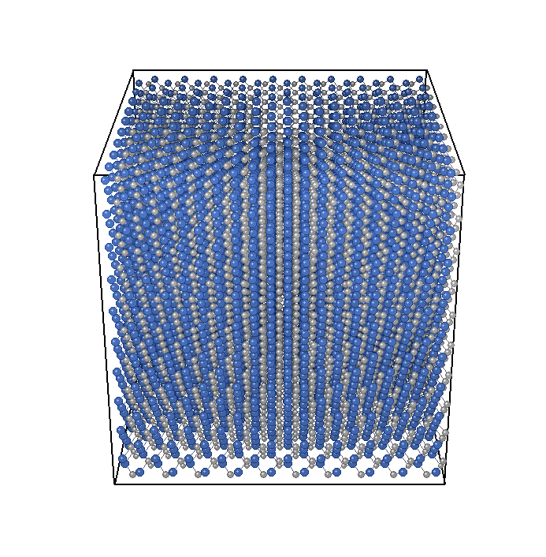
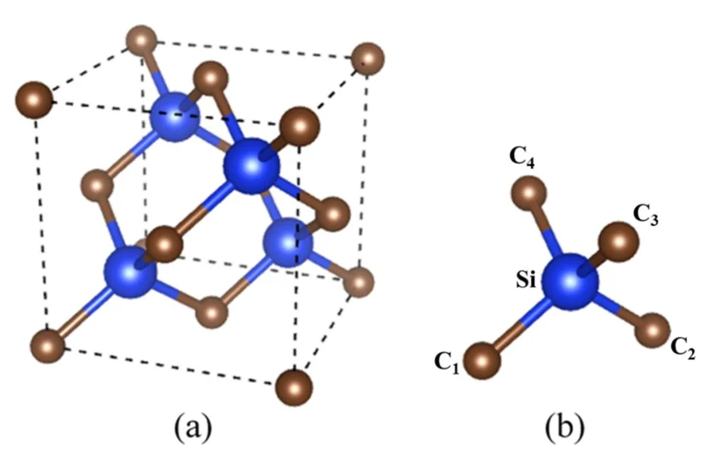
DFTB+
What’s DFTB+?
Open-source quantum mechanical simulation
Approximate Density Functional Theory (DFT) to perform efficiently
What’s our task?
8000-atom SiC crystal simulation
Minimizing runtime while maintaining accuracy on Iris cluster
Unit cell of 3C-SiC (Alfanny et al., 2022)
Input: 8000-atom C-SiC Crystal supercell
Alfanny, D., et al. “First-Principle Calculation of Silicon Carbide (SiC) for Superhard Material Applications.” Journal of Physics: Conference Series, vol. 2376, 2022, p. 012011.
Notes:
"So let me introduce our application — DFTB+. It's an open-source quantum mechanical simulation package that uses an approximate form of Density Functional Theory.
Our task is to run an 8,000-atom silicon carbide crystal simulation on the Iris cluster, and our goal is to minimize the runtime while keeping the results accurate.
Here you can see the unit cell on the right, and more right side is the 8,000-atom supercell we're actually using as input.

Slide 23
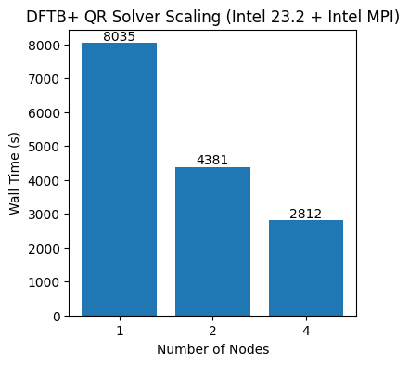
DFTB+: Baseline
Dependencies
Intel Compiler 2023.2.0
Intel MPI 2023.2.0 toolkit provided
Intel MKL 2023.2.0 toolkit provided
DFTB+ 25.1

Slide 24
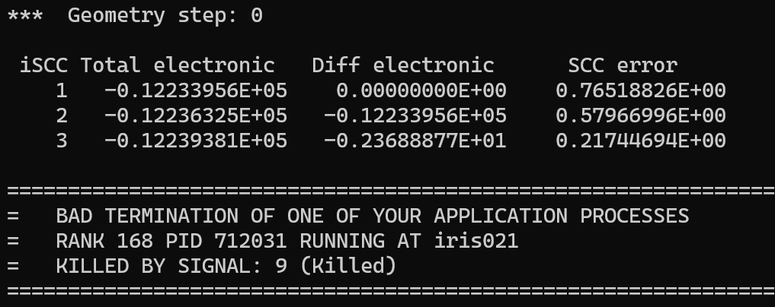
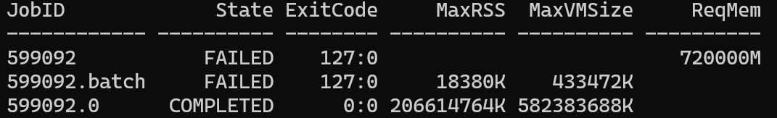
DFTB+: Baseline
Issue
ELPA solver job was killed by OOM
Solution
Update Intel Compiler
~ 206GB memory was used

Slide 25
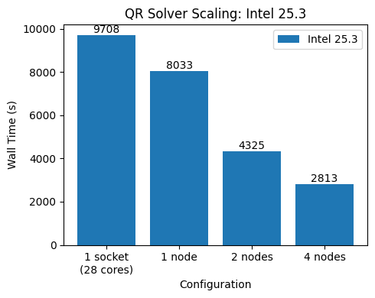
DFTB+: Baseline
Softwares for Baseline
Intel Compiler 2025.3
Intel MPI 2025.3 toolkit-provided
Intel MKL 2025.3 toolkit-provided
DFTB+ 25.1
Scaling Test (vs 1 Node)
2 Nodes: 1.86x speedup
4 Nodes: 2.86x speedup
Scaling Test (vs 1 Socket)
1 Node: 1.21x speedup
2 Nodes: 2.24x speedup
-> QR is dominated by communication, limited by cross-socket UPI communication
Notes:
"For our baseline, we're using Intel Compiler 2025.3 with the toolkit-provided Intel MPI and Intel MKL, running DFTB+ version 25.1. Using the default QR eigensolver, we measured 8,033 seconds on a single node. Scaling to 2 nodes gave us a 1.86x speedup, and going to 4 nodes gave us a 2.86x speedup. So we're getting decent scaling as baseline.

Slide 26
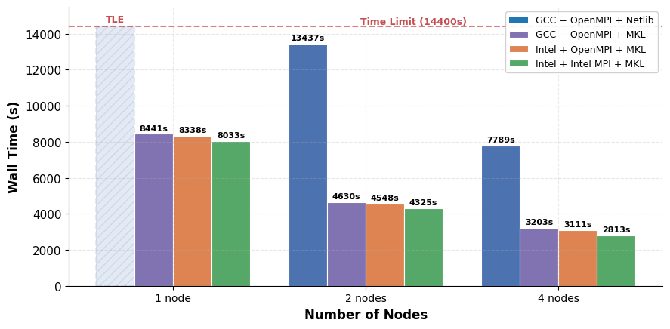
DFTB+: Compiler x MPI Comparison
Compiler
Intel > GCC
Library
Intel MKL >>> Netlib (OpenBLAS, LAPACK)
MPI
Intel MPI > OpenMPI
Best Choice: Intel Compiler + Intel MPI + Intel MKL
Notes:
Then I compare compiler, math library, and MPI combinations for DFTB+ across 1, 2, and 4 nodes.
Let me introduces the takeaways. First, on the compiler side, Intel was better than GCC.
Second, the math library GCC with Netlib BLAS and LAPACK couldn’t ever finish at one node because it hit the time limit.
However, once I swap in Intel MKL, runtime drops around 8000 seconds.
Third, Intel MPI was consistently better than OpenMPI.
Overall, Intel Compiler, Intel MPI, and Intel MKL gave us our fastest configuration at every node count.

Slide 27
DFTB+: Eigensolvers
1. Traditional Dense (LAPACK)
2. Parallel Dense (ELPA)
Full diagonalization via standard linear algebra.
QR: Classic, robust, best for small baseline systems.
DAC (Divide & Conquer): Split the matrix recursively. Faster than QR for large matrices.
RR (Relatively Robust.): Fastest for specific eigenvalue subsets.
Distributed-memory solvers for large-scale HPC.
ELPA 2-stage: Default; optimal for high parallel scaling.
ELPA 1-stage: Faster for smaller matrices/fewer cores.
Autotune: Auto-benchmarks parameters for optimal config.
Notes:
"Now let's talk about eigensolvers, which is really the core of our optimization. DFTB+ supports two families. First, the traditional dense LAPACK solvers — QR, which is the baseline; Divide and Conquer, which splits the matrix recursively and Relatively Robust, which is fastest for specific eigenvalue subsets. Second, there's ELPA, which provides distributed-memory parallel solvers designed for large-scale HPC. ELPA offers some modes to be tuned.

Slide 28
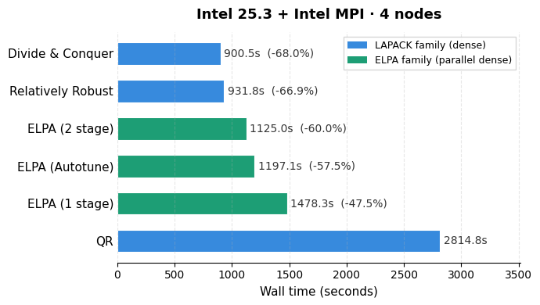
DFTB+: Eigensolvers
Results
DAC is the best
DAC and RR use Intel MKL while ELPA uses own kernel
Notes:
"Here are the results comparing among eigensolvers on 4 nodes with Intel 25.3. Divide and Conquer was the best at 900 seconds. On the ELPA side, ELPA 2-stage was 1,125 seconds, still slower than DAC. ]
The important insight is that DAC and RR use Intel MKL internally, while ELPA uses its own kernels — and in this case, MKL is optimized well that outperforms ELPA’s impelementation"

Slide 29
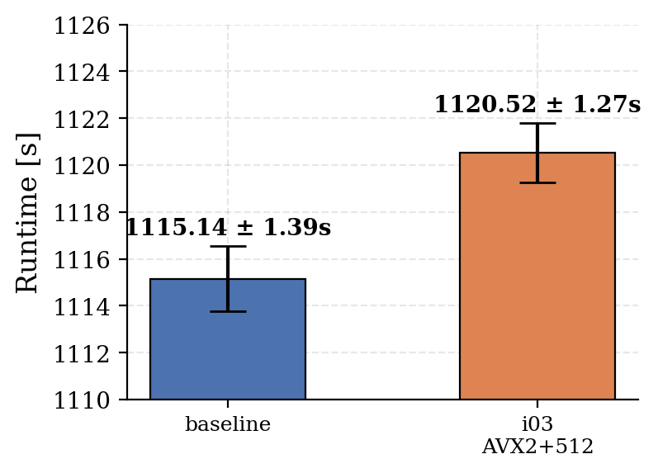
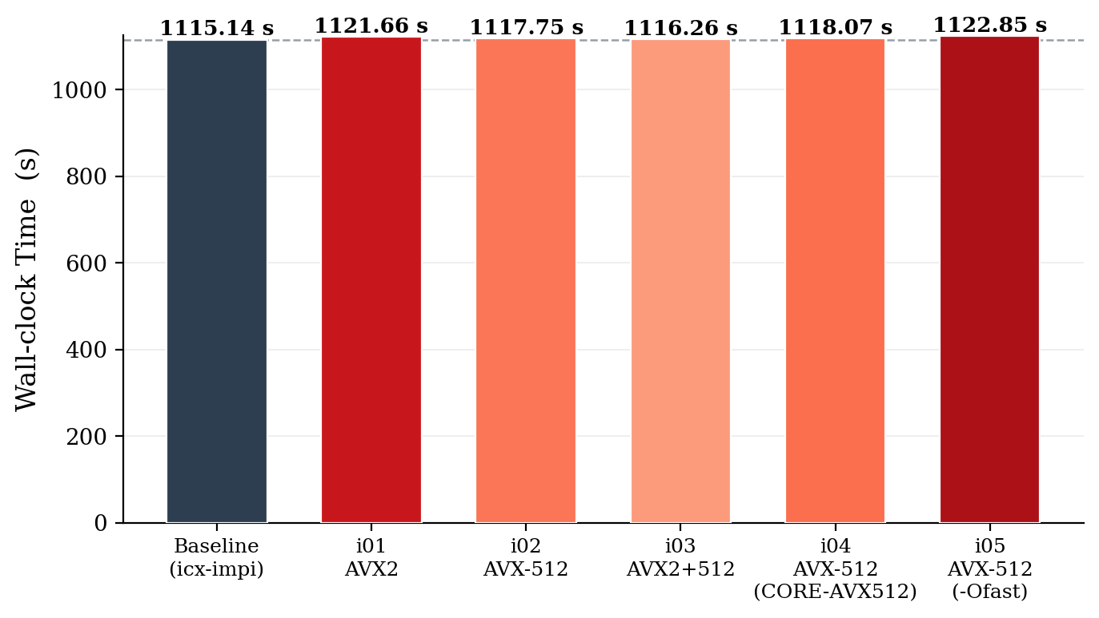
DFTB+: ELPA Kernel Optimization
Hypothesis: Optimized ELPA might perform well as DaC
AVX2/AVX-512 kernel didn’t improve performance
In 3x repeat runs, default setting was the best
ID | SIMD Target | Compiler Flags
baseline | Neither AVX2/AVX-512 | -O3 -march=native -qopenmp
i01 | AVX2 only | -O3 -march=native -qopenmp
i02 | AVX-512 only | -O3 -march=native -qopenmp
i03 | AVX2 + AVX-512 | -O3 -march=native -qopenmp
i04 | AVX-512 only | -O3 -xCORE-AVX512 -qopenmp
i05 | AVX-512 only | -Ofast -xCORE-AVX512 -qopenmp

Slide 30
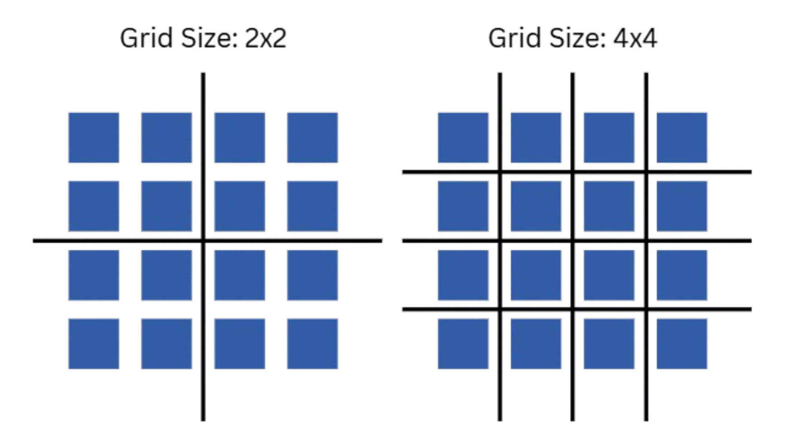
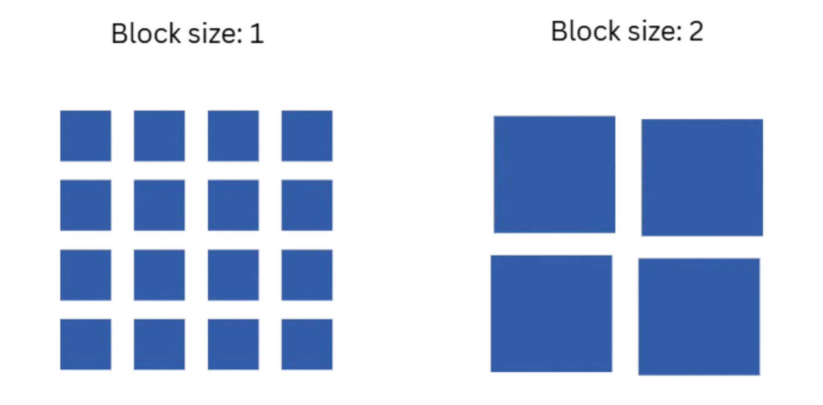
DFTB+: Grid-size & Block size
Grid size
Block size
How many domains the matrix is divided into along each axis.
More divisions -> more subsystems, each smaller
Fewer divisions -> fewer subsystems, each larger
How big each chunk is that gets distributed across MPI ranks.
Too small -> communication-bound
Too large -> cache overflow
Notes:
Let me briefly explain BLACS grid size and block size, since these are important parameters.
Grid size determines how the process grid is laid out — how many domains the matrix is divided into along each axis. More divisions mean smaller subproblems.
Block size determines the granularity of data distribution across MPI ranks. Too small leads more communications to be overrhead; too large and the matrices don't fit in cache."

Slide 31
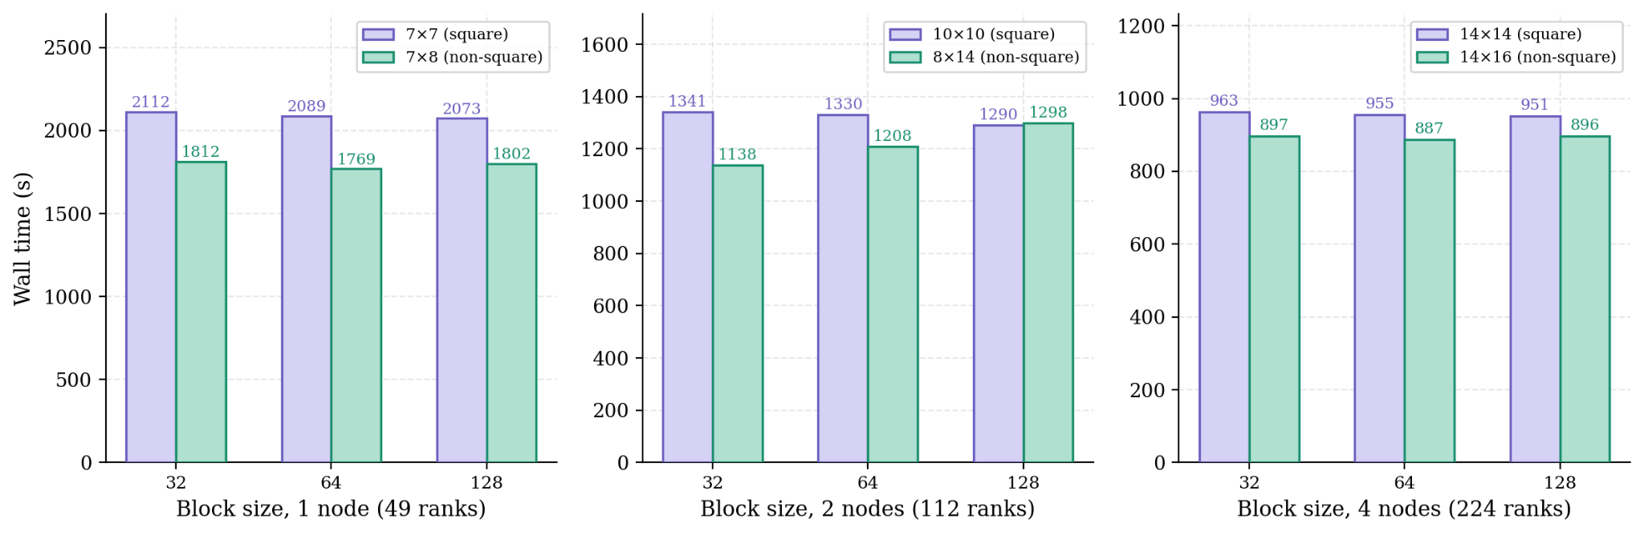
DFTB+: Grid-size & Block size
Hypothesis: Square grids might perform better due to symmetric communication in both row and column directions
Result: Non-square with more ranks > square with fewer ranks
Notes:
We compared square and non-square grids at different node counts, expecting square grids to perform better due to more balanced communication.
However, the results showed the opposite trend. Non-square grids with a higher number of ranks consistently outperformed square grids with fewer ranks. This pattern was consistent across all scales we tested.

Slide 32
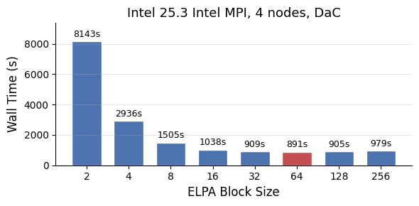
DFTB+: Grid-size & Block size
Blocksize
Too small
  Tiny matrix make communication massive
Too large
  Huge matrix cannot fit in cache
Optimal
Default
Notes:
"For block size, we did a changed blocksize from 2 to 256 using DAC on 4 nodes. We can observe very small block sizes like 2 cause massive communication overhead at over 8,000 seconds. Performance improves rapidly as block size increases, then plateaus around 32 to 128. The optimal value was 64 at 891 seconds, slightly better than the default. Higher than 128 starts to make the performance worse as the blocks overflow cache."

Slide 33
DFTB+: OpenMP Threads
As increasing the threads, execution time got longer
Hypothesis
Local matrices are too small for threaded BLAS
Intel 25.3 + Intel MPI, DaC
Intel 25.3 + Intel MPI, ELPA
MPI Ranks/ Node | Threads | 1 node (s) | 2 nodes (s) | 4 nodes (s)
56 | 1 | 3225 | 1493 | 902
28 | 2 | 3791 | 2009 | 1142
14 | 4 | TLE | 3509 | 1825
7 | 8 | TLE | TLE | TLE
MPI Ranks/ Node | Threads | 1 node (s) | 2 nodes (s) | 4 nodes (s)
56 | 1 | 3775 | 1987 | 1133
28 | 2 | TLE | 3090 | 1625
14 | 4 | TLE | 5718 | 2936
7 | 8 | TLE | TLE | TLE
Notes:
Finally, we evaluated hybrid OpenMP threading. For both the DAC and ELPA solvers, the pure MPI configuration with a single thread consistently delivered the best performance.
As we increased the number of threads and reduced the number of ranks, performance degraded siugnificantly. Even some configurations failed to complete.
We believe this is because the local matrices are too small to effectively utilize threaded BLAS. In such cases, the overhead from thread management and synchronization likely outweighs any computational benefit.

Slide 34
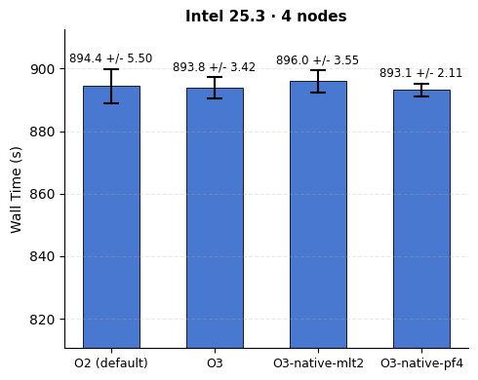
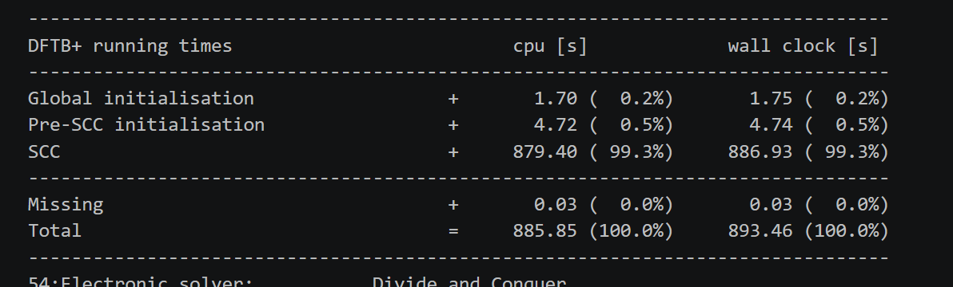
DFTB+: Compilation Optimization
Optimizing Compler flags for DFTB+ doesn’t show improvements
Compiler flags only affect the DFTB+ code (I/O, Initialization), not the computation
99.3% of wall time was used for SCC
native: -march=native
mlt2: -qopt-mem-layout-trans=2
pf4: -qopt-prefetch=4
Notes:
We also explored whether tuning compiler flags for DFTB+ itself could improve performance. We tested several configurations.
In practice, all four configurations produced nearly identical results, within the margin of error. This is because compiler flags only affect the DFTB+ source code, which mainly handles tasks like I/O and initialization.
However, the timing breakdown shows that 99.3% of the total runtime is spent in the SCC loop, where it is calling external libraries such as MKL and ELPA. Then, changing compiler flags for DFTB+ itself has no effect on overall performance

Slide 35
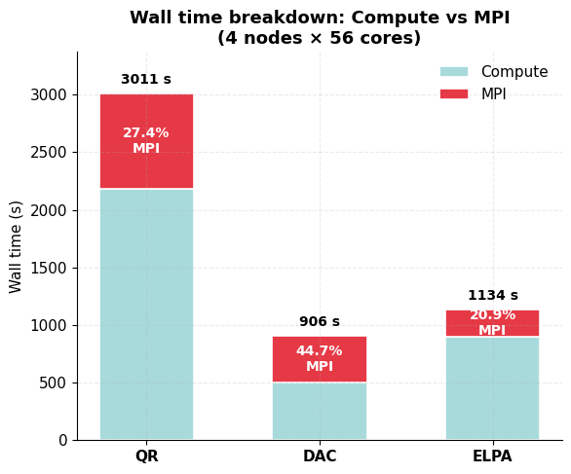
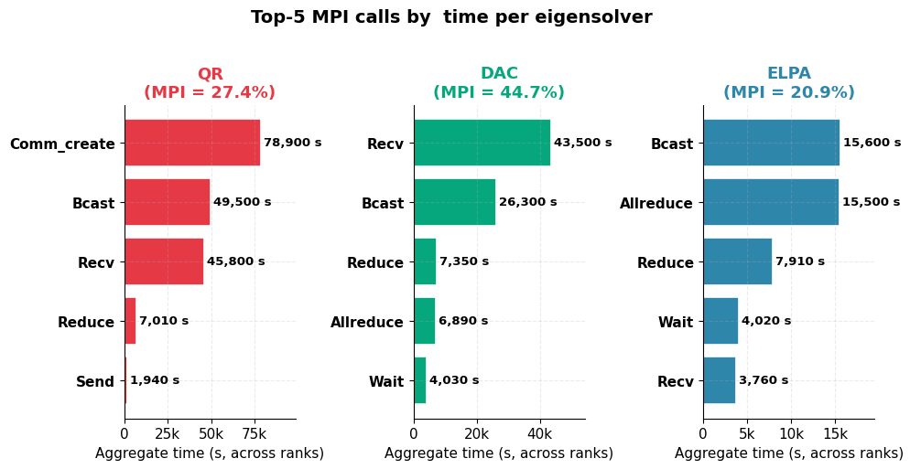
DFTB+: MPI Profiling
MPI communication dominated in DAC
QR: Comm_create dominant
likely waiting ranks finish the serial dsteqr2 phase at different times, then synchronize
DAC: Recv dominant
likely repeated BLACS broadcasts during DAC ~175M point-to-point receives across ranks
Notes:
I profiled MPI communication across three eigensolvers to understand where each one spends its time.
QR is dominated by Comm_create and Bcast — it constantly rebuilds sub-communicators for factorization and back-transformation.
DAC's bottleneck is Recv — processes waiting for other processes during the merge phase of divide-and-conquer. Overall, DAC achieved the shortest runtime, while ELPA was the most communication-efficient.

Slide 36
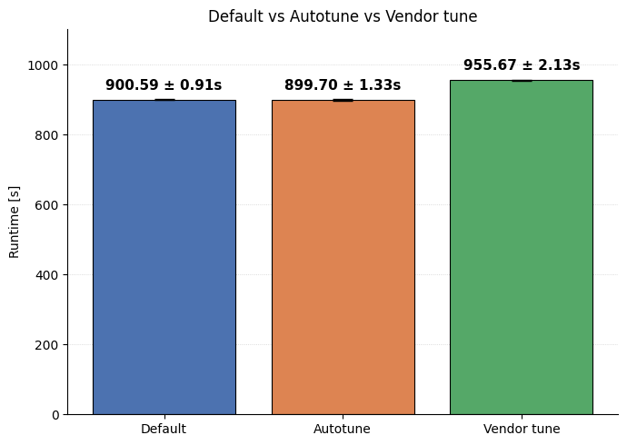
DFTB+: MPI Optimization
MPI-level tuning offered no significant differences.
Used Core Binding
  Socket Binding setting exceeded time limit
Vendor tune: The vendor-provided Intel MPI tuning file for Cascade Lake (tuning_clx-ap_shm-ofi.dat)
Notes:
As we have seen MPI communication was dominant for DAC solver,
we tried to optimize the MPI communication using Autotune feature for Intel MPI.
The results are shown on the right, the default setting without any special flags and the autotuned results showed almost same results.
Also, we tried vendor tune, which is vendor-provided tuning file for specific CPU architecture bundled with Intel MPI.

Slide 37
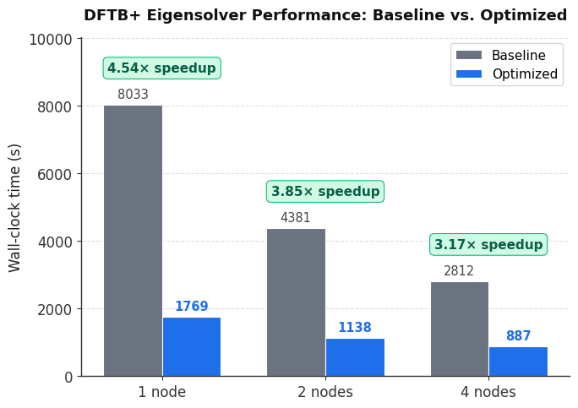
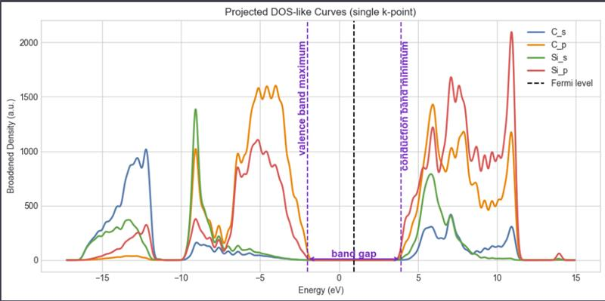
DFTB+: Conclusion
Highlight
Intel 2025.3 + Intel MKL + Intel MPI
FLAGS: -O3
Solver: Divide And Conquer
BLAS Blocksize: 64
Notes:
In conclusion, we achieved 4.54 speed up for 1 node, and 3.17x speed up for 4nodes. by focusing on solvers,

Slide 38
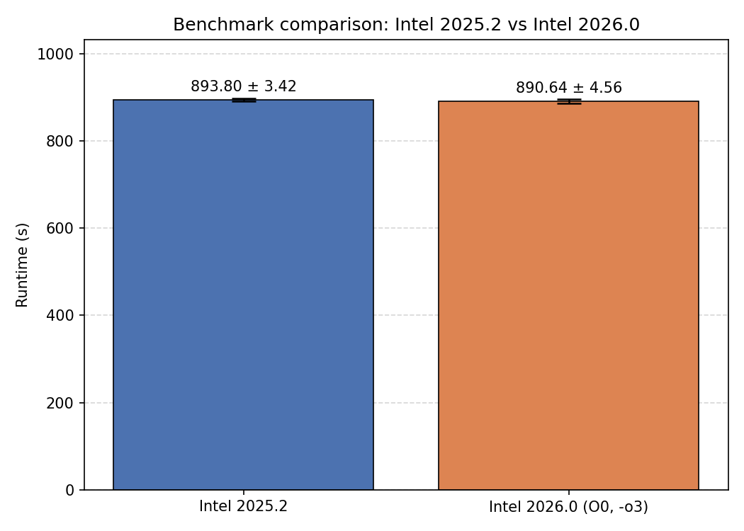

Appendix. Intel 2026.0
Intel 2026.0 was released 28th April, 2026
Updated Intel Compiler, MKL, MPI
893s -> 890s
Submission scripts have been
updated to Intel 2026.0

Slide 39
OpenFOAM: The Static DrivAer Testcase
ISC26 Virtual Student Cluster Competition

Slide 40
Task: Steady-State DrivAer Aerodynamics in OpenFOAM
About OpenFOAM: Open source CFD toolkit
Experiment: Simulate external air flow around the DrivAer automotive model.
  Experiment set up
    The cooling inlets of the car is closed → no air flow in car, only external
    Steady-State Simulation (solver: SIMPLE)
  Goal:
    Predict pressure(p) and velocity(Ux, Uy, Uz) of external air flow surrounding the car model
Expected results:
  Numerical convergence of Drag Coefficient (Cd) and residuals (p, Ux-Uy-Uz)
  Physical Validation: Pressure-velocity relationship is physically realistic (satisfies Bernoulli law)
Notes:
In simple terms, the drag coefficient (often written as $C_d$) is a number that tells you how "aerodynamic" or "slippery" an object is as it moves through a fluid, like air or water.
Think of it as a "score" for wind resistance:
A low score means the object is sleek and slices through the air easily (like a teardrop or a race car).
A high score means the object is "blunt" and catches a lot of air, making it harder to move (like a flat sheet of plywood or a brick).

Slide 41
Task 1: Optimization Strategy
Optimization Strategy
Optimization Dimensions
  Compiler (ICC, GCC, ICX)
  Mesh decomposition methods
  Compiler Flags
  MPI Flags
Approach: Baseline → test performance effects of each optimization dimension → best build
Note: Walltime reported and used for analysis is SOLVER TIME (excluding decomposition time, etc)

Slide 42
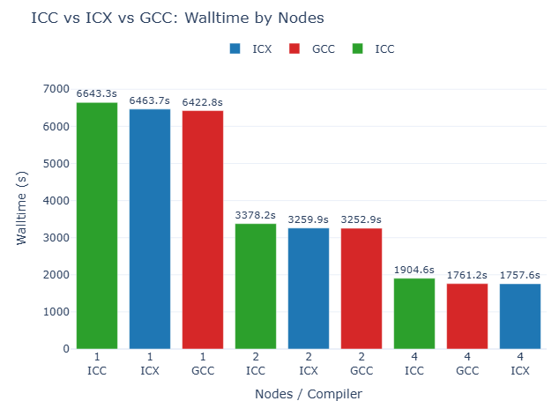
Task 1: Compiler Choice
ICC vs ICX vs GCC
Baseline: ICC23 + HPCX, consistently the slowest
GCC15.2 + OMPI & ICX25 + OMPI have similar performance
→ Adopt GCC 15 and ICX 25 for subsequent compiler optimization flag tuning and performance evaluation.

Slide 43
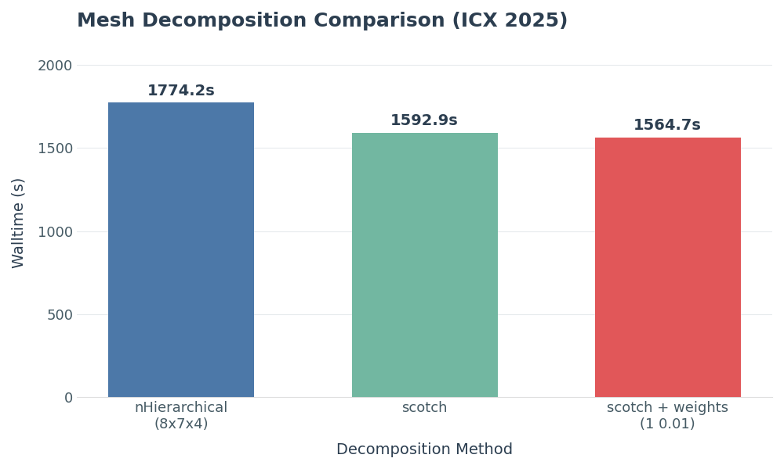
Task 1: Mesh Decomposition Methods
Multi-layer scotch achieves best performance gain by (1) aligning domain decomposition with hardware hierarchy (NUMA/socket), (2) using graph-based partitioning to minimize inter-node communication while maintaining load balance.
Notes:
Weighted Scotch was best because your profile is dominated by MPI_Allreduce and MPI_Waitall, which means the run is limited by synchronization and rank-to-rank waiting, so a decomposition that reduces expensive inter-node communication and gives better load balance lowers those waits more effectively than placement flags alone.
Scotch guarantees that every single processor gets the exact same number of cells
These are run with gcc15 + openMPI, no flags
nHierarchical (8x7x4) - scotch - weighted scotch (4 56) (1 0.01)
TASK: EXPLAIN WHY M-SCOTCH IS BETTER THAN THE OTHERS → Linking to how OpenFOAM decomposes the mesh

Slide 44
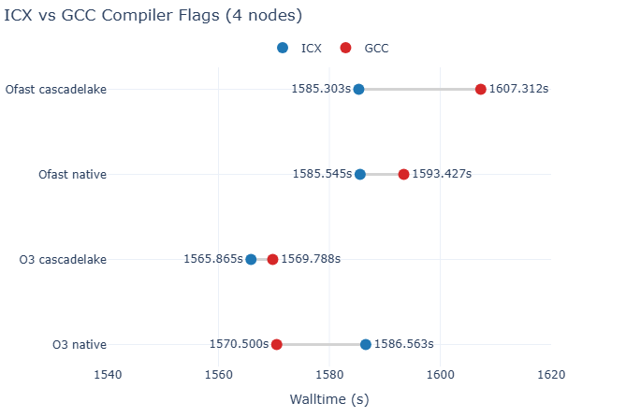
Task 1: Compiler Flags
Cluster hardware characteristic
Intel(R) Xeon(R) Platinum 8280 (Cascade Lake)
AVX-512 wide SIMD support
Optimization flag selection
Use architecture-specific flags (-march=cascadelake)
Evaluate optimization levels (-O3 vs -Ofast)
RESULTS
ICX generally performs better due to Intel-specific optimizations → ICX + “O3 cascadelake” is the best
Performance differences are moderate across O3 and Ofast → workload not purely
Notes:
TASK: EXPLAIN METHOD TO FIND SUITABLE COMPILATION FLAGS: explore hardware and then come up with corresponding flags

Slide 45
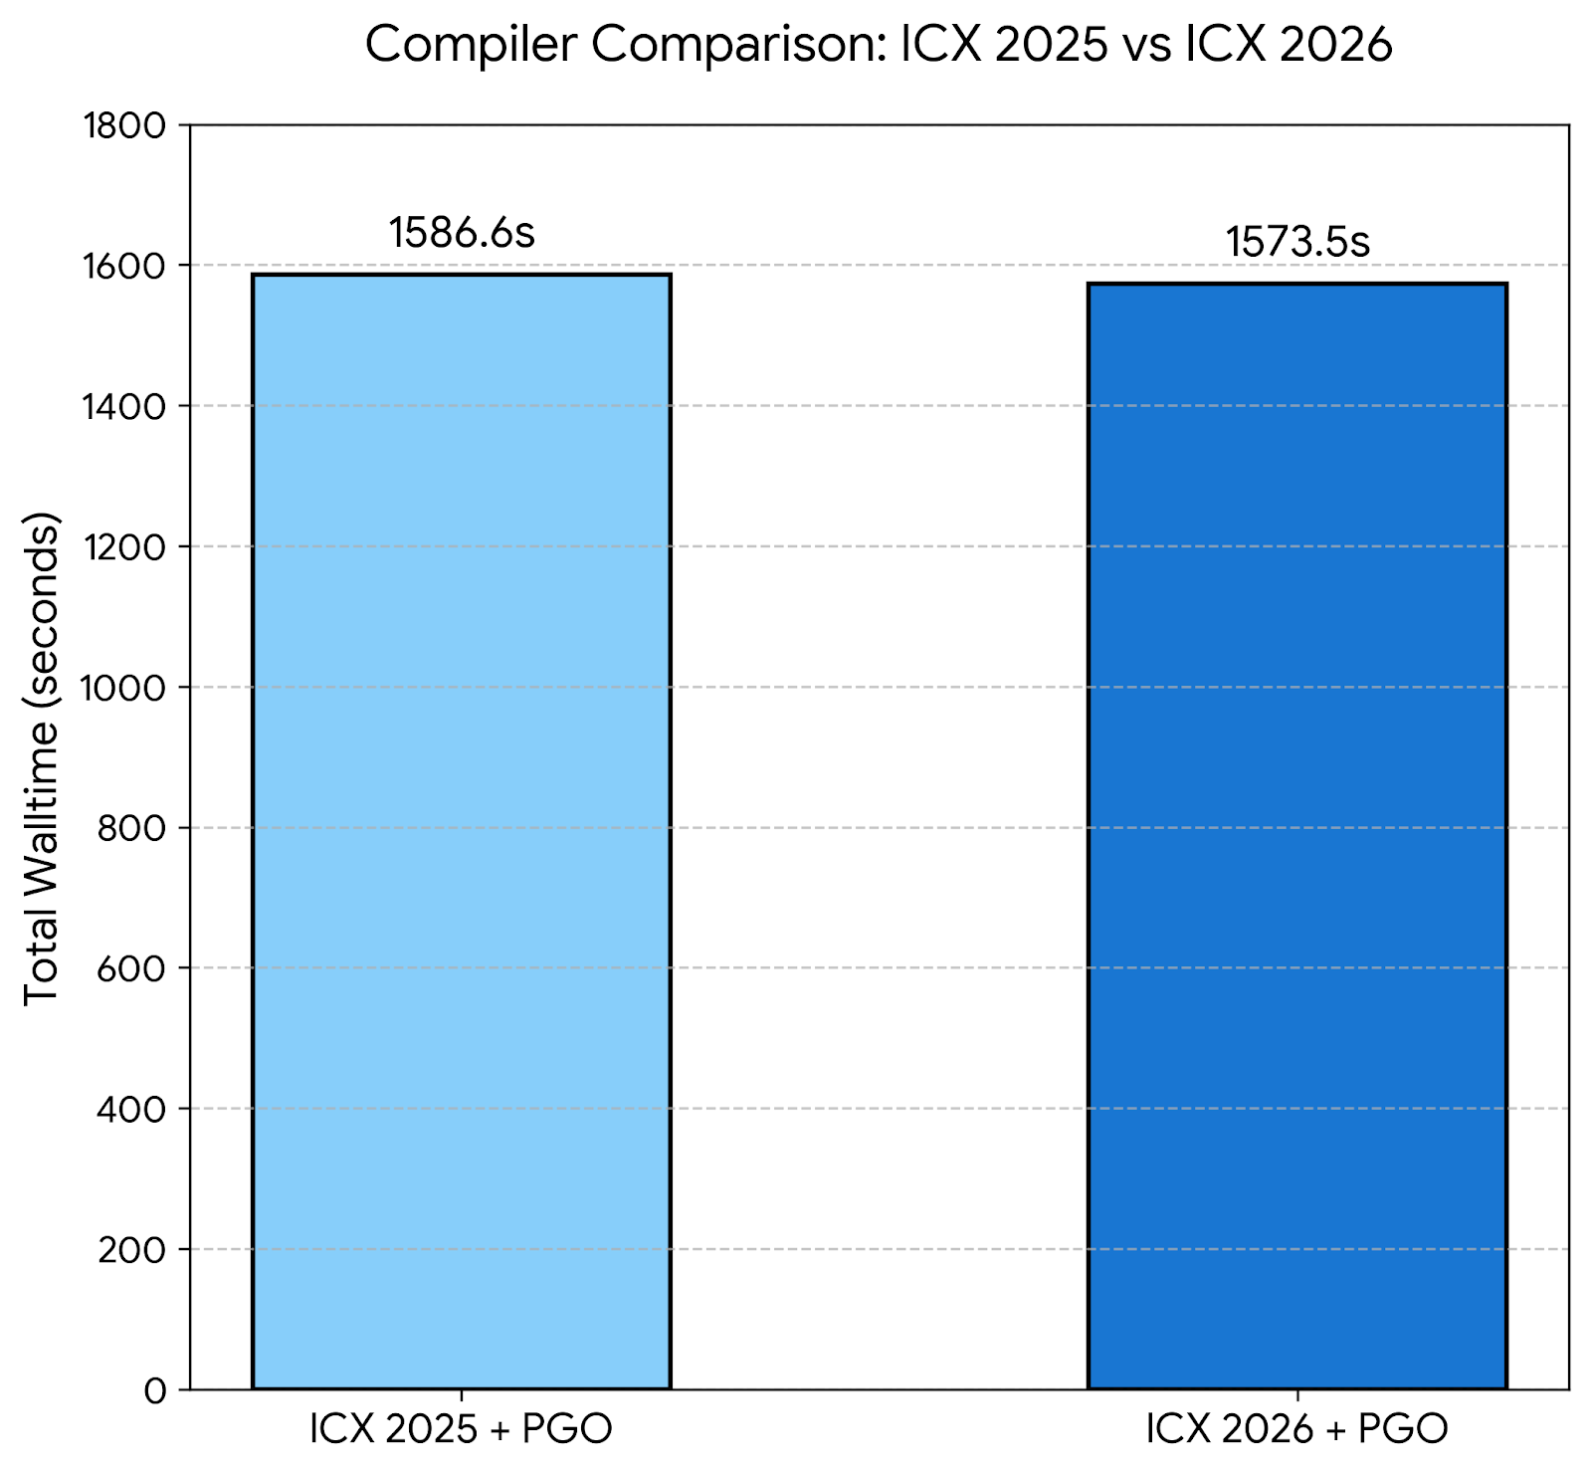
Task 1: Performance Guided Optimization (PGO)
Tailors branch prediction
Improves cache locality
Tested ICX26, which performed similarly but slightly better than ICX25

Slide 46
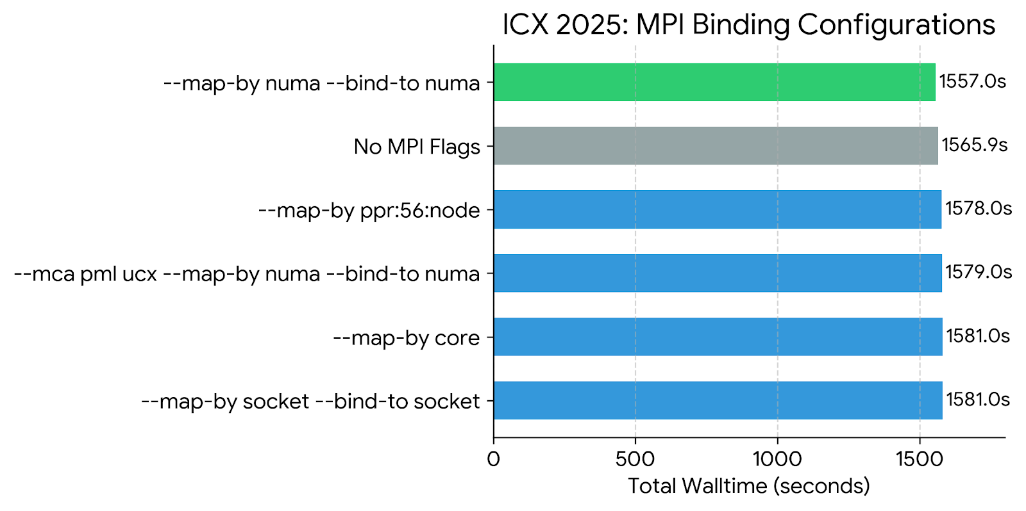
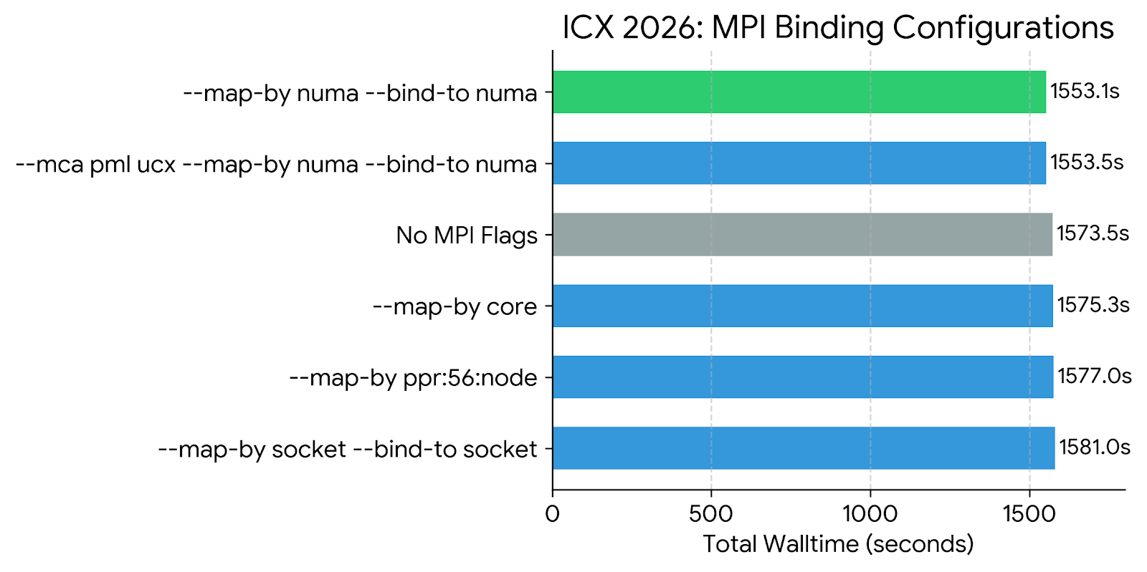
Task 1: MPI Flags
Enforcing NUMA-level binding resolved memory bandwidth limits, but ICX 2026 responded better to it, reporting the fastest walltime of 1553.1s
Notes:
We mapped out the MPI bindings for ICX 2025, but hit a wall—the compiler actually regressed when we tried to enforce core bindings. We then tested the same methodologies on ICX 2026, which cleanly interpreted the NUMA hardware topology and allowed us to drop our walltime from 1565s down to 1553s.

Slide 47
Task 1: Best build
 | Baseline | Best-build
Compiler and MPI | ICC23 + HPCX | ICX26 + OpenMPI
Decomposition method | nHierachical (8x7x4) | Multi-layer Scotch
Compiler optimization flag | None | -O3 -xCASCADELAKE -fprofile-use
MPI flag | None | --map-by numa --bind-to numa
Solver time | ~1904 seconds | ~1553 seconds
RESULT: ~18.46% FASTER COMPARED TO BASELINE
Notes:
THIS SLIDE IS FOR BEST BUILD VS BASELINE (IMPROVEMENT, TAKEAWAYS)

Slide 48
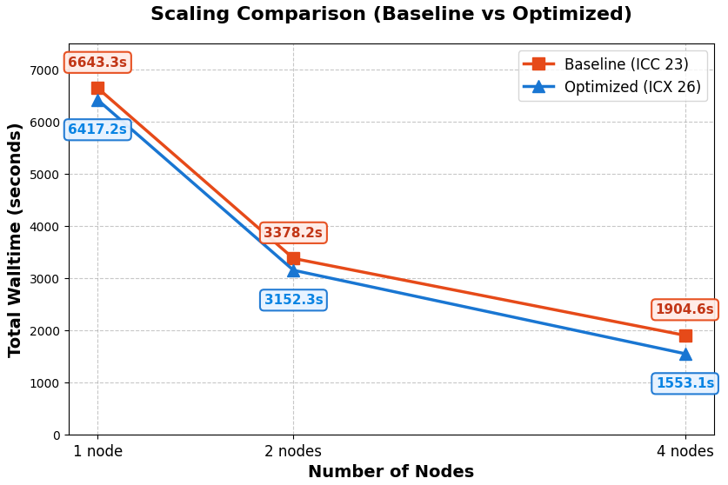
Task 2: Scalability (Baseline vs Optimized)
Baseline vs Optimized
1 node, 2 node & 4 nodes
Scaling analysis: Scaling is near-linear from 1 to 2 nodes, delivering a 2.04x speedup, and remains slightly superlinear at 4 nodes with a 4.13x speedup overall.
Performance comparison: ~18.46% faster

Slide 49
Task 3: Profiling
MPI Analysis
4 nodes
What are the 3 most used MPI calls in terms of number of calls and in terms of total CPU time consumed?

Slide 50
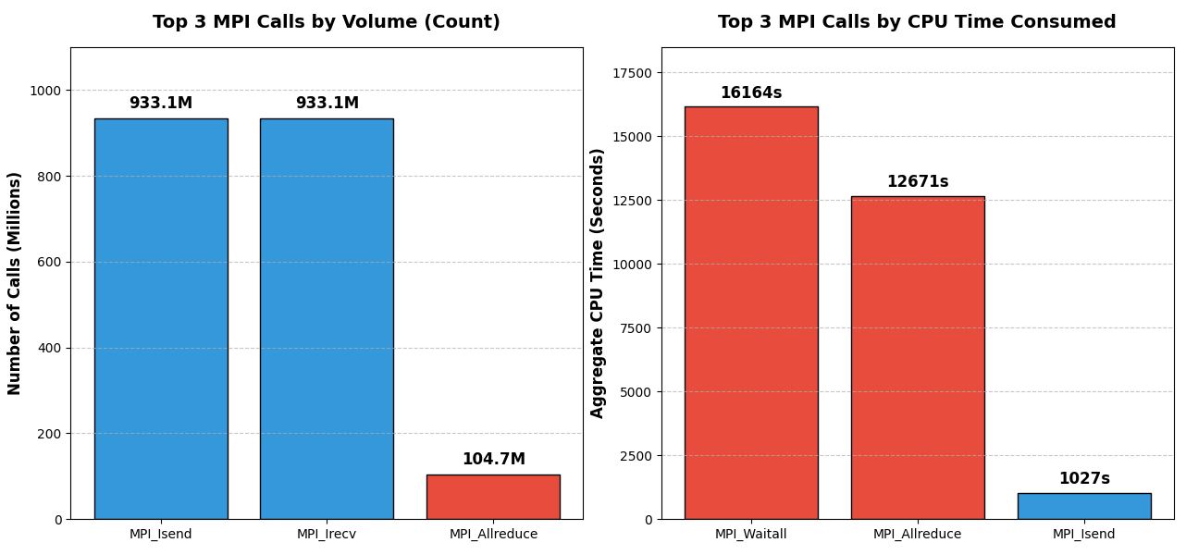
Task 3: Profiling (IPM) on SimpleFoam
Point-to-point exchanges (Isend/Irecv) dominate call count, but synchronization delays (Waitall/Allreduce) dominate CPU time. Computation time takes up 91.2% of total time while MPI takes up 8.8%
Notes:
● ICX26 PGO, 224 ranks, 4 nodes:
┌─────────┬───────┬───────┐
│ │ Time │ % │
├─────────┼───────┼───────┤
│ Compute │ 1439s │ 91.2% │
├─────────┼───────┼───────┤
│ MPI │ 139s │ 8.8% │
├─────────┼───────┼───────┤
│ Wall │ 1578s │ 100% │
└─────────┴───────┴───────┘
MPI breakdown:
┌───────────────┬─────────┬────────┬─────────┐
│ Function │ Avg (s) │ % wall │ Max (s) │
├───────────────┼─────────┼────────┼─────────┤
│ MPI_Waitall │ 72.2 │ 4.6% │ 136.8 │
├───────────────┼─────────┼────────┼─────────┤
│ MPI_Allreduce │ 56.6 │ 3.6% │ 99.1 │
├───────────────┼─────────┼────────┼─────────┤
│ MPI_Isend │ 4.6 │ 0.3% │ 18.5 │
├───────────────┼─────────┼────────┼─────────┤
│ MPI_Bcast │ 2.7 │ 0.2% │ 6.4 │
├───────────────┼─────────┼────────┼─────────┤
│ MPI_Allgather │ 1.6 │ 0.1% │ 3.6 │
└───────────────┴─────────┴────────┴─────────┘

Slide 51
Task 4: Visualisation
Paraview Images (2000 iterations)
Convergence plot of the drag coefficient (Cd), pressure (p), and velocities (Ux, Uy, Uz)
Pressure distribution and streamline
Notes:
Graphs to show:
Show reference results
Extra
What visualization aims to do:
Prove our solver works (show convergence): drag coeff convergence (1 slide), Ux & p (1 slide), error image (1 slide)
Show that our results agree with physics: p distribution, streamline (explain physics: p & U)

Slide 52
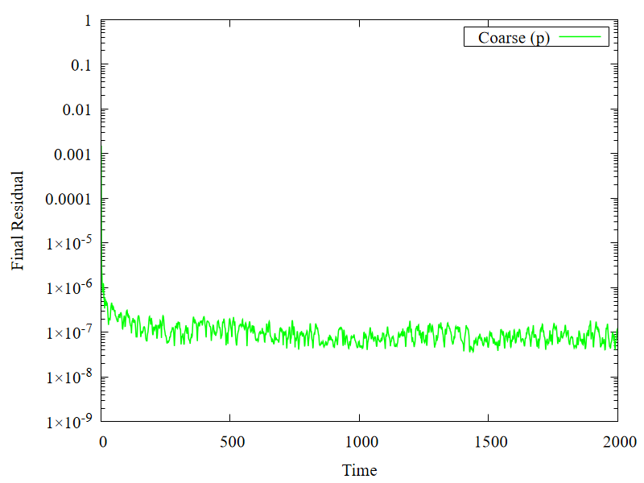
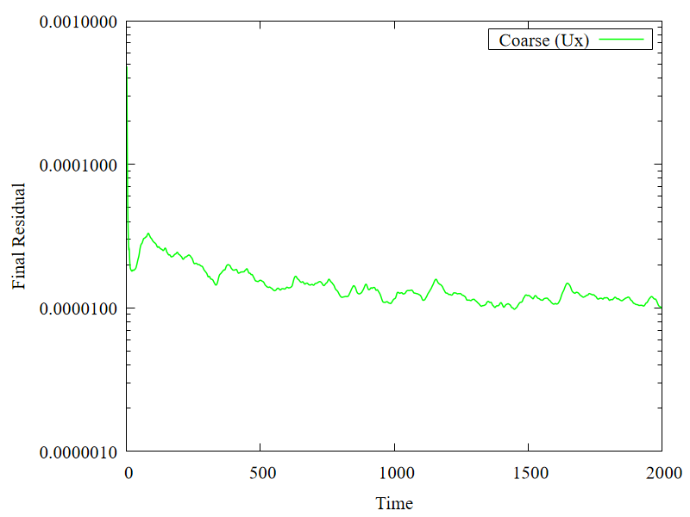
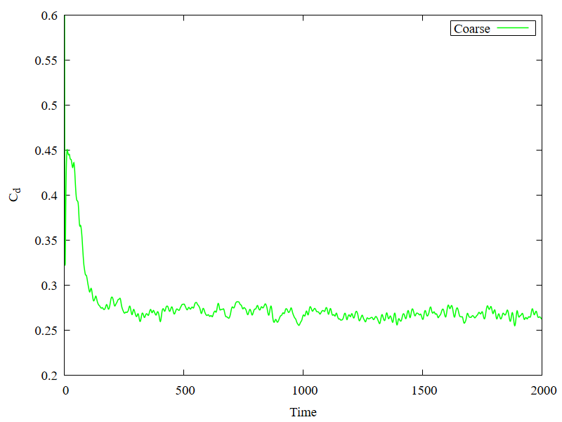
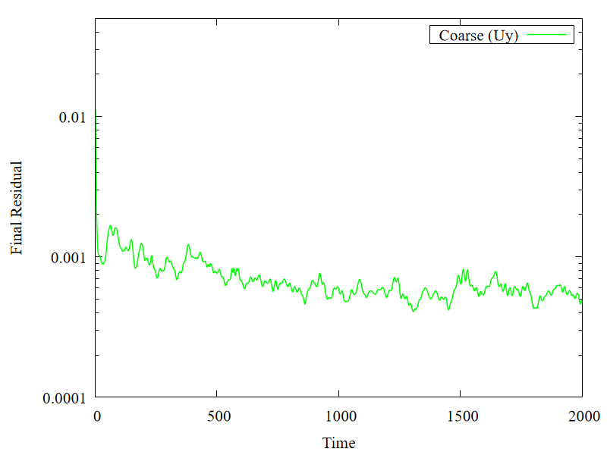
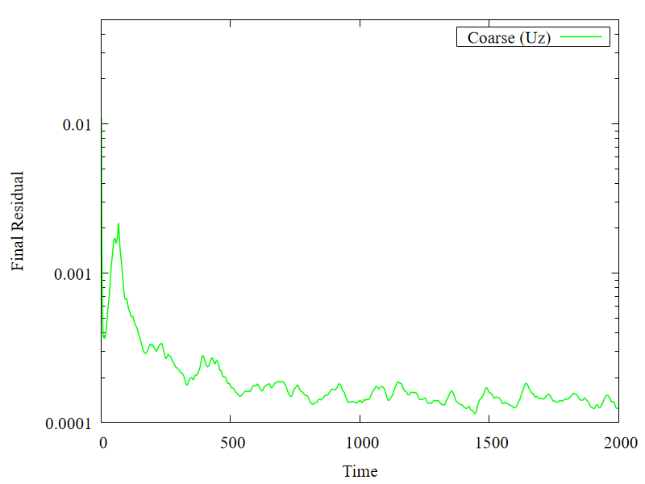
Task 4: Cd, p, and U convergence
Drag coefficient convergence
Pressure and Velocities convergence
Notes:
Decomposition method changes which cells sit on which processor and therefore how the domain is partitioned at processor boundaries GAMG builds its coarse level hierarchy based on cell connectivity — different decomposition = different coarse level structure = different number of effective GAMG cycles needed per iteration With nHierarchical the coarse mesh may be partitioned such that 12 GAMG iterations don't fully converge pressure, leaving residuals at ~1e-5 With Scotch weighted your decomposition likely produces better-balanced, lower-interface-area partitions, making GAMG more efficient — so it fully converges within 12 iterations, landing at ~1e-7 and producing your flatline

Slide 53
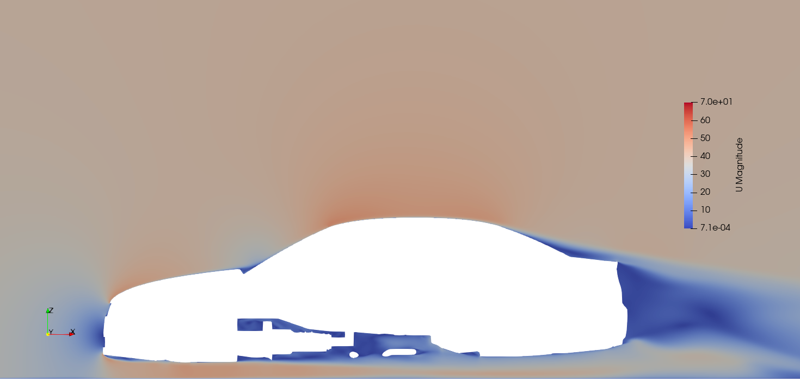
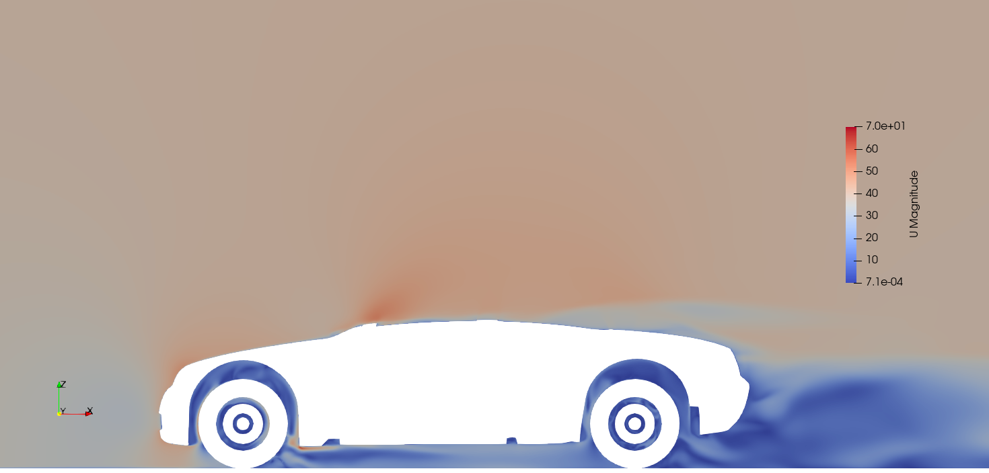
Task 4: Velocity
Velocity slice at y = 0m
Velocity slice at y = 0.75m

Slide 54
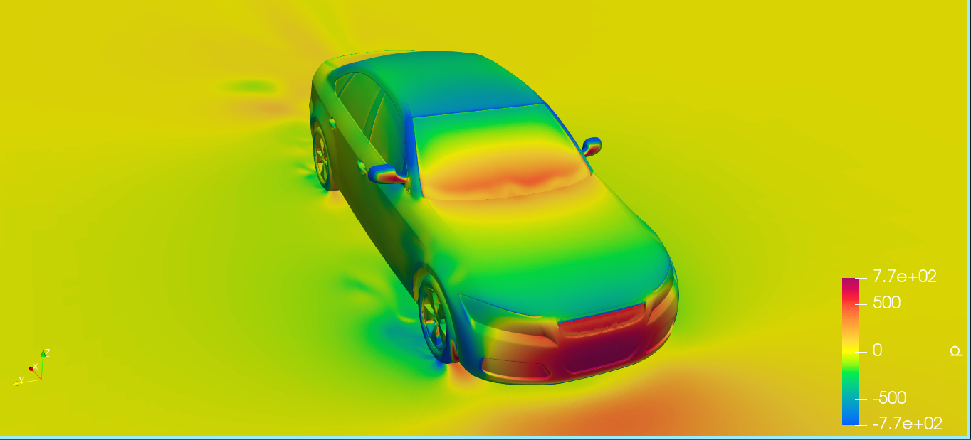
Task 4: Pressure distribution
Pressure distribution at the surface

Slide 55
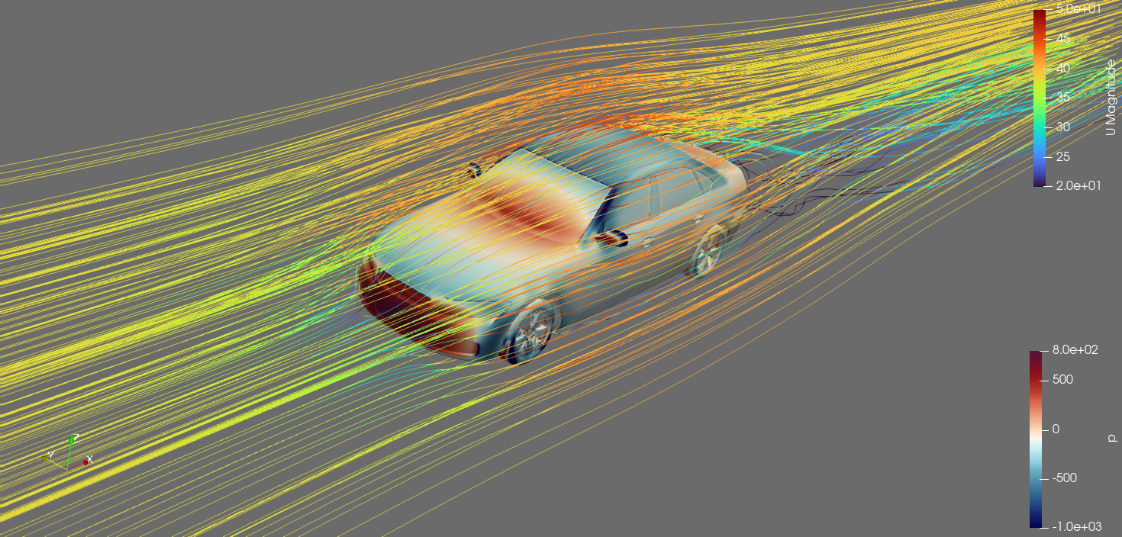
Task 4: Air streamlines
Streamline (velocity - pressure illustration)

Slide 56
Task 5: Mesh Decomposition (Bonus)
Analyse the performance of different mesh decompositions methods
Simple
nHierarchial (different XYZ splits)
scotch
multi-layer scotch (different weight-split combinations)
metis
kahip
multilevel

Slide 57
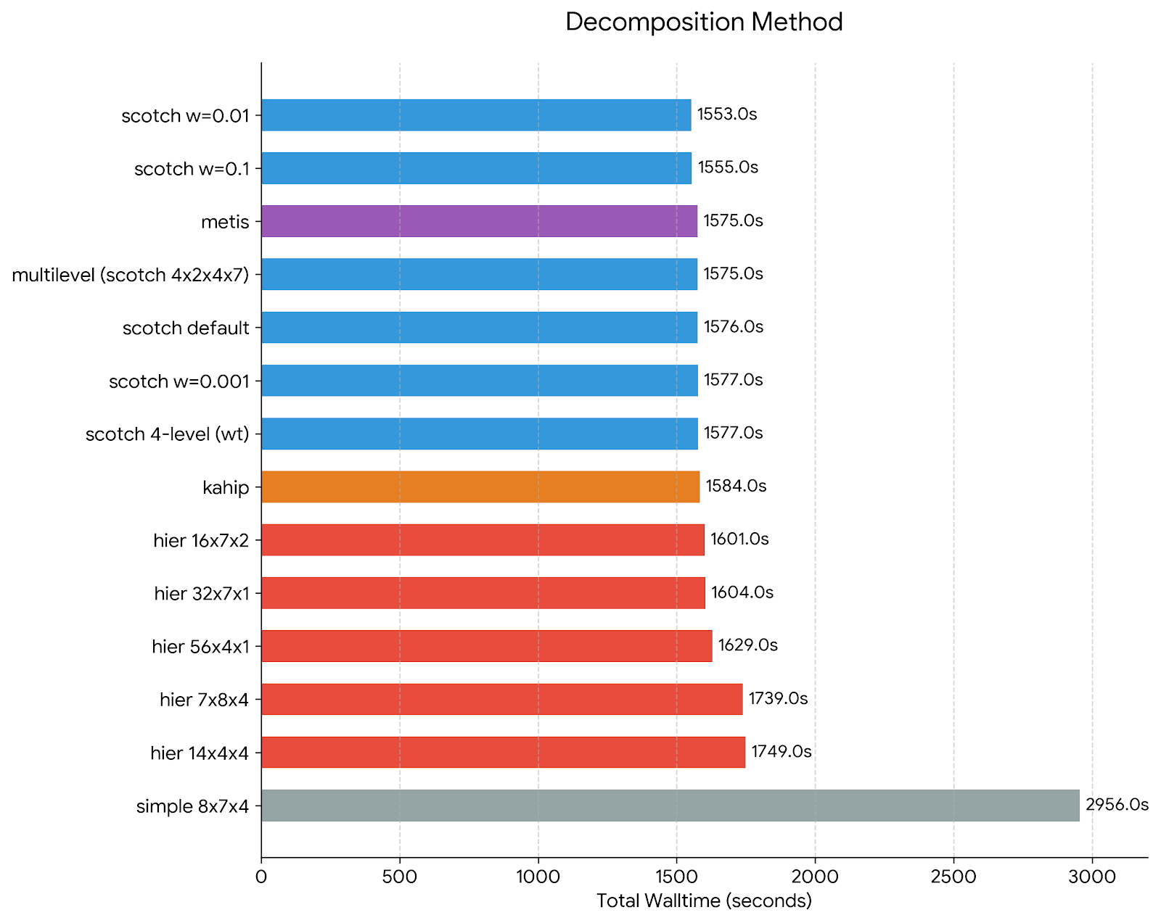
Task 5: Mesh Decomposition (Bonus)
Observations:
  Simple is worst → Fixed geometric split → severe load imbalance + high communication
  Hierarchical improves but limited → Better locality, but doesn’t target communication
  Graph-based methods (Scotch/Metis/Kahip) outperform → Minimize communication edges while maintaining load balance
Best configuration
  Multi-level Scotch (domains (4 56); domainWeights (1 0.01);) achieves best performance
  → Topology-aware (node → socket → core)
  → Minimizes inter-node communication
  → Maintains load balance
Notes:
Weighted Scotch was best because your profile is dominated by MPI_Allreduce and MPI_Waitall, which means the run is limited by synchronization and rank-to-rank waiting, so a decomposition that reduces expensive inter-node communication and gives better load balance lowers those waits more effectively than placement flags alone.
simple (8x7x4)
nHierarchical (7x8x4)
nHierarchical (14x4x4)
nHierarchical (16x7x2)
nHierarchical (32x7x1)
nHierarchical (56x4x1)
scotch (default)
metis
kahip
scotch {domains (4 56); weight (1 0.1)}
scotch {domains (4 56); weight (1 0.01)}
scotch {domains (4 56); weight (1 0.001)}
scotch {domains (4 2 4 7); weight (1 0.2 0.05 0.01)}
multiLevel {0: 4, scotch; 1: 2, scotch; 2: 4, scotch; 3: 7, scotch}

Slide 58
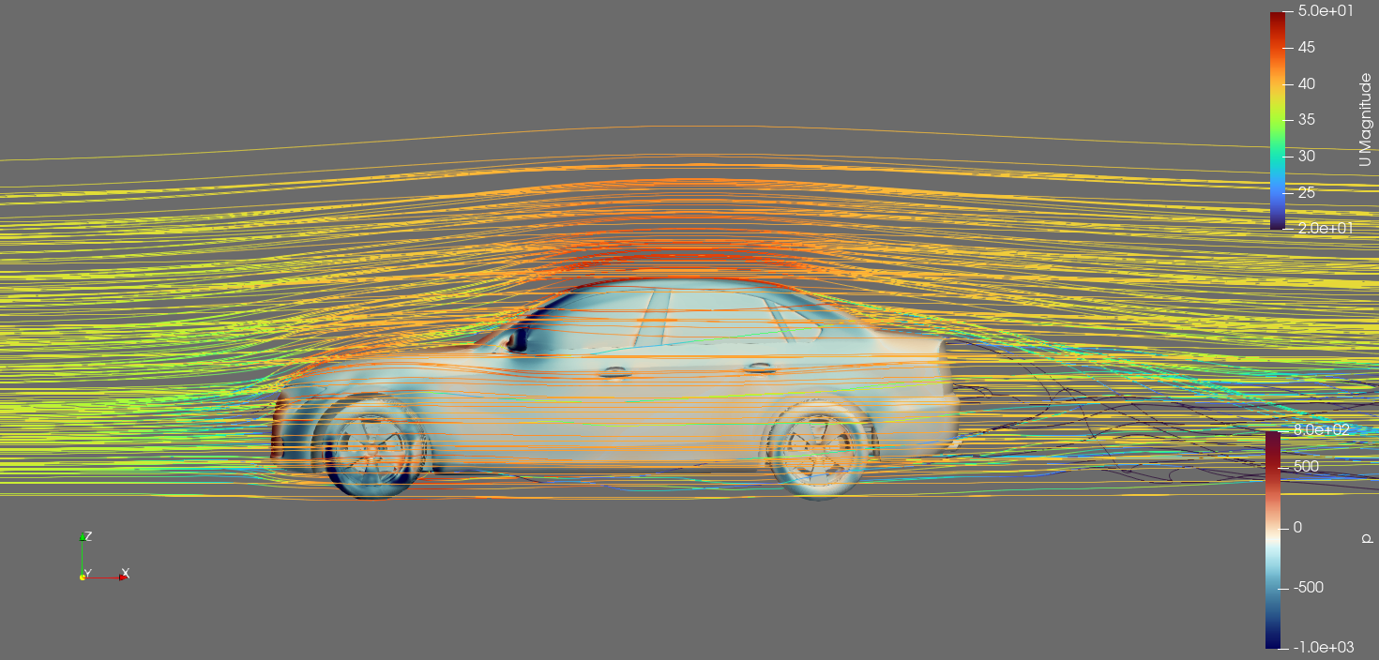
Results Summary of OpenFoam
Task 1 (Optimzation):
Best build: ICX26 + OPENMPI, “-O3 -xCASCADELAKE -fprofile-use”,
Best run : “--map-by numa --bind-to numa”
Decomposition method: “multi-layer scotch”
~18.46% performance gains compared to baseline
Task 2 (scalability analysis):
Linear scalability
Task 3 (profiling):
By time: Allreduce, Waitall, Isend
By count: Isend, Irecv, Allreduce
Task 4 (Visualization):
Cd, p, and U converges
p-U relation adheres to Bernoulli’s law
Task 5 (Decomposition methods):
Tested and analyse 14 decomposition methods
Multi-level scotch introduces the best performance gain
Notes:
Summarize tasks here, can change structure if needed to be more coherent

Slide 59
ASCOT5
ISC26 Virtual Student Cluster Competition

Slide 60
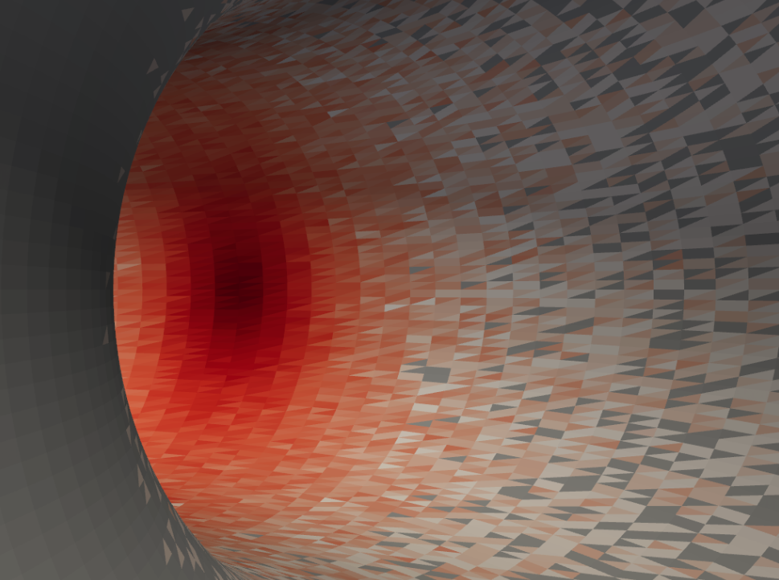

Overview - ASCOT5
ASCOT5 is a simulation tool used in fusion energy science and engineering
It solves test particle trajectories in magnetized plasmas using the Monte Carlo method
Has full 3D geometry capability, enabling visualisations of wall loads

Slide 61
Overview
Tasks
Run with GPUs on Romeo cluster
Run with CPUs on Iris cluster
Compare 1M input to 5M input on single GPU node (4 GPUs)
Perform MPI profiling on both clusters
Visualize the results

Slide 62
GPU - Dependencies
ASCOT5 5.6.3
CUDA 13.2
HPCX 2.26
NVC 26.1
HDF5 1.14.6
ACC 2.7

Slide 63
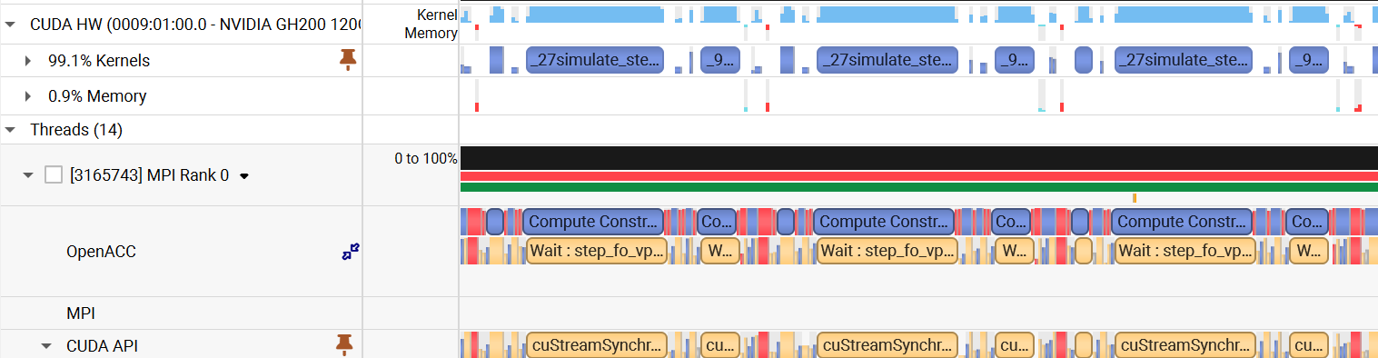
GPU - Profile
Nsys Profile
simulate step
endcon check
cpu launches kernels, calls cuStreamSynchronize to wait

Slide 64


GPU - Profile
Cuda API Summary
GPU Kernel Summary

Slide 65
GPU - Compiler Flags
Testing different optimization flags, only -Ofast gave a notable improvement
-Ofast implies -O3 -Mfma -Mfprelaxed -Mno-nan -Mno-inf -Mstack_arrays
-O3 is used as baseline as it is enabled by default when using -ACC
Flags | Time(s) | vs Baseline
-O3 (Baseline) | 127.0 | —
-O3 -Mfma | 128.3 | +1.0%
-O3 -Mfprelaxed | 90.0 | -29.1%
-O3 -Mno-nan -Mno-inf | 126.2 | -0.6%
-O3 -Mstack_arrays | 133.6 | +5.2%
-Ofast | 89.9 | -29.2%
Mfprelaxed drives most of the improvement
Mfprelaxed enables relaxed precision for certain operations. i.e. division, reciprocal, sqrt, etc…

Slide 66


GPU - MPI
MPI is only used at start and end of simulation
MPI_Recv is used the most, accounting for 90.5% of total MPI time
Top 3 calls are MPI_Recv, MPI_init_thread, MPI_Finalize

Slide 67

GPU - Scaling
1.7x speedup from 1 -> 2 nodes
1.6x speedup from 2 -> 4 nodes
Sublinear scaling
MPI time significant compared to simulation time

Slide 68

GPU - 1M vs 5M inputs
5M input took 4.22x time compared to 1M input
Efficiency improved by ~15.6% at the 5M scale compared to the 1M baseline: MPI time amortized

Slide 69
CPU - Dependencies
ASCOT5 5.6.3
ICC 2021.10.0
Intel MKL 2023.2.0
HPCX 2.25.1
HDF5 1.14.6

Slide 70

CPU - Procs & Threads
Each cluster node consists of 2 NUMA nodes, 28 cores each with no hyperthreading
Mix and match procs x threads = 56
2x28 works best, aligning with the NUMA architecture

Slide 71

CPU - Compiler Flags
-xHost gave the biggest improvement, enables AVX-512 instructions
-ipo optimizes better than -ip, with tradeoff of longer compilation times
34.9% improvement over baseline

Slide 72

CPU - NSIMD
NSIMD controls number of particles batched together and processed by each thread via SIMD vectorization
At 16, loop overhead is amortized and fully pipelined

Slide 73

CPU - Scaling
2x speedup from 1 -> 2 nodes
2 x speedup from 2 -> 4 nodes
linear scaling
particle simulation is embarrassingly parallel
minimal MPI usage + amortized

Slide 74


Visualisation
Positions of the lost markers (red) on the reactor wall (black).

Slide 75
Summary
GPU
Best timing of 89.9s
29.2% improvement over baseline
MPI time significant compared to runtime - sub-linear scaling
CPU
Best timing of 765.14s
34.9% improvement over baseline
MPI time not significant compared to runtime - linear scaling
Overall
Extremely parallelizable workload with minimal MPI usage
GPU much faster than CPU due to this
Speeding up may come at cost of numerical accuracy

Slide 76
HemeLB
ISC26 Virtual Student Cluster Competition
Notes:
Moving to HemeLB.

Slide 77

HemeLB: Overview
HemeLB uses Lattice Boltzmann methods (LBM) to simulate fluid dynamics
openFOAM: macroscopic Navier-Stokes equation; LBM: microscopic
Faster for complex boundaries, e.g. blood vessels
Collision is localized in nature which enables better parallelization especially on GPUs
Memory bandwidth-bound on modern CPUs and GPUs
2 Stages:
Collision: localized, memory bandwidth-bound
Streaming: need halo exchange, memory bandwidth and inter-node comms bound
HemePure defaults to D3Q19 LBGK, which means 3D grid space with 19 possible directions to stream to. Other variants includes D3Q27.
Notes:
HemeLB uses LBM to simulate fluid dynamics
Unlike openFOAM which solves the Navier-Stokes equation on macro level, LBM uses a grid to simulate particle density on a micro level.
Because its grid structure naturally models boundaries well, it can be much faster to run for cases with complex boundaries, for example blood vessels
The LBM process has 2 stages that runs in a loop.
Collision, which is highly localized but memory bandwidth bound
Streaming, which requires halo exchanges and is memory or communication bound
QnA on details of 2 stages:
Collision, where particles collide within a grid to decide each particle’s ending velocity. Collision is highly localized as it only care about one grid, but it is memory bandwidth bound as it need to read and write large amount of direction data
Streaming, where particles move from current grid to a neighboring grid in the direction determined by collision. This step needs to exchange information with immediate neighbors, which can be memory bandwidth or communication bound depending on where the neighbour is.

Slide 78
HemeLB: Config Terms
Config 1 — Baseline
Config 2 — Best Flags
Config 3 — Code Optimizations
Upstream code from UCL-CCS, FullBuild.sh benchmark mode, ParMETIS=OFF, LOG=Info, using given system compilers
Intel 2024.3 bundled with Intel MPI 4.1
Newer compiler with optimal compiler flags, ParMETIS=ON for CPU, OFF for GPU, SIMD bug fix, no code changes
GCC 15.2 with OpenMPI 5.0.8
CPU: Prefetch, Persistent MPI, Fused LBGK, int32, pull streaming
GPU: Scalarized kernels, persistent MPI, hybrid 6+1 streams, int32, pull streaming
GCC 15.2 with OpenMPI 5.0.8
CUDA 13.2
Notes:
I will use 3 terms to represent different stages of optimization. Config 1 refers to the benchmark mode of the baseline script, following all given instructions. Config 2 switches to the best compiler across many that we tested, and adding compiler flags without touching the source code. Config 3 is with various source code optimizations. For the following results, we report based on our best which is config 3, unless otherwise specified.

Slide 79


ParMETIS on Iris (CPU)
With a huge # of ranks (224), ParMETIS is crucial for scalability by balancing workload better.
Partitioning overhead break-even at ~12K steps. Beyond that, it is a net wall time improvement.
Notes:
Firstly on choice of parmetis. On CPU, it clearly helps because with the huge 224 ranks to partition, it causes up to 89% workload imbalance which hinders scalability. We also accounted for the partitioning overhead which will break even around 12k steps on 4 nodes.

Slide 80

ParMETIS on Romeo (GPU)
Simulation time increased 33.2s → 36.1s on 4N.
Load balance improvement is limited: 18.4% → 3.4% imbalance, as much less ranks
The default algorithm (PartKway) reduces spatial locality for GPU LBM kernel’s SoA layout, which heavily depends on coalesced memory access.
A better option is to use PartGeomKway of ParMETIS or other algos with better spatial locality
Notes:
However, on GPUs, we have surprising results where the pure simulation time also increased with parmetis on.
This can be attributed to 2 things.
Firstly, the load imbalance is not as significant compared to on CPU. Parmetis does improves it but here comes the second part.
The default algorithm used looks to minimize inter process communication but ignores real 3D coordinates. This make physically nearby grids to be scattered in memory, forcing the kernel to read scattered memory addresses. This reduces cache locality, compared to a basic decomp where you have sites that are geometrically next to each other also together in the memory, so they can be read together in one cycle.

Slide 81

Task 1.1: CPU Strong Scaling on Iris
Results (C3, 50k steps, MLUPS)
(mon ON) / (mon OFF)
1N 213.3 / 242.6
4N 883.7 / 1,005.8
4.14× speedup 1N → 4N (mon ON)
103.6% efficiency at 4N: super-linear
Notes:
CPU shows strong scaling on Iris across all 3 configs, with our optimized version moving from sublinear to superlinear scaling, because our code changes shifted the bottleneck from communication to compute. In our report, we also estimated further scaling trends.

Slide 82

Task 1.1: CPU Strong Scaling on Iris
For D3Q19,
Working set = sites/rank x 19 x 8 bytes x 2 (fOld + fNew)
Why Super-Linear Scaling (in C3 only)
Code + compiler optimizations reduced comms bottleneck, shifting to compute bottleneck
Driven by cache effect: working-set shrinks 268 → 67 MB (7× → 1.7× L3)
Predicted to be linear beyond 380 ranks due to working set < L3 cache
Notes:
Super-linear scaling comes from the cache effect. As calculated for this specific task and iris cluster, the working set shrinks with more ranks approaches the L3 size as we scale. The cache locality is what enables this super scaling, and we expect it to revert to linear beyond 380 ranks where the working set goes below L3 cache size.

Slide 83

Task 1.2: MPI Rank Count: Bandwidth-bound on Iris
Config 3, Aneurysm-VIRTUAL, 50k steps, monitoring OFF
Finding: LBM is memory-bandwidth-bound on Iris
28 → 56 cores on 1 node: only +10.8% throughput despite 2x compute
Each socket -> 6 DDR4-2933Mhz (~110GB/s), 14/socket nearly saturate bandwidth
Per-core efficiency drops 45%
Scale out > scale up by adding fresh memory bandwidth. 4N/56 rank provide 2.3x 1N/56 rank MLUPS despite same total ranks
LB calc max drops only ~11% with 2× cores: memory BW, not ALU, is the bottleneck
Notes:
We studied changing MPI ranks per node. Doubling cores from 28 to 56 on one node only gains 10.8% throughput, while using the same 56 ranks but across 4 nodes give 2.3 times throughput. This confirms a well known bottleneck of LBM which is memory bandwidth. By scaling out, we are effectively scaling memory bandwidth per rank.

Slide 84


Task 1.3: Monitoring Overhead (ON vs OFF)
Notes:
Monitoring is the process of extracting values like velocity and pressure during the simulation to check stability. This requires global aggregation.
Monitoring costs a consistent 12–14% across all node counts. MPI Waitall drops 17% when we turn monitoring off because the rank doing the monitoring will take longer while everyone else wait for it.
QnA:
The other changes are statistical noise. Only waitall and startall. Startall is due to monitoring forcing more CPU cache eviction which causes OS jitter and make each MPI call slower.

Slide 85

Task 1.4: Intrinsics: Upstream Bug Discovered
#ifdef chain in src/lb/lattices/Lattice.h:359 checks SSE3 before AVX2
FullBuild.sh benchmark mode set both ON, runs the 128-bit SSE3 path ONLY
Fixed config: SSE3=OFF, AVX2=ON - picked up as part of Config 2
Auto-vec refers to compiler flag -mprefer-vector-width=256 which we turned on for all tries
Notes:
On CPU intrinsics, we found a bug in the code. It checks for SSE3 before AVX2 in a ifdef chain, so the default benchmark mode with both turned on will prematurely go to the SSE3 path and ignore the AVX2 kernel. Fixing this bug gave benefit of 0.4% over benchmark mode.

Slide 86

CPU Optimization Journey (Iris, 4N, mon OFF)
Notes:
Here we show a cumulative chart of our various optimizations. Due to time limit I will only go through some of them, and the others you can find in our submitted report or during QnA

Slide 87
CPU Compiler Flags/Env Var
GCC 16.1.0
-O3 -march=native -funroll-loops -falign-loops=32 -falign-functions=32 -flto=auto -flto-toplevel-asm-heuristics
-mprefer-vector-width=256
  AVX512 no improvement on Iris due to CPU downclock
various math optimization flags with correctness validated. -Ofast results in numerical error.
-fselective-scheduling2 -fmodulo-sched -fmodulo-sched-allow-regmoves
  improves instruction scheduling to keep CPU pipeline full
HEMELB_USE_SSE3=OFF, AVX2=ON
HEMELB_USE_PARMETIS=ON
HEMELB_LOG_LEVEL=Warning
Notes:
Here are the final compiler flags we arrived at. We did not use AVX512 because test result shows no benefit due to cpu downclocking. We do expect newer generations of CPUs with less penalty to have a net improvement on AVX512.
For all math related flags, we verified their numerical accuracy, notably, Ofast results in numerical error. For the instruction scheduling ones, they only became useful after we did pull streaming as it shifted bottleneck from memory bandwidth to instruction scheduling. The same also caused us to switch from intel compiler to GCC, as the latter seem to do this better.

Slide 88

Persistent MPI
MPI_Startall replaces MPI_Isend and MPI_Irecv in sim loop
Inspired by Collom, G., Burmark, J., Pearce, O., & Bienz, A. (2024). Persistent and partitioned MPI for stencil communication. HPEC 2024
Notes:
Persistent MPI is introduced by Collom, and we implemented it, because HemeLB involves a lot of small but frequent halo exchanges via MPI, which is very latency sensitive. It reduces the number of MPI calls significantly while also making it nearly invariable to rank counts, which improves scalability.

Slide 89


CPU: Pull Streaming (original impl. on BFL boundary cond.)
Optimization transferred to GPU for bigger improvement. Correctness validated to within 1.23 × 10⁻⁶
Notes:
Pull streaming is one of our original implementation. We implemented it with the BFL boundary condition, and there is no reference open source implementation for that so it took us very long to get it numerically correct. Push streaming does scattered writes per site, while pull does contiguous writes and scattered reads. This greatly reduces read for ownership overhead on writing, as proven by vtune profiler.
We also ported this to GPU, which gave a even bigger win due to higher compute to memory bandwidth ratio.

Slide 90
CPU Optimization Summary
~30% consistent improvement across 1-4 nodes on MLUPS VS baseline (bench mode)
Improved baseline from sub-linear scaling to super-linear scaling up to cache size benefit
Correctness strictly validated by comparing point-wise every float in output files
Mostly inspired by CPU-GPU co-optimization flywheel (transferring optimizations that works on 1)
Profiled using Intel VTune and Intel Advisor
Details in report
Notes:
Overall, we achieved constant 30% improvement over 1 to 4 nodes compared to baseline in benchmark mode, and made it from sublinear scaling to super linear scaling.
One trick we used is to do CPU and GPU co-optimization. This is sort of a flywheel where we try to port optimizations that only existed on either side to the other.

Slide 91
GPU: note on mpirun -np N
The default setup uses N = num GPU
Sub-optimal as rank 0 used as I/O rank exclusively while GPU is kept idle
Corrected: -np N+1
  i.e. -np 5 for 1 node, -np 17 for 4 nodes
All Config 1 (C1) results based on -np N+1 for fairness
If using -np N as baseline:
  +297% (single-node C1 → C3)
  +85.6% (4 nodes C1 → C3)
Notes:
Before getting to GPU results, we need to clarify something on the MPI run arguments.
The instruction given uses N to be same as number of GPUs, which we found to be suboptimal. It actually keeps 1 GPU idle because that rank is used exclusively for IO.
For fairness sake, in all subsequent comparisons, we assume np equals N+1.

Slide 92

Task 2.1: GPU Strong Scaling on Romeo
Results (C3, 50k steps, mon OFF)
1N (4 GPU): 26,577 (6,644/GPU)
4N (16 GPU): 72,253 (4,516/GPU)
Peak: 6,644 MLUPS/GPU at 1N
Efficiency falls: comms overhead outweighs compute, per-rank site count too little
Notes:
On GPU side, we have even greater performance improvements. The original code scales slightly sublinearly, and our optimized version is a whole level higher performance but scaling efficiency seems to drop. We investigated and I will explain this in detail later.

Slide 93
Task 2.2: I/O Frequency Impact (4N × 4 GPU, Config 3)
Modifying <propertyoutput> period: default ANUplane=5000, inlet/outlet=10000
Config | ANUplane period | Inlet/Outlet period | Extractions | Sim (s) | MLUPS | vs default
No I/O (disabled) | — | — | 0 | 30.47 | 81,203 | +12.4%
0.1× (less frequent) | 50,000 | 100,000 | ~1 | 30.49 | 81,150 | +12.3%
1× default | 5,000 | 10,000 | ~40 | 34.25 | 72,253 | —
10× (more frequent) | 500 | 1,000 | ~400 | 58.9 | 42,007 | −41.9%
Findings
Default cost ~12.4% vs I/O-off
10× is expensive (−41.9%) - each extraction is GPU → host transfer + MPI gather → rank 0 + file I/O
Notes:
On the output frequency impact. Default costs about 12% vs no I/O. 0.1× is almost same as no-I/O, because it is just 1 extraction. 10× the output frequency costs 42%. So there is significant impact from I/O.

Slide 94

GPU Optimization Journey (Romeo, 4N × 4 GPU)
Notes:
Here is an overview of all the optimizations we did. Again, i will go through some of these only.

Slide 95

GPU Optimization Journey (Romeo, 4N × 4 GPU)
Notes:
Here is the scaling effect of each of our optimizations. You can see that they pretty much improve if not maintain scalability except for the pull streaming, which I will explain later.

Slide 96
GPU: Compiler Flags
GCC 15.2.0
-O3 -march=armv8.5-a+sve+sve2+dotprod+i8mm+bf16+crypto+lse -mtune=neoverse-v2 -flto=auto -fipa-pta -fno-math-errno -fno-trapping-math -fno-signed-zeros -funroll-loops
NVCC 13.2
-O3
--maxrregcount=128 : intentionally limit occupancy to reduce cache thrashing. Against conventional wisdom that higher occupancy → higher performance. 256 tested to be worse.
Undocumented NVCC heuristics behaviour: specifying this flag with any number will turn off compiling for occupancy, and will INCREASE register usage (44→126)
CMAKE_CUDA_ARCHITECTURES=90
Notes:
Firstly the compiler flags. CPU side is basically same as on Iris. For NVCC side, the key is maxregcount. We discovered undocumented behaviour in nvcc heuristics. Normally you would think higher occupancy on GPU means higher performance. But actually for LBM this is not the case. Without this flag, nvcc will compile it to use only 44 registers, so that it can maximize occupancy of the 256 available on Hopper GPUs. However this causes significant cache thrashing due to register spilling. By providing this flag, regardless of what value you set it to, it will change the heuristic to prioritize hitting the max you specify, even if that reduce occupancy.
By deliberately limiting occupancy, we reduce cache thrashing and thus improved throughput. We have done assembly analysis to confirm this.

Slide 97



GPU: Scalarizing Kernel
Eliminated local memory usage (from 59.04M Inst), zero register spill
-95% ICC req, -50% IMC req → much less instruction cache miss, more efficient loops
Eliminated IDC req → zero indexed constant
Halved L1<->L2 and L2<-> VRAM traffic
Notes:
The most beneficial optimization we done is to rewrite the kernel code to scalarize it. The existing code uses array indexing which is not recommended in cuda programming guide as it causes a lot of local memory usage. By doing so, we eliminated 59 million instructions for local memory, halved L1 to L2 and L2 to VRAM traffic, and greatly improved instruction fetching and caching.

Slide 98

GPU: Hybrid 6+1 CUDA Streams
12 CUDA streams were launched: 6 collision types x 2 phases, PreSend and PreReceive
Merged 6 PreReceiver interior kernels as no inter-type dependence
Reduces stream management overhead
Scales well

Slide 99

GPU: Pull Streaming
Notes:
By switching to pull streaming, we reduced 31% of kernel runtime by greatly improving compute and memory utilization, and saturating L2 cache bandwidth.

Slide 100
GPU: Pull Streaming Scalability (Strong Scaling)
Pull-streaming’s benefit scales with volume/sites per rank
Adds cost that scales with surface/boundaries per rank
As rank grows, volume to surface ratio drops
Cross-over ~2M sites/rank
For Aneurysm-VIRTUAL, 4N = 3.1M sites / rank, 8N = 1.5M
At 4N, Pull +8% vs Push. At 8N, Pull -24% vs Push
At 8N, ~80M sites would bring to even. ~200M sites would restore 40% gain over push
Notes:
Now back to why pull streaming seems to be less scalable in strong scaling. The main reason is that pull streaming optimizes compute time which scales with sites per rank, but adds a cost that scales with surface per rank. As rank count grow, volume to surface ratio drops. We estimate empirically that the cross over is about 2 million sites per rank. We tried running on 8 nodes and it was much slower than push streaming for this reason. However, we estimate that with a larger problem size, pull streaming can maximize its benefit and show up to 40% improvement.
QnA:
what is additional cost on surface that dont exist on push streaming
Push streaming uses scattered writes which is already bottlenecked on GPU. The costs of scaling with surface is completely masked by cost of slowing compute efficiency
On pull streaming, the compute part which scales with sites per rank is not bottlenecked anymore. However, it relies on a sequential memory layout, and boundaries must be packed into a halo buffer before it can be read sequentially. This additional packing step, together with removed compute bottleneck, makes the whole process now bottlenecks by boundaries per rank.

Slide 101

GPU Optimization Summary
Single node gain of 132%
4-node gain of 68.2% (limited by problem size)
Notes:
In summary, we achieved single node gain of 132% and 4 node gain of 68.2%, limited by problem size.

Slide 102

Task 3.1: MPI Profiling on Iris
Notes:
Moving to MPI profiling on Iris. Generally the top one is waitall as expected in most distributed work. Focusing on this, our optimizations cut per-rank Waitall by 74%. Note that Allreduce in config 3 comes from ParMETIS, and is not part of the simulation loop.

Slide 103


Task 3.1: MPI Profiling on Iris
Notes:
Comparing 1 node to 4 nodes, the baseline shows increased MPI time because adding more rank worsens the workload imbalance, but after our optimizations, it flipped to decreasing. This reflects improved workload balance and MPI overhead despite having more ranks to communicate.

Slide 104

Task 3.1: MPI Profiling on Iris
Notes:
You can see that our optimizations reduce both compute and communication time.

Slide 105

Task 3.1: MPI Profiling on Iris (Config 3 excl. All Reduce)
Notes:
Across node counts, our persistent MPI implementation made total MPI call count invariant to node counts, greatly improving scalability on the comms side.
Notice that 2 nodes has worst compute to comm ratio due to introducing inter-node comms, commonly known as denominator effect in strong scaling. But for 4 nodes, it actually have the least comms overhead, and that’s because the reduction in working set enables higher cache locality which significantly reduced per rank compute time and the impact of imbalanced workload.
The timings for startall and Isend are not meaningful because these are async calls.

Slide 106
Task 3.1: MPI Profiling on Iris (Config 3)
Per-rank Waitall %time peaks at 2N (20.3%) then drops to 9.2% at 4N
2N has worst compute/comm ratio: large working sets AND inter-node latency
4N: working set fits closer to L3 → cache reuse reduces per-step time
Confirms hypothesis on CPU super-linear scaling (Task 1.1)
Persistent MPI optimization made relevant MPI calls (Startall) to not scale with node count, reducing scaling-induced MPI overhead
All Reduce is from ParMETIS only and it scales with rank count only. Not involved in iterative simulation.

Slide 107

Task 3.2: MPI Profiling on Romeo
Notes:
Moving on to MPI profiling on Romeo. Our optimizations reduced aggregate Waitall by 70%, similar to Iris. The top 3 functions remain same.

Slide 108

Task 3.2: MPI Profiling on Romeo
MPI Waitall % time increases from 11.2% to 27.6% for Config 3
Notes:
On Config 3, we see that MPI wait time percent doubled from 2 to 4 nodes, which is also a larger percentage increase than Config 1. This is different from Iris.This shows that on Romeo, the internode comms is more bottlenecking than on Iris because of much faster compute, which is amplified by our compute related optimizations. This is the major blocker for scaling, and can be partly attributed to the small test case size.

Slide 109
Task 3.2: MPI Profiling on Romeo (Config 3)
2N → 4N saw compute time halve (61.9s → 36.7s), but MPI wall time % increase (11.2% → 27.6%) due to halo exchange surface per rank having to serve 2x as many neighbour pairs inter-node.
MPI_Waitall aggregate increase 102s → 229s as ranks wait longer for neighbour. Dominant factor slowing down scaling.
After code optimizations (from Config 1 to Config 3), MPI wall time % increased as compute time decreased more than MPI time decreased

Slide 110

Task 3.3: MPI Profiling Iris VS Romeo
Top 3 Calls by wall time (Config 3 on 4 Nodes, mon OFF)
Observations
Waitall higher % on GPU is misleading
Send/Receive are optimized away by Persistent MPI, not shown in profiler
The rest are one-time/infrequent MPI calls
Notes:
Comparing Iris and Romeo, both are dominated by Waitall, but the mechanism differs.

Slide 111


Task 3.3: MPI Profiling Iris VS Romeo (Config 3)
Waitall on GPU ≠ idle - kernels run async inside the wait (real idle ≈ 7% from Nsys timings)
Waitall on CPU = partially idle - compute/communication not fully overlap due to contention of CPU
Notes:
Waitall on GPU is misleading because it is not actually idle time. Once the CPU launches the GPU kernel, it can move away and focus on MPI calls. Nsys timeline shows that GPU kernels keep running inside the waitall, effectively overlapping comms and compute. Real measured idle time is only about 7% in between kernel launches. On CPU however, MPI calls like Waitall have to compete for CPU resource. So one cannot directly compare these figures across CPU and GPU.

Slide 112

Task 4: Visualization
Notes:
Here is a top down visualization

Slide 113

Task 4: Visualization
Notes:
This shows the blood flow during a cardiac cycle. The arrows show the velocity of the blood, and we can see blood being pumped into the neck then slowly flowing out. The planes are digital slices that allows researchers to extract the exact data through them. Through the velocity data, we can calculate wall shear stress which helps to predict whether the blood vessel may break and cause internal bleed.

Slide 114
Results Summary of HemeLB
CPU improvements over baseline, monitoring OFF
+19.6% @ 1N
+30.5% @ 4N
GPU improvements over baseline, monitoring OFF, np=N+1
+132% @ 1N
+68.2% @ 4N
Notes:
Here is a summary of our optimizations on 1 and 4 nodes.

Slide 115
Challenges Faced
ISC26 Virtual Student Cluster Competition
Notes:
Moving to HemeLB.

Slide 116
Challenges
Unstable NFS on Iris
  Hard to debug: differing and random symptoms such as missing module files, missing executables, stalls when saving data etc.
  Workaround (before organizer fixed)
    Run one-time probe to test file system and accessibility of files
    Use SLURM job parameter to exclude problematic nodes
    Move/Rebuild needed libraries to unaffected mount points
Slow iteration due to long-running jobs
  Solution: modify respective input files to limit timesteps/complexity/runtime to within minutes
  Greatly sped up iterative performance optimization process

