Slide 1
A
PRESENTATION
ON
AIRLINE RESERVATION
SYSTEM
GUIDE : SUBMITTED BY:
Miss. Manisha Israni Shrikant Dewangan

Slide 2
CONTENT
Introduction.
Definition of Problem.
Objective & Scope.
Theoretical Background Of Project.
Details Of h/w & S/w Used.
Data Flow Diagram.
Tables.
Screenshots.
Conclusion.

Slide 3
INTRODUCTION
Airline Reservation System contains the details about flight schedules and its fare tariffs, passenger reservations and ticket records. An airline’s inventory contains all flights with their available seats. One of the core functions of the inventory management of airline reservations is the inventory control. Inventory control steers how many seats are available for the different booking classes, by opening and closing individual booking classes for sale. In combination with the fares and booking conditions stored in the Fare Quote System the price for each sold seat is determined.

Slide 4
PROBLEM OF DEFINITION
The definition of our problem lies in manual system and a fully automated system.
Manual system : The system is very time consuming and lazy. This system is more prone to errors and sometimes the approach to various problems is unstructured.
Technical system : With the advent of latest technology if we do not update our system then our business result in losses gradually with time. The technical systems contains the tools of latest trend i.e. computers printers, fax, Internet etc. The systems with this technology are very fast, accurate, user-friendly and reliable.

Slide 5
OBJECTIVE & SCOPE
Manual work has to be reduced.
Get accuracy.
Result to be received very quickly.
It uses concept of user friendliness.
It provides using of multiple applications at a time.
Increase security, speed, storing and accuracy.
Customer services can not only be satisfied but also enhanced to the extent that one can obtain or cancel a reservation from any branch for any route at any given time.
To speed up the operation.
Managing and maintaining data becomes easier.
Provide convenience to travelers.
It decreases manpower and high cost.

Slide 6
SCOPE
The name of the application is “AIRLINE BOOKING SYSTEM”. This application provides alternatives for watching different routes available with different timings for a particular time frame and provides clients with the service to publication a admission, change or terminate a particular reservation but it does not offer the clients with information of price of the admission and it does not allow the client to alter a particular aspect of his reservation and he/she can change all his information

Slide 7

Theoretical Background
FRONT END

Slide 8
Back End

Slide 9
H/W Requirement
MINIMUM HARDWARE REQUIREMENTS:-
  RAM - 2 GB
  Processor – Pentium-IV
  Hard disk space – 8 GB or more
  Mouse- PS-2 or USB
  Keyboard- PS-2 or USB
  Screen Resolution- 1366 x 768
  Monitor- VGA

Slide 10
S/W REQUIREMENT
MINIMUM SOFTWARE REQUIREMENTS
  Operating System: Microsoft Window7
  Front End tools: JAVA
  Back End tools: MS ACCESS 2007

Slide 11
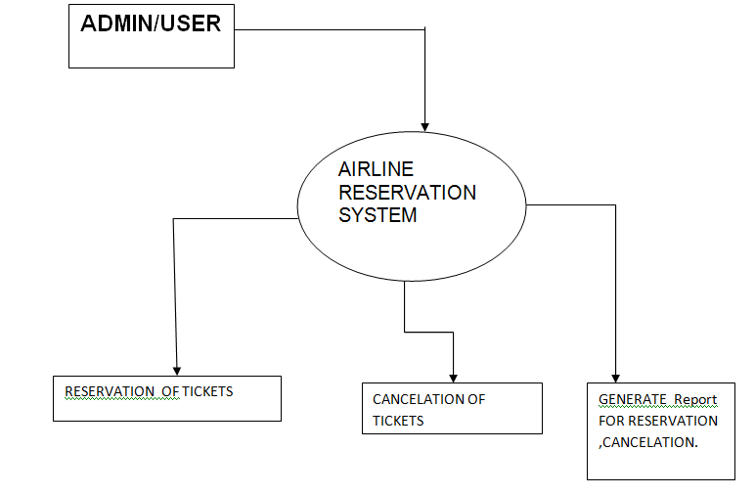
Data Flow Diagram
Context Level(Level 0 ):-

Slide 12
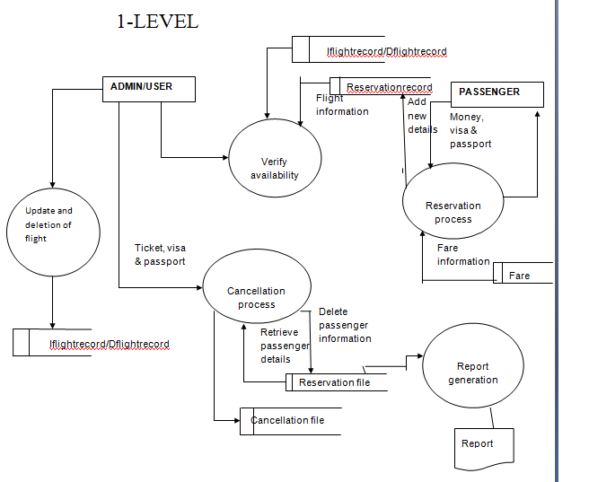
Level 1:-

Slide 13
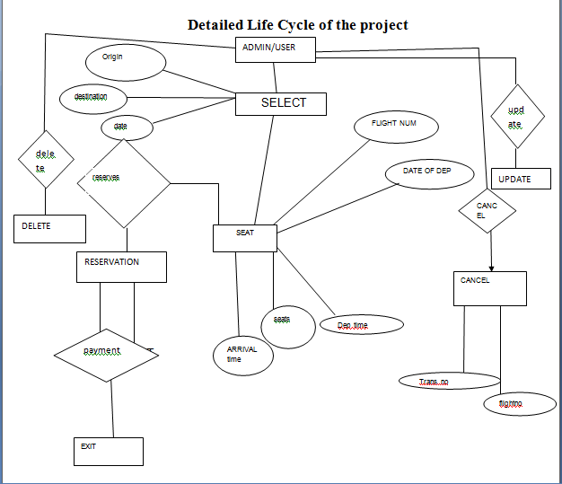
E-R DIAGRAM

Slide 14
Database Design
The database has following tables:-
LOGIN TABLE
EMPLOYEE_DETAIL
CUSTOMER_DETAIL TABLE
VEHICLE_DETAIL TABLE
LOADING_DETAIL TABLE
BOOKING_DETAIL TABLE
BILL

Slide 15
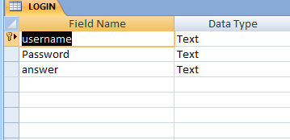
1.Login table
Description: The table is used to store Login Detail.
.

Slide 16
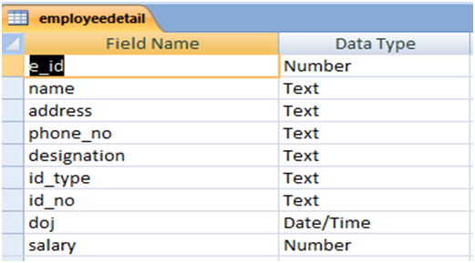
2.Customer_Detail Table
Description: The table is used to store Customer Detail.

Slide 17
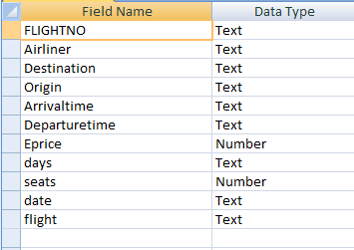
3.Iflights Table
Description: The table is used to store International flights Detail.

Slide 18
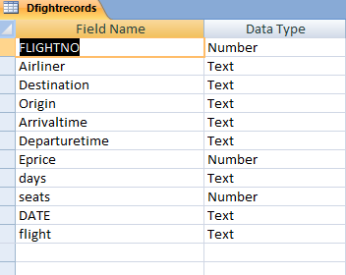
4.DflightsDetails Table
Description: The table is used to store Domestic flight detail.

Slide 19
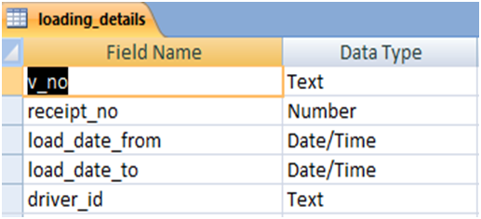
5.Cancelation Detail Table
Description: The table is used to store ticket cancellation Detail.

Slide 20
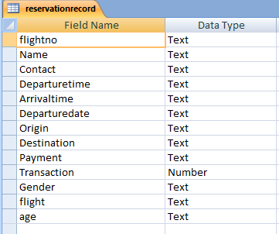
6.Reservation Detail Table
Description: The table is used to store reserve ticket Detail.

Slide 21
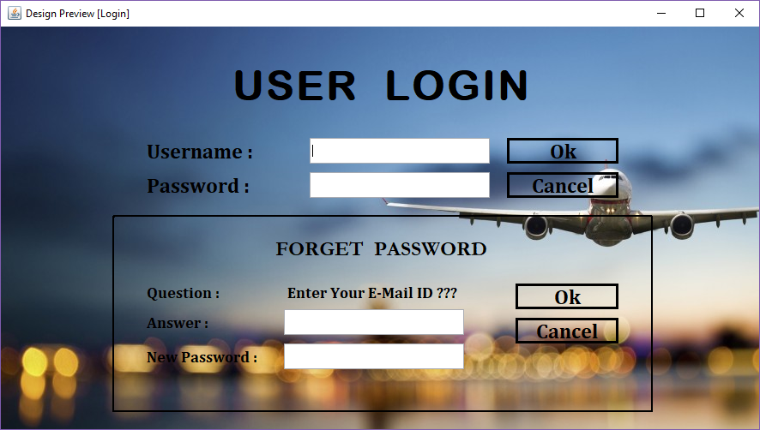
Login Form and Forget password Form

Slide 22
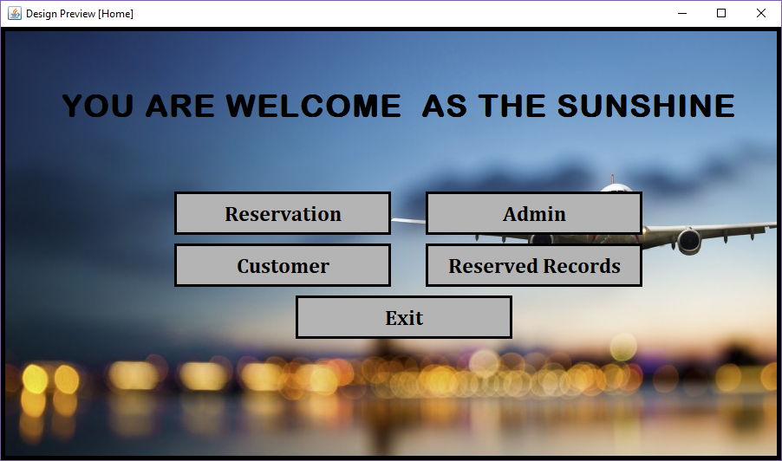
Home Page

Slide 23
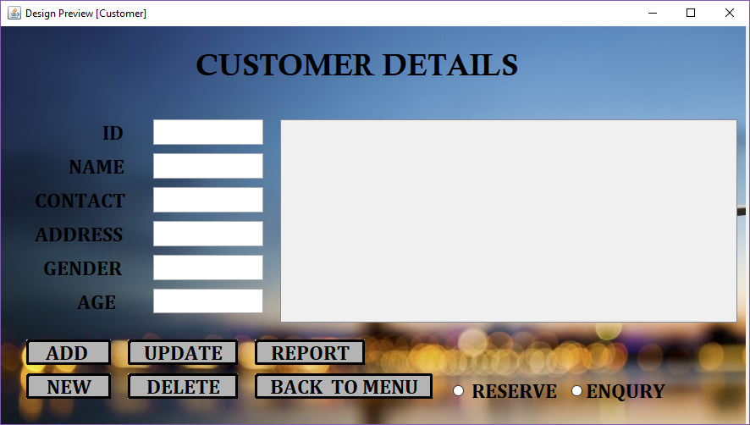
Customer Detail Form

Slide 24
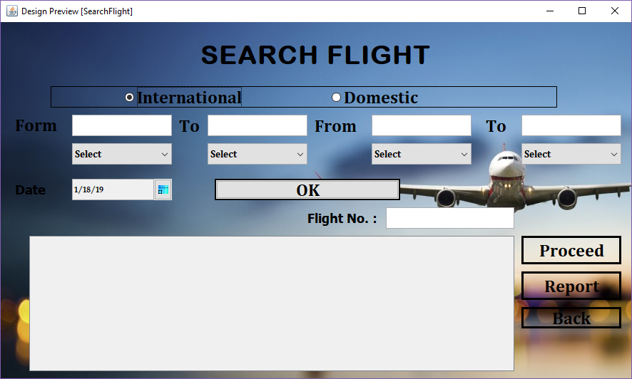
Select Flight Form

Slide 25
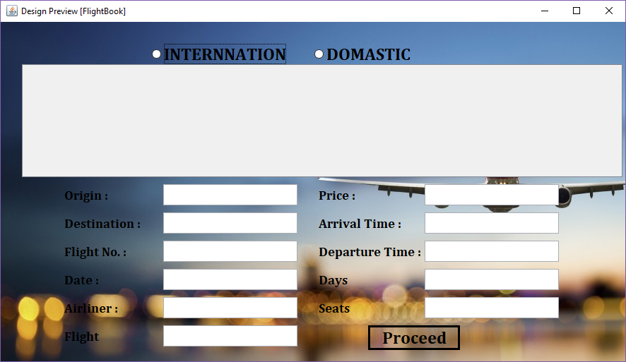
Booking Detail Form

Slide 26
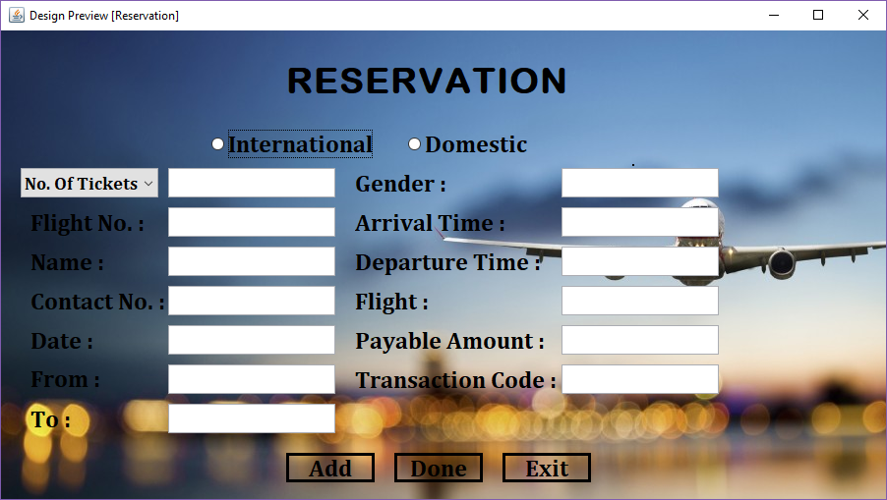
Reservation Detail Form

Slide 27
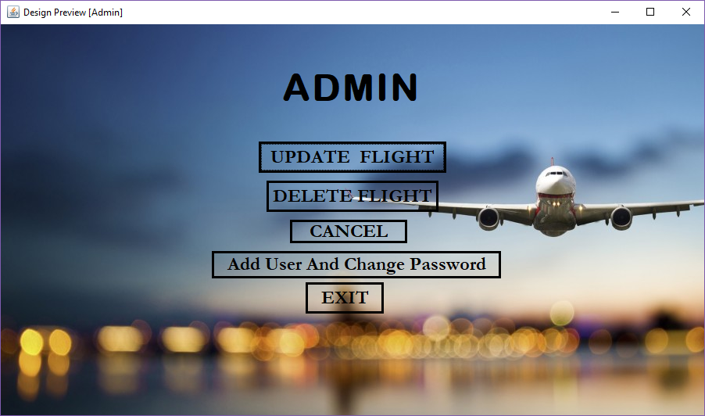
Admin Form

Slide 28
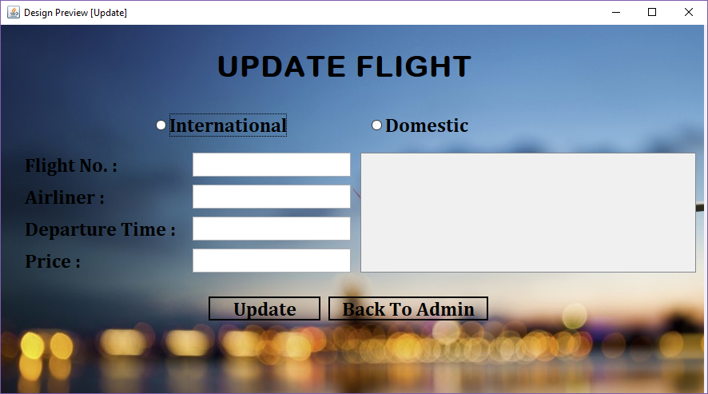
Update Flight Form

Slide 29
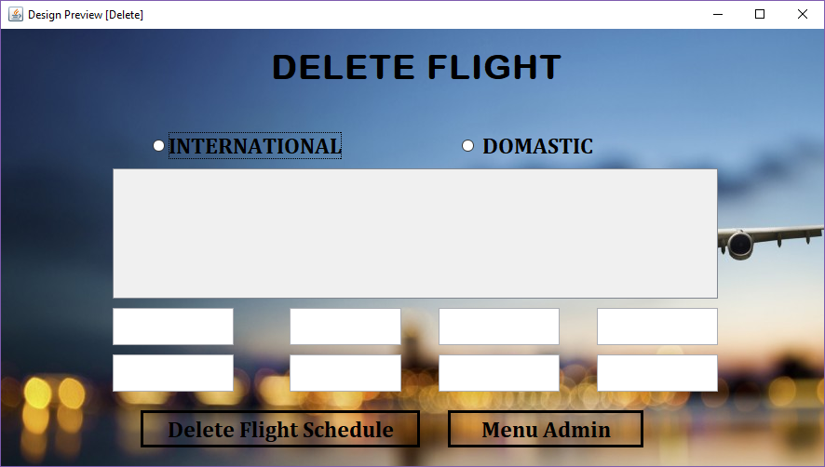
Delete flight Form

Slide 30
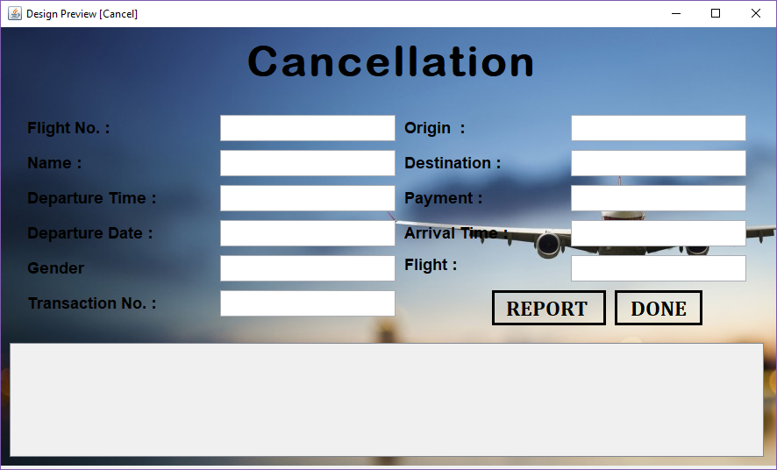
Cancel Flight Form

Slide 31
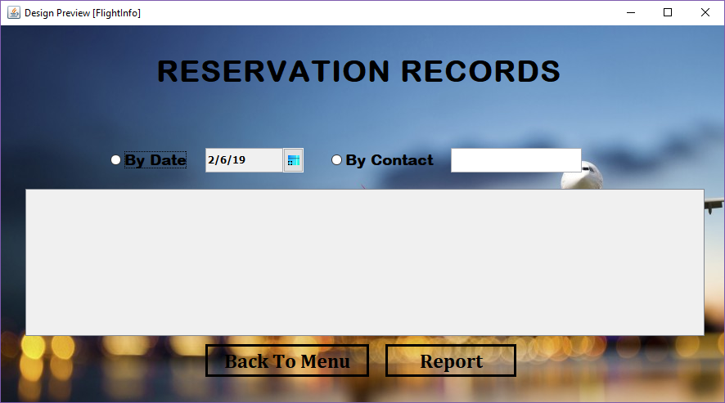
Reserve Record Form

Slide 32
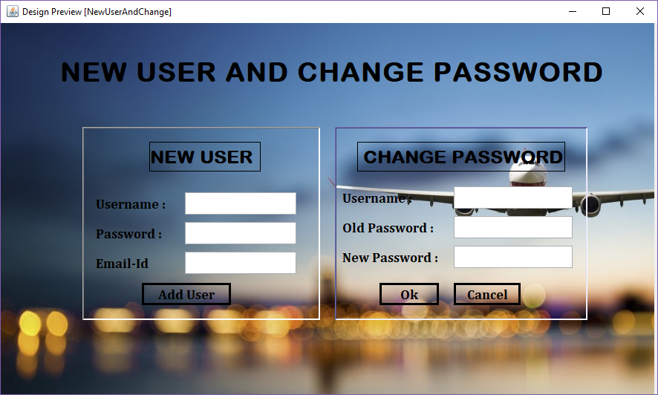
New user and Change password form

Slide 33
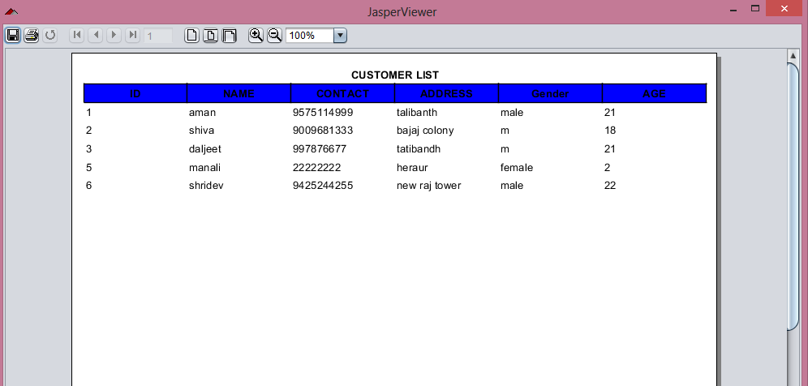
Reports Generated
CUSTOMER REPORT

Slide 34
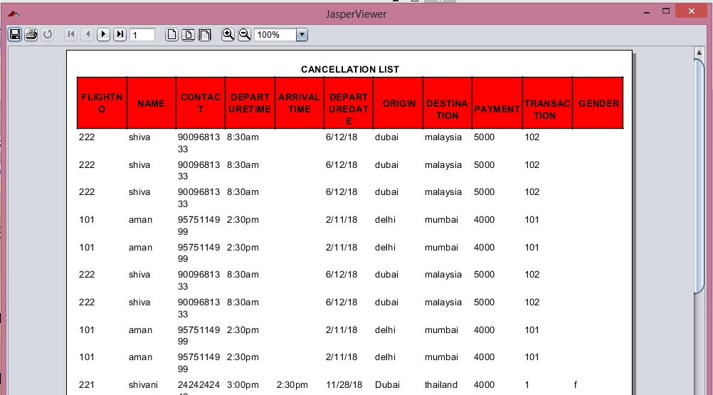
CANCELLATION REPORT

Slide 35
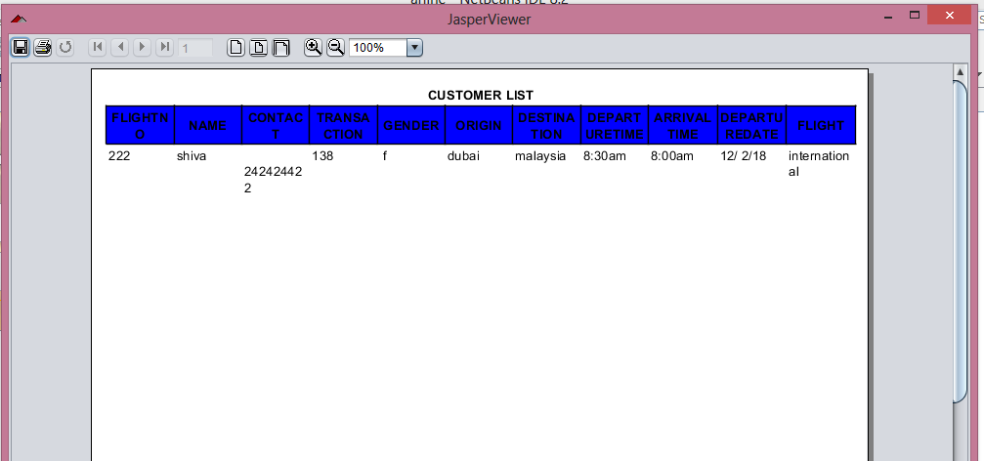
TICKET REPORT

Slide 36
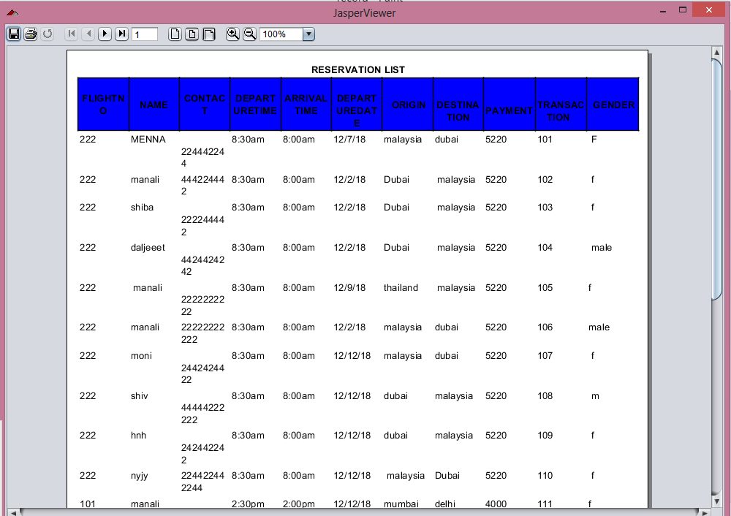
RESERVATION REPORT

Slide 37
CONCLUSION…
The project Work entitled “AIRLINE RESERVATION MANAGEMENT SYSTEM” is a complete solution for any organization. The software saves efforts and resources involved in the process of managing all records, to customer, flights and also contain records of Reservation as well as cancellation.
The software also provides a simple way to generate reports of , Reservation record report, cancellation report, customer report and flights reports.

Slide 38
THANK YOU….

