Slide 1
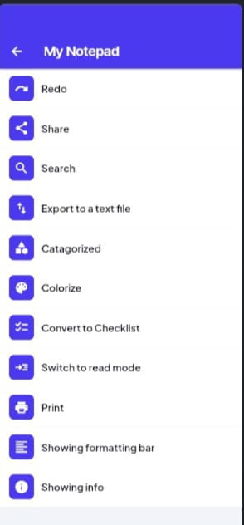
SIMPLE NOTE-TAKING APP
Team Name*: [Insert Team Name]
Team Members*: [List Names of All Members]
College Name*: [Insert College Name]-
Email ID of Team Leader*: [Insert Email ID]-
Brief Tagline: "Organize Your Thoughts, Simplify Your Life"

Slide 2
The Problem With Note-Taking Apps
Features | Existing apps | User needs
Ease of Use | Complex and cluttered | Simple and intuitive
Organization | Limited folders/tags | Folders, tags, categories
Search Functionality | Basic or ineffective | Quick and efficient
Offline Access | Often unavailable | Essential for all users
Beginner-Friendly | Not always | Must be beginner-friendly
Dark Mode | Optional in some apps | Highly desired feature
Complexity: Many apps are overloaded with features, making them difficult for casual users.
Lack of Organization: Users struggle to organize notes efficiently, leading to scattered information.
Poor Retrieval: Finding specific notes is often time-consuming due to inadequate search functionality.
Offline Access: Limited or no offline access in many apps. -
Beginner-Unfriendly: Beginners find it hard to adapt to cluttered interfaces.
Key Insight: Users need a simple, intuitive, and organized* note-taking solution.

Slide 3
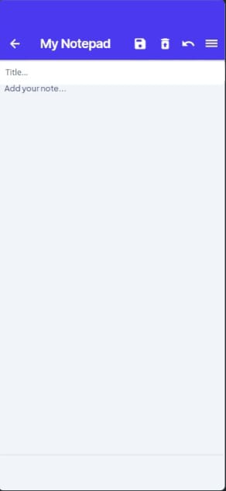
Proposed Solution
Core Idea:
A minimalist, user-friendly note-taking app designed for simplicity and efficiency.
Key Features:
Simple UI: Minimalistic design for distraction-free writing.
Quick Note Creation: Users can instantly create, edit, and auto-save notes.
Organized Storage: Notes can be categorized into folders, tags, or color-coded categories.
Search Functionality: Easy retrieval of notes based on keywords or tags.
Sync & Backup: Uses Fire-store database to store and sync notes across devices.
Dark Mode: Reduce eye strain with a sleek dark theme.
Unique Selling Point (USP):
Combines simplicity with powerful organization tools, making it ideal for both beginners and advanced users.
Mock-up of app interface

Slide 4









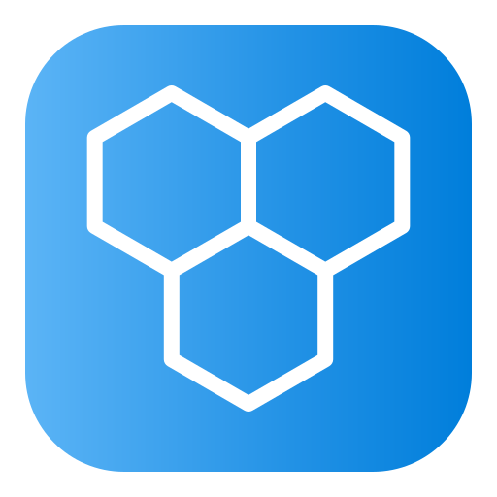

Technical Architecture
Frontend:
Flutter (Dart): For building a cross-platform mobile app with a single codebase.
Backend:
Firebase:
Fire-store : For real-time database and note storage.
Authentication: For secure user login and signup.
State Management:
Provider: For efficient app state handling and reactivity.
Local Storage:
Hive: For offline note storage and quick access.
Version Control:
GitHub: For collaboration and version control.
Top Layer (Frontend) -
Flutter(Dart)
Middle Layer (Backend)-
Firebase
Authentication
Bottom Layer (Local Storage and Version Control)-
GitHub
Hive Storage

Slide 5








Workflow Of The App
User Authentication Login or sign-up using Google/email authentication via Firebase.
Home Screen Access Users land on a dashboard showing recent notes and categories.
Creating a New Note Tap the “+ New Note” button to start writing.
Editing & Formatting Users can edit text, add checklists, images, or voice memos.
Organizing Notes Notes can be tagged, color-coded, or moved into folders.
Auto-Save & Syncing Notes are saved locally and synced to Firestore for cloud backup.
Search & Retrieve Users can quickly find notes using a keyword search or filters.
Customization & Dark Mode
Users can switch themes, adjust text size, and personalize settings.

Slide 6







Implementation Of The App
Setting Up the Flutter Project:
Initialized a new Flutter project, configured dependencies, and set up project structure.
2. Designing the UI:
Created a clean and responsive Home Screen, Note Editor, and Settings Page using Flutter widgets.
3. Integrating Firebase Backend:
Connected Firebase Authentication, Fire-store for real-time data storage, and Cloud Storage for media.
4. Implementing the Core Features:
Developed features for creating, editing, organizing, and searching notes efficiently.
5. Syncing and Offline Support:
Enabled auto-save, real-time sync via Fire-store, and offline access* using Hive database.
6. Testing and Deployment:
Debugged, optimized performance, and deployed to Google Play Store for public access.
Flutter Project Set Up
UI Design
Features Implementation
Firebase Integration
Syncing and Offline Support
Testing and Deployment

Slide 7
Real-World Impacts
For Students
Organize lecture notes, study materials, and assignments efficiently.
Improve productivity with quick search and retrieval of important information.
Scalability
Potential to expand with features like collaboration, voice notes, and AI-powered organization. - Can be adapted for educational institutions, businesses, and personal use.
1.
6.
For Professionals
Manage meeting notes, project ideas, and task lists in one place.
Enhance workflow with color-coded categories and reminders.
2.
Minimalist Design
Reduce cognitive overload with a clean, distraction-free interface. Dark mode option for comfortable use in low-light environments.
IMPACTS
5.
3.
For casual users
Simplify personal note-taking for daily tasks, shopping lists, and reminders.
Enjoy a clutter-free interface that’s easy to use.
4.
Offline Access
Access and edit notes anytime, anywhere, even without an internet connection.
Ideal for users in areas with poor connectivity.

Slide 8
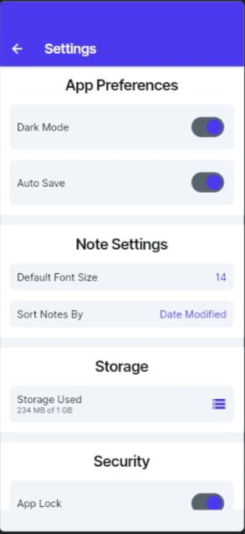
CONCLUSION
Our Smart Note-Taking App simplifies and enhances the note-taking experience by providing a clean, organized, and efficient platform. With Flutter for a seamless UI and Firebase for real-time syncing, users can easily create, manage, and retrieve notes anytime, even offline. The app’s features, such as folders, tags, search functionality, and dark mode, ensure both usability and personalization, making it an ideal tool for students, professionals, and casual users.
Moving forward, we aim to optimize performance, refine UI/UX, and introduce advanced features like voice-to-text, AI-powered suggestions, and collaborative note-sharing. This project not only addresses current inefficiencies in note management but also lays the foundation for a scalable, smart, and user-friendly solution.
THANK YOU !

