Slide 1
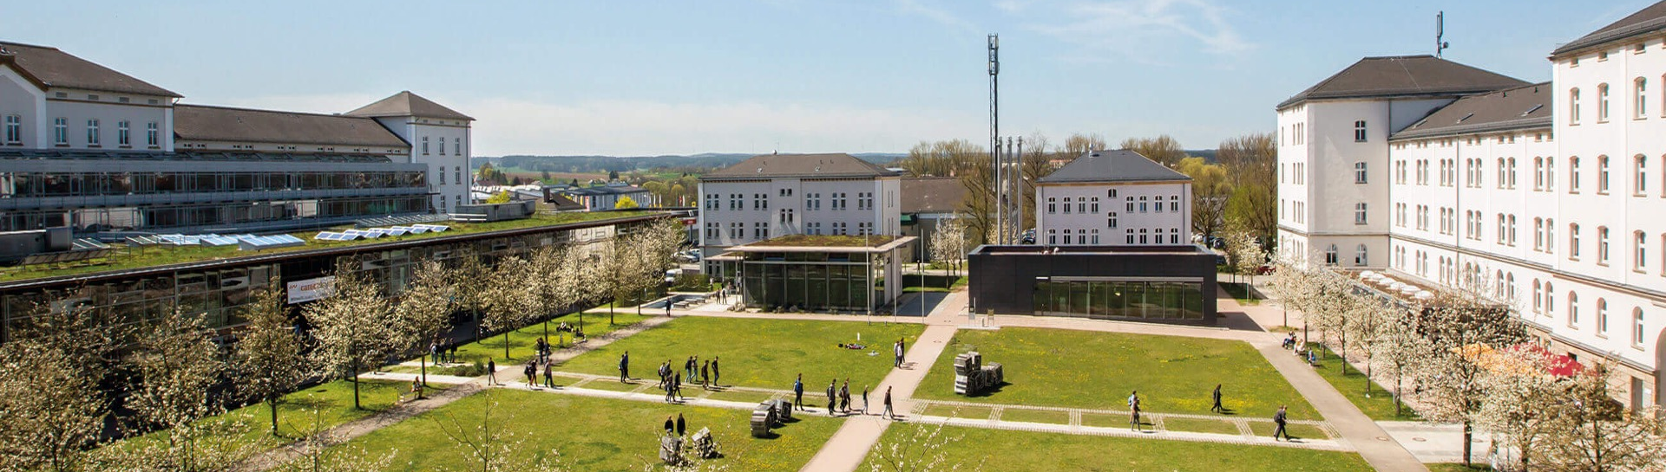
Industry 4.0: Happy Home Project
Shaikh Zaka Tabish
16TH July 2025
© 2025 OTH Amberg-Weiden

Slide 2
INDEX
01
Introduction
02
Objectives
03
Code
04
Database
05
Results
06
Future Scope
07
References and Inspiration
08
Thank You !

Slide 3
1. Introduction:
Problem: There is proactive smart home system that can effectively reduce stress because
There is security and privacy concerns if the system is connected to internet.
No large ML models can be used as they can not be made standalone.
There is no proven method to exactly measure human stress levels by Image recognition alone.
There is a high chance that the system can cause trouble if false signals are captured.
Solution : Happy home system that reduces stress levels by reducing human input for maintaining pleasant indoor environment.
System is based on edge computing and is completely stand-alone considering privacy and security.
System is based on light weight design that can be run on a small microcontroller.
Uses a work-around strategy by utilizing location input to maintain best possible environment for user.
No chance of false trigger as it does not rely on facial expression or body language.

Slide 4
2. Objectives

Slide 5
3. Why OpenCv

Slide 6
4. Signal Processing Chain
Group photo sessions in Old Tow
Local stories shared by ISC guides
Exploring narrow alleys and cozy cafés
Visited a public beer garden in the city center

Slide 7
5. Results
Enhanced understanding of German history
Intercultural bonding and networking
Improved language and social interaction skills
Memorable moments with international peers

Slide 8
6. Future Scope
Deep-rooted traditions and architecture
Intercultural bonding and networking
Warm hospitality and strong local pride
Similar to Amberg in charm, yet more historical in scale

Slide 9
7. References and Inspiration
A perfect balance of learning and fun.
Made lifelong friendships
Inspired to explore more German heritage sites.

Slide 10
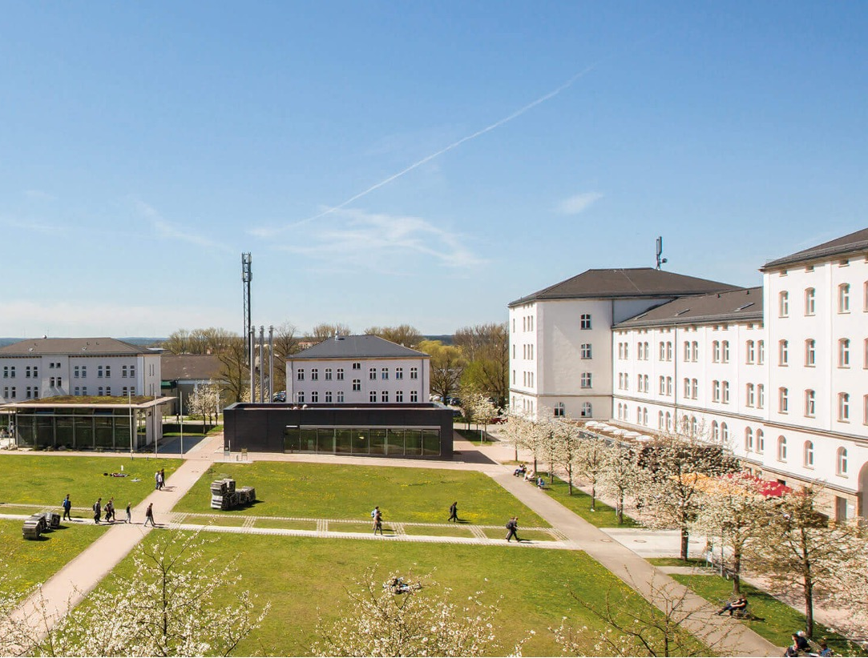
VIELEN DANK!

