Slide 1
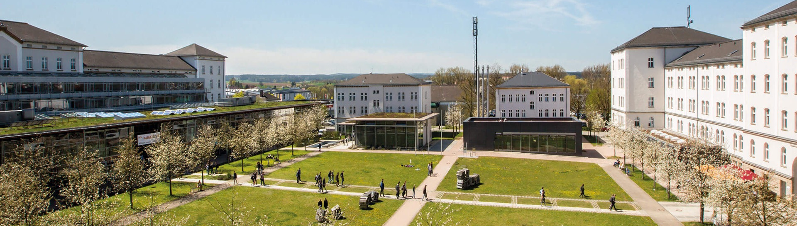
Industry 4.0: Happy Home Project
Shaikh Zaka Tabish
16TH July 2025
© 2025 OTH Amberg-Weiden

Slide 2
INDEX
01
Introduction
02
Objectives
03
Code
04
Database
05
Results
06
Future Scope
07
References and Inspiration
08
Thank You !

Slide 3
1. Introduction:
Problem: There is proactive smart home system that can effectively reduce stress because
There is security and privacy concerns if the system is connected to internet.
No large offline ML models can be used as they can not be made standalone.
There is no proven method to exactly measure human stress levels by Image recognition alone.
There is a high chance that the system can cause trouble if false signals are captured.
Solution : Happy home system that reduces stress levels by reducing human input for maintaining pleasant indoor environment.
System is based on edge computing and is completely stand-alone considering privacy and security.
System is based on light weight design that can be run on a small microcontroller.
Uses a work-around strategy by utilizing location input to maintain best possible environment for user.
No chance of false trigger as it does not rely on facial expression or body language.

Slide 4
2. Objectives
Develop a Smart Home Concept Design a proactive, AI-supported smart home system to prevent depression through environmental interventions.
Conduct In-Depth Literature Research Analyze current scientific publications on depression and smart home healthcare interventions.
Design System Architecture Architect a system integrating sensors, decision-making logic, and smart devices for real-time action.
Simulate Key Functionalities Demonstrate proactive smart home behavior using tools like Webots and SimPy.
Foster Multidisciplinary Skills Apply and expand competencies in AI, system modeling, simulation, and research—preparing for master's studies.
Create a Poster Visualization Present the concept visually using LaTeX and Icograms for public and academic display.
Enable Future Applications Pave the way for technical reports, further research, or a startup in intelligent care environments.
From : Project definition HAPPY-HOME 2025-04-04.pdf (File on moodle).

Slide 5
1. Smart Home Concept Design
Objective 1: Develop a proactive smart home concept.
Solution:
Simulates user behavior through random room transitions
Uses environmental sensing (external temp/light/noise) to modify internal comfort settings
Embeds decision logic via .csv lookup – a form of pseudo-AI as per instruction
Emulates proactive care without explicit user commands

Slide 6
2. Literature Research
Objective 2: Conduct literature review on depression prevention via smart homes
Solution:
Project logic references preventive cues (light, temperature, music) identified in medical literature
External states (low light, noise, etc.) are intelligently mapped to internal corrective actions, following WHO/Healthline recommendations
The environment simulation embodies findings such as mood enhancement via ambient regulation

Slide 7
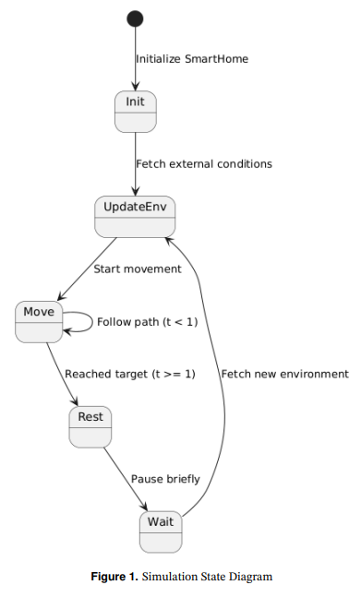
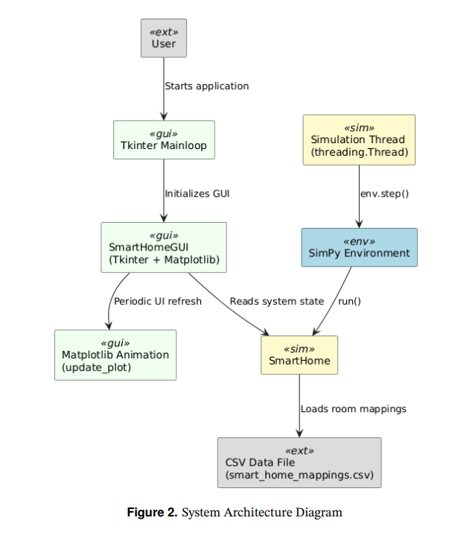
3. System Architecture
Objective 3: Define system structure and interactions

Slide 8
4. Simulation
Objective: Demonstrate system behavior through simulation
Fulfilment:
Uses SimPy to model user movement and state transitions
Integrates real-time plotting via matplotlib and GUI via tkinter
Animates internal temperature, lighting, and music in response to external stimuli
Pseudocode AI mimics smart decisions without manual triggers

Slide 9
5. Skill Development
Objective: Enhance technical and interdisciplinary skills
Fulfillment:
Implements real-world simulation framework
Integrates Python libraries: SimPy, Tkinter, Matplotlib, Pandas
Fuses software engineering, AI, HCI, and data logic
Encourages modular thinking, concurrency (threads), and UI development

Slide 10
6. Poster Visualization
Objective: Visual communication of system design.
Fulfillment:

Slide 11
7. Future Application Enablement
Objective: Future Scope :
Scalable design allows further integration (e.g., real sensors, machine learning)
Modular logic (via .csv) facilitates rapid experimentation
GUI and simulation enable demos for technical reports or investor pitches
Framework can serve as a base for master thesis or product prototype

Slide 12
References and Inspiration
Y. Li, Z. Wang, W. Zhang, et al., “Smart home for elderly care: Development and evaluation of a context-aware system”, in 2021 IEEE International Conference on Consumer Electronics (ICCE), IEEE, 2021, pp. 1–6. doi: 10.1109/ICCE50685.2021.9686498. [Online]. Available: https://ieeexplore.ieee.org/document/ 9686498.
N. Gao, M. Marschall, J. Burry, S. Watkins, and F. D. Salim, “Understanding occupants’ behaviour, engagement, emotion, and comfort indoors with heterogeneous sensors and wearables”, arXiv preprint arXiv:2105.06637, 2022. doi: 10.48550/arXiv.2105. 06637. [Online]. Available: https://arxiv.org/abs/2105.06637.

Slide 13
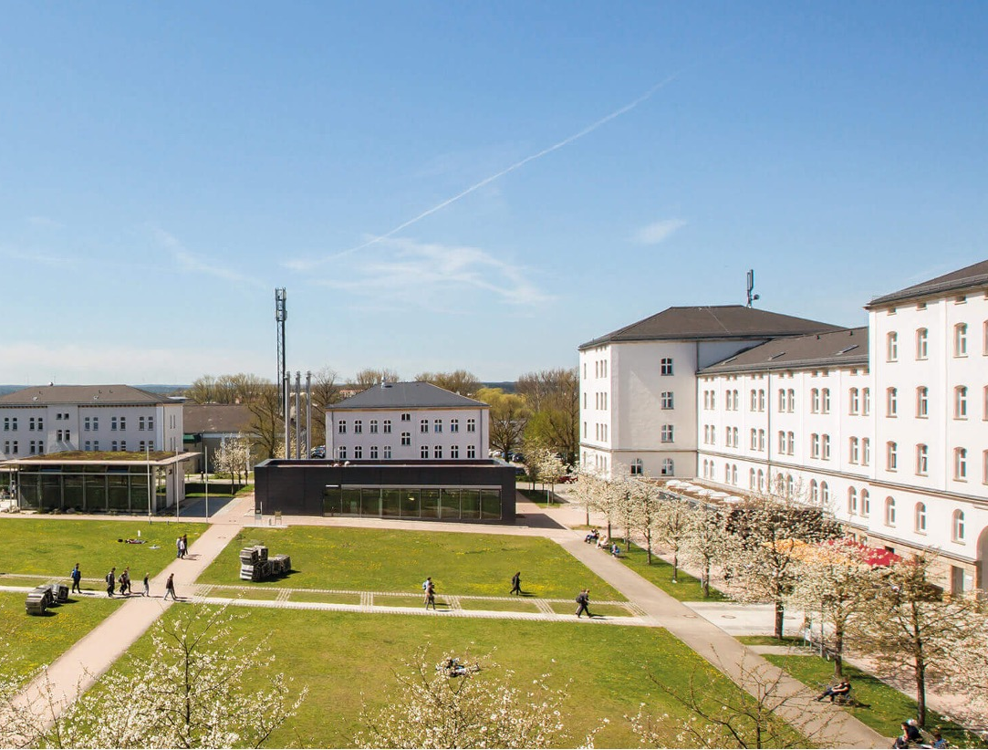
VIELEN DANK!

