Slide 1
Topic:- City Waste Management System With Van Tracking.
Presented By
Zaka Tabish Shaikh(210)
Faisal Mohammed(230)
Shaikh Mohammad(217)
Mohammad Abedi(229)
Guide: MS.Sushma Deshmukh

Slide 2
Proposed System
Real Time Tracking : (Implementing GPS technology to track garbage collector van movement).
User-Friendly Web App : (To develop a web app for residents to monitor van locations submit complains and receive notification).
Efficiency and optimization : (Aim to improve Waste management processes by streamlining operations, leading to enhance efficiency in garbage collections).

Slide 3
Existing System:
An app Swachhata-MoHUA an existing app that is used currently by GOI.
The app enables a citizen to post a civic-related issue (eg; a garbage dump) which is then forwarded to the city corporation concerned and thereafter assigned to the sanitary inspector of the particular ward.
The app does not have Real Time GPS systems for accurate tracking.
The app does not have Location Based Complaint system and tracking.

Slide 4
Implementation Details
Hardware requirements-
Node MCU
GPS module
Software requirements-
MERN stack
Frontend:
1.HTML
2.TAILWINDCSS
3.REACT JS
Backend:
1.Express JS
2.MongoDB
3.NodeJS

Slide 5
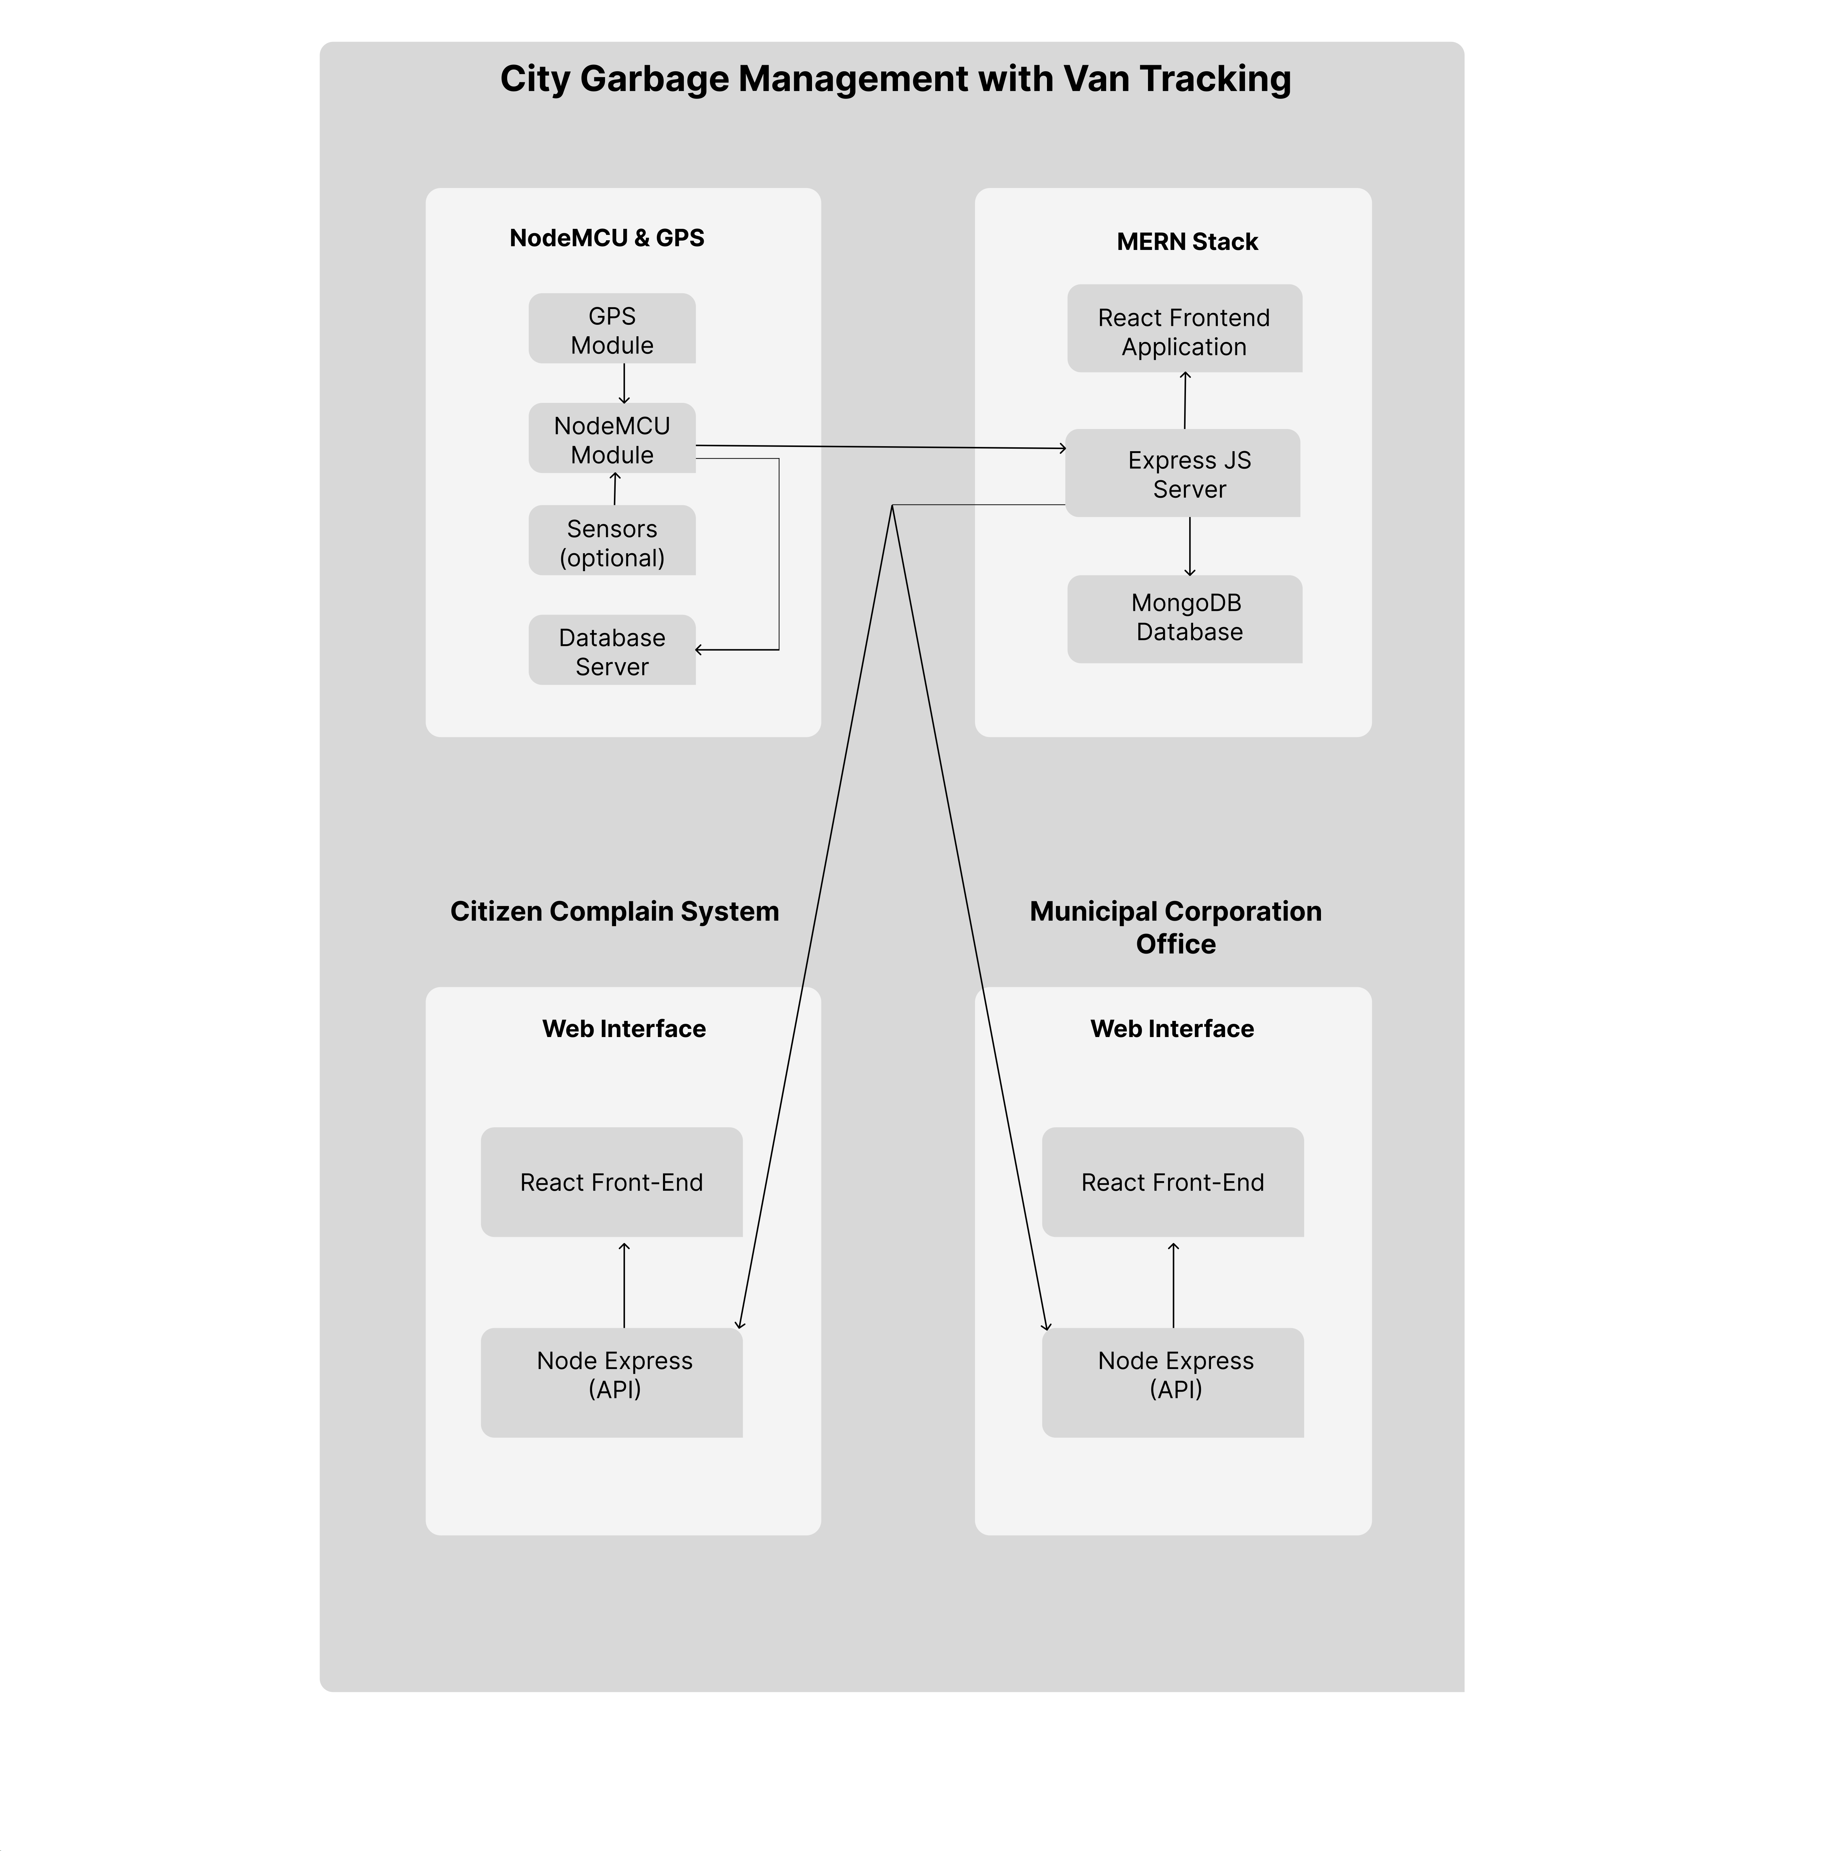
System Architecture

Slide 6
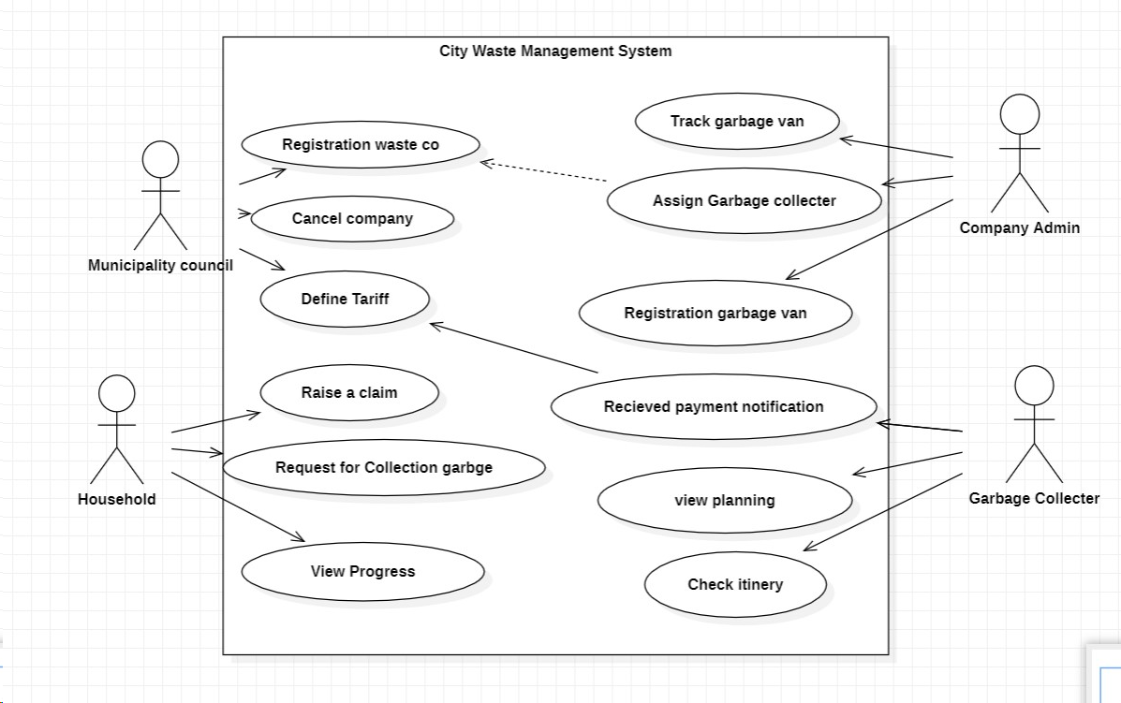
Use Case Diagram

Slide 7
References
https://ieeexplore.ieee.org/document/9142068
https://ieeexplore.ieee.org/document/1002513
https://www.researchgate.net/figure/Use-Case-Diagram-Solid-Waste-Collection-Management_fig3_350193293
https://www.researchgate.net/figure/System-Architecture-for-Solid-Waste-Collection-Management_fig1_350193293

