Slide 1

AI-Powered Software Testing System
Requirement-to-Release Testing Automation Powered by Local AI
Presented by: HARSHA B H
Reg. No 2538M0097
Under the Guidance of
Mr SURENDREN D

Slide 2
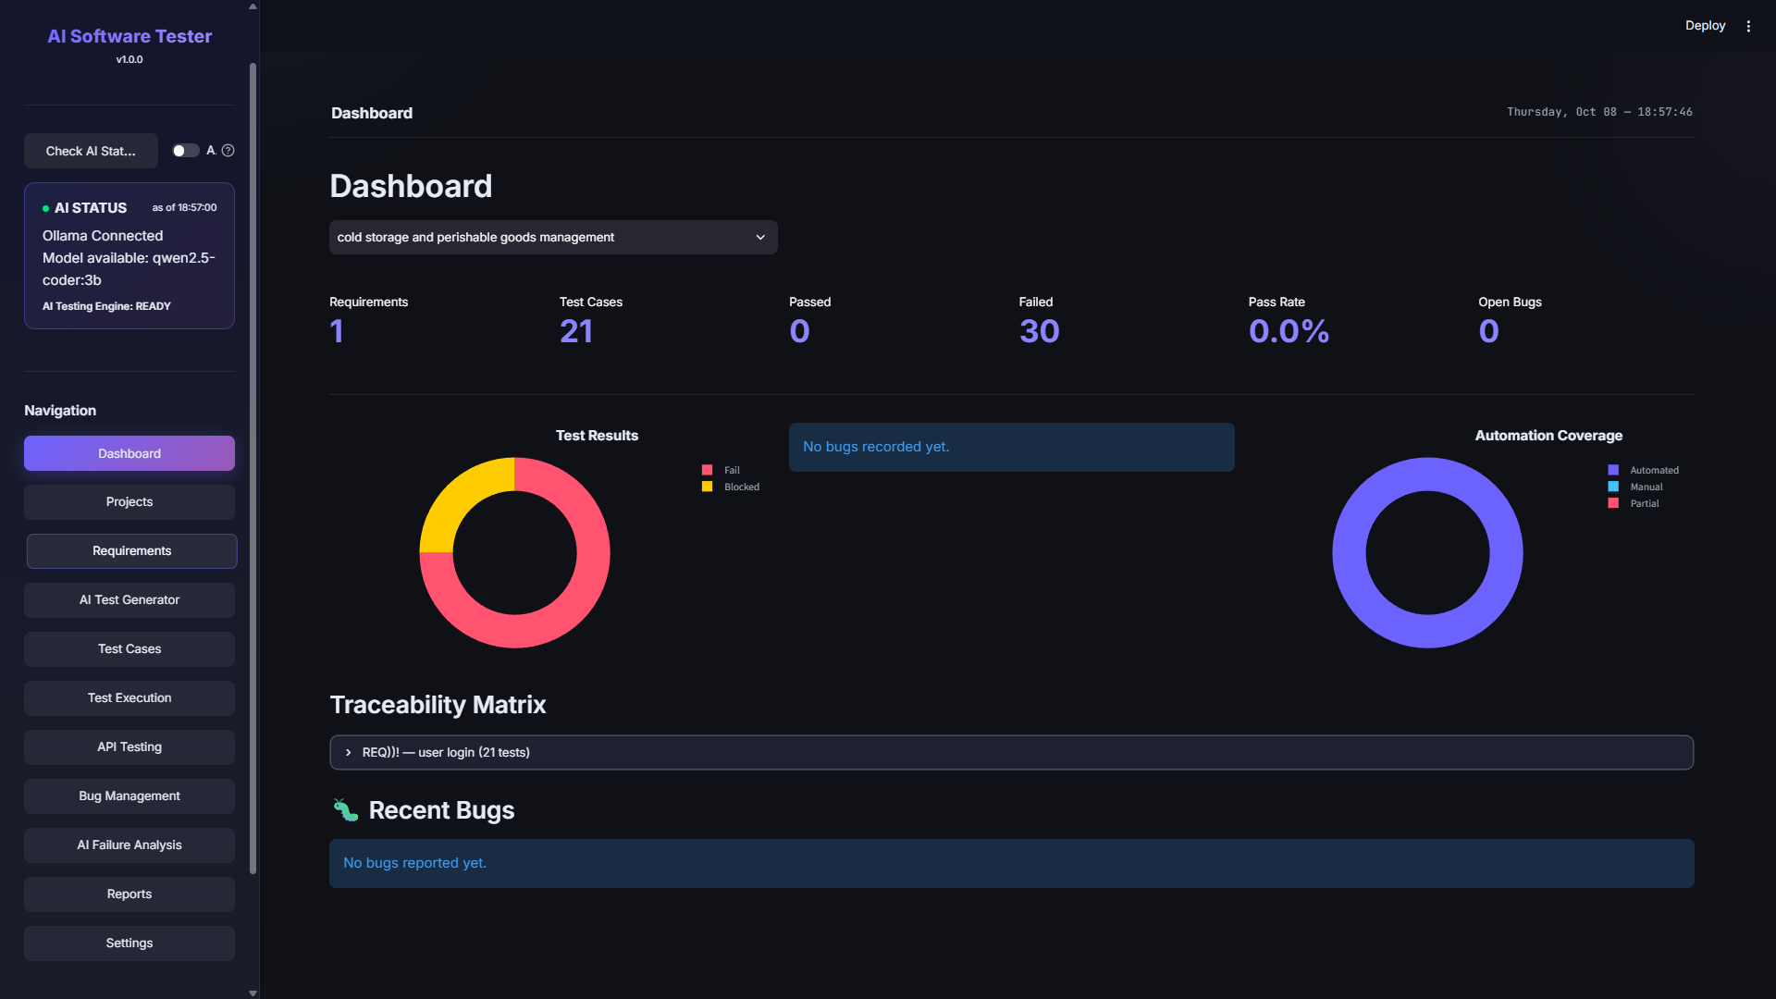
Input Design
KEY DATA-ENTRY SCREENS
AI-Powered Software Testing System
11

Slide 3
Input Design
KEY DATA-ENTRY SCREENS
AI-Powered Software Testing System
11

Slide 4
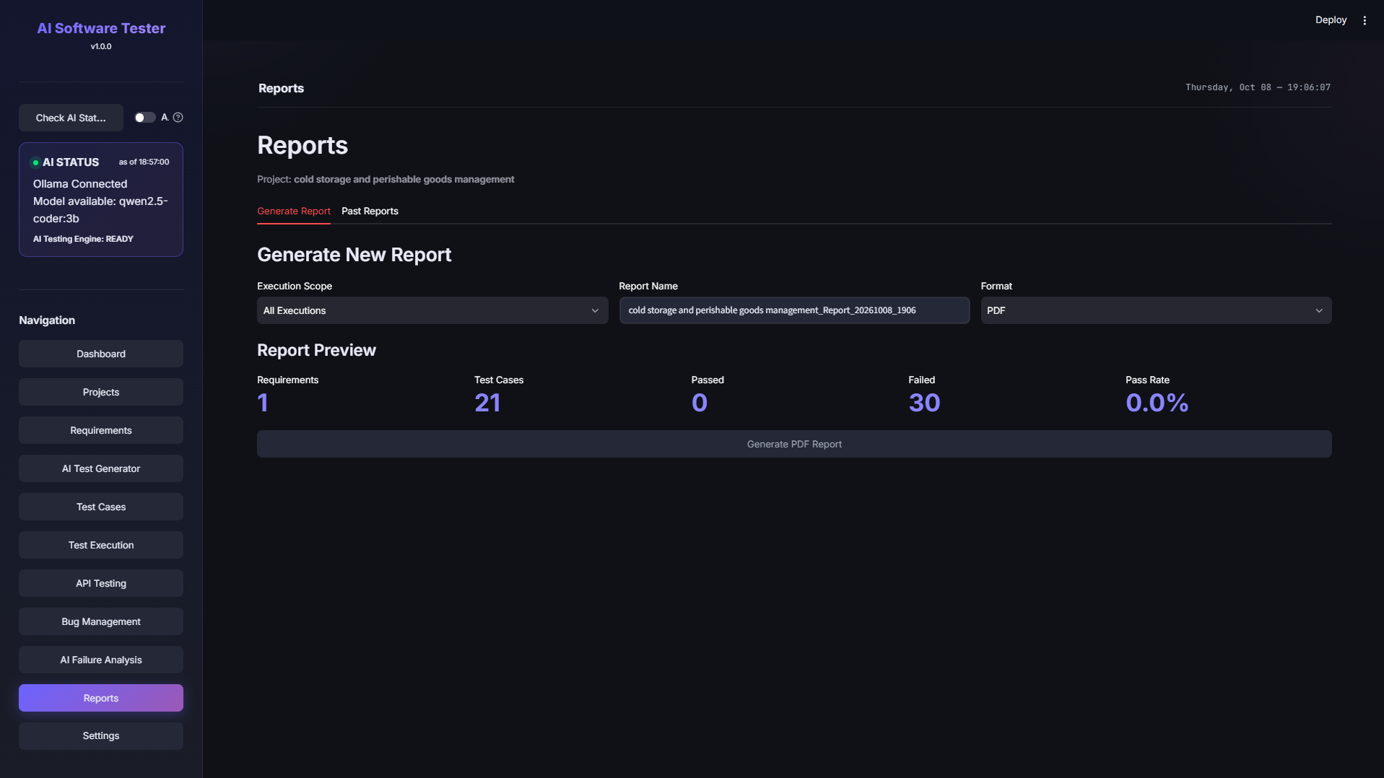
Output Design
WHAT THE SYSTEM PRESENTS
AI-Powered Software Testing System
12

Slide 5
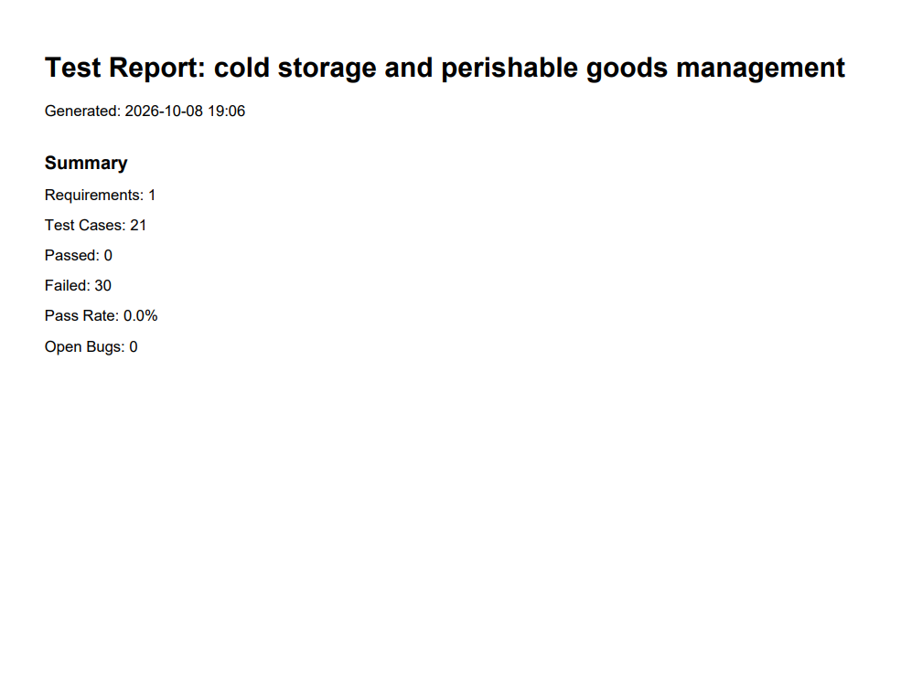
Output Design
AI-Powered Software Testing System
12

Slide 6
Testing Strategy
AI SOFTWARE TESTER VALIDATION
Testing scope
AI response parsing: extract plain, fenced and embedded JSON, then validate the required fields.
Action safety: enforce the allowlist and reject unknown or shell-like actions before execution.
Data and metrics: check project, requirement, test-case and result persistence, plus empty and mixed pass-rate calculations.
Execution and reporting: validate UI/API outcomes, record failures and evidence, and generate project reports.
TESTING OBJECTIVE
Verify that AI output becomes structured, safe-to-run tests and that every execution result remains traceable.
Analyze requirements
Generate test cases
Validate and execute UI or API actions
Record results, defects and reports
Project workflow under test
Requirements move through AI analysis and test generation. Validated actions run through Playwright or the API engine, then results feed metrics, bug reports and exports.
AI-Powered Software Testing System
13

Slide 7
Project Test Cases
AI SOFTWARE TESTER MODULES
Representative checks mapped to the project’s AI, safety, database and metrics test modules.
ID | Module | Scenario | Expected result
TC-AI-01 | JSON parser | Plain, fenced or embedded valid JSON | Parser extracts JSON for schema validation.
TC-AI-02 | Test-case schema | Generated case omits steps or expected result | Parser rejects the incomplete response.
TC-AI-03 | Action safety | AI returns a shell or unknown action type | Validator rejects it before execution.
TC-AI-04 | Action fields | Navigate has no URL; assert_text has no text | Validator rejects each missing required field.
TC-DB-01 | Database | Create and retrieve project, requirement, case and steps | Records persist with their requirement and case links.
TC-KPI-01 | Metrics | Three passes and one failure; then an empty project | Pass rate is 75%; empty-project counts and pass rate are zero.
AI-Powered Software Testing System
14

Slide 8
Conclusion
SUMMARY & FUTURE ENHANCEMENTS
Conclusion
Brings requirements, AI-generated tests, automation, and defects into one platform.
Reduces manual effort through AI-assisted analysis and test generation.
Validates automation actions before execution for safer, predictable runs.
Gives clear traceability from requirement through to defect resolution.
Presents progress and quality through a live dashboard and exportable reports.
FINAL OBJECTIVE
This system aims to make software testing faster, more consistent, and more transparent — using local AI to connect every stage from requirement to release.
Future Enhancements
CI/CD pipeline integration
Parallel and cloud-based execution
Support for additional local/remote AI models
AI-Powered Software Testing System
15

