Slide 1
Gnosvia (Ai & Ml Club)

Slide 2
AGENDA
Why AI & ML
About Us
Our Vision & Goals
What We Provide
Meet the Teams
How to Get Started
How To Join Us
Q&A Session

Slide 3
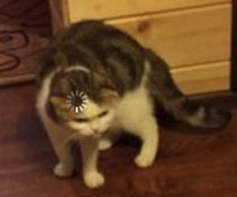
Why AI & ML?

Slide 4

About Us : Gnosvia
We are a community of passionate learners, builders, and innovators dedicated to exploring the vast world of Artificial Intelligence and Machine Learning.
Our Mission: To demystify AI/ML for everyone, foster a culture of collaborative learning, and empower students to apply their knowledge to solve real-world problems. Whether you're a complete beginner who's just curious or an experienced coder, this is the place for you.

Slide 5

Our Goals
Our primary goal is your growth. We aim to:
Build a Strong Foundation: Provide a clear path to understanding the core mathematical and programming concepts behind AI/ML.
Bridge Theory and Practice: Move beyond textbooks. We focus on hands-on projects, workshops, and competitions.
Foster a Collaborative Community: Create a space where you can ask questions, share ideas, find project partners, and learn together.
Develop Industry-Ready Skills: Equip you with the tools and experience that companies are looking for.
Promote Ethical AI: Encourage discussions about the responsible development and deployment of AI technologies.

Slide 6
What We Provide?
Your Member Benefits

Slide 7
Hands-on Workshops: From "Python for Machine Learning" to "Building Your First Neural Network," we'll guide you step-by-step.
Project-Based Learning: Work in teams on exciting projects, building a portfolio that showcases your skills. Imagine building a model that can predict stock prices or generate its own poetry!
Kaggle Competitions: We form teams and participate in global data science competitions on platforms like Kaggle. It's a fantastic way to test your skills against a global community.
Guest Lectures & Seminars: Learn from industry experts, professors, and senior students who share their experiences and insights.
Mentorship Program: Get paired with senior members who can guide you on your learning journey, projects, and career path.
Networking Opportunities: Connect with like-minded peers, alumni, and professionals in the field.

Slide 8
Meet the Teams - Find Your Fit!
Current Teams:
Computer Vision
Natural Language Processing
Multimodal AI
Reinforcement Learning
Research and Optimization
PR & Outreach
Future Teams (Proposed)*:
Bioinformatics & Healthcare
Quantum Computing
Embedded & IoT
* Total Number of Members in Club ought to be under upper limit set by Society

Slide 9
Your Learning Path A Structured Roadmap
Phase 1: The Essentials (Beginner)
Programming: Master Python and its key libraries (NumPy, Pandas, Matplotlib).
Mathematics: *Linear Algebra, *Probability, and **Calculus.
Phase 2: Core Machine Learning (Intermediate)
*Machine Learning, **Deep Learning, **Domain Specifics
Model Optimization
Phase 3: MLOps
Deployment & Production
Model Monitoring
P.S Our Club has resources for * and resources are being compiled for **

Slide 10
Excellent Resources to Get Started:
Roadmaps: Developer Roadmaps - roadmap.sh
Competitions & Datasets: Kaggle is the #1 platform for data science. You can find datasets for any project you can imagine, compete, and learn from others' code.
Community & Models: Hugging Face is the go-to place for pre-trained NLP models and datasets.
AI Tools: AI Tools Directory , The best AI productivity tools in 2025 | Zapier

Slide 11
How to Get Into the Club
The Recruitment Process:
Application Form: Fill out our online form [Scan QR]. Tell us about yourself and why you're interested in AI/ML.
MCQ Test: A small, non-graded task designed to assess your problem-solving approach and logical thinking and in context to the team. Don't worry, it's beginner-friendly! We want to see how you think.
Personal Interview: A short, friendly chat with us. We want to get to know you, understand your interests, and see if you're a good fit for our community culture. It's a two-way street—you can ask us questions too!
We are recruiting for all teams! Indicate your preference in the application form.

Slide 12
Any Questions?

Slide 13
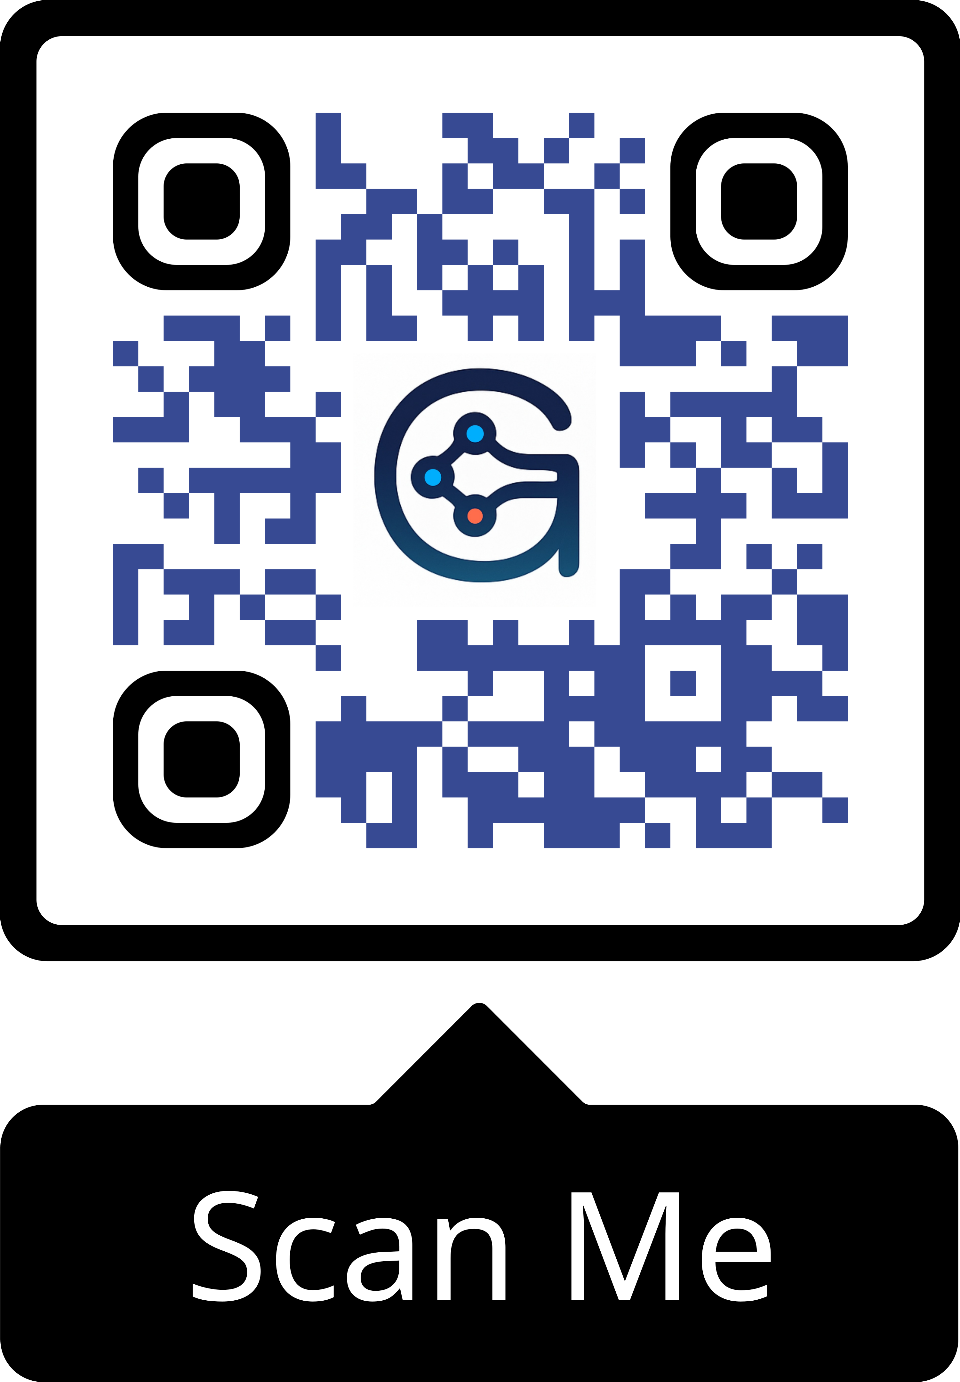

Slide 14
Thank you
Contact us:
president_aiml_ppts@csvtu.ac.in
vicepresident_aiml_ppts@csvtu.ac.in

