Slide 1


SMART INDIA HACKATHON 2025
Problem Statement ID – SIH25033
Problem Statement Title-
Al-Based Smart Allocation Engine for PM Internship Scheme
Theme- Smart Automation
PS Category- Software
Team ID -
Team Name (Registered on portal)

Slide 2
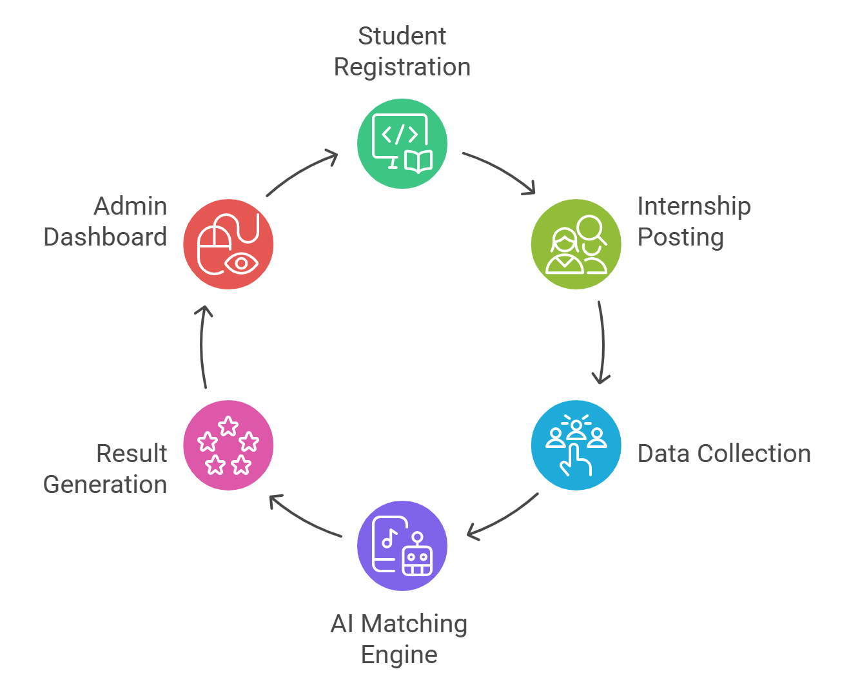
Al-Based Smart Allocation Engine for PM Internship Scheme
BUG-0
Problem : The PM Internship Scheme struggles with manual matching, leading to delays, inefficiency, and unfair selections, particularly in applying quotas for rural students, social categories, and previous participants.
Proposed Solution
AI-based matching by skills, location, and quotas
Fair representation through affirmative action
Transparent, explainable results
Admin dashboard for compliance and analytics
Real-time updates to students and companies

Slide 3
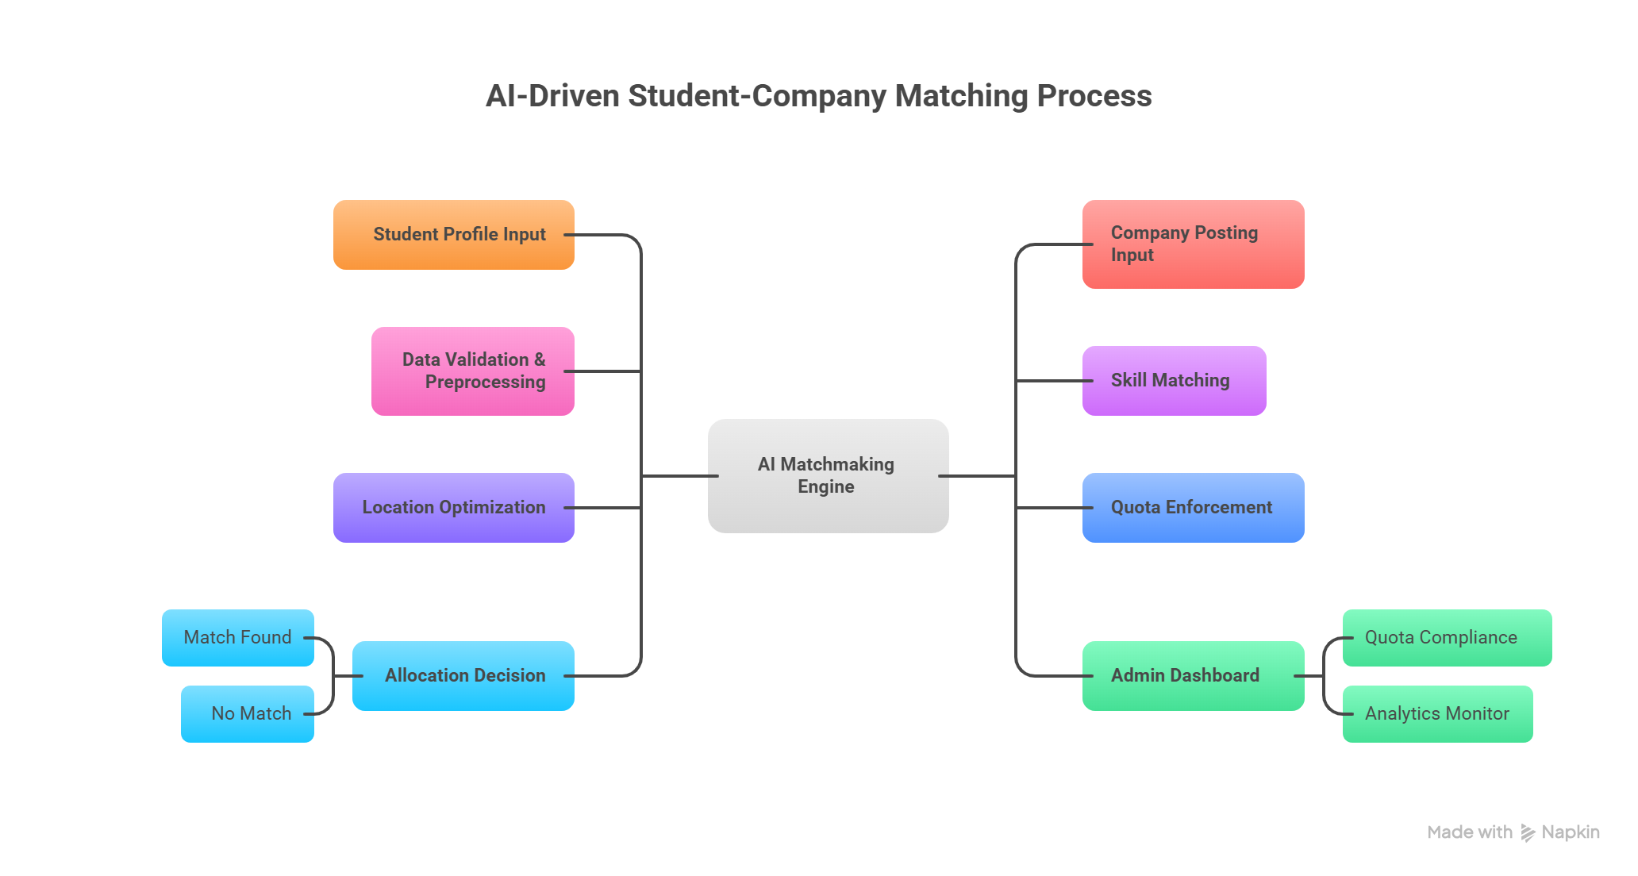
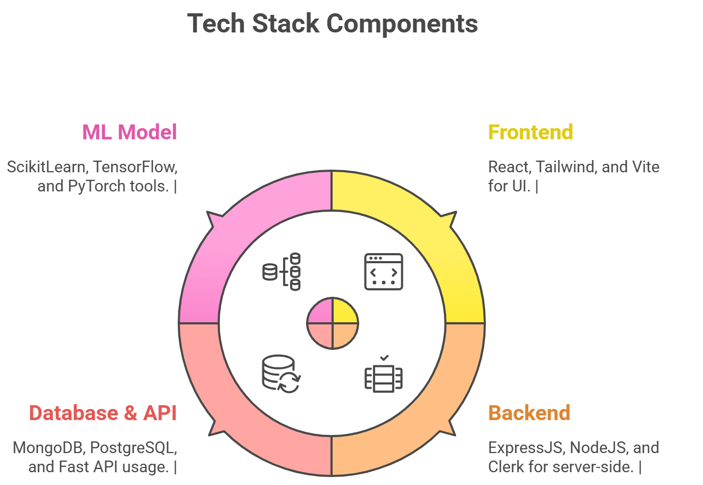
TECHNICAL APPROACH
BUG-0
Algorithm Used
1.Similarity Matrix
2. Kth Nearest Neighbour
3. TF-IDF (Term Frequency-Inverse Document Frequency)
4. Locality Sensitive Hashing (for Fast and Effective matching In larger datasets)
5. Inverted Index
6. Approximate Nearest Neighbour

Slide 4
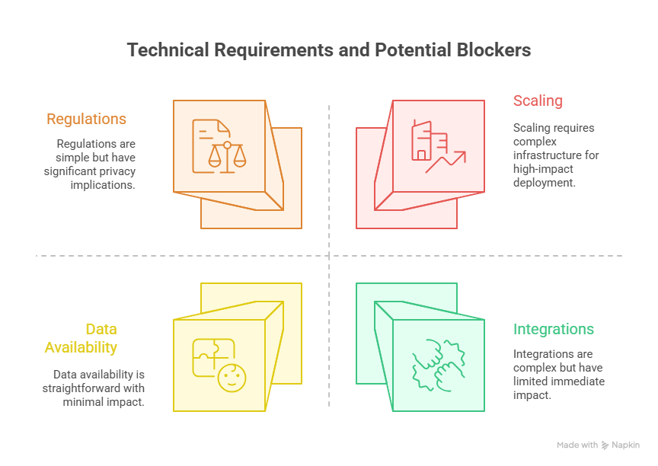
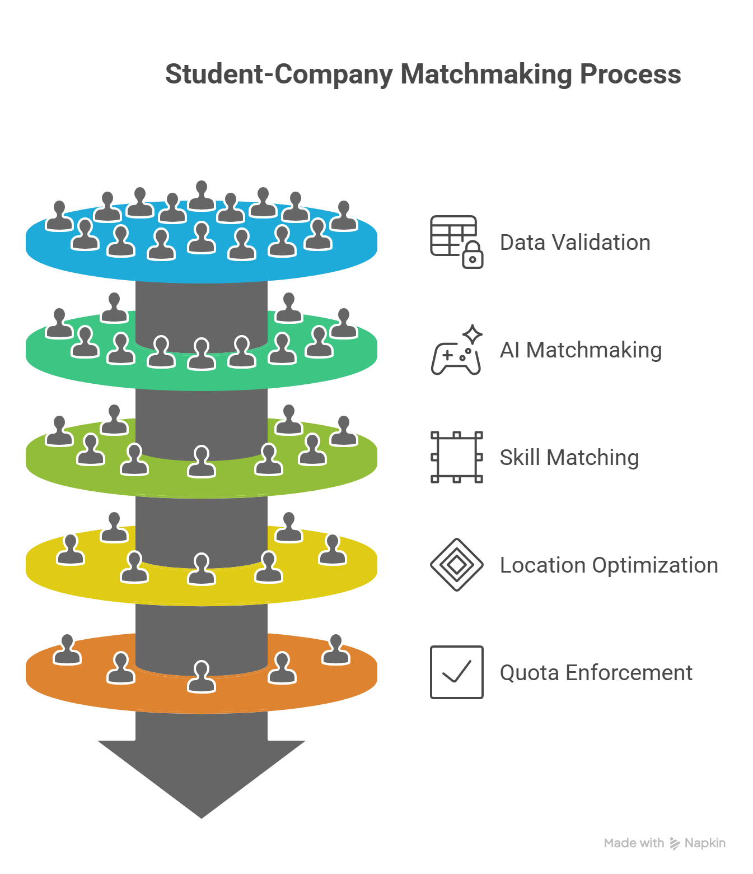
FEASIBILITY AND VIABILITY
BUG-0

Slide 5
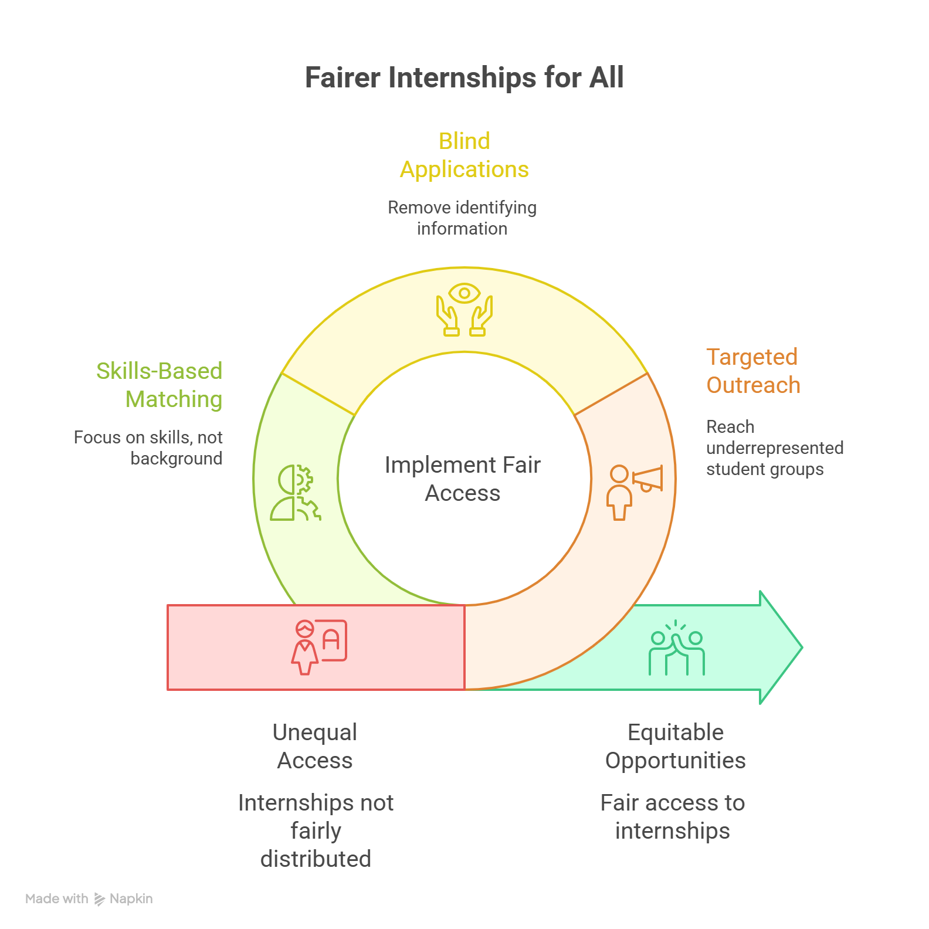

IMPACT AND BENEFITS
BUG-0

Slide 6
RESEARCH AND REFERENCES
BUG-0
AI-Based Internship Recommendation System
Explores hybrid recommendation algorithms for personalized internship matches.
A Case-based Reasoning (CBR) Internship Placement Model
IJCA Paper: CBR Internship Placement Model
Discusses AI-driven profile matching for internship acquisition with real-time analytics.
From Affirmative Action to Affirmative Algorithms: Legal Challenges
Examines fairness and legal challenges in algorithmic affirmative action in AI systems.
AI Matching Platforms and Advanced Technology in Job Matching
Overview of technological advances in job and internship matching platforms.
Navigating Techniques in Job Recommender Systems
Discusses algorithms and techniques suitable for internship recommendation systems.

