Slide 1

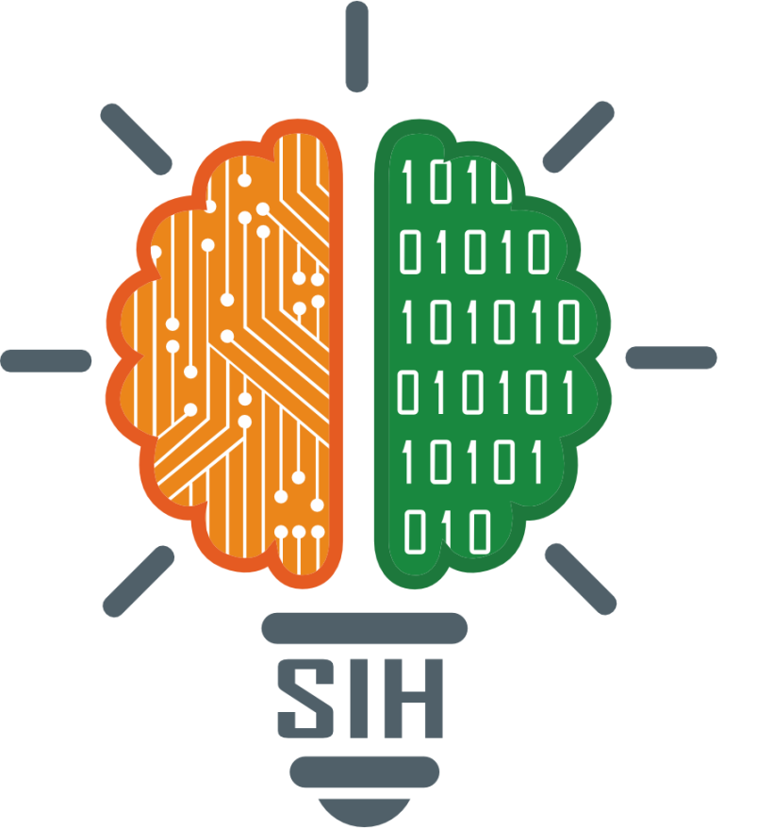
SMART INDIA HACKATHON 2025
Problem Statement ID – SIH25185
Problem Statement Title- Al-Powered DPR Quality
Assessment and Risk Prediction System for MDoNER
Theme- Smart Automation
PS Category - Software
Team ID -
Team Name – Automation Guy’s

Slide 2
Automation coders
Smart DPR Evaluation and Risk Prediction Platform
The Smart DPR Evaluation and Risk Prediction Platform is an AI-powered system designed to automatically assess Detailed Project Reports (DPRs) for projects like road construction, healthcare, and tourism. It evaluates technical feasibility, cost accuracy, and potential risks using Natural language Processing (NLP) and Predictive Analytics.
Why do we need an AI-based DPR Analysis System?
Manual DPR reviews are slow → Officials spend weeks/months checking big reports.
Human errors → People can miss mistakes in cost, timeline, or technical details.
Inconsistent judgments → Different reviewers give different opinions.
Hidden risks go unnoticed → Environmental, financial, or resource risks are not spotted early.
Growing number of projects → Government has many DPRs, but not enough experts to check all quickly.

Slide 3








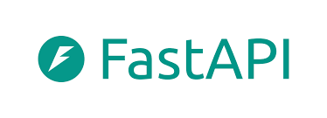
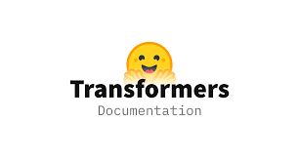

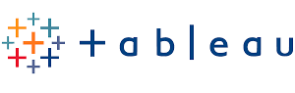
Automation coders
Technologies Used →
1. Data Extraction (Text, Tables, Charts)
PyPDF2 / pdfplumber → Extract text from PDFs
Camelot / Tabula → Extract tables from DPRs
Tesseract Optical Character Recognition (with pytesseract) → For scanned DPR images
OpenCV → For chart/graph recognition
2. Natural Language Processing (NLP)
NLTK → Tokenization, stopword removal, stemming
spaCy → Named Entity Recognition (NER)
scikit-learn → Text classification, keyword extraction
Hugging Face Transformers → Pre-trained models (BERT, RoBERTa for DPR understanding)
3. Dashboard & Visualization
React.js / Angular → Interactive dashboard
Streamlit → Quick ML dashboards
Plotly /Dash → Interactive graphs
Matplotlib / Seaborn → Data visualization
Power BI / Tableau (optional) → If external BI tools are allowed
4. Backend Development
Flask (lightweight API backend)
Django (full-fledged web backend)
Fast-API (fast and modern backend for ML models)

Slide 4
Automation coders
Work Flow of Project…
INPUT DPR
STEP 1 : Text & Tables/Chart Extraction
STEP 2 : Implement NLP techniques
STEP 3 : Automated Analysis and Prediction
STEP 4 : Presentation Layer
1. Text Tokenzation
1 Automated Compliance Verification Engine
1. Designing the User-Centric Evaluation Dashboard
2. Stop Word Removal
2. Cross-Verification and Inconsistency Detection
2. Effective Data Visualization for Risk and Compliance
3. Stemming
4. Named Entity Recognition
3. Predictive Risk Modeling
5. Keywords Extraction
4.Benchmarking Against Historical Projects
6. Text Classification
7. Sentiment Analysis

Slide 5
Feasibility & Viability →
Automation coders
Feasibility:
DPRs vary in structure, but NLP can standardize analysis.
ML models can efficiently predict risks using historical data.
Challenges & Risks:
Limited labeled data : May reduce model accuracy.
Prediction accuracy : Risk of misleading risk scores.
Strategies to Overcome:
Use NLP with custom section extraction for structure.
Apply semi-supervised learning and data augmentation.
Integrate domain rules and expert feedback for accuracy.

Slide 6
Impact & Benefits
Automation coders
Impact :
Speeds up DPR evaluation with higher accuracy.
Detects risks early for proactive management.
Ensures standardized, data-driven decisions.
Benefits:
Saves time and reduces project costs.
Supports safety planning in project execution.
Promotes environmental sustainability through risk-aware decisions.
Enhances transparency and accountability.
End…..

