Slide 1


SMART INDIA HACKATHON 2025
Problem Statement ID: SIH25175
Problem Statement Title:
MAITRI: An AI Assistant for Psychological
And Mental Well-Being of Astronauts
Theme: Space Technology
PS Category: Software
Team ID:
Team Name: Visioneers

Slide 2
MAITRI: The Bond Beyond Space
Visioneers
Proposed Solution:
How It Addresses the Problem:
An AI companion that observes astronauts’ face and voice.
Reduces loneliness by acting like a friendly presence.
It notes changes in mood or stress levels.
Helps astronauts manage stress and tiredness in real time.
Offers short supportive conversations and simple activities.
Ensures safety by warning about health risks early.
Sends alerts to ground team if it detects serious issues.
Supports focus and productivity during missions.
Innovation and Uniqueness :
Not just a chatbot — it can see, listen, and understand emotions.
Adaptive — the suggestions change based on each astronaut’s state and daily routine.
Keeps a memory of emotional trends over time
combines human-like empathy with scientific evidence (breathing exercises, positive talk, reminders).
Works independently without internet, ideal for space missions.

Slide 3
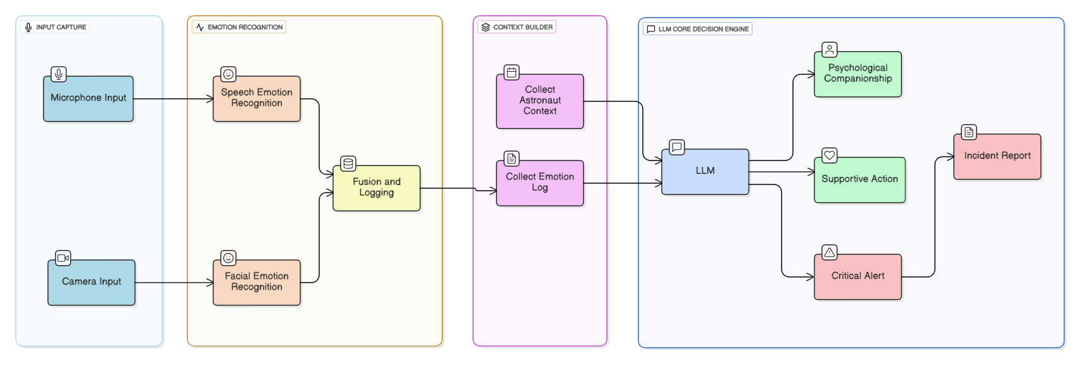







TECHNICAL APPROACH
Visioneers
Tech Stack:

Slide 4
FEASIBILITY AND VIABILITY
Visioneers
Feasibility:
Potential Challenges and Risks:
Emotion detection from face and voice is already proven on Earth.
Accuracy issues: AI may misread emotions due to lighting, noise, or fatigue.
Compact AI models can run offline on local systems, suitable for space stations.
Trust factor: astronauts may hesitate to rely on AI for emotional support.
The assistant only needs short interactions, keeping it lightweight and practical.
Privacy concerns: constant monitoring may feel intrusive.
Can be built step-by-step: emotion logging → basic conversations → advanced support.
Hardware limits: space systems have restricted computing power.
Strategies to Overcome these Challenges:
Use combined signals (face + voice) to improve accuracy.
Allow transparent controls so astronauts can pause or manage monitoring.
Keep human-in-the-loop: serious cases always flagged to ground crew.
Optimize AI models to run efficiently on low-resource hardware.

Slide 5
IMPACT AND BENEFITS
Visioneers
Potential impact on Astronauts:
Enhanced Mental Well-Being : Provides real-time emotional support, stress management, and personalized counselling for astronauts during long-duration missions.
Reduced Isolation & Loneliness: Acts as a digital companion, reducing the psychological burden of long-term space missions away from family and Earth.
Decision Support in Emergencies: AI-driven recommendations during medical or psychological crisis when immediate ground communication is delayed.
Boost in Productivity & Focus: By ensuring astronauts remain mentally balanced and physically fit, overall mission performance and efficiency increase.
Benefits of MAITRI:
Improved Mental Quality of Astronaut in Space: Helps astronauts maintain emotional resilience and motivation.
Promotes Human-Centric Space Exploration: Prioritizes astronauts’ health, showing commitment to ethical and safe space travel.
Medical Cost Savings for Space Agencies: Prevents costly medical evacuations, mission failures, or downtime caused by astronaut health issues.
Efficient Lifestyle of Astronaut : Optimizes exercise, nutrition, and sleep schedules, reducing unnecessary resource consumption in space.

Slide 6
RESEARCH AND REFERENCES
Visioneers
Wave2Vec2: A Framework for Self-Supervised Learning of Speech Representations. [Click Here🔗]
Unsupervised Cross-lingual Representation Learning for Speech Recognition. [Click Here 🔗]
Deep Facial Emotion Recognition: A Survey, Shan Li and Weihong Deng. [Click Here 🔗]
AI Chatbots for Mental Health: Values and Harms from Lived Experiences of Depression. [Click Here 🔗]
The Typing Cure: Experiences with Large Language Model Chatbots for Mental Health Support. [Click Here 🔗]
The Burden of Space Exploration on the Mental Health of Astronauts: A Narrative Review. [National Institue of Health (NIH)] [Click Here 🔗]
Mental Well-Being in Space. [NASA] [Click Here 🔗]
Supporting the Mind in Space: Psychological Tools for Long-Duration Missions. [Click Here 🔗]

