Slide 1

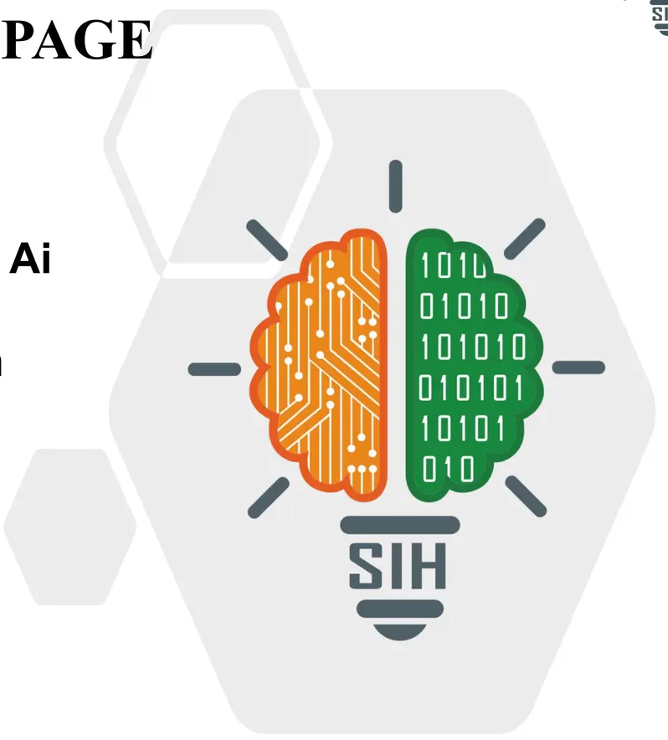









SMART INDIA HACKATHON 2025
TITLE PAGE
Problem Statement ID – SIH25016
Problem Statement Title – Automated Student Attendance Monitoring and Analytics System for colleges
Theme – Smart Education
PS Category – Software
Team ID –
Team Name – AttenAI

Slide 2
AttenAI
IDEA TITLE
Academic Excellence
Marks attendance(Automatic on one click + Manual teacher).
Attendance Data available on real time at dashboard to avoid error.
Complete Academic semester exam report .
Smart report (student/ Subject wise exportable).
Advanced security
Unregistered Face Tracking.
Suspicious gathering detection(Fight prevention )
Emergency Alert (Fire, intruder, Hazards)
Requires secure login credentials.
Student Engagement
Class sentimental analysis(Camera + feedback)
Engagement study material and content specially for free period.
Weekly Mood report (Avoid Pressure Atmosphere)
direct feedback/suggestions to individual students.
Streamlined Management
Manage Users access without prior knowledge of coding
Seemless upload of content by teacher with 30 min training
Video links and quiz data.
Supports reporting and analytics for teachers and administrators
System Architecture – Dashboards
Student Dashboard
Real-time attendance tracking
Assignment and exam reports
Low attendance warnings
Announcements and quizzes
Teacher’s Feedback
Teacher Dashboard
Attendance setup and manual override
Student performance reports
Content upload and management(Without request)
Quiz creation and monitoring(Ai + manual)
Management Dashboard
Academic performance tracking
Access control and role allotment.
Track and provide dashboard to unidentified people (if needed).
System health monitoring
Director Dashboard
User and role oversight
Task assignment management
Content approval workflows
Security alert monitoring

Slide 3
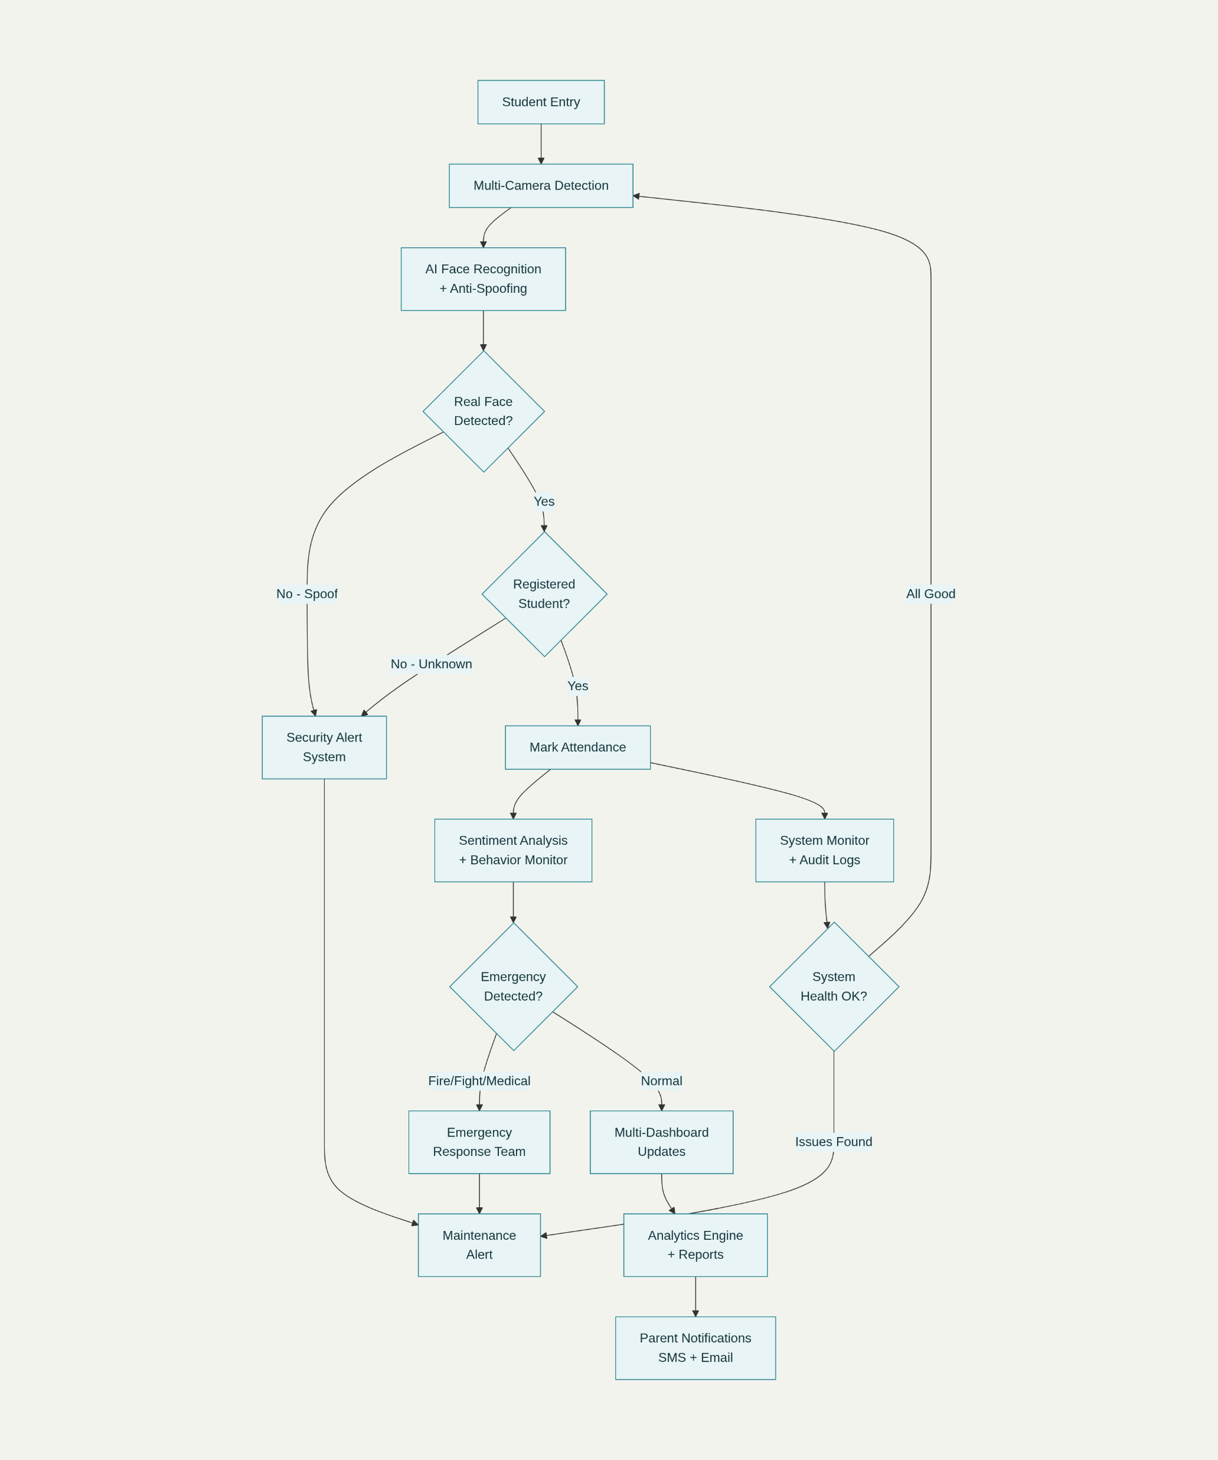
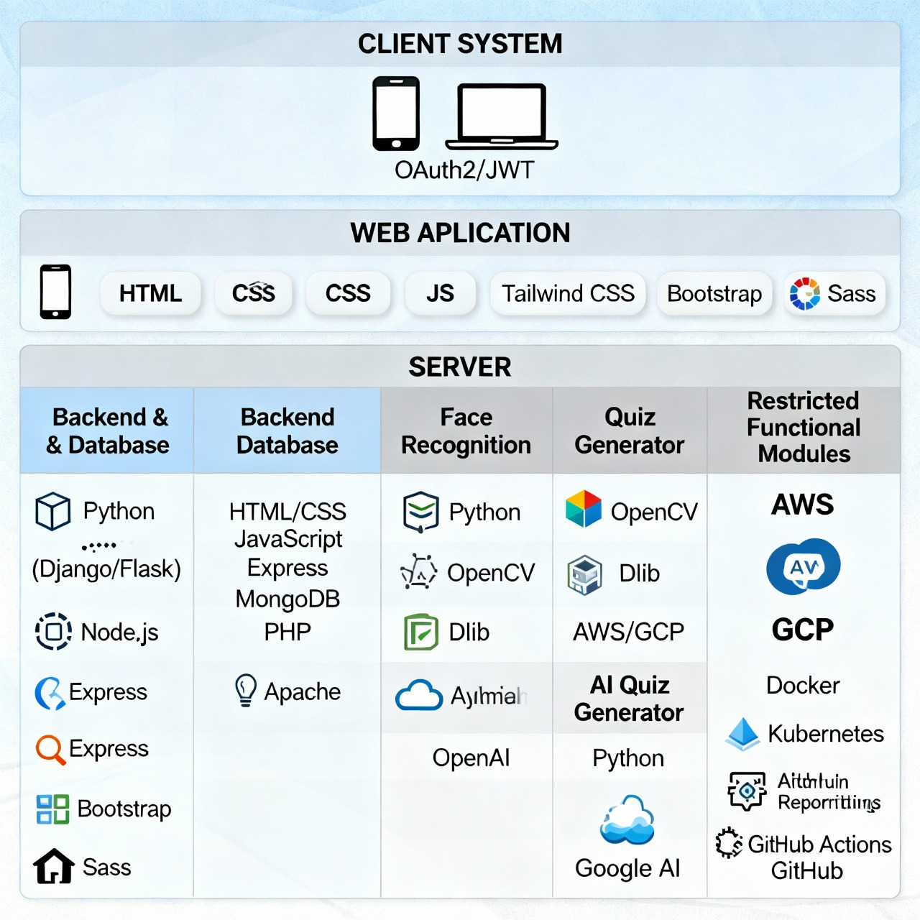
AttenAI
TECHNICAL APPROACH
Java
Frontend
HTML
CSS
Python

Slide 4
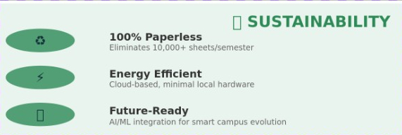
AttenAI
FEASIBILITY AND VIABILITY
Feasibility
Technical Feasibility
99% Face Recognition Accuracy - OpenCV + TensorFlow proven stack.
Real-Time Processing - 30 seconds for 50+ students simultaneously .
Phase Implementation - Attendance → Security → Analytics → AI Quiz
Operational Feasibility
Minimal Training - Teachers can use interface with just 20-30 min training.
Instant Adoption - Works with existing CCTV/webcams.
Dashboards ensure transparency for both students & faculty.
Viability
Educational Viability
Improves class discipline
reduces proxy attendance
ensures fair evaluation via AI quizzes.
Economic Feasibility
Cost-effective: Open-source libraries + existing hardware (CCTV).
Open-Source Core - Python, OpenCV, React (no licensing fees).
6- month ROI – break –even with 10+colleges.
Future Scope
Expand into a full smart campus solution:
ID-less entry
automated safety alerts
integration with LLM.
Commercial Viability
Scalable to schools/colleges (attendance, quizzes)
offices (attendance & access)
Security environment (threat detection).

Slide 5

AttenAI
IMPACT AND BENEFITS
IMPACT
Automated attendance
Minimum 80% presence rule ensures fairness.
Manual attendance override for valid exceptions.
Controlled video & AI-generated quiz system for productive free periods.
Student engagement tracking with time logs.
Flexible content distribution and feedback by teachers.
Secure, credential-based login ensures accountability.
Dashboards provide real-time insights for students, teachers, and administrators.
BENEFITS OF THE SOLUTION
Targeted Audience
AI Generated quizzes for free periods
Engagement Tracking
STUDENTS
FACULTY
ADMINISTRATORS
80% Presence Rule
Manual attendance override

Slide 6


AttenAI
RESEARCH AND REFERENCES
Research and Practices
Feature | Manual Roll call | RFID Cards | Biometric Systems | AttenAI
Proxy Prevention | ❌ High Risk | ⚠️ Card Sharing | ✅ Good | ✅ Impossible
Contactless | ❌ No | ❌ No | ❌ No | ✅ Yes
Emergency Detection | ❌ No | ❌ No | ❌ No | ✅ Fire/Fight Alerts
Setup Complexity | Easy | Medium | Hard | ✅ Very Easy
Hardware Required | none | RFID Readers | Scanners | ✅ Just Camera
OpenCV Documentation –
https://docs.opencv.org
TensorFlow Tutorials –
https://www.tensorflow.org/tutorials
IEEE Xplore: AI in Smart Education –
https://ieeexplore.ieee.org
Student Engagement & Attendance Systems
https://www.researchgate.net
React Official Documentation –
https://react.dev
Plotly Dash for Analytics –
https://dash.plotly.com
Statista: EdTech Adoption Reports –
https://www.statista.com
NITI Aayog Reports on AI in Education –
https://www.niti.gov.in
Demo Experience: Abhishek4312.info

