Slide 1

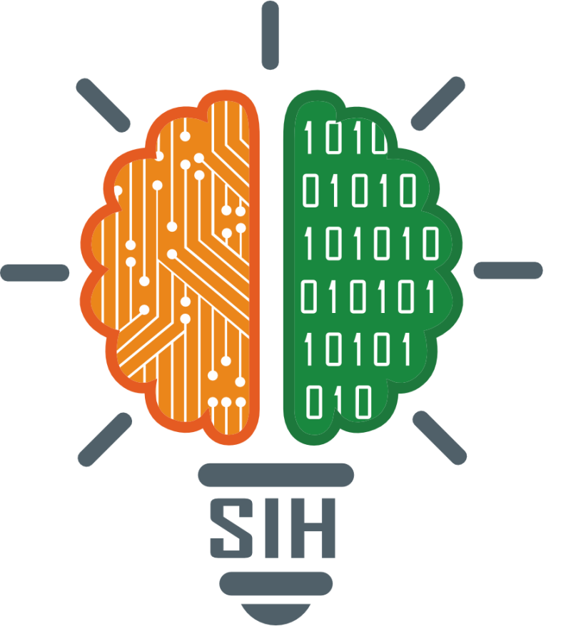
SMART INDIA HACKATHON 2025
Problem statement ID – SIH25061
Problem Statement Title – Digitize and Showcase Monasteries of Sikkim for Tourism and Cultural Preservation
Theme – Travel and Tourism
PS Category – Software
Team ID –
Team Name - TechTrek

Slide 2
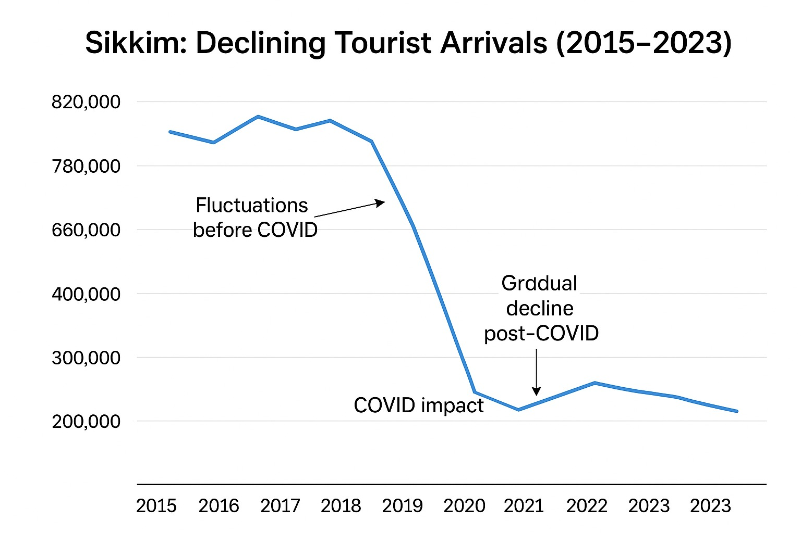
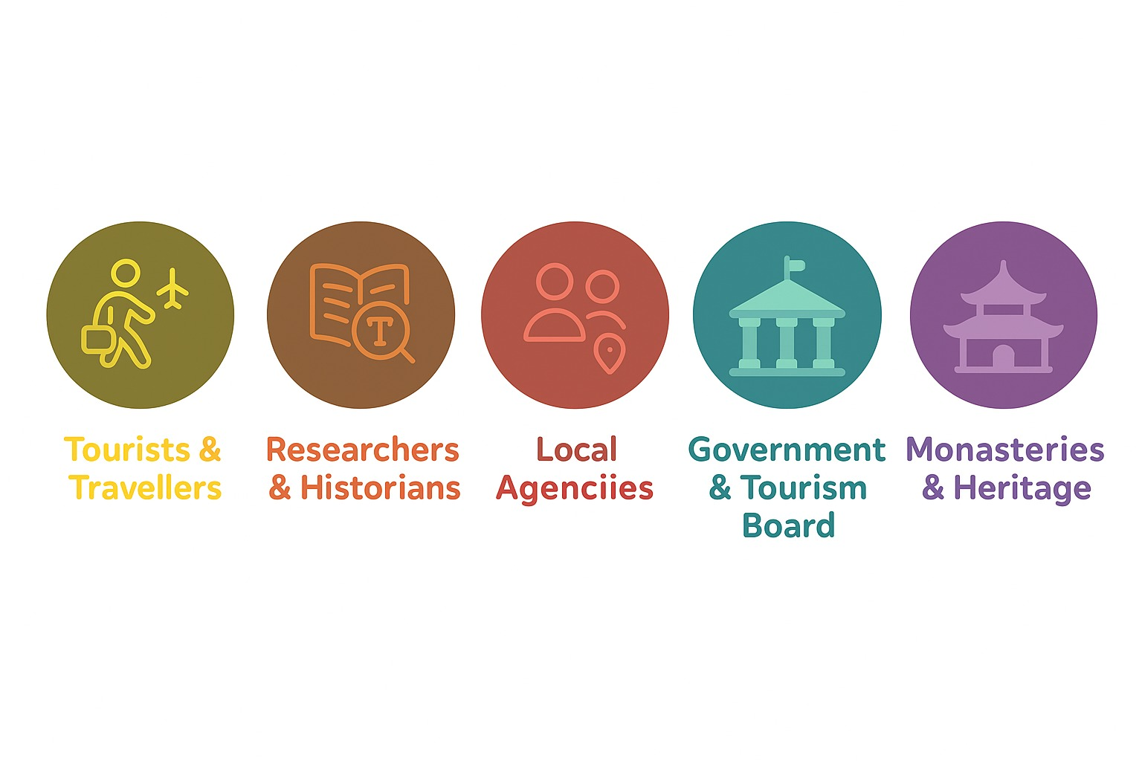


IDEA TITLE
TechTrek
Problem
PROPOSED SOLUTION
The rich cultural, spiritual, and architectural heritage of Sikkim’s 200+ monasteries lacks proper preservation and global visibility due to fragmented efforts and the absence of a unified digital platform for tourists and researchers.
Our idea is to create a Digital Heritage Platform that preserves Sikkim’s monasteries through virtual tours and cultural archives, while also promoting tourism and empowering local communities.
Virtual 360 Tours for immersive monastery experiences
Interactive monastery gallery with visuals & cultural insights
Digital marketing solutions
Promotion of local events to connect tourists with culture
TARGET AUDIENCE

Slide 3
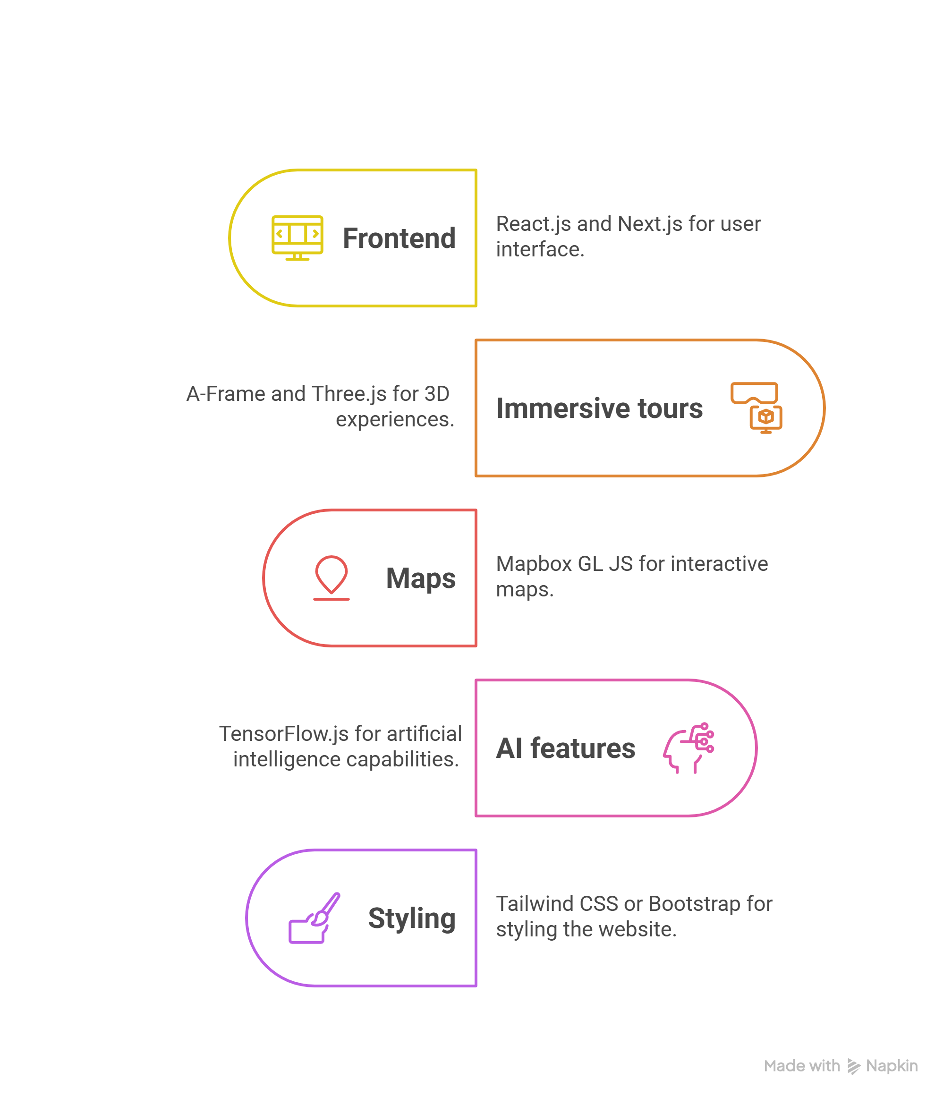
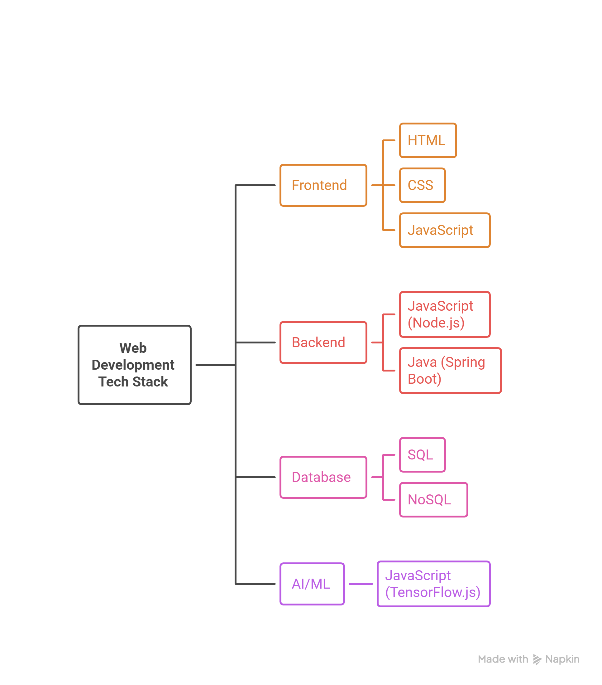
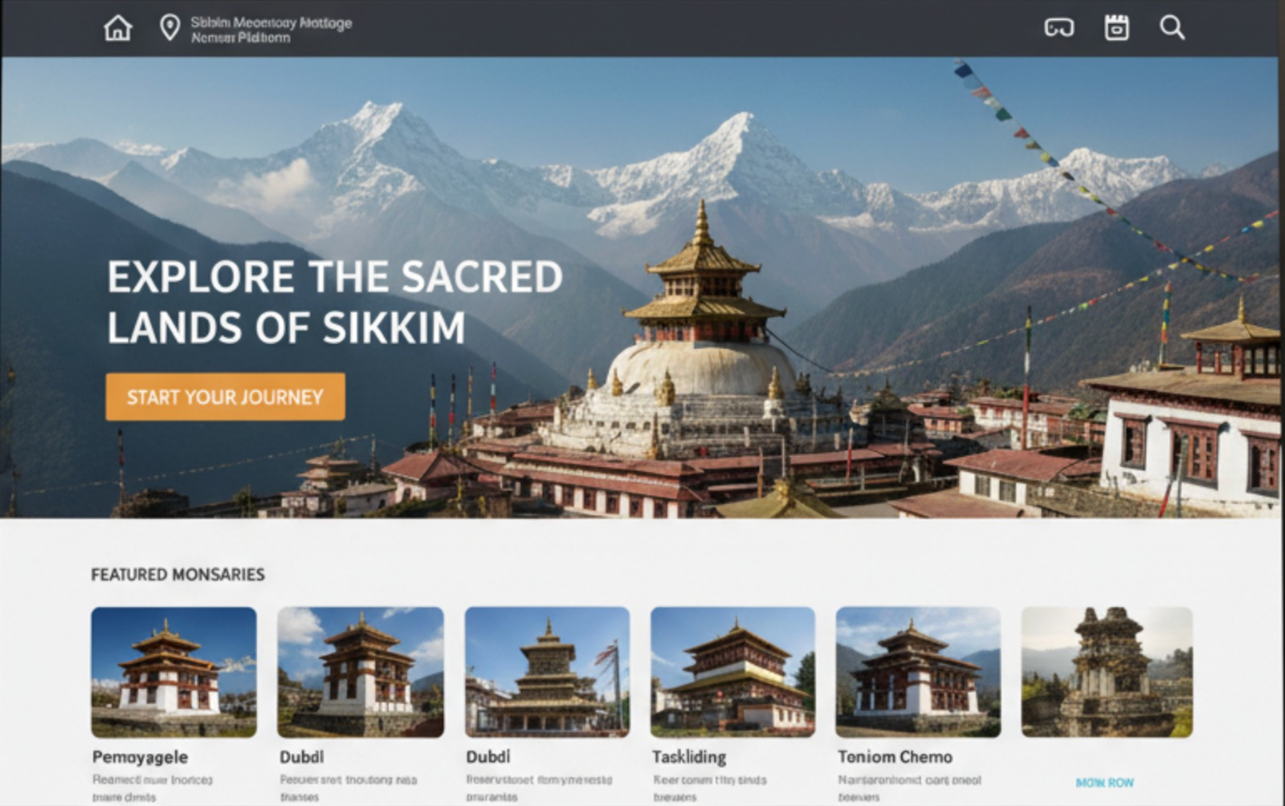
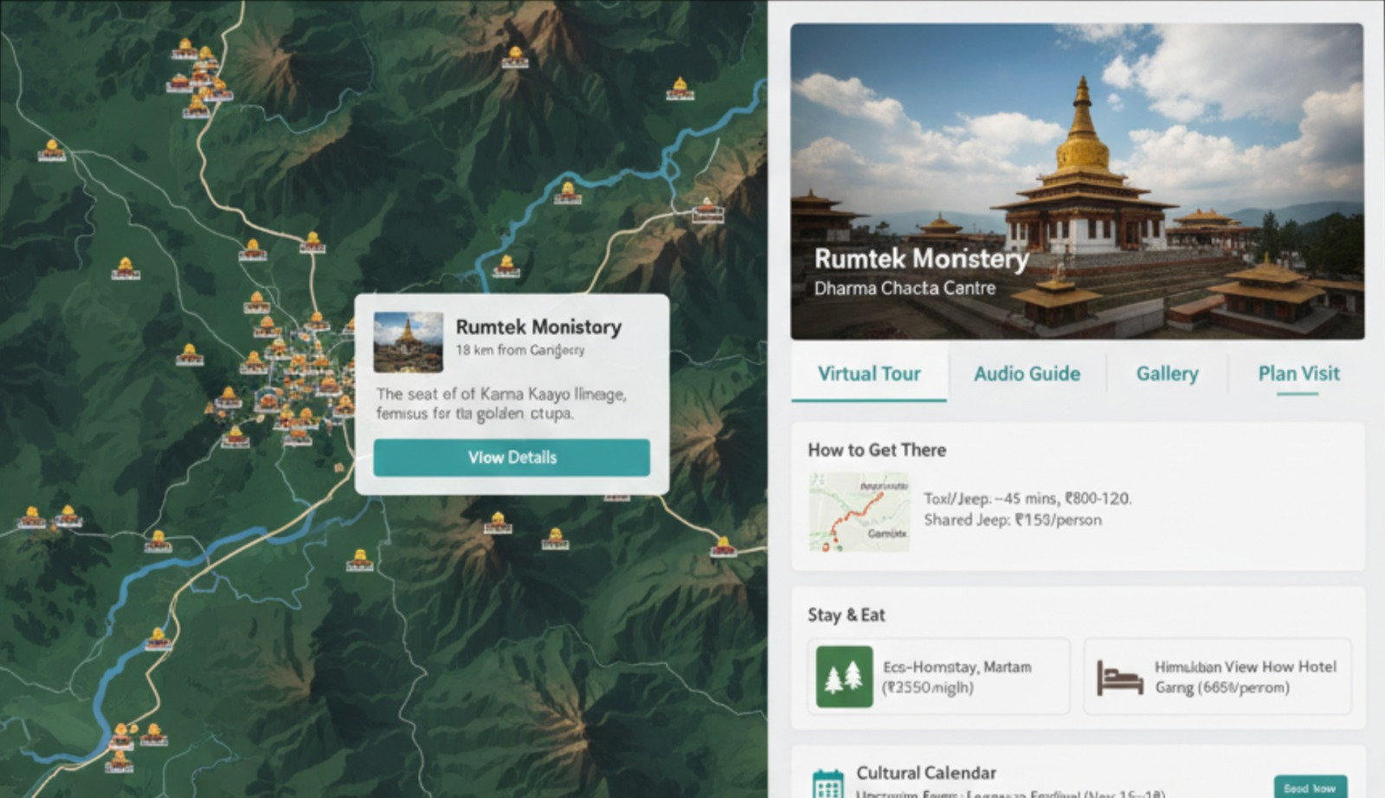
TECHNICAL APPROACH
TechTrek
Technologies Used
Model Working Structure
Our Prototype

Slide 4
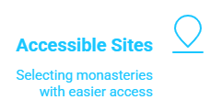
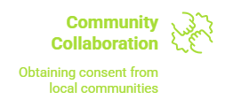

FEASIBILITY AND VIABILITY
TechTrek
Analysis of the Feasibility of the Idea
Challenges
🔹 Technical Feasibility
Open source software
Easy integration with existing systems
Scalable design to support future growth
🔹 Economic Feasibility
Cost-effective by using open-source tools and low-cost cloud services.
Promotes local goods through digital marketing
Revenue & support via tourism partnerships, bookings, and cultural grants.
🔹 Operational Feasibility
Easy to use and maintain with community participation, multilingual support, and offline access.
Designed for adoption by tourists, locals, and researchers.
Bridging the gap for local communities to adopt digital technologies
Verifying historical accuracy and avoiding misinterpretation.
Limited accessibility to remote monastries and villages for data collection.
Solution

Slide 5
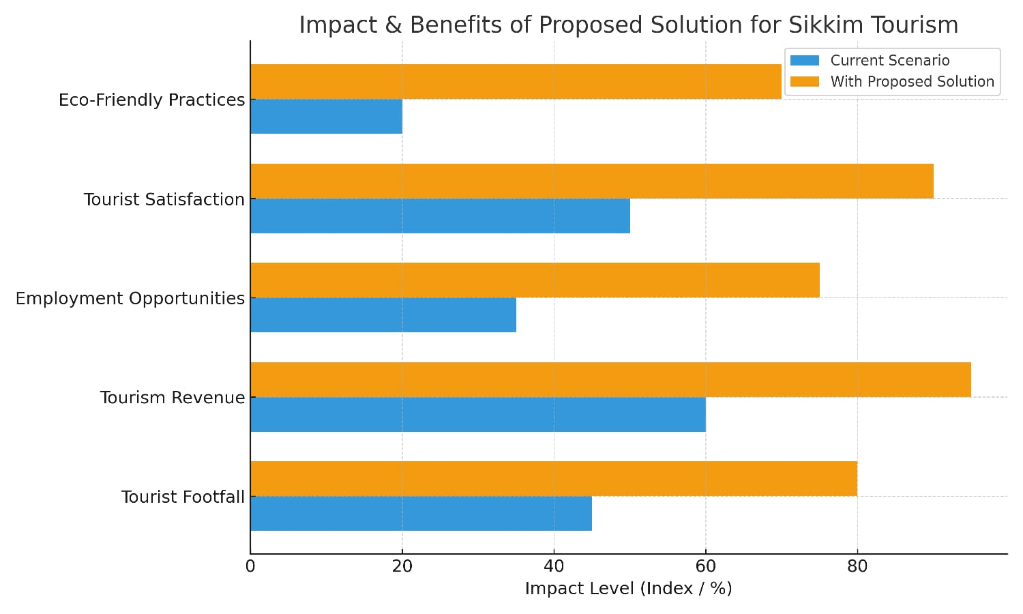
IMPACT AND BENEFITS
TechTrek
Benefits
Impact
Digital Promotion – Online platforms/websites will enable global promotion of the region and its services.
Cost-Effectiveness – A single digital platform reduces the high costs of physical preservation, documentation, and promotion.
Easy Access to Information – Tourists will have access to all travel-related information in one place.
Aspect | Current/Existing Methods | Our Digital Solution | Improvement
Tourist Reach | Limited to on-site visitors (2–3 million/year) | Global online access (billions worldwide) | 10x–50x reach
Preservation Cost | High (>$50M+ total per site for restoration, maintenance) | Low (once digitized, storage & updates <10% of cost) | ~90% cost saving
Accessibility | Seasonal; depends on travel & weather | Always online, multi-language, climate-friendly | Year-round, global
Long-Term Value | Physical records deteriorate in decades | Digital archives last centuries with upgrades | Sustainable & permanent

Slide 6
RESEARCH AND REFERENCES
TechTrek
1. Tourism Survey for the State of Sikkim (MOT, 2012) PDF download: https://tourism.gov.in/sites/default/files/2020-04/Sikkim%20tourism%20Final%20Report%2019th%20July.pdf
2. MOT Annual Report 2022-23 & Related Surveys/Studies https://www.scribd.com/document/680705949/MOT
3. Act text (law as passed): https://prsindia.org/files/bills_acts/acts_states/sikkim/2024/Act23of2024SK.pdf
4.Latest reports On tourism by government of Sikkim

