Slide 1

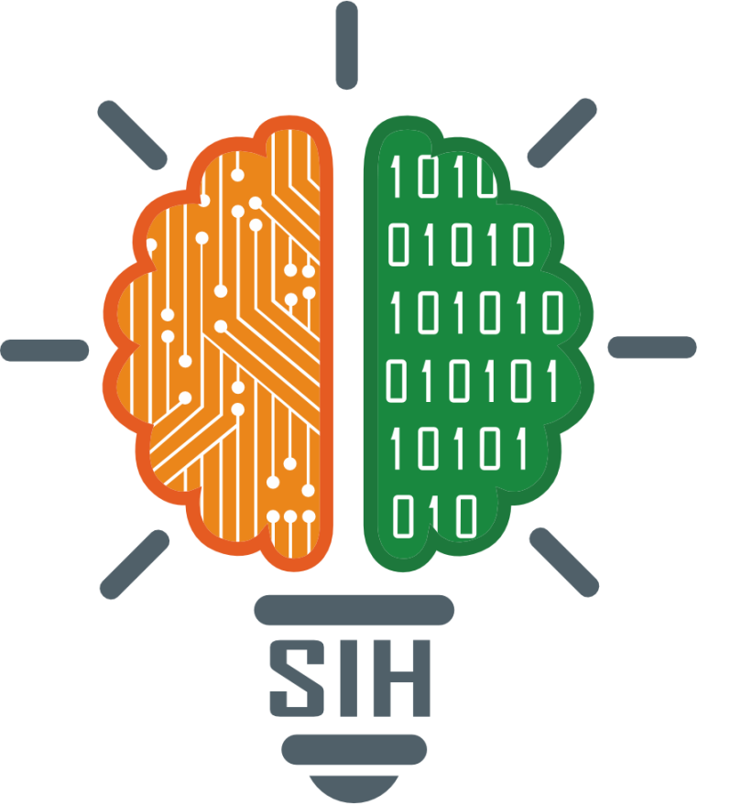
SMART INDIA HACKATHON 2025
TITLE PAGE
Problem Statement ID – SIH25027
Problem Statement Title- Develop a blockchain-based system for botanical traceability of Ayurvedic herb, including geo-tagging from the point of collection(farmers/wild collectors) to the final ayurvedic formulation label.
Theme- Blockchain & Cybersecurity
PS Category- Software
Team ID-
Team Name :- HERBARIUMX

Slide 2

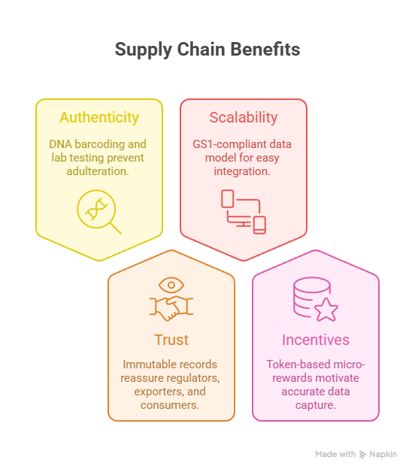
IDEA TITLE
Blockchain-based Botanical Traceability Platform for Ayurvedic Herbs
Our solution ensures end-to-end transparency from herb collection to final product labelling using a permissioned blockchain network.
Key Components
Collector App: Farmers/wild collectors capture geo-tag, photo, weight & timestamp. Data is digitally signed and sent to the blockchain.
Immutable Ledger: Events like collection, transport, lab test, and manufacturing are recorded as tamper-proof transactions.
Off-chain Storage: Photos, lab reports, and DNA data stored on IPFS/cloud; cryptographic hashes anchored on-chain for integrity.
Quality & DNA Verification: Partner labs upload test results and DNA barcode hashes to confirm herb authenticity.
Manufacturer Dashboard: Combines verified batches into final formulations and generates a QR/GS1 label for each lot.
Consumer Verification: Scanning the product QR instantly reveals the full provenance—origin, quality tests, DNA badge, and blockchain timestamp.

Slide 3
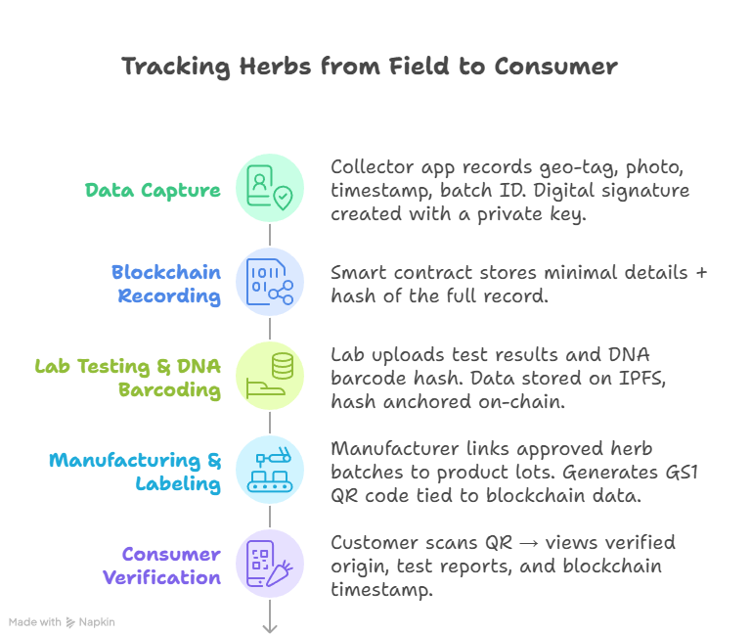






TECHNICAL APPROACH
Technologies to be Used
Programming & Frameworks
Backend / Blockchain:
Hyperledger Fabric (permissioned blockchain for secure, private transactions)
Node.js + Express (API layer to interact with the chain)
Frontend:
React / React Native (web + mobile app for collectors, labs, manufacturers, consumers)
Smart Contracts:
Chaincode (Go/Node.js) for event recording and verification logic
Storage:
IPFS / Secure Cloud (AWS S3) for lab reports, images, and heavy files with hashes stored on-chain
QR / Barcoding:
GS1–compliant QR codes using libraries like qrcode or zxing
Database (off-chain indexing):
MongoDB / PostgreSQL for fast querying and dashboards

Slide 4
FEASIBILITY AND VIABILITY
Analysis of Feasibility
Technical Feasibility:
✅ Proven technologies: Hyperledger Fabric, IPFS, QR/GS1 are mature and open-source.
✅ Mobile & web stack (React/Node.js) well supported for fast prototyping.
✅ DNA barcoding labs are available in most major cities for pilot testing.
Operational Feasibility:
1. Farmers/collectors already use smartphones; simple app with offline capture works even in rural areas.
2. Works with existing Ayurvedic supply chain—no drastic changes needed.
Economic Feasibility:
1. Initial pilot costs limited to cloud, blockchain nodes, and lab testing.
2. Scales gradually; consortium model allows cost-sharing among manufacturers and regulators.
Potential Challenges & Risks
Data Authenticity Risk: Farmers might fake geo-tags/photos or misreport quantities.
Connectivity & Adoption: Remote areas may face poor internet, low digital literacy among collectors.
Integration Barriers: Manufacturers and labs might resist adding new systems.
Privacy Concerns: Exact farm locations and personal data must be protected.
Regulatory Hurdles: Need alignment with AYUSH and export guidelines.
Strategies to Overcome Challenges
Data Integrity:
Use digital signatures & device attestation to prove data origin.
Random audits and cross-check GPS/photo metadata.
Offline & Simple UX:
App works offline and syncs when connected.
Provide local-language interface and training for farmers.
Stakeholder Incentives:
Offer micro-rewards (tokens/points) for verified batches.
Privacy Protection:
Store exact GPS encrypted; public chain shows only coarse region.
Policy & Standards:
Early engagement with regulators; follow GS1 standards for global acceptance.

Slide 5
IMPACT AND BENEFITS
🌟 Impact and Benefits
🎯 Potential Impact on Target Audience
Consumers:
1. Gain trust and confidence in the purity and origin of Ayurvedic products.
2. Easy QR scan reveals full journey from farm to formulation.
Farmers & Wild Collectors:
1. Recognition as verified suppliers.
2. Opportunity for better prices through proof of authenticity and quality.
Manufacturers & Exporters:
Faster regulatory approvals and stronger brand reputation in domestic and global markets.
Regulators & Certifiers:
Real-time access to tamper-proof data for inspections and compliance.
💡 Social Benefits
1. Empowers rural farmers with digital identity and fair trade opportunities.
2. Promotes traditional Ayurvedic knowledge with modern technology.
3. Builds consumer trust in herbal medicine and natural wellness.
💰 Economic Benefits
1. Reduces losses from counterfeit or adulterated herbs.
2. Opens premium export markets demanding verified supply chains.
3. Reduces paperwork and middlemen, improving efficiency.
🌱 Environmental Benefits
1. Encourages sustainable harvesting by rewarding authentic, responsibly sourced herbs.
2. Provides data for better monitoring of wild-collection areas and biodiversity.

Slide 6
📚RESEARCH AND REFERENCES
Blockchain in Supply Chain
IBM Food Trust – using blockchain for food traceability 👉ibm.com/blockchain/solutions/food-trust
Hyperledger Fabric – open-source blockchain platform 👉 hyperledger.org/use/fabric
Ayurvedic / Herbal Traceability
HerBChain – blockchain for herbal products 👉 herbchain.org
Ministry of AYUSH – quality & export guidelines 👉 ayush.gov.in
DNA Barcoding for Plants
Barcode of Life – global plant DNA barcoding methods 👉 barcodeoflife.org
Global Product Labels
GS1 – international barcode & QR standards 👉 gs1.org
Digital Identity
W3C – decentralized identity & verifiable credentials 👉 w3.org/TR/did-core

