Slide 1



SMART INDIA HACKATHON 2025
TITLE PAGE
Problem Statement ID – SIH25012
Problem Statement Title - Automated Attendence Sytem For Rural Schools
Theme - Smart Automation-Enchanching Attendence Tracking In Rural Education
PS Category - Software
Team ID -
Team Name (Registered on portal) - NeuralNexus

Slide 2
FACE RECOGNITION BASED ATTENDANCE SYSTEM
NEURALNEXUS
Proposed Solution
Develop an AI-powered face recognition attendance system that eliminates manual roll-calls
and proxy attendance.
• Automatically mark attendance in the system/database and generate reports.
• Ensure accuracy, speed, and security while being user-friendly for both students and
administrators.
• Provide a mobile dashboard for faculty to view, edit, and download attendance records.
• Integrate with existing college ERP systems for seamless operation.
• Reduce errors, save time, and improve transparency in attendance management
2

Slide 3
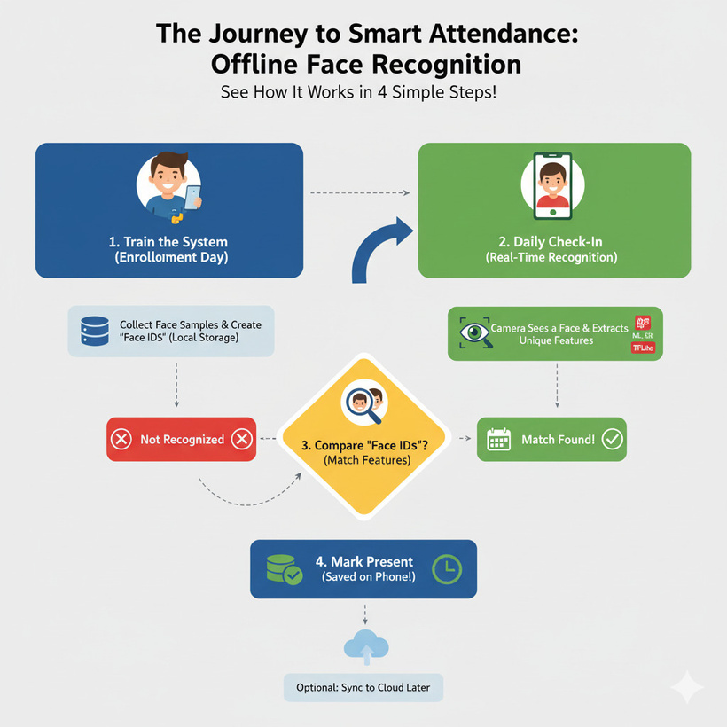
NEURALNEXUS
TECHNICAL APPROACH
Data Acquisition
Capture face images during registration using camera.
Store face embeddings in a secure database using Sql
Face Detection & Recognition
Use OpenCV / Pathlib / Mediapipe / Tenserflow / Sklearn libraries for face detection.
Match live faces against stored embeddings with a set threshold accuracy.
Attendance Marking
On successful recognition, mark attendance automatically with timestamp.
Update the central database in real-time.
System Architecture
Frontend: Mobile app (Flutter, etc.) for faculty & student interaction
Backend: Python/Node.js server with APIs to handle recognition requests
Databsae : Using a Sql database to store attendance logs & face data.
Additional Features
Notification alerts for absent students.
Analytics dashboard with attendance trends.
A calender to show the monthly presents,absents and late.
3

Slide 4
NEURALNEXUS
FEASIBILITY AND VIABILITY
Feasibility Analysis
1. Technical
Detection: ML Kit, Mediapipe (Android 7+, offline)
Recognition: MobileFaceNet, ArcFace Lite (CPU-friendly)
2. Operational
Flow: Camera → Detect → Recognize → Log
Admin: Python utility or in-app registration
3. Legal & Ethical
Privacy: Fully local, no cloud
Consent: Required at registration
Viability Analysis
1.Economic Viability
No need for cloud infrastructure.
2. Market Viability
Competitive Advantage
3.Risks & Mitigation
False positives/negatives
Challenges
1.Privacy Risks
2.Accuracy Limitations
3.Infrastructure Gaps
4.Technical Dependency
5.Ethical and Legal Hurdles
4

Slide 5
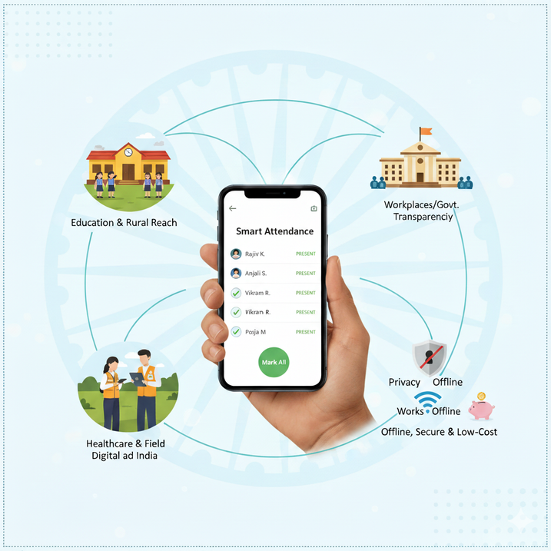
NEURALNEXUS
IMPACT AND BENEFITS
Impacts
Education: Reliable student attendance, including rural schools.
Workplaces/Govt.: Reduces proxy attendance, improves transparency.
Healthcare & Field: Tracks staff in remote clinics and field projects.
Rural Reach: Compatible with Android 7+, fits India's phone market.
Privacy: Local storage avoids Aadhaar-like data concerns.
Digital India: Offline-first design suits patchy networks.
Benefits
Offline Functionality: Attendance without internet.
Low Cost: No cloud/server dependency, ideal for schools and SMEs.
Fast & Real-Time: Marks multiple attendances instantly.
Lightweight: Runs on common smartphones.
Secure: On-device data with optional encryption.
Future-Ready: Syncs when online, supports scaling.
5

Slide 6
NEURALNEXUS
RESEARCH AND REFERENCES
https://educationforallinindia.com/can-ai-powered-face-recognition-attendance-system-transform-indian-colleges-and-beyond/
https://www.globalscientificjournal.com/researchpaper/
ChatGPT (OpenAI) – Used for generating explanations, ideas, and debugging help
Copilot – Assisted in code completion and AI-based programming support.
Replit – Used as an online IDE and collaborative development environment.
6

