Slide 1

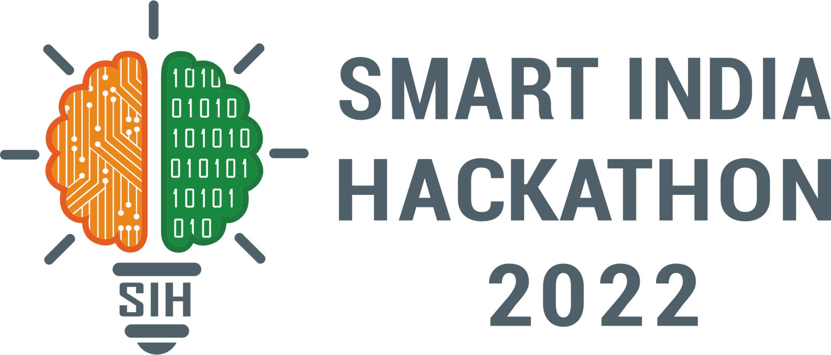

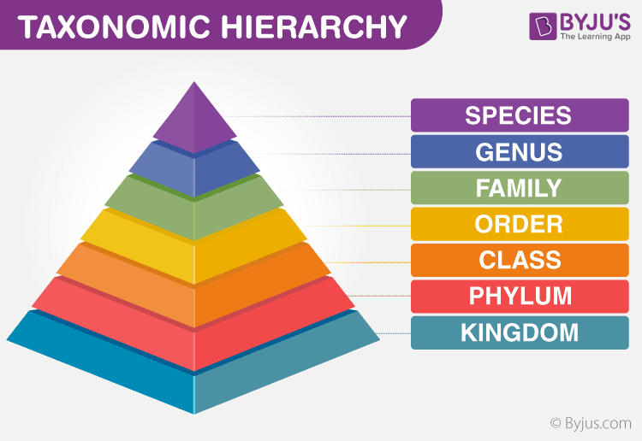
SMART INDIA HACKATHON 2025
AI-Driven Deep-Sea eDNA Biodiversity Assessment
Problem Statement ID – SIH25042
Problem Statement Title- Identifying Taxonomy
and Assessing Biodiversity from eDNA Datasets
Theme- Miscellaneous
PS Category- Software
Team ID-
Team Name : Deep Sea Explorers

Slide 2
AI-Powered eDNA Analysis Platform for Marine Biodiversity Mapping
Deep Sea
Explorers
Problem:-
Deep-sea ecosystems remain largely unexplored, covering 65% of Earth’s surface.
Incomplete DNA reference databases → Misclassification of species.
Traditional biodiversity surveys are slow, manual, and expensive.
Rising threats from deep-sea mining, trawling, and climate change.
Proposed Solution :-
AI-driven pipeline for real-time taxonomy classification directly from raw eDNA.
Database-independent identification using deep learning.
Automated biodiversity mapping and novel species detection.
Easy-to-use dashboard for visualization and reporting.

Slide 3
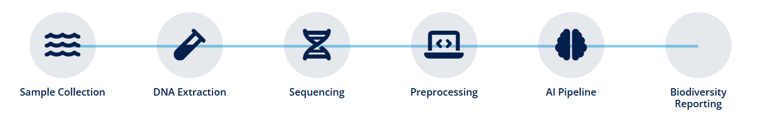

TECHNICAL APPROACH
Deep Sea
Explorers
Technologies to be used:-
Core Language: Python
AI/ML Frameworks: TensorFlow / PyTorch -for custom Deep Learning models.
Bioinformatics Tools: Biopython -DNA sequence handling & processing.
HDBSCAN – Unsupervised clustering for species classification ,etc.
Data Processing: Pandas, NumPy, Scikit-learn.
Deployment/Interface: Docker(for developing the interactive user dashboard)

Slide 4
FEASIBILITY AND VIABILITY
Deep Sea
Explorers
Analysis of the feasibility of the idea:-
Authentic deep-sea datasets from CMLRE expeditions and NCBI references.
Portable sequencers (Oxford Nanopore) for on-site, real-time data collection.
Local high-performance machines for fast DNA analysis without cloud dependency.
Established protocols for DNA extraction and sequencing.
Challenges:
Noisy and incomplete data from deep-sea samples.
Large datasets require optimized computational techniques.
Limited operational time during expeditions.
Our Strategy:
Use optimized bioinformatics pipelines with deep learning models for speed.
Perform computations locally using high-performance systems .
Self-supervised learning to reduce dependency on incomplete reference databases.
Lightweight deployment using Docker for reproducibility and easy installation.

Slide 5
IMPACT AND BENEFITS
Deep Sea
Explorers
Potential impact on the target audience:-
Target Audience: Ministry of Earth Sciences (MoES), Forest Departments, Central Pollution Control Board (CPCB), Wildlife Researchers, and Ecological NGOs.
Ultimate Goal: Transform biodiversity monitoring from a time-consuming, expert-dependent process to a rapid, automated, and standardized digital workflow.
Benefits of the solution:-
Type of Benefit | Key Outcome
Environmental | Early Detection & Conservation: Rapidly identifies invasive, rare, or threatened species across vast ecosystems (aquatic, soil), enabling timely conservation action.
Economic | Reduced Monitoring Cost: Significantly lowers the cost and time of biodiversity surveys by reducing the need for extensive fieldwork and specialized morphological taxonomic expertise
Social | Informed Policy: Provides reliable, high-resolution data to inform state and national environmental impact assessments (EIAs) and policy decisions.
Technological | Democratization of Science: Makes advanced bioinformatics accessible to non-specialists, promoting scientific capacity building.

Slide 6
RESEARCH AND REFERENCES
Deep Sea
Explorers
eDNA- https://www.nhm.ac.uk/discover/what-is-environmental-dna-edna.html
NCBI BLAST Database – blast.ncbi.nlm.nih.gov
Oxford Nanopore Technologies – nanoporetech.com
Illumina Sequencing – illumina.com
HDBSCAN Clustering – hdbscan.readthedocs.io

