Slide 1
Azure Functions
Carlos Cardoso
Lázaro Menezes

Slide 2
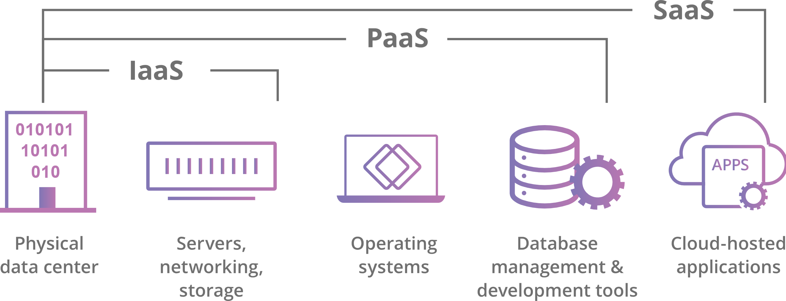
Cloud services “flavors”
https://www.cloudflare.com/learning/cloud/what-is-the-cloud/

Slide 3
Serverless (some call it FaaS)
Similar to PaaS…
…but simpler
There’s no need to worry even on how scaling will happen

Slide 4
Azure Functions - Stacks
.Net Core
NodeJS
Python
Java
PowerShell Core
Or you can deploy it as a docker container

Slide 5
Azure Functions - Triggers
HTTP
Timed (cronjob)
Queue
Event Hubs
IoT Hub
Blob Storage
And many others (https://docs.microsoft.com/en-us/azure/azure-functions/functions-triggers-bindings)

Slide 6
Azure Functions - Pricing
Consumption
Premium
Dedicated (App Service Plan)
https://docs.microsoft.com/en-us/azure/azure-functions/functions-scale#hosting-plan-support

Slide 7
Hands On
(show me how it works)

