Slide 1
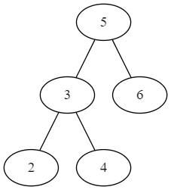
Schritt | next() | hasNext() | cursor
0
1
2
3
4
5

Slide 2
Schritt | next() | hasNext() | cursor
0 | - | true | 2
1
2
3
4
5

Slide 3
Schritt | next() | hasNext() | cursor
0 | - | true | 2
1 | 2 | true | 3
2
3
4
5

Slide 4
Schritt | next() | hasNext() | cursor
0 | - | true | 2
1 | 2 | true | 3
2 | 3 | true | 4
3
4
5

Slide 5
Schritt | next() | hasNext() | cursor
0 | - | true | 2
1 | 2 | true | 3
2 | 3 | true | 4
3 | 4 | true | 5
4
5

Slide 6
Schritt | next() | hasNext() | cursor
0 | - | true | 2
1 | 2 | true | 3
2 | 3 | true | 4
3 | 4 | true | 5
4 | 5 | true | 6
5

Slide 7
Schritt | next() | hasNext() | cursor
0 | - | true | 2
1 | 2 | true | 3
2 | 3 | true | 4
3 | 4 | true | 5
4 | 5 | true | 6
5 | 6 | false | null

