Slide 1

Programming Fundamentals 1
An Introduction to the module
Produced by:
Ms. Mairead Meagher
Ms. Siobhan Roche
Department of Computing and Mathematics
setu.ie

Slide 2
Agenda
Lecturers / Tutors
Module Structure & Delivery
Technologies
Module Assessment (Assignments)
Troubleshooting
Ethos

Slide 3


Introducing your lecturers / tutors
Siobhan Roche
Profile: https://www.setu.ie/staff/siobhan-roche
Email: siobhan.roche@setu.ie
Mairead Meagher
Profile: https://www.setu.ie/staff/mairead-meagher
Email: mairead.meagher@setu.ie

Slide 4


Programming Technologies

Slide 5
Assignments
100% Continuous Assessment (CA).
All Individual assignments
(no team-based ones).
Submit via Moodle assignment dropboxes.
Hard deadlines; extensions only permitted if mitigating circumstances apply.
Interviews

Slide 6
What to do if you don’t know what to do…
Ask in Class or at labs: Just put your hand up or wait until the end of the class, its up to you but asking during the class really helps all the students
Message your lecturer in Slack: You can always send us a private message and we will respond before the end of the next college day.
We encourage classmates to help each other (peer learning), if you know the answer to another student’s issue, please do respond.
Post the issue in Slack; think of it as asking a question in a classroom. Include any screen shots, screen recordings, etc. you think might help with solving the problem.

Slide 7
Ethos
Self-directed learning outside of lectures / labs.
Inquisitive and motivated.
Help your peers (use #Slack!).
Engagement and staying current with the module.
All work submitted must be your own work.
all code/approaches given in the module by us can be re-used / re-purposed in your assignments.

Slide 8

Introduction to BlueJ

Slide 9
What is BlueJ?
BlueJ is a simple program you’ll use to learn Java. It’s designed for beginners, so it avoids the clutter of professional coding tools and lets you focus on the basics.
You’ll see your program as boxes (classes) that you can click on.
You can create objects and test what they can do without writing extra code.
The editor helps you write neatly and spot mistakes more easily.
It’s free and works on most computers.
Think of BlueJ as training wheels for Java: it helps you experiment, see results quickly, and understand the core ideas of programming.

Slide 10
What language is behind Bluej
BlueJ doesn’t come with its own Java — it depends on the Java Development Kit (JDK) you install.
The current release (BlueJ 5.7.0, May 2024) works with:
Java 11 (LTS)
Java 17 (LTS)
Java 21 (LTS, current recommended version)

Slide 11
Why are we using BlueJ?
It’s developed for introductory programming courses
Objects first approach
Minimal interface and reduced distraction versus full Integrated Development Environments
Immediate Feedback
Notes:
Can visually the result of your programming code.
Visual confirmation that your code is correct.
Little “ceremony” around getting a piece of code to work…simple IDE and you can have a program with only one line of code if you wish.
Helps with understanding flow of control e.g. sequence, selection (if), iteration (loops)

Slide 12
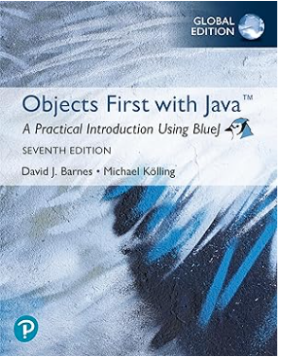
References
This course is largely based on the Book
Objects First with Java: A Practical Introduction Using BlueJ,
Global Edition Paperback – 21 July 2025
by David Barnes (Author), Michael Kölling (Author)
Notes:
Can visually the result of your programming code.
Visual confirmation that your code is correct.
Little “ceremony” around getting a piece of code to work…simple IDE and you can have a program with only one line of code if you wish.
Helps with understanding flow of control e.g. sequence, selection (if), iteration (loops)

Slide 13

Questions?

