Slide 1

Arrays and Classes
Produced
by:
Dr. Siobhán Drohan,
Ms. Mairead Meagher,
Ms. Siobhán Roche.
Department of Computing and Mathematics
http://www.setu.ie/

Slide 2
Topics list
1. Arrays of different types
Arrays of primitive types
Arrays of objects
String
Person

Slide 3
Let’s Look at arrays of different types
Arrays can store any type of data
Let’s look at some examples:
Array of primitives - int
Array of objects – String
Array of objects - Product

Slide 4
An array can store any type of data.
Primitive Types
int numbers[] = new int[10];
byte smallNumbers[] = new byte[4];
char characters[] = new char[26];
Object Types
String[] words = new String[4];
Person[] friends = new Person[4];

Slide 5
Topics list
1. Arrays of different types
Arrays of primitive types
Arrays of objects
String
Person

Slide 6
Structure of an int primitive array
int[] numbers;
numbers
null

Slide 7
Structure of an int primitive array
int[] numbers;
numbers
numbers = new int[4];
0 | 0
1 | 0
2 | 0
3 | 0

Slide 8
Structure of an int primitive array
int[] numbers;
numbers
numbers = new int[4];
numbers[2] = 18;
0 | 0
1 | 0
2 | 18
3 | 0
We are directly accessing the element at index 2 and setting it to a value of 18.

Slide 9
Structure of an int primitive array
int[] numbers;
numbers
numbers = new int[4];
numbers[2] = 18;
0 | 12
1 | 0
2 | 18
3 | 0
numbers[0] = 12;
We are setting the element at index 0 to a value of 12.

Slide 10
Structure of an int primitive array
int[] numbers;
numbers
numbers = new int[4];
numbers[2] = 18;
0 | 12
1 | 0
2 | 18
3 | 0
numbers[0] = 12;
print(numbers[2]);
Here we are printing the contents of index location 2 i.e. 18 will be printed to the console.

Slide 11
Topics list
1. Arrays of different types
Arrays of primitive types
Arrays of objects
String
Person

Slide 12
An array can store any type of data.
Primitive Types
int numbers[] = new int[10];
byte smallNumbers[] = new byte[4];
char characters[] = new char[26];
Object Types
String[] words = new String[4];
Person[] friends = new Person[4];

Slide 13
Structure of a String object array
String[] words;
words
null

Slide 14
Structure of a String object array
String[] words;
words
words = new String[4];
0 | null
1 | null
2 | null
3 | null

Slide 15
Structure of a String object array
String[] words;
words
words = new String[4];
0 | null
1
2 | null
3 | null
words[1] = “Dog”;
“Dog”

Slide 16
Structure of a String object array
String[] words;
words
words = new String[4];
0 | null
1
2 | null
3 | null
words[1] = “Dog”;
“Dog”
We are directly accessing the element at index 1 and setting it to a value of “Dog”.

Slide 17
Structure of a String object array
String[] words;
words
words = new String[4];
0 | null
1
2 | null
3
words[1] = “Dog”;
“Dog”
words[3] = “Cat”;
“Cat”

Slide 18
Structure of a String object array
String[] words;
words
words = new String[4];
0 | null
1
2 | null
3
words[1] = “Dog”;
“Dog”
words[3] = “Cat”;
“Cat”
The element at index 3 is set to “Cat”.

Slide 19
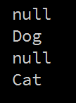
Structure of a String object array
String words[];
words = new String[4];
words[1] = "Dog";
words[3] = "Cat";
for (int i=0; i < words.length; i++)
{
System.out.println(words[i]);
}
Notes:
Should this be string object array

Slide 20
Topics list
1. Arrays of different types
Arrays of primitive types
Arrays of objects
String
Person

Slide 21
An array can store any type of data.
Primitive Types
int numbers[] = new int[10];
byte smallNumbers[] = new byte[4];
char characters[] = new char[26];
Object Types
String[] words = new String[4];
Person[] friends = new Person[4];

Slide 22
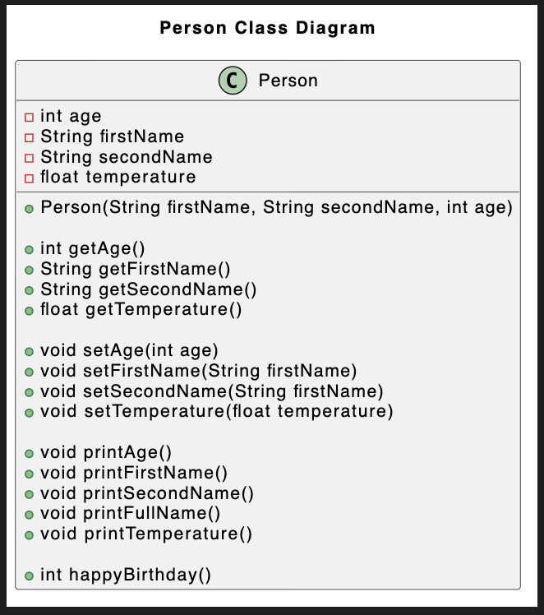
Person Class
Object Type/ Class Name
Fields i.e. the attributes of the class
Methods i.e. the behaviours of the class

Slide 23
Structure of a primitive array of Person
Person[] friends;
friends
null

Slide 24
Structure of a Product primitive array
Person[] friends;
friends
friends = new Person[4];
0 | null
1 | null
2 | null
3 | null

Slide 25
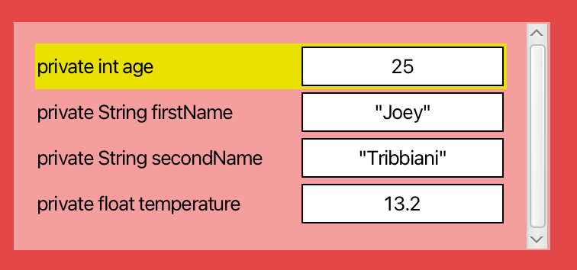
Structure of a Product primitive array
Person[] friends;
products
friends = new Person[4];
0 | null
1
2 | null
3 | null
friends[1] = new Person(“Joey”, “Tribbiani”, 25,);

Slide 26
Example using a Person object array
public void printFriends() {
if (size == 0 ) return “Sorry no Friends”;
else { for (int i = 0; i < friends.length; i++) { friends[i]. printFirstName();
friends[i]. printSecondName(); }
} }
Prints first and second names of all friends stored in the primitive array.

Slide 27
Example using a Person object array
public String listOfFriends(){
String listOfStudents = "List of friends \n";
for (int i = 0; i < friends.length; i++) {
listOfStudents += friends[i].getFirstName() + " "
+ friends[i].getSecondName() + "\n";
return listOfStudents;
}
}
}
Returns the first and second names of all friends stored in the primitive array.

Slide 28

Questions?

