Slide 1

Strings
Strings and their methods
Produced
by:
Dr. Siobhán Drohan
Ms Mairead Meagher
Ms Siobhan Roche
Department of Computing and Mathematics
setu.ie

Slide 2
Topics list - Strings
Primitive Types: char
Object Types: String
Strings and Java API
Strings – methods
Method calls
Internal
External
Dot notation
Using String methods: some examples

Slide 3
Recap: Primitive Types
Java programming language supports eight primitive data types.
The char data type stores one single character which is delimited by single quotes(‘) e.g.
char letter = ‘a’;
Data Type | Default Value
byte | 0
short | 0
int | 0
long | 0L
float | 0.0f
double | 0.0d
char | '\u0000'
boolean | false

Slide 4
Primitive Types: char
// VALID USE
char letter = ‘n’; //Assign ‘n’ to the letter variable
char letter = ‘N’; //Assign ‘N’ to the letter variable
// INVALID USE
char letter = n; //ERROR – no single quotes around n.
char letter = “n”; //ERROR – double quotes around n.
char letter = “not”; //ERROR – char can only hold one character.
Source: Reas & Fry (2014)

Slide 5
Primitive Types: char
char is a 16-bit Unicode character.
It’s values range:
from '\u0000‘ (or 0)
to '\uffff' (or 65,535)
For example:
‘A’ is ‘\u0041’
‘a’ is ‘\u0061’
https://unicode-table.com/en/#control-character
http://en.wikipedia.org/wiki/List_of_Unicode_characters
Notes:
char letter = 'A';
char letterLower = 'a';
char uFada = 218;
for (int i = 0; i < 26; i++)
{
print(letter);
letter++;
}
for (int i = 61; i < 87; i++)
{
print(letterLower);
letterLower++;
}
// 218 U fada
println();
println(uFada);
println ('\u00DA');

Slide 6
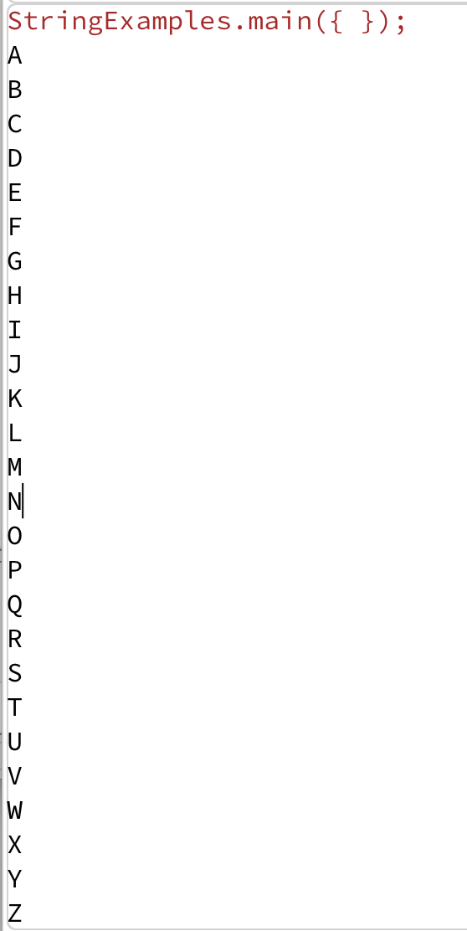
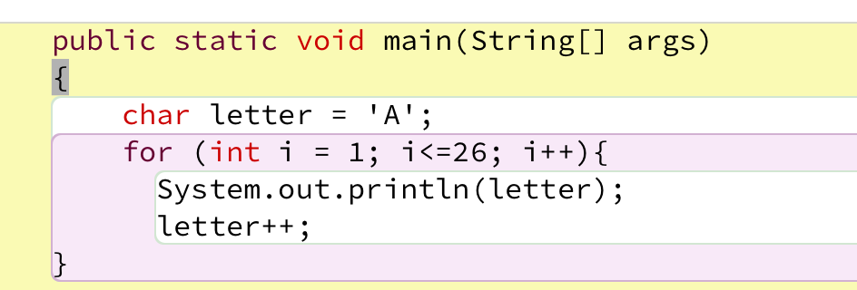
Example 3.18 – Alphabet
This code uses the underlying Unicode value for ‘A’ (i.e. ‘\u0041’) and adds one to it each time the for loop is iterated.
As the for loop is iterated 26 times, and the starting value is ‘A’, our loop will print the alphabet to the console.
Source: Reas & Fry (2014)
Notes:
char letter = 'A';
char letterLower = 'a';
char uFada = 218;
for (int i = 0; i < 26; i++)
{
print(letter);
letter++;
}
for (int i = 61; i < 87; i++)
{
print(letterLower);
letterLower++;
}
// 218 U fada
println();
println(uFada);
println ('\u00DA');

Slide 7
Topics list - Strings
Primitive Types: char
Object Types: String
Strings and Java API
Strings – methods
Method calls
Internal
External
Dot notation
Using String methods: some examples

Slide 8
Object types e.g. String
Strings, which are widely used in Java programming, are a sequence of characters enclosed by double quotes (“”). e.g. “seq of chars”
In Java, a String is an object type.
The Java platform provides the String class to create and manipulate strings.
The most direct way to create a String is to write:
String greeting = "Hello world!";
http://www.tutorialspoint.com/java/pdf/java_strings.pdf

Slide 9
Object types - String
// VALID USE
String str = “I am a sentence”; //Assigns the full sentence to str variable.
String word = “dog”; //Assigns the word “dog” to the word variable.
String letter = “A”; //Assigns the letter “A” to the letter variable.
// INVALID USE
String letter = n; //ERROR – no double quotes around n.
String letter = ‘n’; //ERROR – single quotes around n; use double.
string letter = “n”; //ERROR – String should have a capital S.
Object Data Types start with a Capital Letter to distinguish them from Primitive data types
Source: Reas & Fry (2014)

Slide 10
Strings are objects
Variables created with the String data type are called objects.
Objects are software structures that combine
variables
with methods that operate on those variables e.g.
every String object has a built-in method that can capitalise its letters.

Slide 11
Topics list - Strings
Primitive Types: char
Object Types: String
Strings and Java API
Strings – methods
Method calls
Internal
External
Dot notation
Using String methods: some examples

Slide 12
Strings and Java’s API
This link is to Java’s Application Programming Interface (API), version 8.
https://docs.oracle.com/javase/8/docs/api/index.html?overview-summary.html
More information on the String’s methods:
https://docs.oracle.com/javase/8/docs/api/java/lang/String.html

Slide 13
Topics list - Strings
Primitive Types: char
Object Types: String
Strings and Java API
Strings – methods
Method calls
Internal
External
Dot notation
Using String methods: some examples

Slide 14
Strings - some API methods
Return Type | Method Name | Description
int | length() | Returns the length of this string.
String | toLowerCase() | Converts all of the characters in this String to lower case.
String | toUpperCase() | Converts all of the characters in this String to upper case.
String | trim() | Returns a string whose value is this string, with any leading and trailing whitespace removed.
String | substring(int beginIndex, int endIndex) | Returns a string that is a substring of this string.
char | charAt(int index) | Returns the char value at the specified index.
Check for others here >
https://docs.oracle.com/javase/8/docs/api/java/lang/String.html

Slide 15
Topics list - Strings
Strings and Java API
Strings – methods
Method calls
Internal
External
Dot notation
Using String methods: some examples

Slide 16
External method calls
We want to check the length of this String:
String name = “Joe Soap”;
Looking at the String API, we can see this method:
A call to a method of another object is called an external method call. (objects {e.g.String} are usually defined in their own separate files)
https://docs.oracle.com/javase/8/docs/api/java/lang/String.html
Return Type | Method | Description
int | length() | Returns the length of this string.

Slide 17
External method calls
External method calls have the syntax:
object.methodname ( parameter-list)
To find out the length of this String:
We make the following external method call:
String name = “Joe Soap”;
name.length();

Slide 18
Topics list - Strings
Primitive Types: char
Object Types: String
Primitive Types versus Object Types
Strings and Java API
Strings - methods
Method calls
Internal
External
Dot notation
Using String methods: some examples

Slide 19
Dot Notation
Java code can call methods of other objects using dot notation.
The syntax is:
object.methodname ( parameter-list)
It consists of:
An object
A dot
A method name
The parameter(s) for the method
name
.
length
();

Slide 20
Topics list - Strings
Primitive Types: char
Object Types: String
Primitive Types versus Object Types
Strings and Java API
Strings - methods
Method calls
Internal
External
Dot notation
Using String methods: some examples

Slide 21
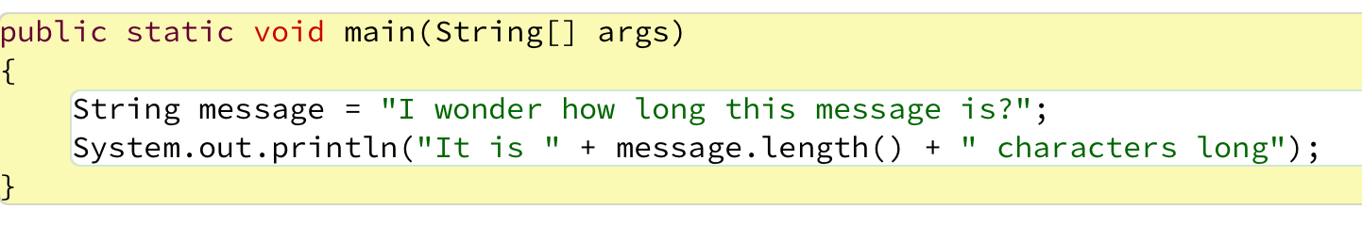

Example 1
Printing the length of a String to the console.
Notes:
String message = "I wonder how long this message is";
print(message.length());

Slide 22
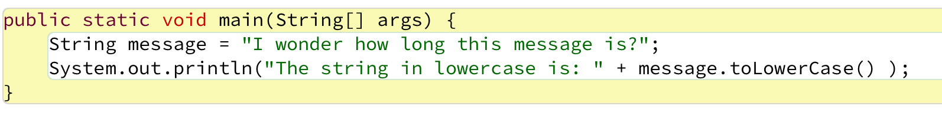
Example 2
Converting a String to lowercase and printing it to the console.
Notes:
String message = "I wonder how long this message is";
print("The String in Lowercase is: " + message.toLowerCase());

Slide 23
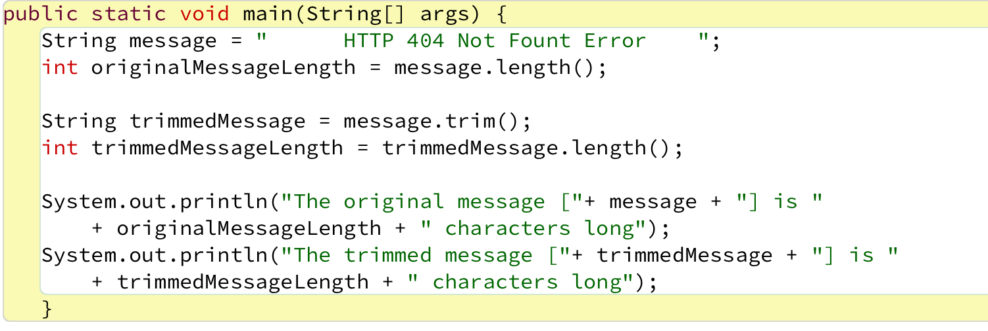
Example 3
Trim - Removing all the leading and trailing spaces in a String and printing it to the console.
Notes:
String message = " HTTP 404 Not Found Error ";
int originalLengthOfMsg = message.length();
String trimmedMessage = message.trim();
int trimmedLengthOfMsg = trimmedMessage.length();
println("The original message " + message
+ " is " + originalLengthOfMsg + " characters long");
println("The trimmed message " + trimmedMessage
+ " is " + trimmedLengthOfMsg + " characters long");

Slide 24

Questions?

Slide 25
References
Reas, C. & Fry, B. (2014) Processing – A Programming Handbook for Visual Designers and Artists, 2nd Edition, MIT Press, London.

