Slide 1

Using Methods
Writing your own methods
Produced
by:
Dr. Siobhán Drohan
Mr. Colm Dunphy
Ms Mairead Meagher
Ms Siobhan Roche
Department of Computing and Mathematics
setu.ie

Slide 2
Topics list
Quick Recap of method terminology:
Return type
Method names
Parameter list
Writing your own methods:
With no parameters
With parameters
That return data

Slide 3
Recap: Methods in Processing
A method is comprised of a set of instructions that performs some task.
When we invoke (call) the method, it performs the task.
Some methods we have used are:
main – (we write the code for main)
print(), println() – we call these methods

Slide 4
Recap: Method terminology
Method signature / header
void sayHello()
{
System.out.println(“hello”);
}
Method body

Slide 5
Recap: Method signature
Return type
Method name
Parameter list
void sayHello()

Slide 6
Topics list
Recap of method terminology:
Return type
Method names
Parameter list
Writing your own methods:
With no parameters
With parameters
That return data

Slide 7

Writing methods with NO parameters
Write a method that prints a hello message,
every time it is called (invoked) it will print the message.

Slide 8
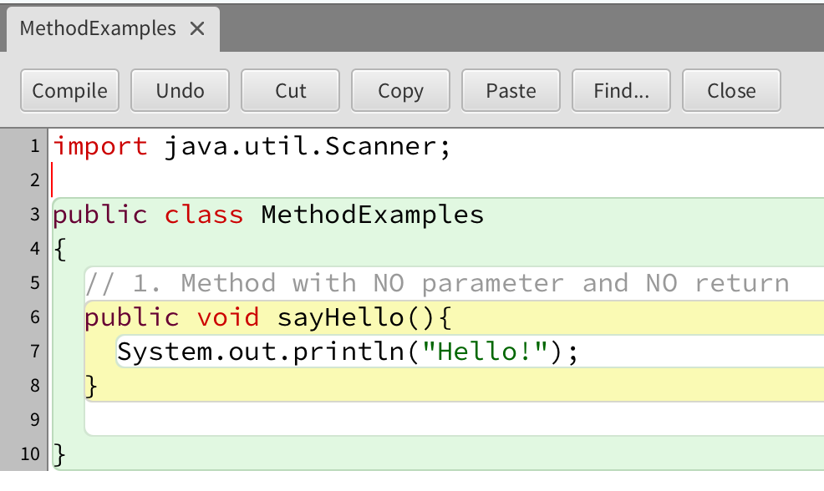
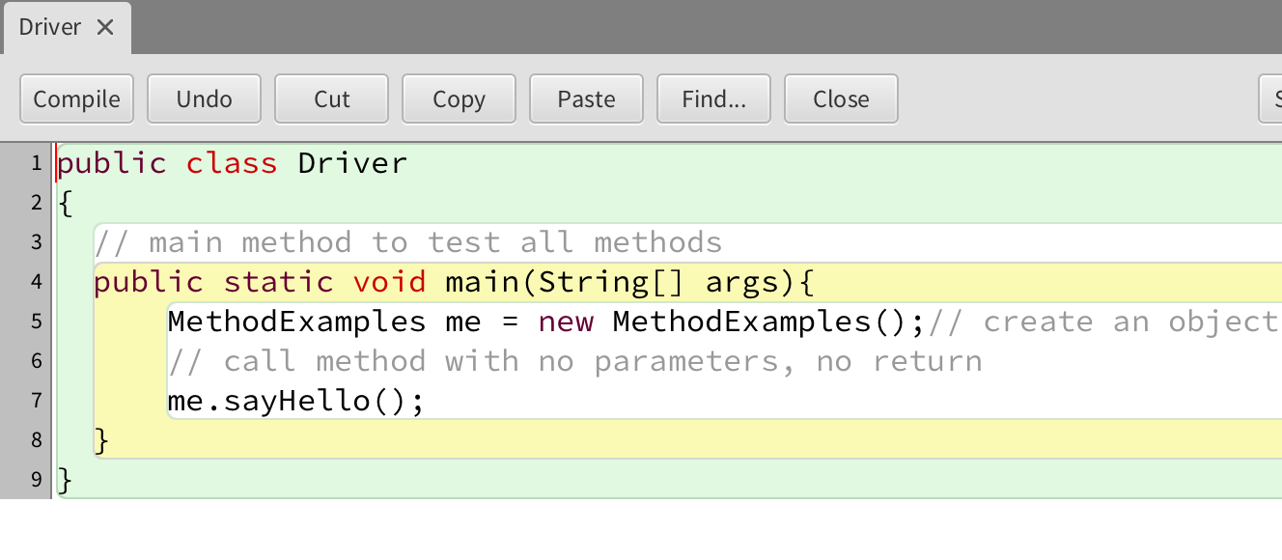
Example 1
Method definition
Create an instance of the class
Method call

Slide 9
Topics list
Recap of method terminology:
Return type
Method names
Parameter list
Writing your own methods:
With no parameters
With parameters
That return data

Slide 10
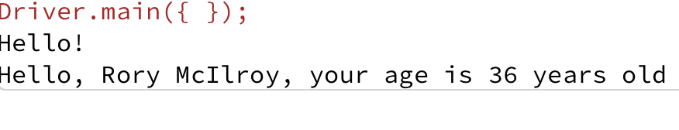
Writing methods with parameters
Now update the code so that you can: pass in a String to hold a name – this method will print a message using that name

Slide 11
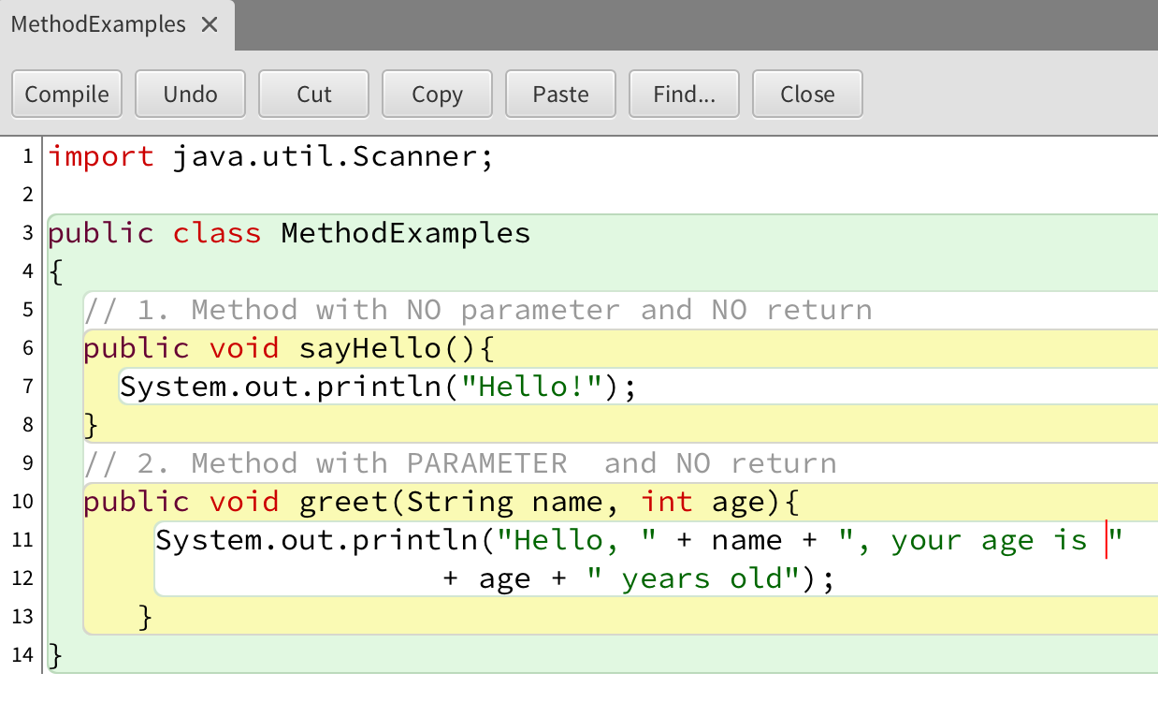
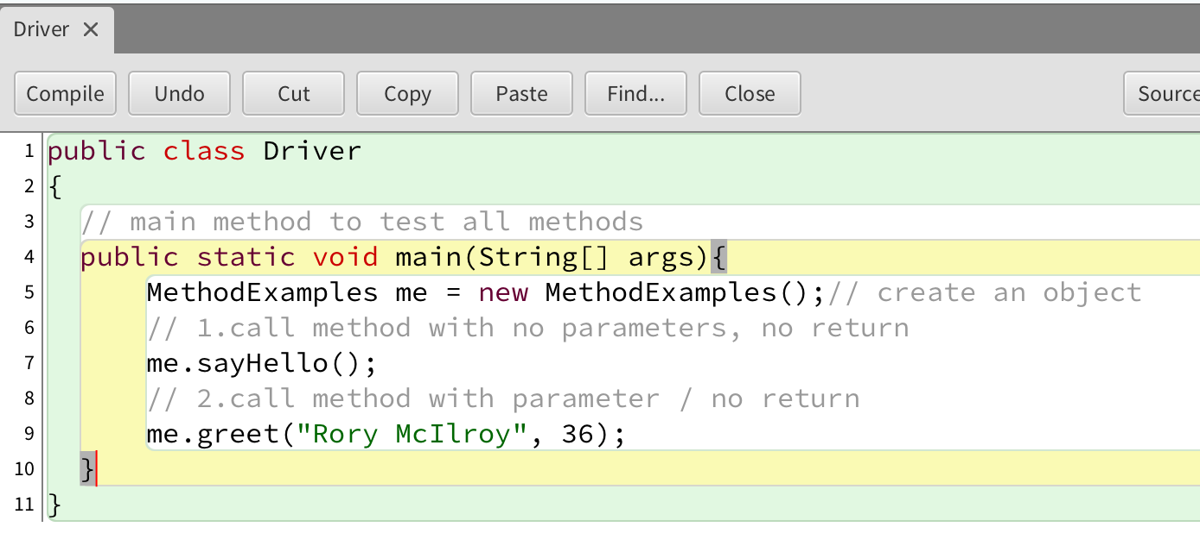
Example 2
Notes:
void setup()
{
size(200,200);
background(20,70,105);
}
void draw()
{
drawRedSquare(60);
}
void drawRedSquare(int length)
{
fill(255,0,0);
square(70,70,length, length);
}

Slide 12
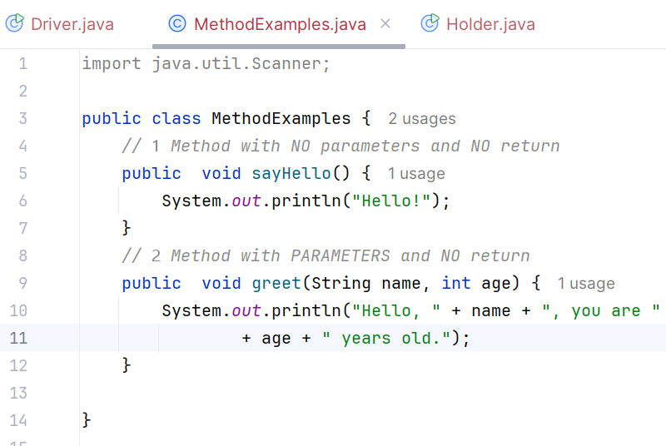
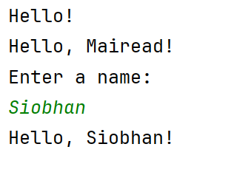
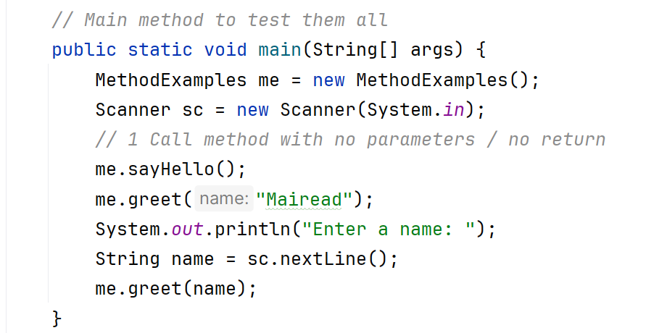
Using Scanner Example 3

Slide 13
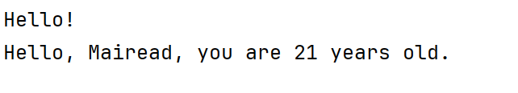
Writing methods with parameters
Now update the code so that you can pass in the:
name
age
into the method, greet().

Slide 14
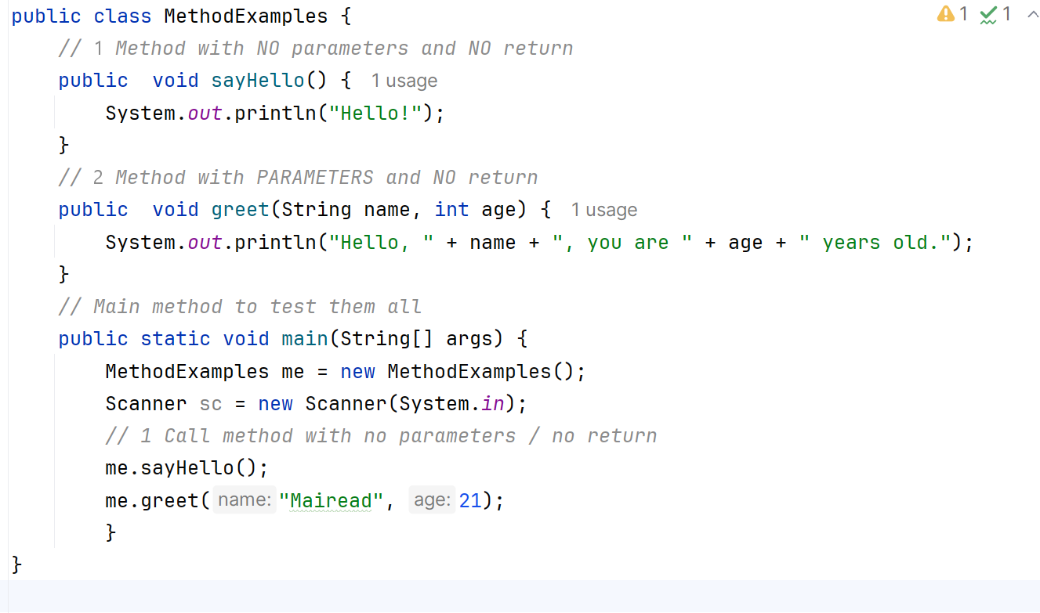
Example 3.3
Notes:
void setup()
{
size(200,200);
background(20,70,105);
}
void draw()
{
drawRedSquare(60, 70, 40);
}
void drawRedSquare(int length, int xCoord, int yCoord)
{
fill(255,0,0);
square(xCoord,yCoord, length);
}

Slide 15
Topics list
Recap of method terminology:
Return type
Method names
Parameter list
Writing your own methods:
With no parameters
With parameters
That return data

Slide 16
Writing methods that return data
Write a method called timesTwo.
This method should
take in one int parameter.
multiply this int by 2 and
return it back to where the timesTwo method was called from.
The returned value should be printed to the console.

Slide 17
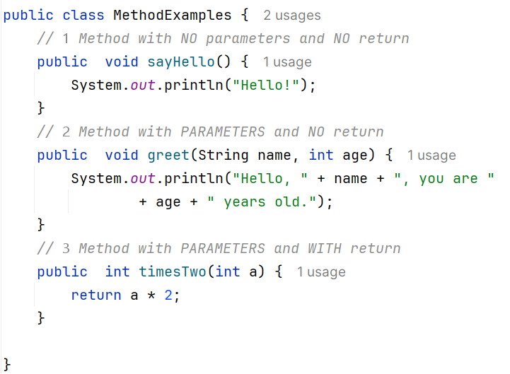
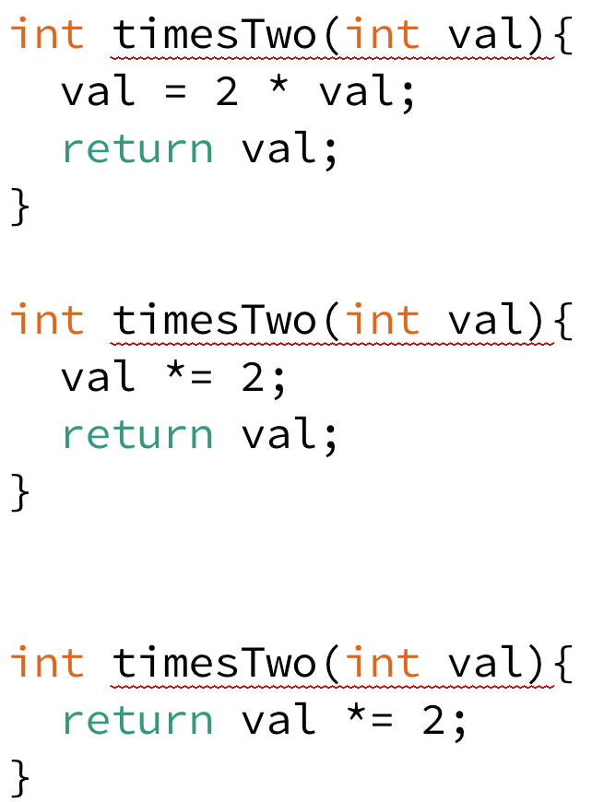
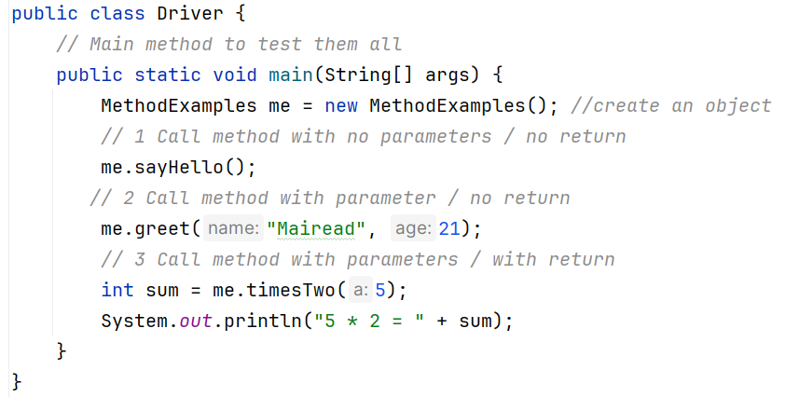
Example 3.4
Alternative implementations of timesTwo:

Slide 18

Questions?

