Slide 1


Understanding class definitions 4
Local Variables
Produced
by:
Ms. Mairead Meagher,
Ms. Siobhán Roche.
Department of Computing and Mathematics
http://www.setu.ie/
7.0

Slide 2
Upcoming
Local variables.

Slide 3
Variables – a recap
Fields are one sort of variable.
They store values through the life of an object.
They are accessible throughout the class.
Parameters are another sort of variable:
They receive values from outside the method.
They help a method complete its task.
Each call to the method receives a fresh set of values.
Parameter values are short lived.

Slide 4
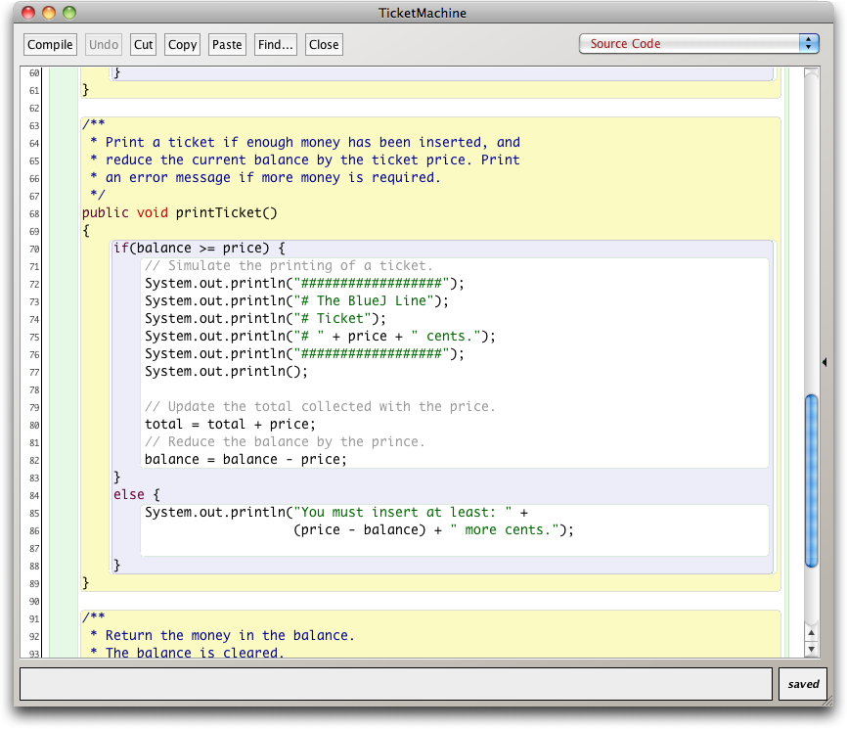
Scope highlighting

Slide 5
Scope and lifetime
Each block defines a new scope.
Class, method and statement.
Scopes may be nested:
statement block inside another block inside a method body inside a class body.
Scope is static (textual).
Lifetime is dynamic (runtime).

Slide 6
To think about
How could we write a method to ‘refund’ an excess balance?
We need to return the value in balance.
We need to set the balance to zero.
How can we do the first without losing the value in balance?
Notes:
write method in BlueJ;
first: do it wrong

Slide 7
Unsuccessful attempt
public int refundBalance()
{
// Return the amount left.
return balance;
// Clear the balance.
balance = 0;
}
It looks logical, but the language does not allow it.
A method will terminate immediately after executing a return statement!

Slide 8
Local variables
Methods can define their own, local variables:
Short lived, like parameters.
The method sets their values – unlike parameters, they do not receive external values.
Used for ‘temporary’ calculation and storage.
They exist only as long as the method is being executed.
They are only accessible from within the method.
They are defined within a particular scope.

Slide 9
Local variables
public int refundBalance()
{
int amountToRefund;
amountToRefund = balance;
balance = 0;
return amountToRefund;
}
A local variable
No visibility
modifier

Slide 10
Scope and lifetime
The scope of a field is its whole class.
The lifetime of a field is the lifetime of its containing object.
The scope of a local variable is the block in which it is declared.
The lifetime of a local variable is the time of execution of the block in which it is declared.

Slide 11
Review (1)
Class bodies contain fields, constructors and methods.
Fields store values that determine an object’s state.
Constructors initialise objects – particularly their fields.
Methods implement the behavior of objects.

Slide 12
Review (2)
Fields, parameters and local variables are all variables.
Fields persist for the lifetime of an object.
Local variables are used for short-lived temporary storage.
Parameters are used to receive values into a constructor or method.

Slide 13
Review (3)
Methods have a return type.
void methods do not return anything.
non-void methods always return a value.
non-void methods must have a return statement.

Slide 14
Review (4)
‘Correct’ behavior often requires objects to make decisions.
Objects can make decisions via conditional (if) statements.
A true-or-false test allows one of two alternative courses of actions to be taken.

Slide 15

Questions?

