Slide 1

Input / Output
Scanner class
Dr. Siobhán Drohan,
Ms. Mairead Meagher,
Ms. Siobhán Roche.
Produced
by:
Department of Computing and Mathematics
http://www.setu.ie/

Slide 2
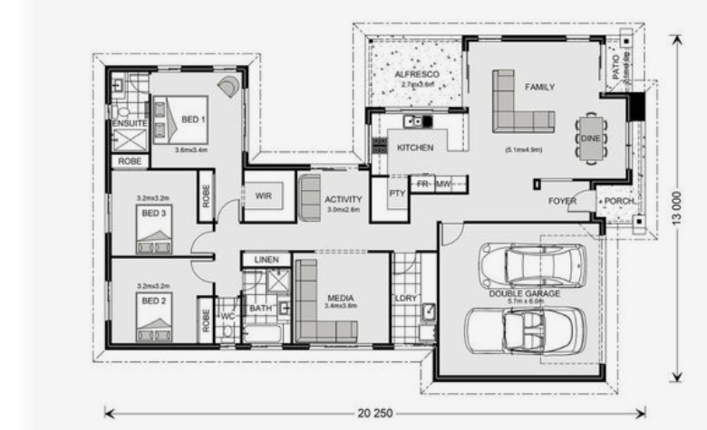
Before we start..
Java is an Object Orientated (OO) Language,
Everything in Java is associated with classes and objects, along with its attributes and methods. For example: in real life, a house is an object. The house has attributes, such as owner and numberOfRooms, and methods, such as changeOwner and calculateArea.
A Class is like an object constructor,
or a "blueprint" for creating objects
e.g. the house plan.

Slide 3

Before we start (contd)..
An object is an instance of a class, created based on that blueprint.
You need to create an object before you can use the methods of a class because methods belong to objects—they are the actions that objects can perform based on the blueprint provided by the class.
In Java, you create an object using the new keyword followed by the class name and any necessary arguments to the constructor, if applicable. Once the object is created, you can call its methods using the dot notation (object.method()).

Slide 4
Packages
Packages are containers for organising classes and interfaces in Java.
Packages help manage large codebases, prevent naming conflicts, and improve code organisation.
Packages contains Classes that help us to code
We will import them into our code and use them to reduce the amount of code that we need to write.
Example: java.util package contains utility classes like ArrayList, HashMap, Scanner

Slide 5
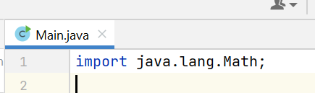
Accessing Methods in Packages
Importing: Use the import statement to access methods from other packages.
Syntax: import package_name.ClassName;

Slide 6
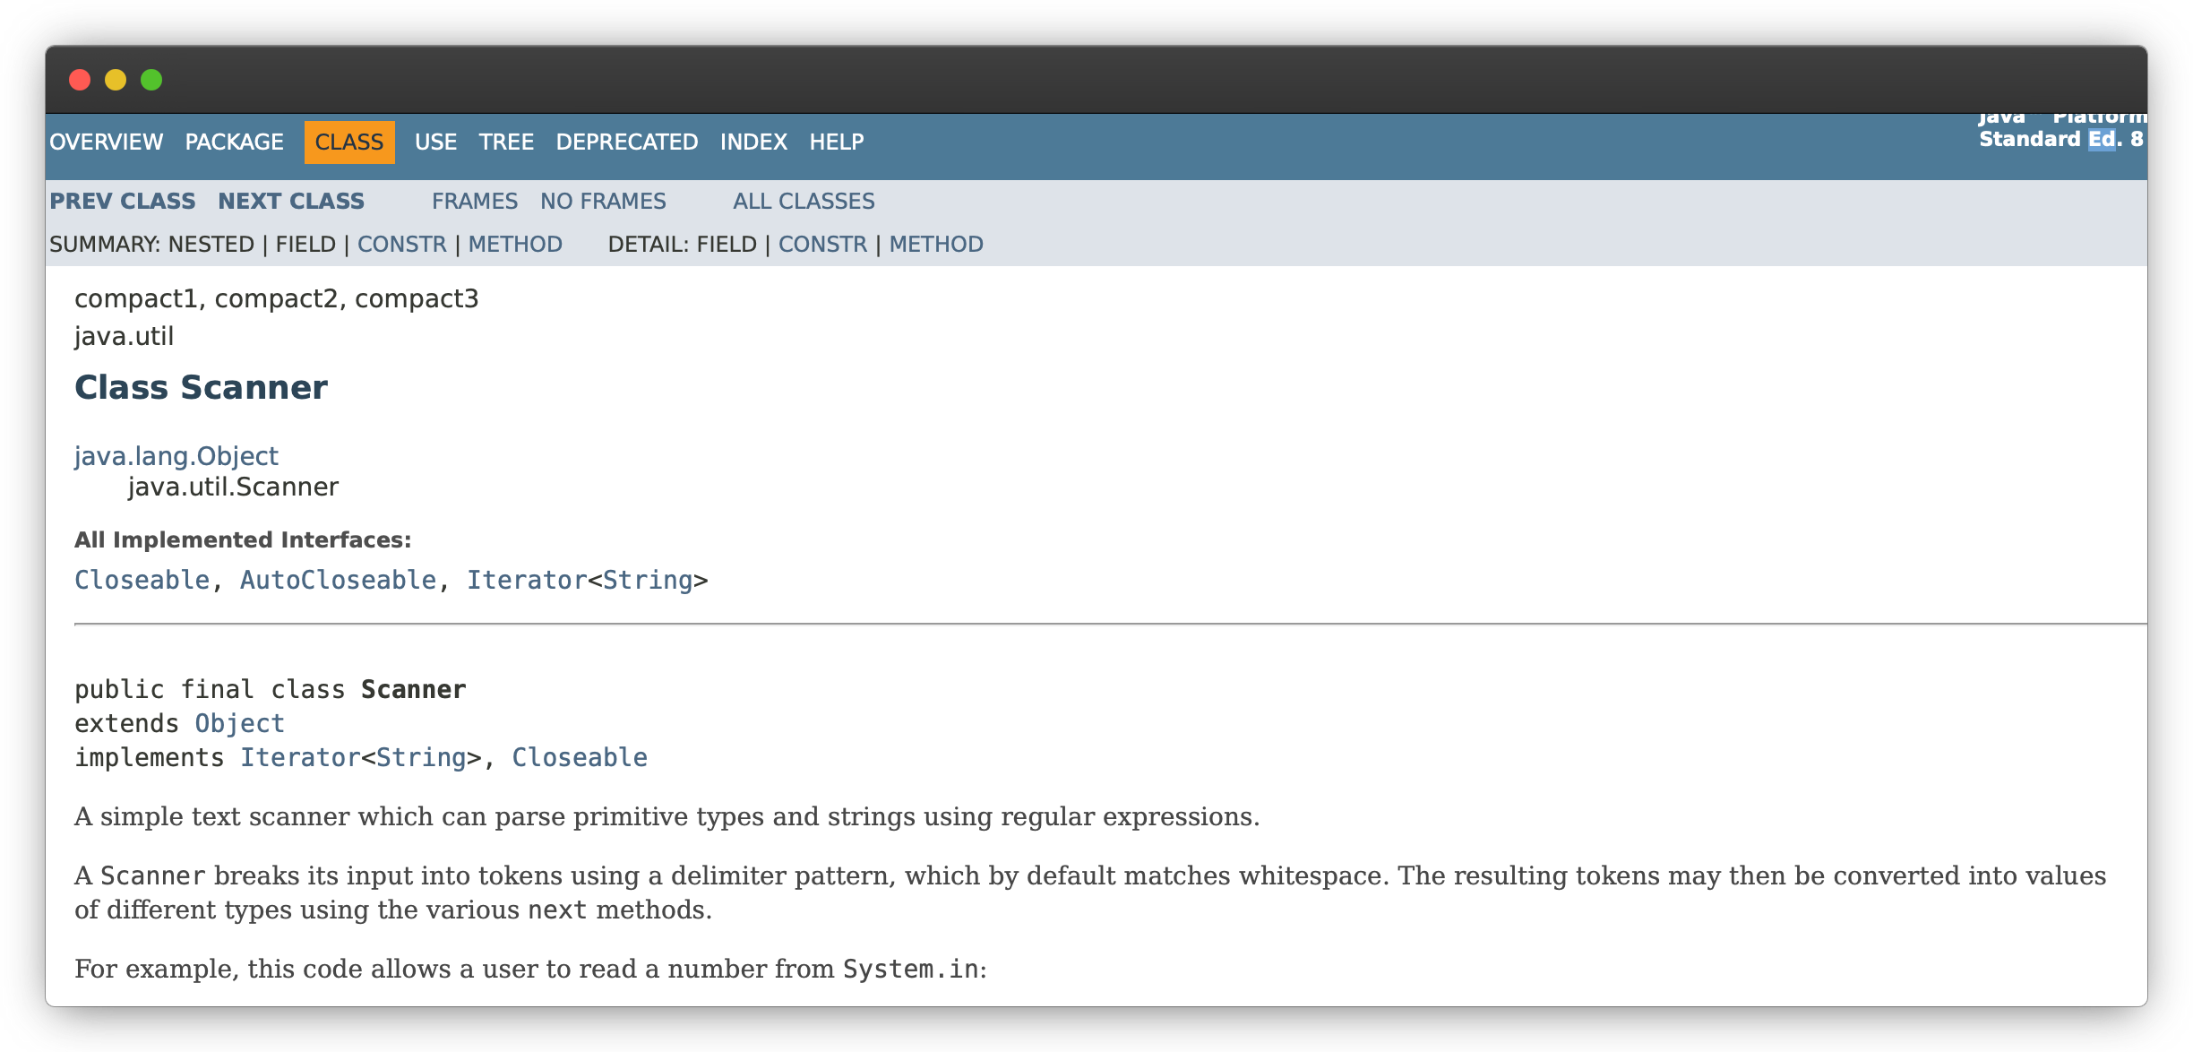
Input in Java: the Scanner Class
The Scanner class comes with Java.
The Scanner class allows us to read input from various sources, such as the keyboard or a file.
It allows us to take in data from the console / terminal window.
It is part of the java.util package in the Java Application Programming Interfaces (API).

Slide 7
How Does Scanner Work?
Create a Scanner Object: To use the Scanner class, you first need to create a Scanner object. This object is your tool for reading input.
Specify Input Source: Next, you specify where you want to read input from. In most cases, we'll read input from the keyboard, which is represented by System.in.
Read Input: Once you have a Scanner object and specified the input source, you can use various methods provided by the Scanner class to read input. These methods allow you to read different types of data, such as integers, doubles, or strings.

Slide 8
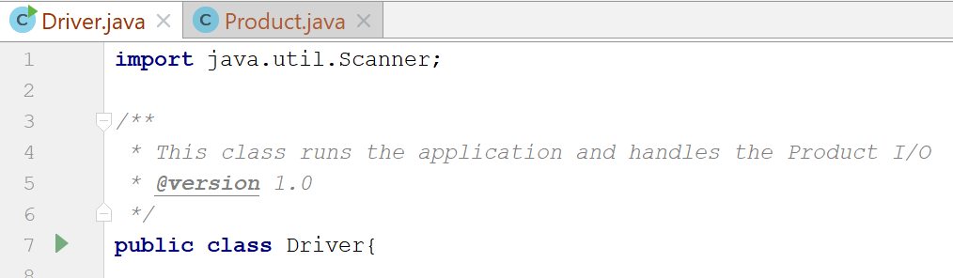
Input in Java: the Scanner Class
In order to use the Scanner class, place the following line as the first line of code in your file (i.e. before class declaration):
import java.util.Scanner;

Slide 9
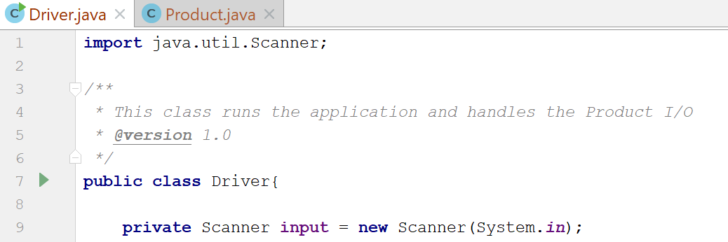
Input in Java: the Scanner Class
Having imported the util package, you will need to write the following instruction in your program.
Scanner input = new Scanner(System.in);

Slide 10
Input in Java: the Scanner Class
This declares a Scanner object called input (you can name this object anything you wish).
You must have this instruction to be able to call the methods in the Scanner class.

Slide 11
Input in Java: the Scanner Class
Now that a Scanner object is set up, we can use all the input methods that have been defined in the Scanner class.
There are methods to take in:
ints | .nextInt()
doubles | .nextDouble()
Strings | .nextLine()
chars | .next().charAt(0)
etc… | See API docs for more (https://docs.oracle.com/javase/8/docs/api/java/util/Scanner.html)

Slide 12
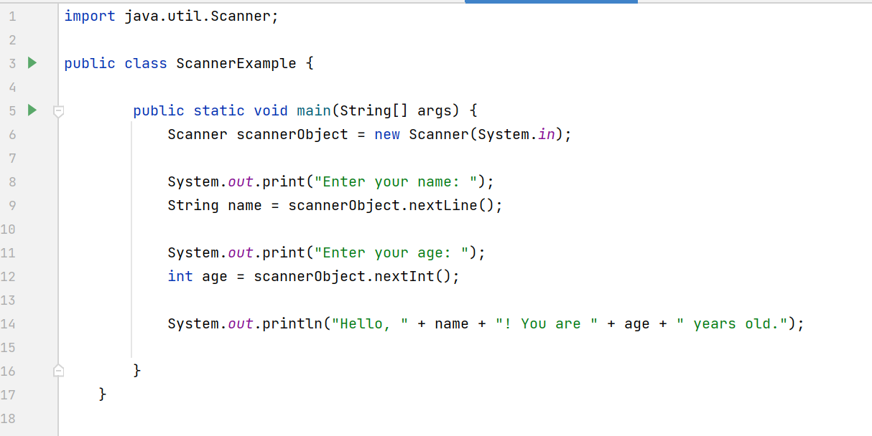
Using Scanner Class

Slide 13

Questions?

