Slide 1

Iteration in Programming
for loops
Produced
by:
Dr. Siobhán Drohan,
Ms. Mairead Meagher,
Ms. Siobhán Roche.
Department of Computing and Mathematics
http://www.setu.ie/

Slide 2
Topics list
There are three types of loop in programming:
while loops:
Counter controlled (n times) - covered in previous talk
Sentinel based (covered later in the course)
Flag based (covered later in the course)
for loops (this slide deck)
do While loops (covered later in the course)
Comparative use of while and for loops
Lab03 - Challenge 1
Lab03 - Challenge 3

Slide 3
For loop pseudo-code
General form of a for loop
for(initialization; boolean condition; post-body action)
{
statements to be repeated
}

Slide 4
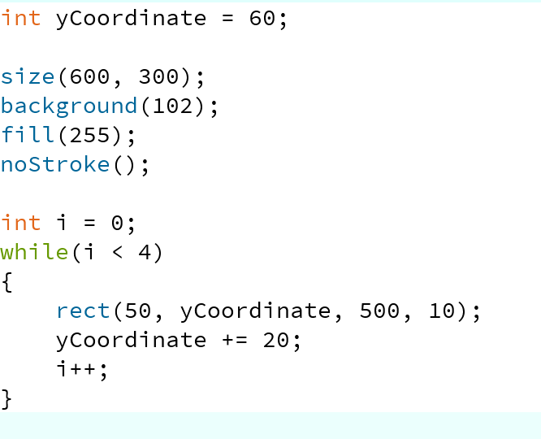
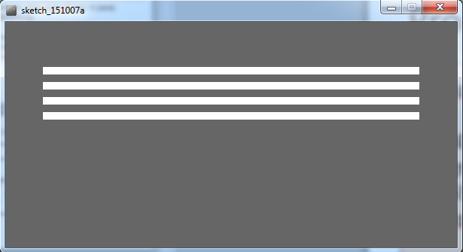
Recap: Processing Example 4.5
This was a slide from the previous talk. We used a while loop to repeatedly print the four rectangles to the display window.
Notes:
int yCoordinate = 60;
size(600, 300);
background(102);
fill(255);
noStroke();
int i = 0;
while(i < 4)
{
rect(50, yCoordinate, 500, 10);
yCoordinate += 20;
i++;
}

Slide 5
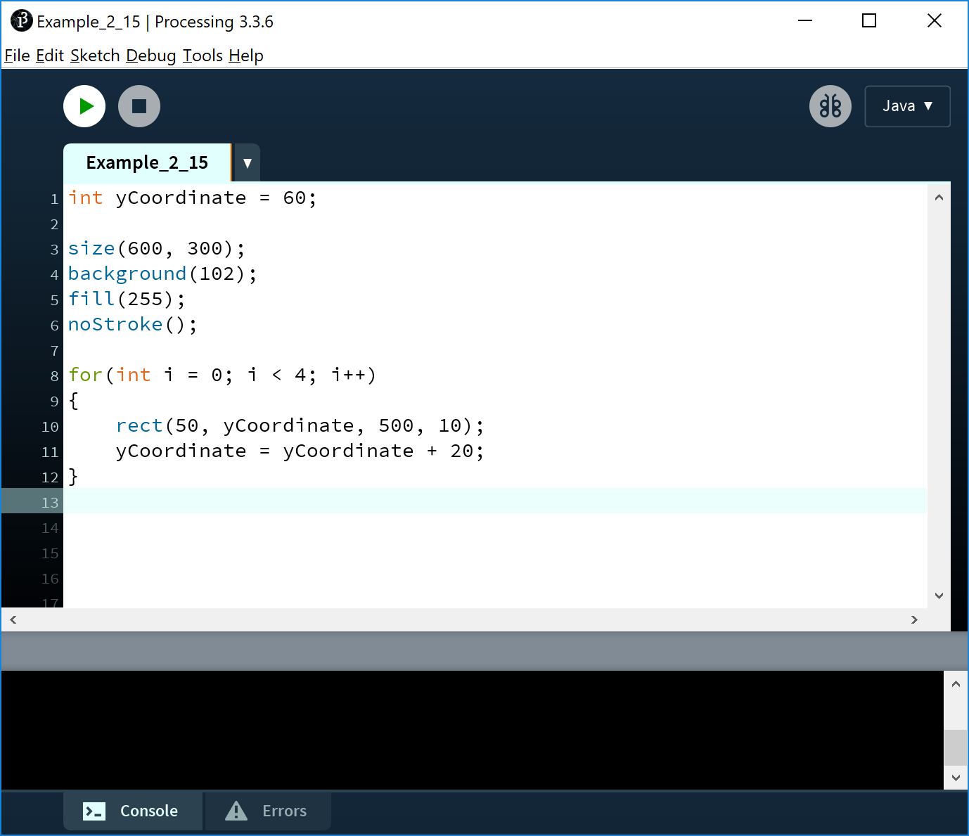
Processing Example 4.7
This code does the same as the previous slide, except that we use a different loop: for
Notes:
int yCoordinate = 60;
size(600, 300);
background(102);
fill(255);
noStroke();
for(int i = 0; i < 4; i++)
{
rect(50, yCoordinate, 500, 10);
yCoordinate = yCoordinate + 20;
}

Slide 6
For loop syntax
for(initialization; boolean condition; post-body action)
{
statements to be repeated
}

Slide 7
For loop syntax
for(initialization; boolean condition; post-body action)
{
statements to be repeated
}

Slide 8
For loop syntax
initialization | int i = 0; | Initialise a loop control variable (LCV) e.g. i. It can include a variable declaration.
boolean condition | i < 4; | Is a valid boolean condition that typically tests the loop control variable (LCV).
post-body action | i++ | A change to the loop control variable (LCV). Contains an assignment statement.

Slide 9

for Loop Flowchart
boolean
condition?
true
statement(s)
update
false
Notes:
for(int i = 0; i < 4; i++)
{
rect(50, yCoordinate, 500, 10);
yCoordinate = yCoordinate + 20;
}

Slide 10
Returning to: Processing Example 4.7
Q: Do we need the yCoordinate variable?
Can you think of a different approach using a for loop?
Notes:
int yCoordinate = 60;
size(600, 300);
background(102);
fill(255);
noStroke();
for(int i = 0; i < 4; i++)
{
rect(50, yCoordinate, 500, 10);
yCoordinate = yCoordinate + 20;
}

Slide 11
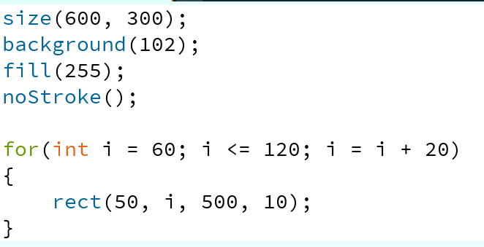
Processing Example 4.8
A: We can eliminate the yCoordinate variable by setting the i variable to 60 and incrementing it by 20.
Notes:
size(600, 300);
background(102);
fill(255);
noStroke();
for(int i = 60; i <= 120; i = i + 20)
{
rect(50, i, 500, 10);
}

Slide 12
For loop: all parts are optional
for ( ; ; )
{
// statements here
}
This is an infinite loop…

Slide 13
For loops can be nested
The value of i is: 0 and j is: 0
The value of i is: 0 and j is: 1
The value of i is: 0 and j is: 2
The value of i is: 0 and j is: 3
The value of i is: 1 and j is: 0
The value of i is: 1 and j is: 1
The value of i is: 1 and j is: 2
The value of i is: 1 and j is: 3
The value of i is: 2 and j is: 0
The value of i is: 2 and j is: 1
The value of i is: 2 and j is: 2
The value of i is: 2 and j is: 3
The value of i is: 3 and j is: 0
The value of i is: 3 and j is: 1
The value of i is: 3 and j is: 2
The value of i is: 3 and j is: 3
for (int i=0; i < 4; i++)
for (int j=0; j < 4; j++)
println("The value of i is: " + i + " and j is: " + j);

Slide 14
Topics list
There are three types of loop in programming:
While loops:
Counter controlled (n times) - covered in previous talk
Sentinel based (covered later in the course)
Flag based (covered later in the course)
For loops (this slide deck)
Do While loops (covered later in the course)
Comparative use of while and for loops
Lab03 - Challenge 1
Lab03 - Challenge 3

Slide 15
for versus while
Processing Example 4.7(for loop)
Variable i is the Loop
Control Variable (LCV). It must be initialised, tested
and changed.
for(int i = 0; i < 4; i++)
{
rect(50, yCoordinate, 500, 10);
yCoordinate += 20;
}
int i = 0 is the initialisation.
i < 4 is the boolean
condition i.e. the test
i++ is the post-body action
i.e. the change.
Processing Example 4.5 (while loop)
int i = 0;
while(i < 4)
{
rect(50, yCoordinate, 500, 10);
yCoordinate += 20;
i++;
}

Slide 16
Topics list
There are three types of loop in programming:
While loops:
Counter controlled (n times) - covered in previous talk
Sentinel based (covered later in the course)
Flag based (covered later in the course)
For loops (this slide deck)
Do While loops (covered later in the course)
Comparative use of while and for loops
Lab03 - Challenge 1
Lab03 - Challenge 3

Slide 17
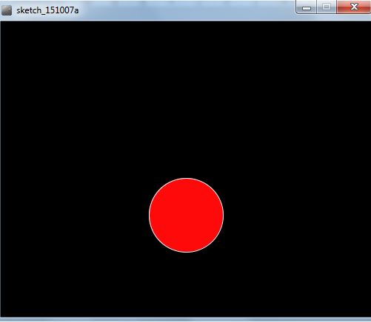
Lab03 - Challenge 1 – bouncing ball
Draw a continuously bouncing ball. (vertical only)
the xCoordinate remains the same value the yCoordinate will change.
Assumptions:
display window is 500 x 400
ball is 100 in diameter.
static xCoordinate is 250.
background is called in the draw() method.
starting yCoordinate is 300.

Slide 18
Lab03 - Challenge 1
float yCoordinate = 300;
void setup() {
size(500,400);
fill(255, 10, 10);
stroke(255);
}
void draw() {
background(0);
ellipse(250, yCoordinate, 100, 100);
}
Assumptions:
display window is 500 x 400
ball is 100 in diameter.
static xCoordinate is 250.

Slide 19
Lab03 - Challenge 1
float yCoordinate = 300;
void setup() {
size(500,400);
fill(255, 10, 10);
stroke(255);
}
void draw() {
background(0);
ellipse(250, yCoordinate, 100, 100);
}
Assumptions:
display window is 500 x 400
ball is 100 in diameter.
static xCoordinate is 250.
background is called in the draw() method.
starting yCoordinate is 300.

Slide 20
Lab03 - Challenge 1
float yCoordinate = 300;
boolean bounceUp = false;
void setup() {
size(500,400);
fill(255, 10, 10);
stroke(255);
}
void draw() {
background(0);
ellipse(250, yCoordinate, 100, 100);
if (bounceUp)
// code to bounce the ball up
if (!bounceUp)
// code when ball is falling
}
We need to track whether the ball is bouncing up or falling.
To do this, we will use a boolean variable bounceUp. It will be:
true if the ball is bouncing up
false if the ball is falling and

Slide 21
void draw() {
background(0);
ellipse(250, yCoordinate, 100, 100);
//ball is bouncing up
if (bounceUp){
if (yCoordinate > 100)
yCoordinate = yCoordinate - 1;
else
bounceUp = false;
}
//ball is falling down
if (!bounceUp){
if (yCoordinate <= 350)
yCoordinate = yCoordinate + 1;
else
bounceUp = true;
}
}
float yCoordinate = 300;
boolean bounceUp = false;
void setup() {
size(500,400);
fill(255, 10, 10);
stroke(255);
}

Slide 22
Topics list
There are three types of loop in programming:
While loops:
Counter controlled (n times) - covered in previous talk
Sentinel based (covered later in the course)
Flag based (covered later in the course)
For loops (this slide deck)
Do While loops (covered later in the course)
Comparative use of while and for loops
Lab03 - Challenge 1
Lab03 - Challenge 3

Slide 23
Lab03 - Challenge 3 – Moving Line
In a new sketch, draw a vertical line that is the height of your display window.
It starts in the left most position of your display window and moves right, pixel by pixel, until it reaches the right hand side of your display window.

Slide 24
Lab03 - Challenge 3 – Moving Line
Upon reaching the right hand side, the vertical line should reverse direction and return, pixel by pixel, to the left hand side of the display window.
As your vertical line is continually traversing the display window, your grayscale background should be varying very slightly in colour.

Slide 25
Lab03 - Challenge 3 – Moving Line
Assumptions:
Window size 300x400.
Background is initially set to 120.
Stroke weight is 4
float background = 120;
void setup()
{
size(300,400);
background(background);
strokeWeight(4);
}

Slide 26
Lab03 - Challenge 3 – Moving Line
Draw a vertical line that is the height of your display window.
Call background to clear the previously drawn line.
float background = 120;
float xCoordinate = 0.0;
void setup(){
size(300,400);
background(background);
strokeWeight(4);
}
void draw()
{
background(background);
line (xCoordinate, 0, xCoordinate, height);
}

Slide 27
Lab03 - Challenge 3 – Moving Line
This vertical line should start in the left most position of your display window and move right, pixel by pixel, until it reaches the right hand side of your display window.
void draw(){
xCoordinate = xCoordinate + 1;
background(background);
line (xCoordinate, 0, xCoordinate, height);
}

Slide 28
Lab03 - Challenge 3 – Moving Line
As your vertical line is continually traversing the display window, your grayscale background should be varying very slightly in colour.
void draw(){
xCoordinate = xCoordinate + 1;
background = background + 0.5;
background(background);
line (xCoordinate, 0, xCoordinate, height);
}

Slide 29
Lab03 - Challenge 3 – Moving Line
Upon reaching the right hand side, the vertical line should reverse direction and return, pixel by pixel, to the left hand side of the display window.
We need to keep track of the direction that the line should be moving i.e. is it going left-to-right, or has it reversed direction and gone from right-to-left?
We will use a boolean variable to do this:
boolean reverseDirection will be initially set to false. indicating a left-to-right direction.
false indicates a left-to-right direction
true indicates a right-to-left direction.

Slide 30
Lab03 – Challenge 3
float background = 120;
float xCoordinate = 0.0;
boolean reverseDirection = false;
void setup(){
size(300,400);
background(background);
strokeWeight(4);
}
void draw()
{
if (!reverseDirection){
background = background + 0.5;
xCoordinate = xCoordinate + 1;
}
else{
background = background - 0.5;
xCoordinate = xCoordinate - 1;
}
background(background);
line (xCoordinate, 0, xCoordinate, height);
}

Slide 31
Lab03 - Challenge 3 – Moving Line
But, we have no code written that will set the flag to true e.g.
reverseDirection = true;
Under what circumstances should the flag be set to true?
And when should it be set back to false?
Notes:
Question

Slide 32
void draw(){
if (xCoordinate == width)
reverseDirection = true;
if (xCoordinate == 0)
reverseDirection = false;
if (!reverseDirection){
background = background + 0.5;
xCoordinate = xCoordinate + 1;
}
else{
background = background - 0.5;
xCoordinate = xCoordinate - 1;
}
background(background);
line (xCoordinate, 0, xCoordinate, height);
}
float background = 120;
float xCoordinate = 0.0;
boolean reverseDirection = false;
void setup(){
size(300,400);
background(background);
strokeWeight(4);
}

Slide 33

Questions?

