Slide 1


Understanding class definitions
Exploring source code
Produced
by:
Ms. Mairead Meagher,
Ms. Siobhán Roche.
Department of Computing and Mathematics
http://www.setu.ie/
7.0

Slide 2
Main concepts to be covered
fields
constructors
methods
parameters
assignment statements

Slide 3
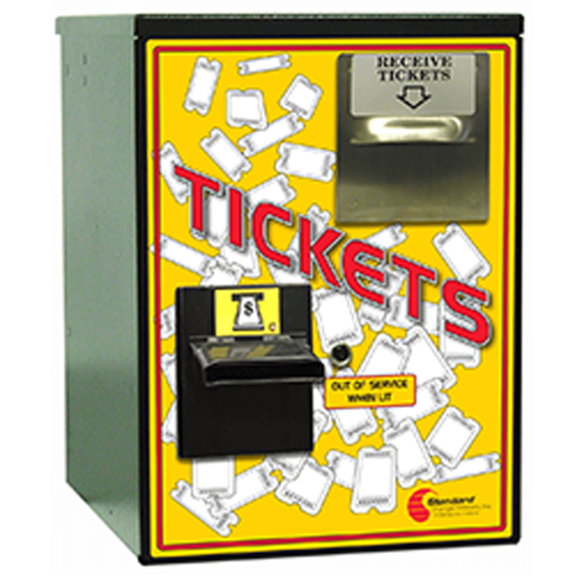
Ticket machine Example
This is a very simple Ticket machine.
It prints a ticket when an amount of money is entered

Slide 4
Ticket machines – an external view
Exploring the behavior of a typical ticket machine.
Use the naive-ticket-machine project.
Machines supply tickets of a fixed price.
How is that price determined?
How is ‘money’ ‘entered’ into a machine?
How does a machine keep track of the money that is entered?

Slide 5
Ticket machine Example
What information do we need to store?
What can the Ticket Machine do?

Slide 6
Ticket machine Example
What information do we need to store?
What can the Ticket Machine do?
Accept Payment
Print Ticket
…
Price of ticket
Amount entered
Amount in machine
…

Slide 7
Ticket machine Example
fields
methods
What information do we need to store?
What can the Ticket Machine do?
Accept Payment
Print Ticket
?
Price of ticket
Number of tickets sold
Amount in machine
?

Slide 8
Ticket machines – an internal view
Interacting with an object gives us clues about its behavior.
Looking inside allows us to determine how that behavior is provided or implemented.
All Java classes have a similar-looking internal view.

Slide 9
Basic class structure
The outer wrapper of TicketMachine
public class TicketMachine
{
Inner part omitted.
}
public class ClassName
{
Fields
Constructors
Methods
}
The inner contents of a class

Slide 10
Keywords
Words with a special meaning in the language:
public
class
private
int
Also known as reserved words.
Always entirely lower-case.

Slide 11
Fields
Fields store values for an object.
They are also known as instance variables.
Fields define the state of an object.
Use Inspect to view the state.
Some values change often.
Some change rarely (or not at all).
public class TicketMachine
{
private int price;
private int balance;
private int total;
//Further details omitted.
}
type
visibility modifier
variable name
private int price;

Slide 12
Constructors
public class TicketMachine
{
private int price;
private int balance;
private int total;
//Further details omitted.
}
Initialise an object.
Have the same name as their class.
Close association with the fields:
Initial values stored into the fields.
Parameter values often used for these.
public TicketMachine(int cost)
{
price = cost;
balance = 0;
total = 0;
}

Slide 13
Passing data via parameters
Parameters are another sort of variable.

Slide 14
Variables
In Programming, variables:
are created (defined) in your programs
are used to store data (whose value can change over time)
have a data type
have a name
are a VERY important programming concept

Slide 15
Choosing variable names
There is a lot of freedom over choice of names. Use it wisely!
Choose expressive names to make code easier to understand:
price, amount, name, age, etc.
Avoid single-letter or cryptic names:
w, t5, xyz123
A good variable name is worth a lot of documentation

Slide 16
Assignment
Values are stored into fields (and other variables) via assignment statements:
variable = expression;
balance = balance + amount;
A variable can store just one value, so any previous value is lost.
Assignment statements work by
Eavluating what appears on the right-hand side of the operator and
copying that value into a variable on the left-hand side.
pattern
example

Slide 17
Next concepts to be covered
Methods, including:
accessor (getter) methods
mutator (setter) methods;
String formatting;
Conditional statements;
Local variables.

Slide 18

Questions?

