Slide 1


Variables, Data Types & Arithmetic Operators
Produced
by:
Ms. Mairead Meagher,
Ms. Siobhán Roche.
Department of Computing and Mathematics
http://www.setu.ie/
7.0

Slide 2
Topics list
Variables.
Java Keywords, tokens
Data Types.
Java’s Primitive Data Types
Whole numbers.
Decimal numbers.
Others.
Arithmetic operators.

Slide 3
Variables
In Programming, variables:
are created (defined) in your programs.
are used to store data (whose value can change over time).
have a data type.
have a name.
are a VERY important programming concept.

Slide 4
Variable names…
Are case-sensitive.
Begin with either:
a letter (preferable),
the dollar sign "$", or
the underscore character "_".
Can contain letters, digits, dollar signs, or underscore characters.
Can be any length you choose.
Must not be a keyword or reserved word e.g. int, while, etc.
Cannot contain white spaces.
https://docs.oracle.com/javase/tutorial/java/nutsandbolts/variables.html
Notes:
We will name our variables beginning with a letter and typically containing only letters (no special characters).
CamelCase for variables and function names that have multiple words. We capitalize each word except the first

Slide 5
Variable names should be carefully chosen
Use full words instead of cryptic abbreviations e.g.
variables named speed and gear are much more intuitive than abbreviated versions, such as s and g.
If the name consists of:
only one word,
spell that word in all lowercase letters e.g. ratio.
more than one word,
capitalise the first letter of each subsequent word e.g. gearRatio and currentGear.
This is called camelCase
https://docs.oracle.com/javase/tutorial/java/nutsandbolts/variables.html

Slide 6
Kinds of variables so far
Fields are one sort of variable.
They store values through the life of an object.
They are accessible throughout the class.
Parameters are another sort of variable:
They receive values from outside the method.
They help a method complete its task.
Each call to the method receives a fresh set of values.
Parameter values are short lived.

Slide 7
Topics list
Variables.
Java Keywords, tokens
Data Types.
Java’s Primitive Data Types
Whole numbers.
Decimal numbers.
Others.
Arithmetic operators.

Slide 8
Java Keywords
Words with a special meaning in the language, e.g:
public
class
private
int
Also known as reserved words.
Special words that the Java language keeps for itself.

Slide 9
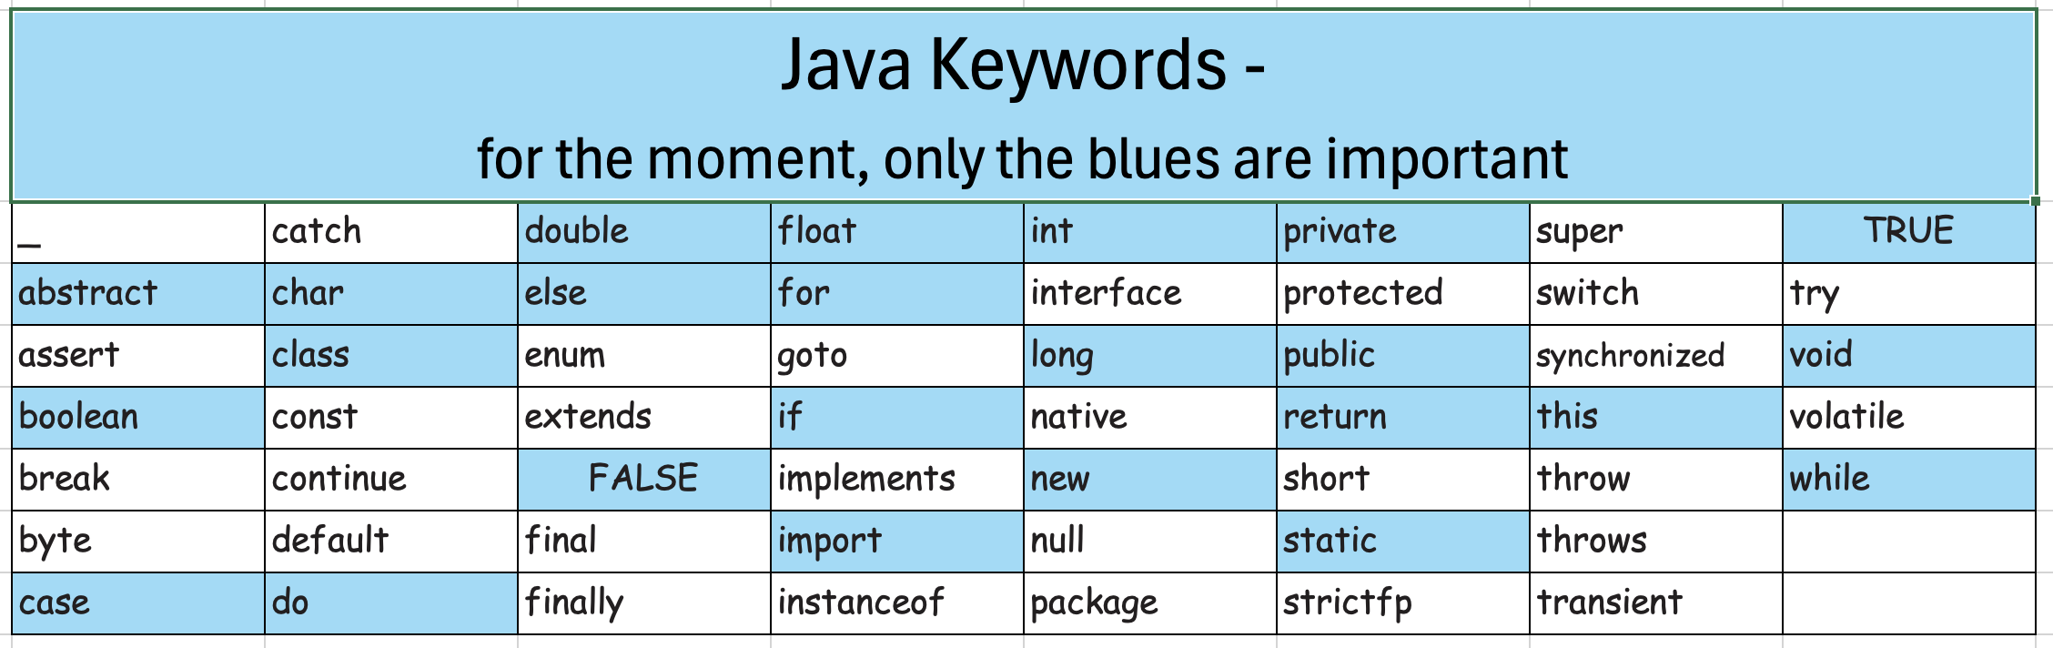
Keywords – list

Slide 10
Keywords (technical description)
A token is small meaningful piece of code
A reserved word (or keyword) in Java is a token that has a predefined meaning in the language’s grammar and cannot be redefined or used as an identifier.
They are part of the Java specification.
They are case-sensitive (e.g., Class is not the same as class).
Using a reserved word as an identifier results in a compile-time error.

Slide 11
Example of tokens – let’s tokenise a stmt
int (a reserved word)
= (an operator)
int age = 21;
; (a separator)
21 =(a literal value)
age (a variable name)

Slide 12
Topics list
Variables.
Java Keywords, tokens
Data Types.
Java’s Primitive Data Types
Whole numbers.
Decimal numbers.
Others.
Arithmetic operators.

Slide 13
Data Types
In Java, when we define a variable, we have to give it a data type.
The data type defines the kinds of values (data) that can be stored in the variable e.g.
- 456
2
45.7897
The data type also determines the operations that may be performed on it.
I Love Programming
S
true
Notes:
Operations…e.g. I cannot divide “I Love Programming” by ‘S’.
E.g. Mathematical operations are only available on numeric types.
E.g. I cannot add ‘S’ to true.

Slide 14
Data Types
Java uses two kinds of data types:
Primitive types
Object types
We are only looking at Primitive types now; we will cover Object types later in the module.

Slide 15
Java’s Primitive Data Types
Java programming language supports eight primitive data types.
A primitive type is predefined by the language and is named by a reserved keyword.
A primitive type is highlighted red when it is typed into the BlueJ editor e.g.
int numberOfItems;
boolean isAlive
float sizeOfSquare;

Slide 16
Topics list
Variables.
Java Keywords, tokens
Data Types.
Java’s Primitive Data Types
Whole numbers.
Decimal numbers.
Others.
Arithmetic operators.

Slide 17
Java’s Primitive Data Types (whole numbers)
Type | Byte-size | Minimum value (inclusive) | Maximum value (inclusive) | Typical Use
byte | 8-bit | -128 | 127 | Useful in applications where memory savings apply.
short | 16-bit | -32,768 | 32,767
int | 32-bit | -2,147,483,648 | 2,147,483,647 | Default choice.
long | 64-bit | -9,223,372,036,854,775,808 | 9,223,372,036,854,775,807 | Used when you need a data type with a range of values larger than that provided by int.
We will mostly use int for whole numbers
Notes:
I usually show them how the minimum and max values for byte are calculated e.g.
8-bit is 2 to the power of 8 = 256
To spread this value over the negative/positive number range, divide by two = 128. so -128 range up to +127, with 0 being on the “positive size”.
Then they can always work out the min/max values for the other whole numbers.

Slide 18
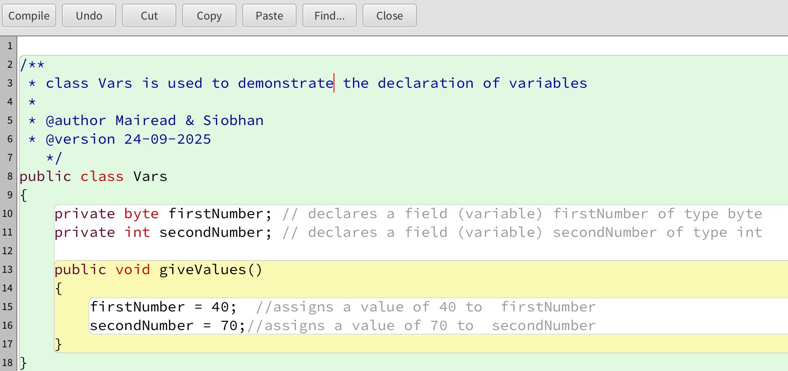
Declaring variables of a specific type

Slide 19
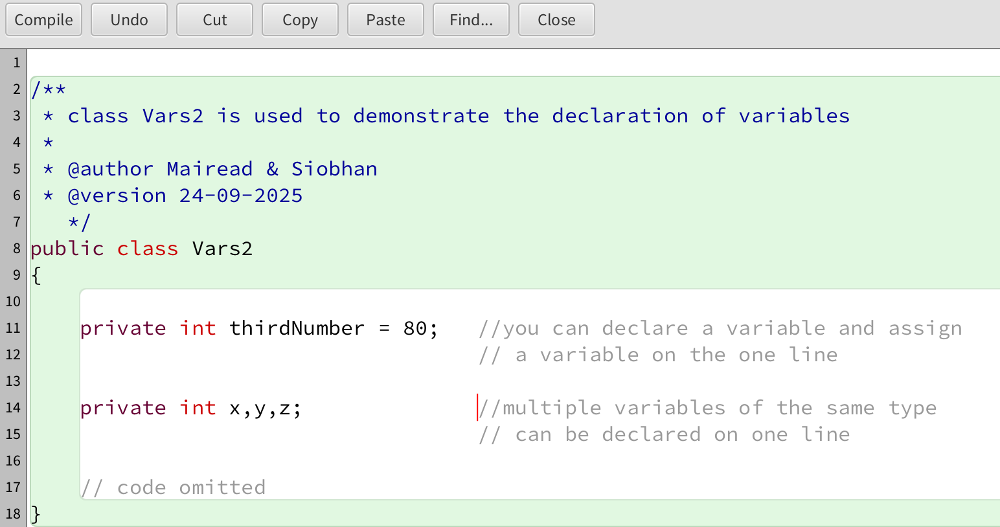
Declaring variables of a specific type
We can assign a value at the same time as declaration. This is called defining the variable

Slide 20
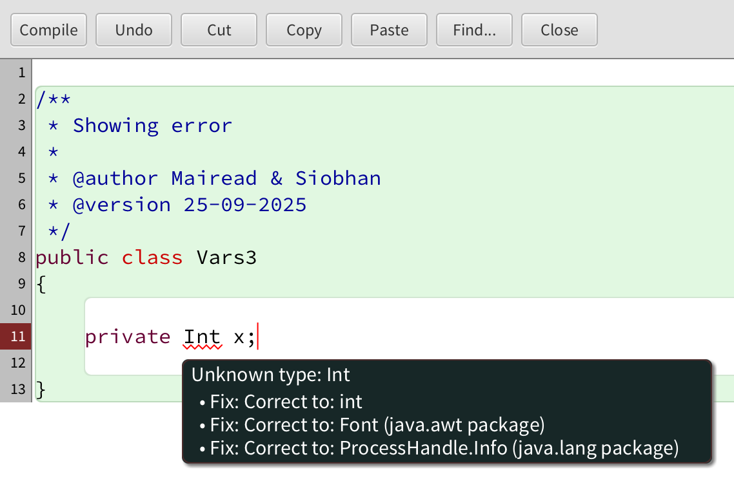
Declaring variables – some errors - 1
If you right-click on red underline, BlueJ will help you fix the error
Data types are case sensitive
Int is not valid
int is valid
Red underline indicates that there is a syntax error.

Slide 21
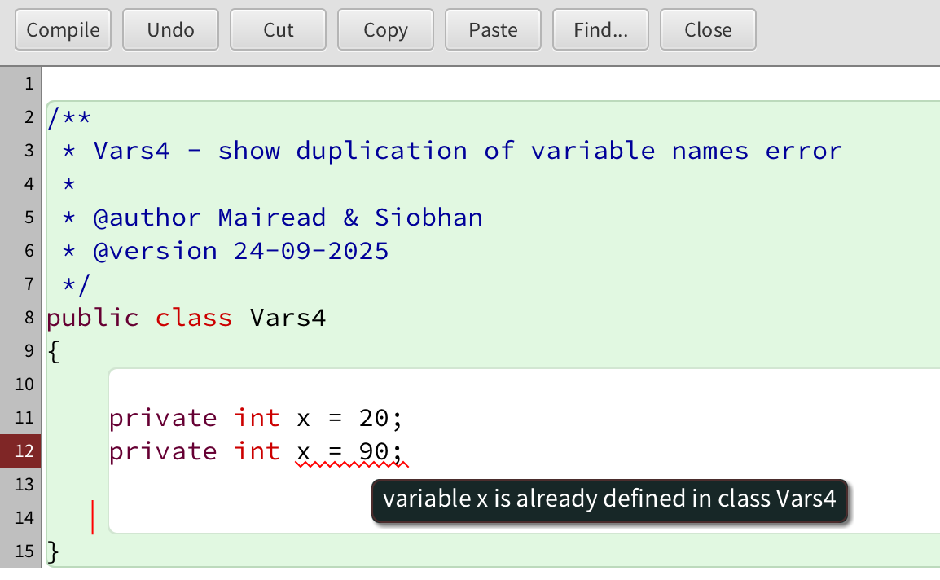
Declaring variables – some errors - 2
You can only have one declaration of any variable in a context.

Slide 22
Topics list
Variables.
Java Keywords, tokens
Data Types.
Java’s Primitive Data Types
Whole numbers.
Decimal numbers.
Others.
Arithmetic operators.

Slide 23
Java’s Primitive Data Types (decimal numbers)
Type | Byte-size | Minimum value (inclusive) | Maximum value (inclusive) | Typical Use
float | 32-bit | Beyond the scope of this lecture . There is also a loss of precision in this data-type that we will cover in later lectures. |  | Useful in applications where memory savings apply. Default choice when using Processing.
double | 64-bit |  |  | Default choice when programming Java apps.

Slide 24
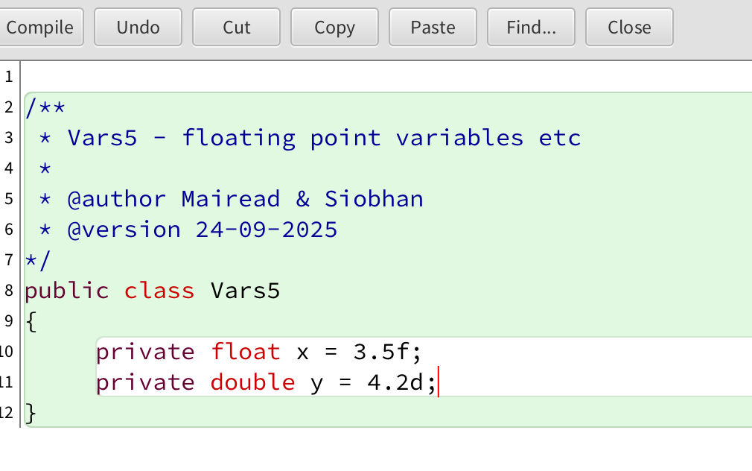
Declaring/defining a floating point field
Use float or double for non-integer numbers.
When assigning numbers, use the f or d suffix with float or double.

Slide 25
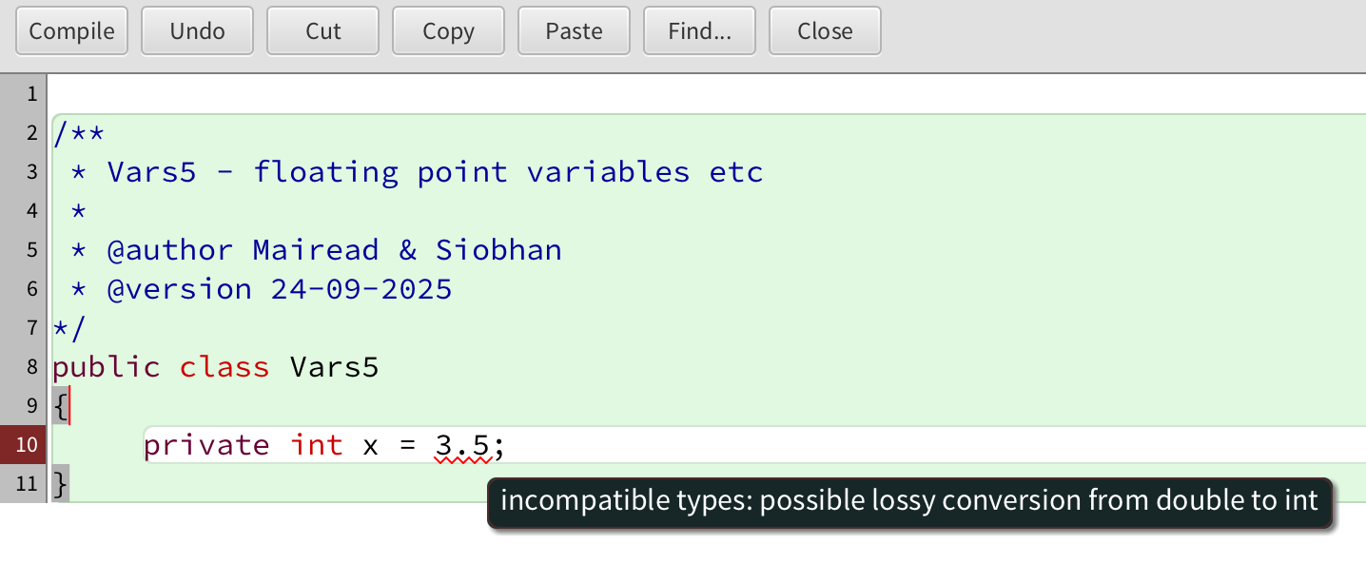
Declaring variables – some errors - 3
Cannot assign a non-integer value to an integer variable.

Slide 26
Topics list
Variables.
Java Keywords, tokens
Data Types.
Java’s Primitive Data Types
Whole numbers.
Decimal numbers.
Others.
Arithmetic operators.

Slide 27
Java’s Primitive Data Types (others)
We will go into more detail on these two data types in later lectures.
Type | Byte-size | Minimum value (inclusive) | Maximum value (inclusive) | Typical Use
char | 16-bit | '\u0000' (or 0) | '\uffff' (or 65,535) | Represents a Unicode character.
boolean | 1-bit | n/a |  | Holds either true or false and is typically used as a flag.
http://en.wikipedia.org/wiki/List_of_Unicode_characters

Slide 28
Topics list
Variables.
Java Keywords, tokens
Data Types.
Java’s Primitive Data Types
Whole numbers.
Decimal numbers.
Others.
Arithmetic operators.

Slide 29
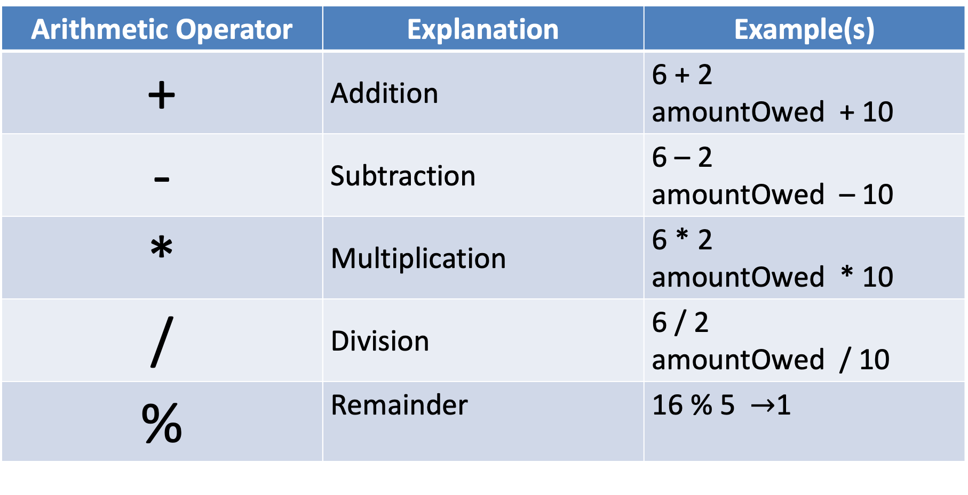
Arithmetic Operators
Arithmetic Operator | Explanation | Example(s)
+ | Addition | 6 + 2 amountOwed + 10
- | Subtraction | 6 – 2 amountOwed – 10
* | Multiplication | 6 * 2 amountOwed * 10
/ | Division | 6 / 2 amountOwed / 10
% | Remainder | 16 % 5 $→$1

Slide 30
Note on division ‘\’ – integer or ‘normal’ division
When we use the ‘/’ operator , how it behaves depends on the type of the two operands :
x → 10
y → 6
x / y
10 / 6
1
x and y are integers
x / y
x / y
10.0 / 6
1.666
Either x or y or both are non-integers
x → 10.0
y → 6

Slide 31

Questions?

