Slide 1


Local Variables and Scope of Variables
Produced
by:
Ms. Mairead Meagher,
Ms. Siobhán Roche.
Department of Computing and Mathematics
http://www.setu.ie/
7.0

Slide 2
Topics list
Local variables.
Scope of variables.

Slide 3
To think about
How could we write a method to ‘refund’ an excess balance?
We need to return the value in balance.
We need to set the balance to zero.
How can we do the first without losing the value in balance?
Notes:
write method in BlueJ;
first: do it wrong

Slide 4
Unsuccessful attempt
public int refundBalance()
{
// Return the amount left.
return balance;
// Clear the balance.
balance = 0;
}
It looks logical, but the language does not allow it.
A method will terminate immediately after executing a return statement!

Slide 5
Local variables
Methods can define their own, local variables:
Short lived, like parameters.
The method sets their values – unlike parameters, they do not receive external values.
Used for ‘temporary’ calculation and storage.
They exist only as long as the method is being executed.
They are only accessible from within the method.
They are defined within a particular scope.

Slide 6
Local variables
public int refundBalance()
{
int amountToRefund;
amountToRefund = balance;
balance = 0;
return amountToRefund;
}
A local variable
No visibility
modifier

Slide 7
Topics list
Local variables.
Scope of variables.

Slide 8
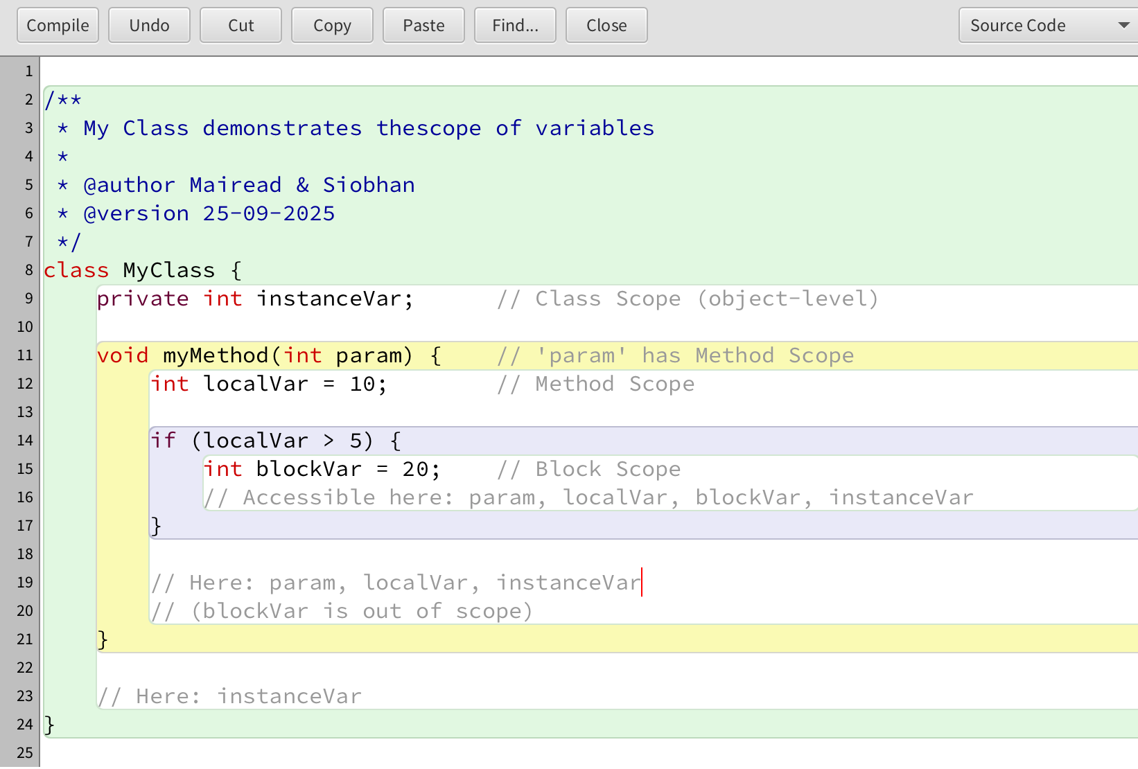
Scope of Variables

Slide 9
Scope of Variables
Outer block – instanceVar is available throughout this block
Method block – param and localVar are both available here

Slide 10
Scope and lifetime
Each block defines a new scope.
Class, method and statement.
Scopes may be nested:
statement block inside another block inside a method body inside a class body.
Scope is static (textual).
Lifetime is dynamic (runtime).

Slide 11
Scope and lifetime
The scope of a field is its whole class.
The lifetime of a field is the lifetime of its containing object.
The scope of a local variable is the block in which it is declared.
The lifetime of a local variable is the time of execution of the block in which it is declared.

Slide 12

Questions?

